Slide 1
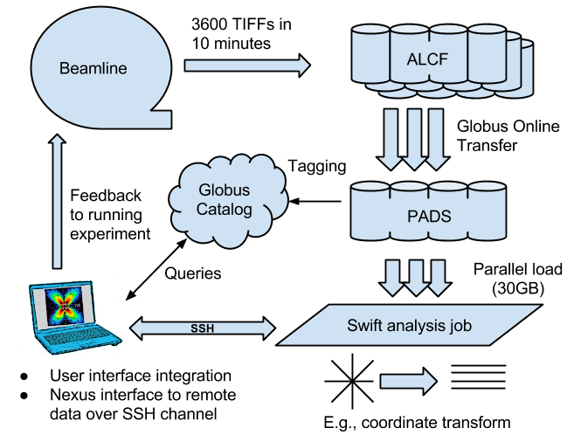
Data ingest/analysis/archive
The October run produced 104 directories containing 5M files totalling about 27 TB.

Slide 2
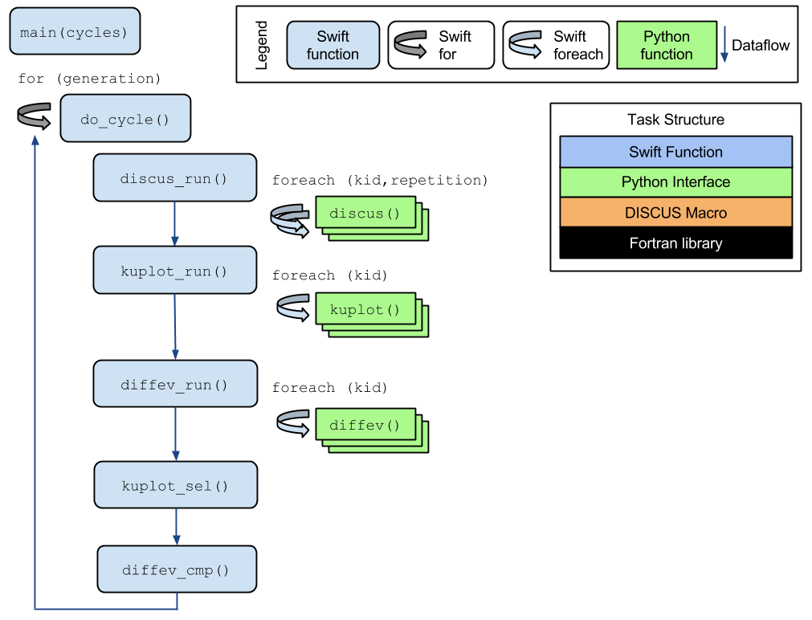
DIFFEV: Genetic algorithm via dataflow
Novel application composed from existing libraries by domain expert!
Potential concurrency: 100,000 cores
Application by Reinhard Neder

