Slide 1
Parallel Scripting for Beamline Science: Connecting Big Data and HPC
Justin M Wozniak
Mathematics and Computer Science Division
Argonne National Laboratory wozniak@mcs.anl.gov
http://www.swift-lang.org
February 20, 2014

Slide 2
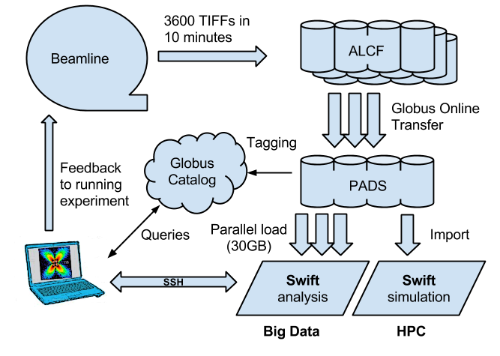
Overview

Slide 3
Project Goals: Computer Science perspective
Data and workflow management
Modify the operating software of APS stations to allow real-time streaming to a novel data storage/analysis platform (Globus, etc.)
Converting data from the standard detector formats (TIFF) to HDF5 and adding metadata and provenance, based on the NeXus data format (CCTW)
Rewrite analysis operations to work in a massively parallel environment (NeXus operations)
Scale up simulation codes that complement analysis (DIFFEV)
Focus areas
Ease of access to high concurrency – compute and data movement
Scalability for fast analysis turnaround
Interactivity and scheduling for near-real-time analysis

Slide 4
Swift: Programmability for scientific problems
Our focus is “many-task” computing: higher-level applications composed of many run-to-completion tasks: input→compute→output Message passing, data movement handled by our implementation details
Language: Swift Run times: Karajan (Grid) and Turbine (HPC)
Why is Swift relevant to scientific data analysis?
Programmability
Natural fit for workflow patterns, data-local processing
Coupling large-scale applications to preprocessing, analysis, and visualization
Resilience
The functional programming model allows for re-execution of failed tasks
Portable/scalable
Common technologies work well on clusters, grids, and the largest supercomputers

Slide 5
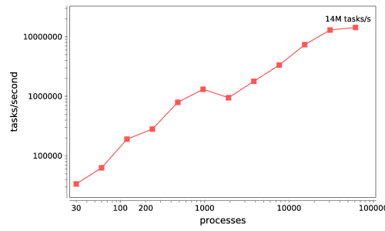
Basic scalability – Python tasks
Swift/T: up to 2 billion tasks on 65,536 cores of Blue Waters, so far

Slide 6
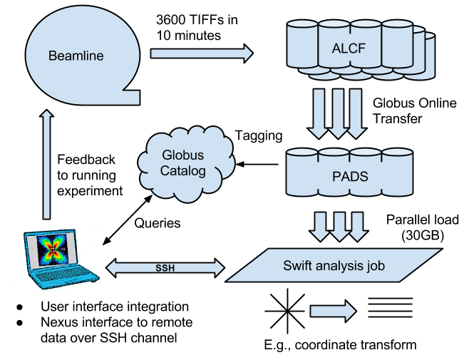
Data ingest/analysis/archive
The October run produced 104 directories containing 5M files totalling about 27 TB.
20x speedup

Slide 7
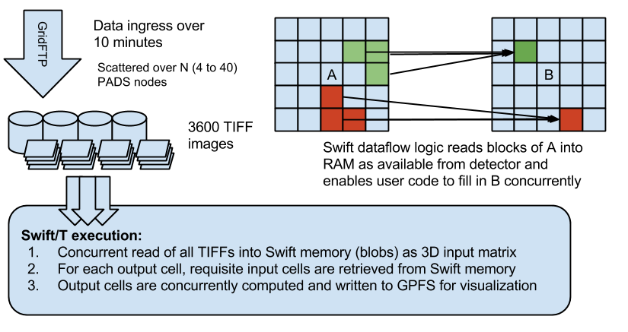
Crystal Coordinate Transformation Workflow

Slide 8
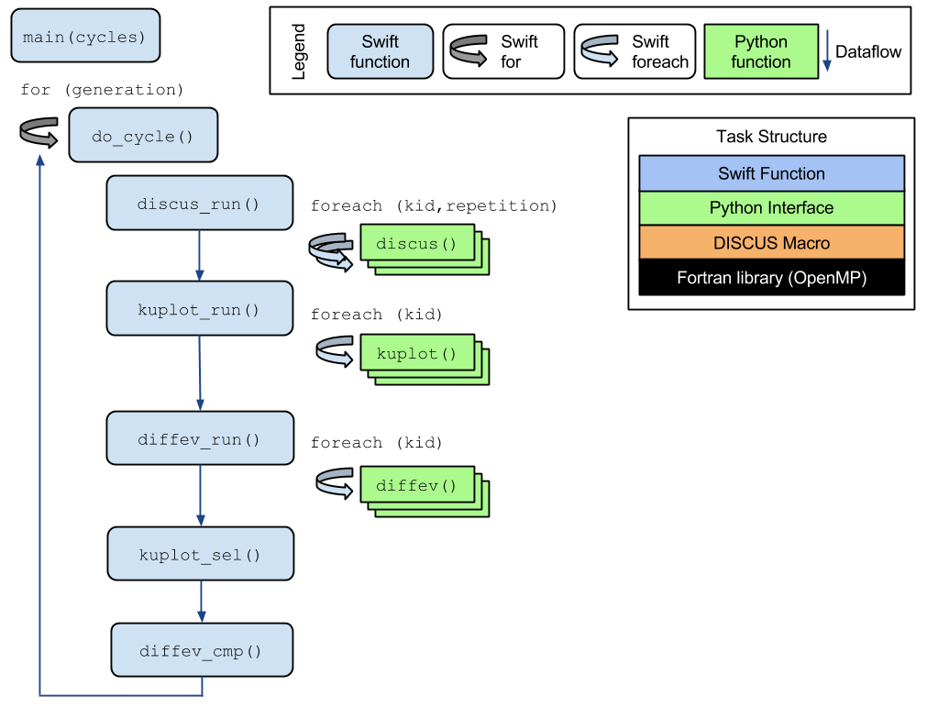
DIFFEV: Genetic algorithm via dataflow
Novel application composed from existing libraries by domain expert!
Potential concurrency: 100,000 cores
Application by Reinhard Neder (U. Erlangen)

