Slide 1
Discovery Engines for Big Data
Rachana Ananthakrishnan Justin Wozniak
on behalf of the DE team
January 16, 2014

Slide 2
Introduction
Proposal areas of focus
Cosmology
Material Sciences
Data and workflow management
Data and Workflow Management
High performance data transfers
Data sharing with collaborators
Rewrite analysis to work in massively parallel environment
Scale up simulation codes
Metadata catalog (experiment data, provenance, derivative data)
Support end to end workflow: data management and analysis

Slide 3
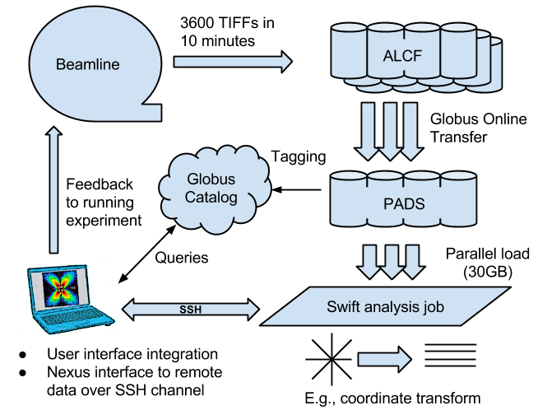
Data ingest/analysis/archive

Slide 4
Globus Transfer & Sharing
Features
Managed high performance data transfer
Sharing of files/directories with collaborators for read/write
Recent work
Continue to support APS endpoint for downloading data
Used to transfer experiment for data for Osborn’s run
Total data transferred: ~20 TB
Moved to cluster at ALCF and PADS cluster
Starting to explore integration with SPADE
Integrate to make data available for end users
Replicate data out, based on policy

Slide 5
Globus Catalog
Ingest and publication
Imagine a DropBox that not only replicates, but also extracts metadata, catalogs, converts
Cataloging
Virtual views of data based on user-defined and/or automatically extracted metadata
Integration with computation
Associate computational procedures, orchestrate application, catalog results, record provenane
Operate on data set
Share, transfer, collaborate, discover (location agnostic)

Slide 6
Use Cases
Ingestion
E.g. XCT use case
Collaboration
E.g. XPCS use case
Publish
E.g HEDM use case
Analysis integration
E.g. CCTW and HEDM FF workflows
Discovery
E.g. HEDM workflow, beam line scientist view etc.
Notes:
Ingestion: automated push
Collaboration: Active phase, share and collaborate, annotation
Publish: immutable

Slide 7
Swift: Programmability for scientific data problems
Our focus is “many-task” computing: higher-level applications composed of many run-to-completion tasks: input→compute→output Message passing, data movement handled by our implementation details
Language: Swift Run times: Karajan (Grid) and Turbine (HPC)
Why is Swift relevant to scientific data analysis?
Programmability
Natural fit for workflow patterns, data-local processing
Coupling large-scale applications to preprocessing, analysis, and visualization
Resilience
The functional programming model allows for re-execution of failed tasks
Portable/scalable
Common technologies work well on clusters, grids, and the largest supercomputers

Slide 8
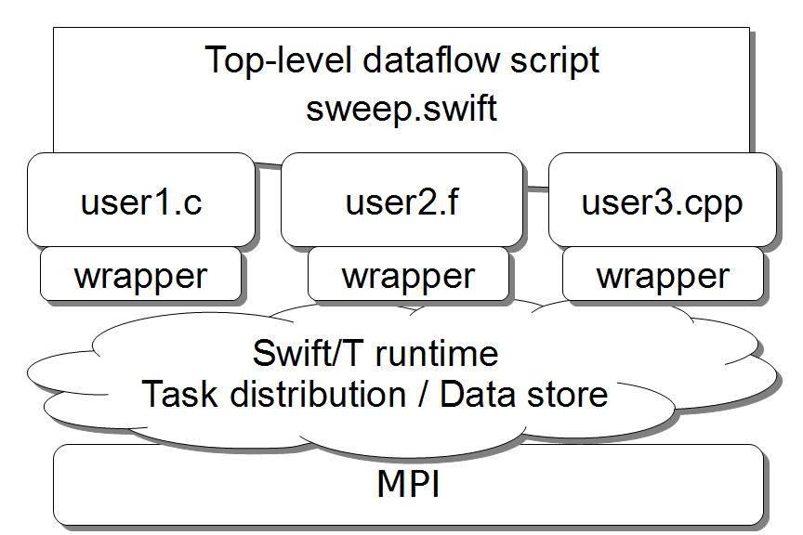
Support calls to native libraries
Including MPI libraries

Slide 9
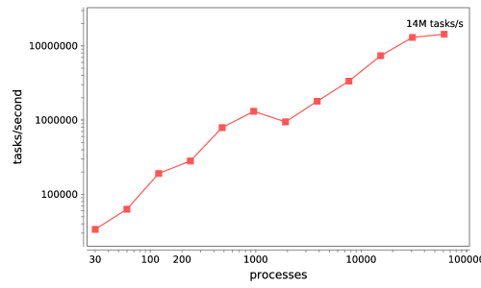
Basic scalability – Python tasks
Swift/T: up to 2 billion tasks on 65,536 cores of Blue Waters, so far

Slide 10
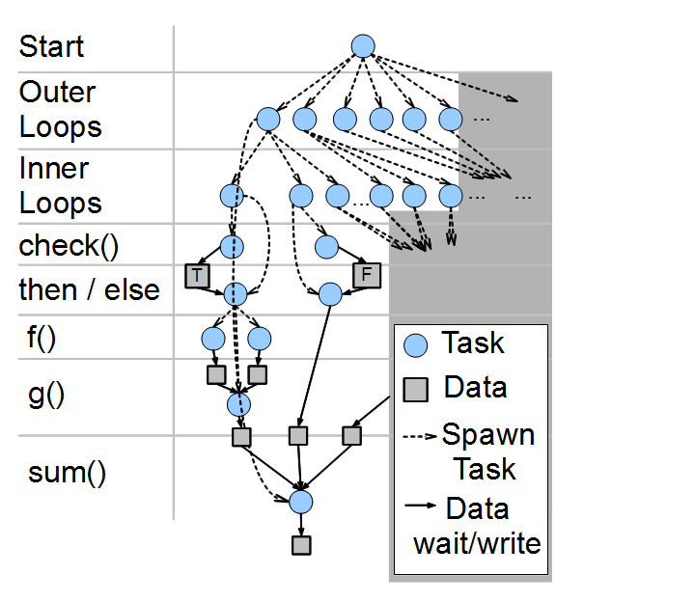
Swift/T: Fully parallel evaluation of complex scripts
int X = 100, Y = 100;
int A[][];
int B[];
foreach x in [0:X-1] {
foreach y in [0:Y-1] {
if (check(x, y)) {
A[x][y] = g(f(x), f(y));
} else {
A[x][y] = 0;
}
}
B[x] = sum(A[x]);
}
Wozniak et al. Swift/T: Large-scale application composition via distributed-memory dataflow processing. Proc. CCGrid 2013.

Slide 11
Data Management for Energy Sciences
“Despite the central role of digital data in Dept. of Energy (DOE) research, the methods used to manage these data and to support the information and collaboration processes that underpin DOE research are often surprisingly primitive…” - DOE Workshop Report on Scientific Collaborations (2011)
Data and workflow management
Modify the operating software of APS stations to allow real-time streaming to a novel data storage/analysis platform. (Globus, etc.)
Converting data from the standard detector formats (usually TIFF) to HDF5 and adding metadata and provenance, based on the NeXus data format. (CCTW)
Rewrite analysis operations to work in a massively parallel environment. (NeXus operations)
Scale up simulation codes that complement analysis. (DIFFEV)

Slide 12
Data ingest/analysis/archive
The October run produced 104 directories containing 5M files totalling about 27 TB.

Slide 13
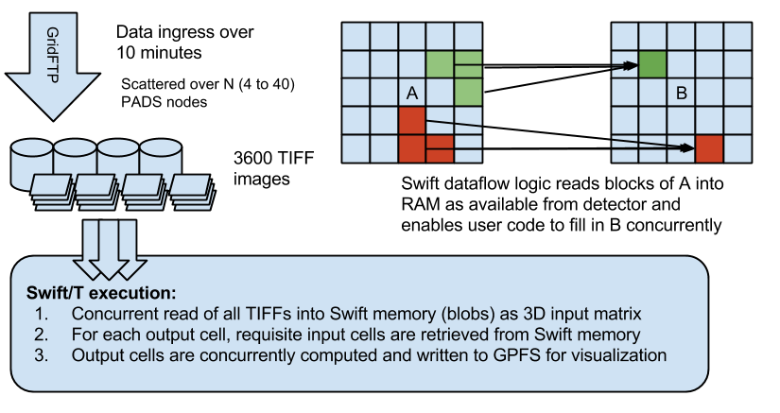
Crystal Coordinate Transformation Workflow

Slide 14
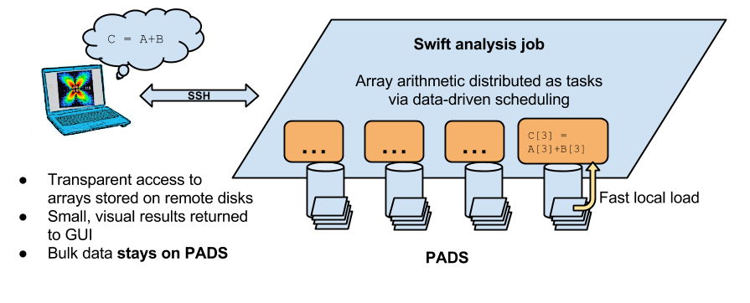
Interactive analysis powered by scalable storage
Replace GUI analysis internals with operations on remote data
Uses Swift’s data locality features

Slide 15
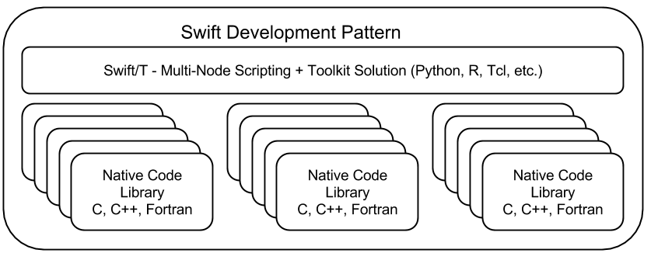
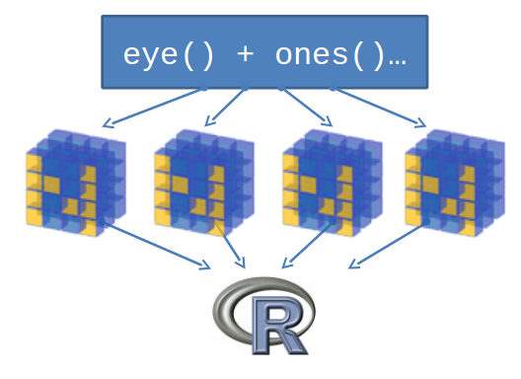
Support calls to embedded interpreters

Slide 16
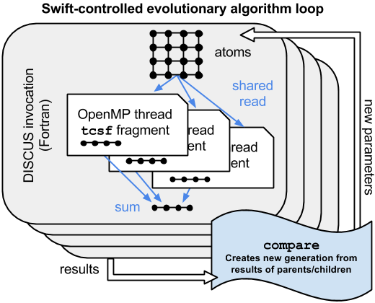
DIFFEV: Scaling crystal diffraction simulation
Determines crystal configuration that produced given scattering image through simulation and evolutionary algorithm
Swift/T calls DISCUS via Python interfaces
Wozniak et al. Mega Python: Scalable interlanguage scripting for scientific computing. Preprint: ANL/MCS-P5020-0913, 2013.

Slide 17
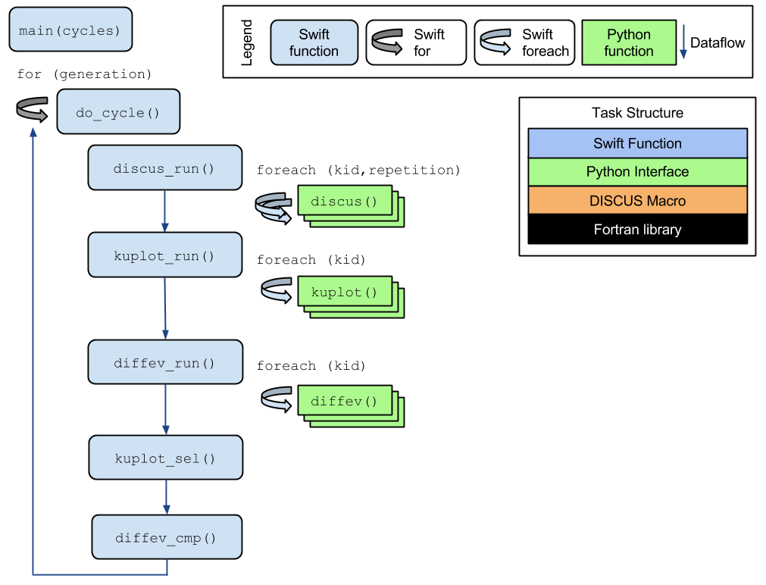
DIFFEV: Genetic algorithm via dataflow
Novel application composed from existing libraries by domain expert!
Potential concurrency: 100,000 cores
Application by Reinhard Neder

Slide 18
Desired state – HEDM & tomo
Acquisition: EPICS + FPGA + Python
Near field acquisition: A angles, B layers, C distances. D conditions
Far field acquisition: L angles, M layers. N conditions
Tomography acquisition: R angles, T conditions
AxBxCXD files
LXMXN files
Metadata/ file
RxT files
Metadata/ file
Metadata/ file
Calibration values, White field and Dark field images, Stitching parameters, in the future: detector corrections (distorsion, correction masks).
Near field calibration values (from Au wire, done at each distance, valid for all layers at that distance): in ICE9, APS-NF
Far-field calibration values including detector distortion (CeO2/LaB6, etc); Fit2d, HEXRD, SHOrt-3DXRD
Preprocessing (corrections, normalizations) on images stitching and generating sinograms
SWIFT, C-code to calculate orientation per pixel, should run on Orthros and elsewhere, use stitching for thick/fine grained samples
SWIFT/C/Python/Matlab codes to first reduce detector images to peaks, then to characteristics per grain, use stitching
Sinograms
Reconstruction and filtering, methods can be different:
FBP, GridRec, ART, SIRT
Raw binary (floating point) volume
Postprocessing and data reduction
Output; voxel orientation, elastic and plastic strains
Output; grain orientation, COM, elastic strain, plastic strain
Reduced data, image files (TIFF)
Visualization: Dream3D, ParaView, Matlab
Visualization: Dream3D, Matlab
Visualization: ImageJ, Paraview
Notes:
Wish to link together NF+FF, paintGrid is a concept to do this; FF sets BC for NF.
Wish to visualize datasets together, paraview a good candidate.
Wish to co-register datasets and link them to modellers; Dream3D good candidate.
Each ‘condition’ can be a variable e.g. (i) time (ii) temperature (iii) applied stress/strain (iv) magnetic field

Slide 19
Questions?

