Slide 1
信息隐藏
冯丙文
Email: 183861354@qq.com

Slide 2
第五讲 水印的模型与原理
1）水印的信道
2）基于通信的水印模型
3）水印的几何模型
4）为基于相关性的提取算法建模

Slide 3
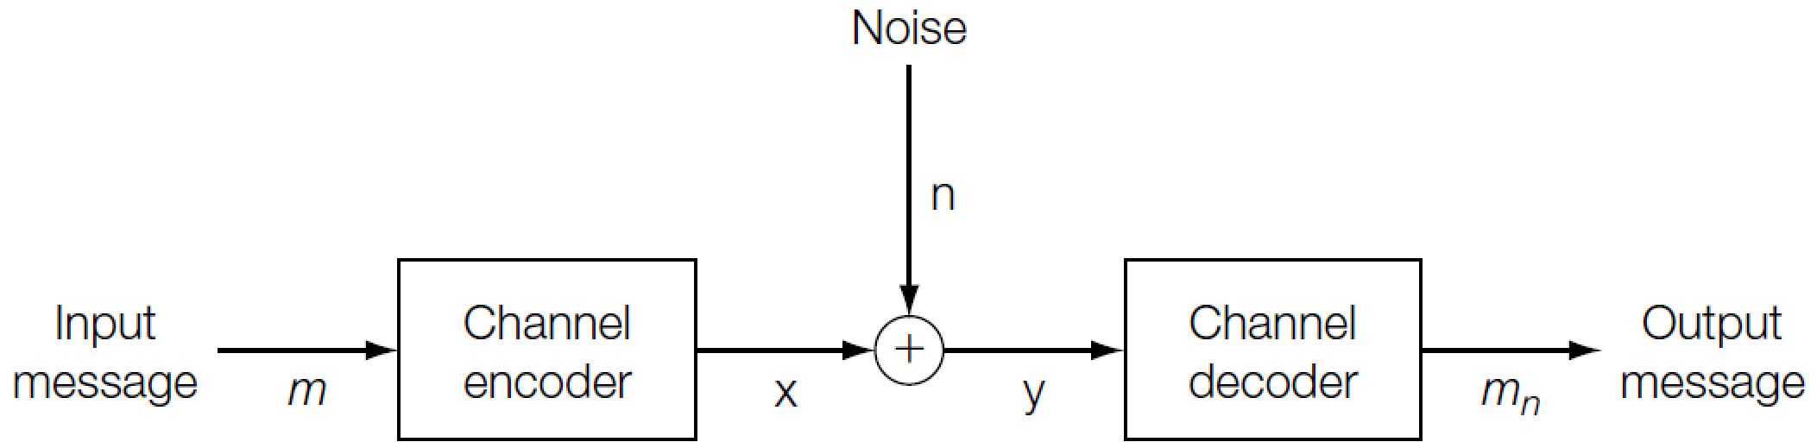

水印的信道
水印的基本元素
Channel encoder
Output: a sequence of real values, x = {x[1] , x[2] , . . . , x[N]}, quantized to some arbitrarily high precision.
$$\sum_{i}{{\left(x\left[i\right]\right)}^{2}}≤p$$

Slide 4
水印的信道
水印的基本元素
2
1
Key
1. prevent unauthorized user reading of the message:
Encrypt the message
2. prevent unauthorized writing:
Select the channel

Slide 5
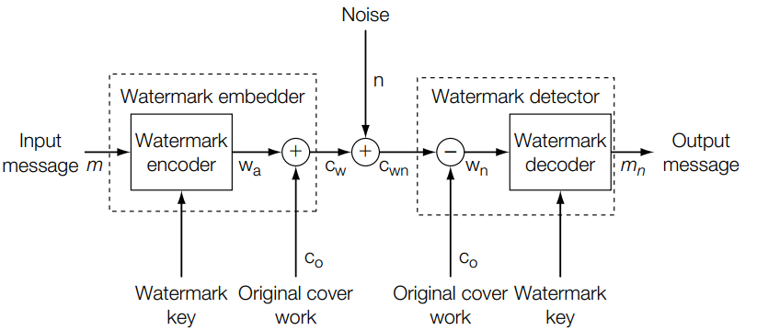
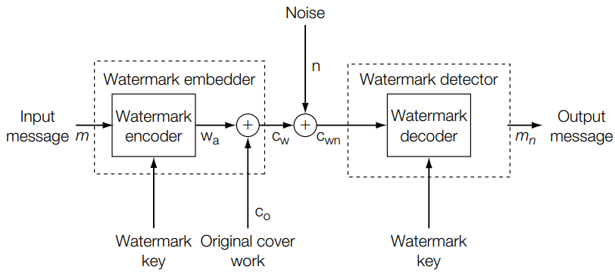
基于通信的水印模型
基本模型
Informed detector
Blind detector

Slide 6
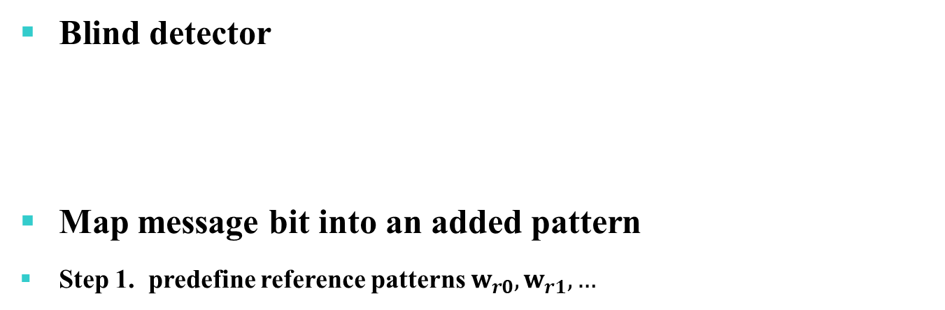
基于通信的水印模型
基本模型
Blind detector
Map message bit into an added pattern
Step 1. predefine reference patterns $w_{r0},w_{r1}, …$

Slide 7

基于通信的水印模型
基本模型
Blind detector
Map message bit into an added pattern
Step 2. encode the message using reference patterns, giving a message pattern $w_{m}$

Slide 8
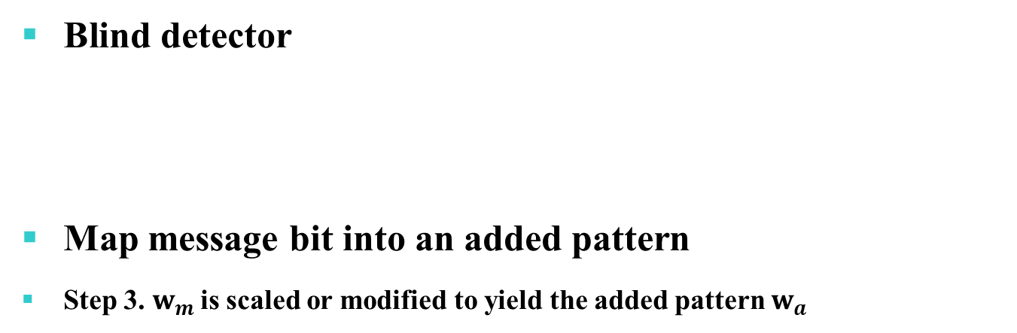
基于通信的水印模型
基本模型
Blind detector
Map message bit into an added pattern
Step 3. $w_{m}$is scaled or modified to yield the added pattern $w_{a}$

Slide 9

基于通信的水印模型
基本模型
一个简单的例子: 1比特水印方案E_BLIND/D_LC
Embedding procedure
Step 1. Define a single reference pattern $w_{r}$, which is an array the same size as the cover image.
Step 2. for the single message $m=0 or 1$
$$w_{m}=\left\{\begin{aligned}\begin{matrix}w_{r} & if m=1\end{matrix} \\ \begin{matrix}−w_{r} & if m=0\end{matrix}\end{aligned}\right.$$
$$w_{a}=αw_{m}$$
$$c_{w}=c_{o}+w_{a}$$
Tradeoff between robustness and visibility

Slide 10



基于通信的水印模型
基本模型
一个简单的例子: 1比特水印方案E_BLIND/D_LC
Detection procedure
Detect the signal $c_{wn}$ in the presence of the noise caused by $c_{o}$ and n.
The linear correlation
$$Z_{lc}\left(c_{wn},w_{r}\right)=\frac{1}{N}\left(c_{o}∙w_{r}+w_{a}∙w_{r}+n∙w_{r}\right)$$
$$→0$$
$$→±αw_{r}∙w_{r}$$
Notes:
在存在AWGN的情况下，检测信号的最佳方法是计算线性相关

Slide 11

基于通信的水印模型
基本模型
一个简单的例子: 1比特水印方案E_BLIND/D_LC
Detection procedure
Detect the signal $c_{wn}$ in the presence of the noise caused by $c_{o}$ and n.
The linear correlation
$$Z_{lc}\left(c_{wn},w_{r}\right)=\frac{1}{N}\left(c_{o}∙w_{r}+w_{a}∙w_{r}+n∙w_{r}\right)$$
$$≈\left\{\begin{aligned}\begin{matrix}αw_{r}∙w_{r}/N & if m=1\end{matrix} \\ \begin{matrix}−αw_{r}∙w_{r}/N & if m=0\end{matrix} \\ \begin{matrix}0 & no watermark\end{matrix}\end{aligned}\right.$$

Slide 12

基于通信的水印模型
基本模型
一个简单的例子: 1比特水印方案E_BLIND/D_LC
Detection procedure
Detector:
Set a threshold $τ_{lc}$
$$m_{n}=\left\{\begin{aligned}\begin{matrix}1 & if Z_{lc}\left(c_{wn},w_{r}\right)>τ_{lc}\end{matrix} \\ \begin{matrix}no watermark & if τ_{lc}≥Z_{lc}\left(c_{wn},w_{r}\right)≥−τ_{lc}\end{matrix} \\ \begin{matrix}0 & if Z_{lc}\left(c_{wn},w_{r}\right)<−τ_{lc}\end{matrix}\end{aligned}\right.$$

Slide 13
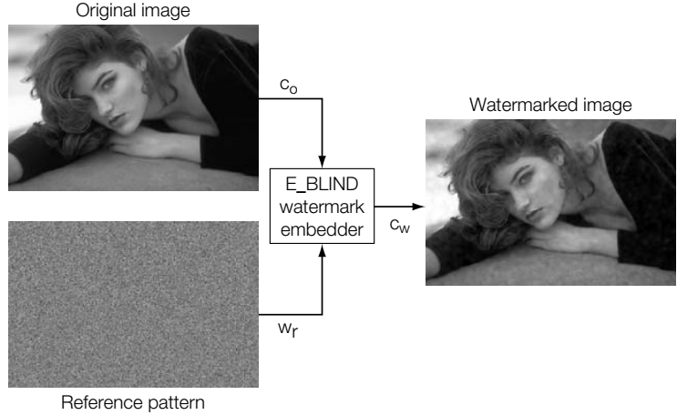
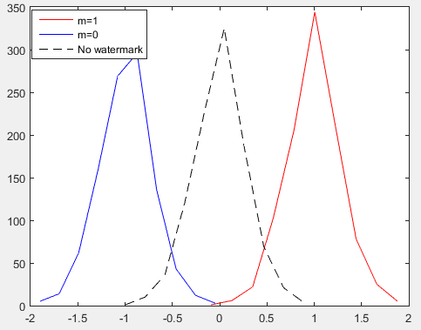
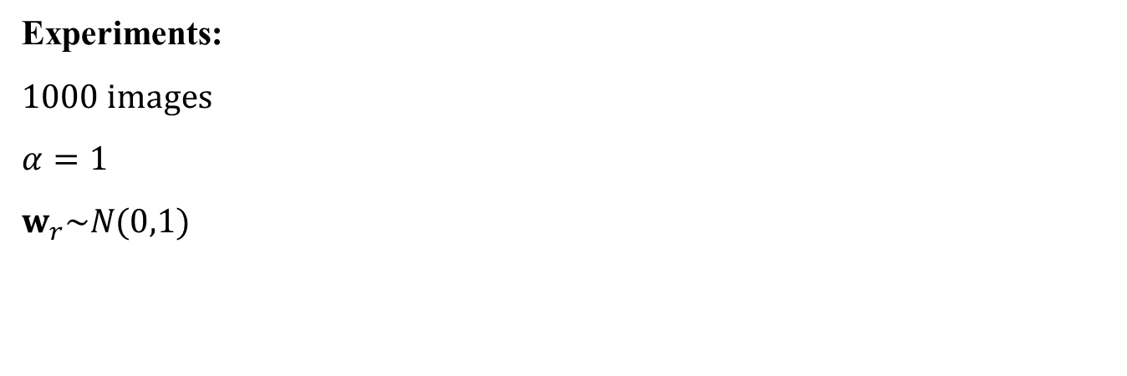
基于通信的水印模型
基本模型
一个简单的例子: 1比特水印方案E_BLIND/D_LC
Experiments:
1000 images
$$α=1$$
$$w_{r}\sim N(0,1)$$

Slide 14

基于通信的水印模型
基本模型
一个简单的例子: 1比特水印方案E_BLIND/D_LC
Experiments:
1000 images
$$α=1$$
$$w_{r}\sim N(0,1)$$
If we choose $τ_{lc}=0.7$, false positive probability is 0.69% (12 with no watermark is classified as m=0 or m=1)
Effectiveness is 86.7% (1733 with watermark is classified correctly)

Slide 15
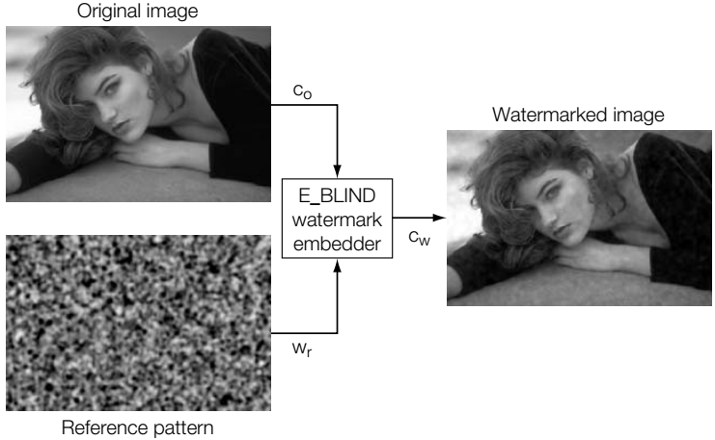
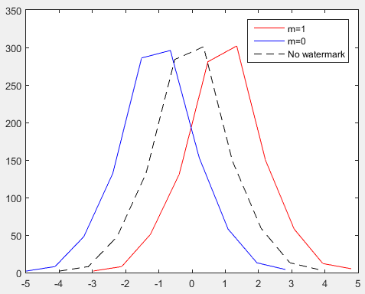
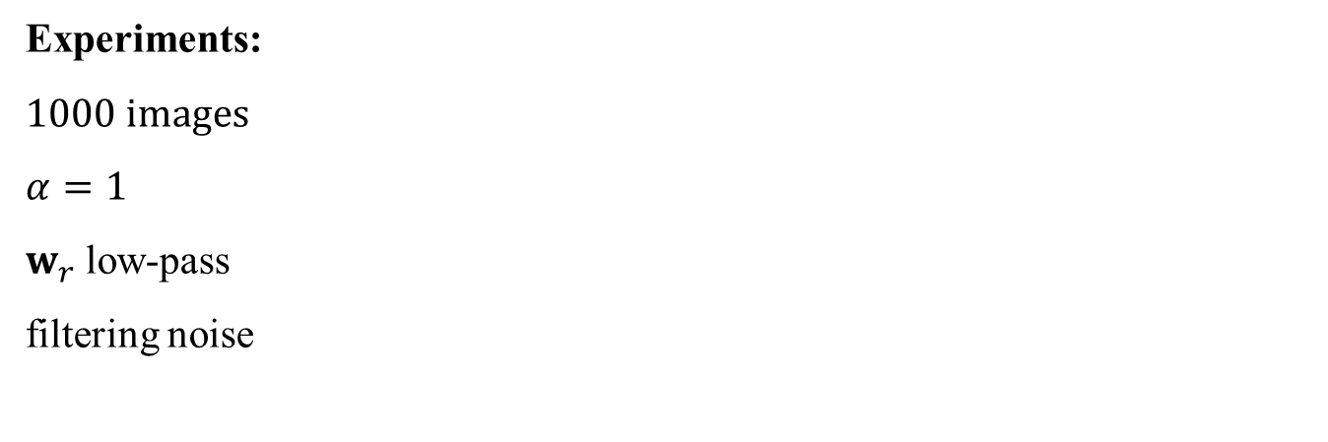
基于通信的水印模型
基本模型
一个简单的例子: 1比特水印方案E_BLIND/D_LC
Experiments:
$$\text{1000 }\text{images}$$
$$α=1$$
$w_{r}$ low-pass
filtering noise

Slide 16

基于通信的水印模型
基本模型
一个简单的例子: 1比特水印方案E_BLIND/D_LC
Experiments:
$$\text{1000 }\text{images}$$
$$α=1$$
$w_{r}$ low-pass filtering noise
With$τ_{lc}=3$, false positive probability is 9.52% (8 with no watermark is classified as m=0 or m=1)
Effectiveness is 3.80% (76 with watermark is classified correctly)

Slide 17
基于通信的水印模型
基本模型
一个简单的例子: 1比特水印方案E_BLIND/D_LC
Reason: linear correlation is optimal only when the image and the noise are Gaussian distributed

Slide 18
基于通信的水印模型
基本模型
一个简单的例子: 1比特水印方案E_BLIND/D_LC
Problem:
This system has less than 100% effectiveness even if there is no noise
It restricts the encoded watermark to be independent of the cover Work.
The unwatermarked cover Work, co, is obviously known to the embedder, there is no reason to enforce this restriction

Slide 19
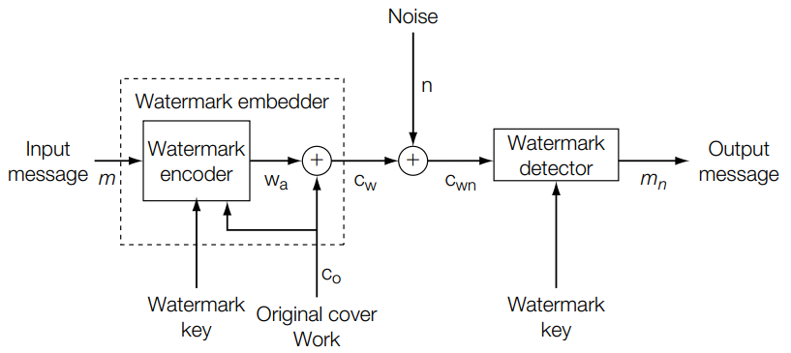
基于通信的水印模型
发送方拥有边信息的模型
Watermarking as communications with side information at the transmitter

Slide 20
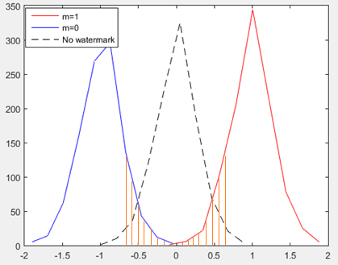
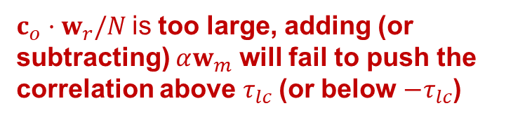
基于通信的水印模型
发送方拥有边信息的模型
例子：改进的水印方案E_FIXED_LC/D_LC
The original system has less than 100% effectiveness, because the tails of the distributions for m=1 and m=0 that lie between the thresholds represent images will fail to embed a watermark
$c_{o}·w_{r}/N$is too large, adding (or subtracting) $αw_{m}$ will fail to push the correlation above $τ_{lc}$(or below $−τ_{lc}$)

Slide 21
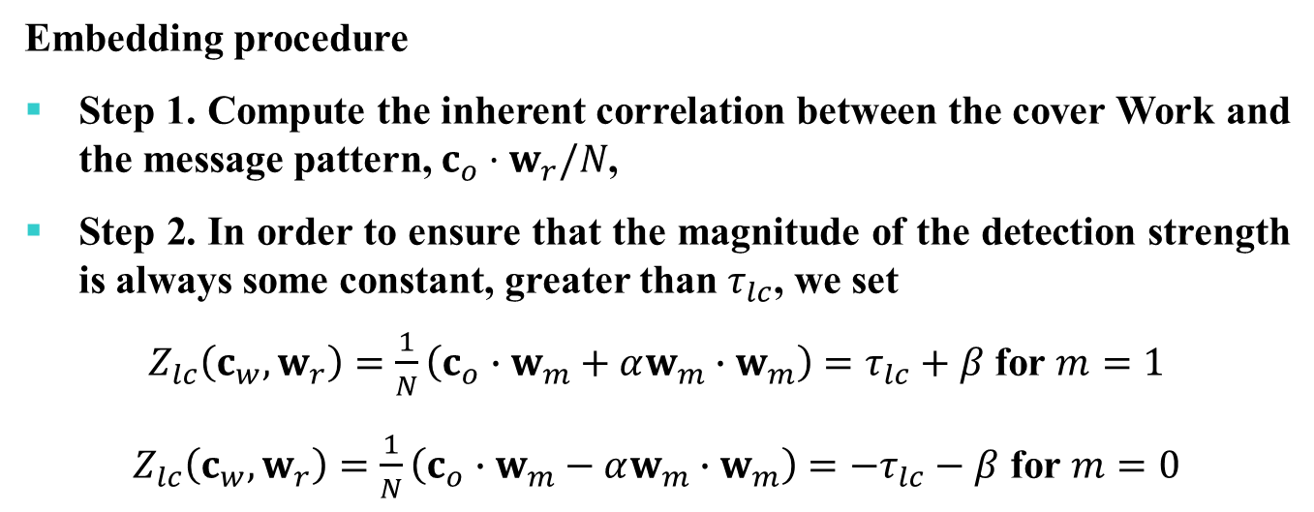
基于通信的水印模型
发送方拥有边信息的模型
例子：改进的水印方案E_FIXED_LC/D_LC
Embedding procedure
Step 1. Compute the inherent correlation between the cover Work and the message pattern, $c_{o}·w_{r}/N$,
Step 2. In order to ensure that the magnitude of the detection strength is always some constant, greater than $τ_{lc}$, we set
$Z_{lc}\left(c_{w},w_{r}\right)=\frac{1}{N}\left(c_{o}∙w_{m}+αw_{m}∙w_{m}\right)=τ_{lc}+β$ for $m=1$
$Z_{lc}\left(c_{w},w_{r}\right)=\frac{1}{N}\left(c_{o}∙w_{m}−αw_{m}∙w_{m}\right)=−τ_{lc}−β$ for $m=0$
Notes:
In the E_BLIND embedder, we assumed that this value was small. In the E_FIXED_LC system, we do not make this assumption

Slide 22
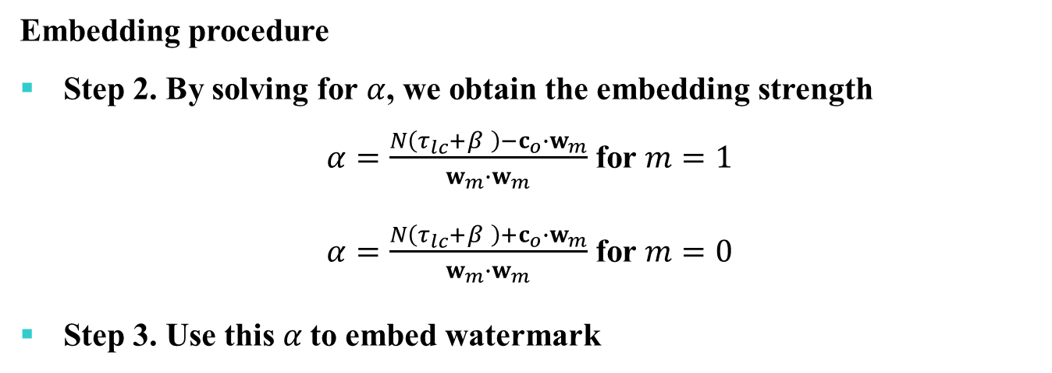
基于通信的水印模型
发送方拥有边信息的模型
例子：改进的水印方案E_FIXED_LC/D_LC
Embedding procedure
Step 2. By solving for $α$, we obtain the embedding strength
$α=\frac{N\left(τ_{lc}+β \right)−c_{o}∙w_{m}}{w_{m}∙w_{m}}$ for $m=1$
$α=\frac{N\left(τ_{lc}+β \right)+c_{o}∙w_{m}}{w_{m}∙w_{m}}$ for $m=0$
Step 3. Use this $α$to embed watermark
Notes:
In the E_BLIND embedder, we assumed that this value was small. In the E_FIXED_LC system, we do not make this assumption

Slide 23
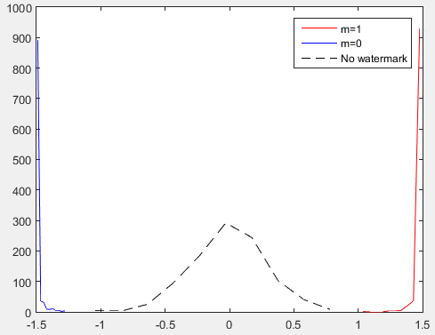
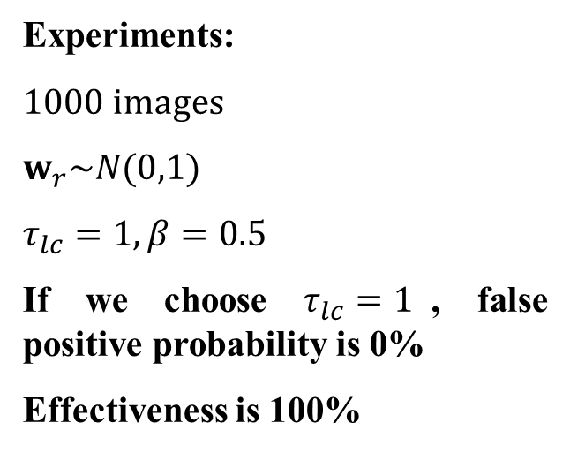
基于通信的水印模型
发送方拥有边信息的模型
例子：改进的水印方案E_FIXED_LC/D_LC
Experiments:
1000 images
$$w_{r}\sim N(0,1)$$
$$τ_{lc}=1, β=0.5$$
If we choose $τ_{lc}=1$, false positive probability is 0%
Effectiveness is 100%
Notes:
In the E_BLIND embedder, we assumed that this value was small. In the E_FIXED_LC system, we do not make this assumption

Slide 24
基于通信的水印模型
发送方拥有边信息的模型
例子：改进的水印方案E_FIXED_LC/D_LC
Problem:
Usually, the cover Work is detected by human being, which is rather different with the decoder of the watermarking scheme
It should not regard the cover Work as part of the transmission channel
Notes:
In the E_BLIND embedder, we assumed that this value was small. In the E_FIXED_LC system, we do not make this assumption

Slide 25
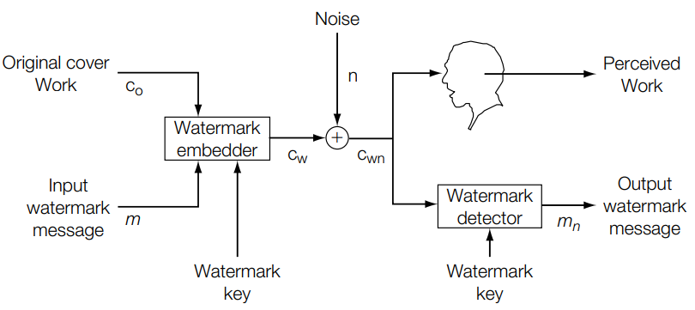
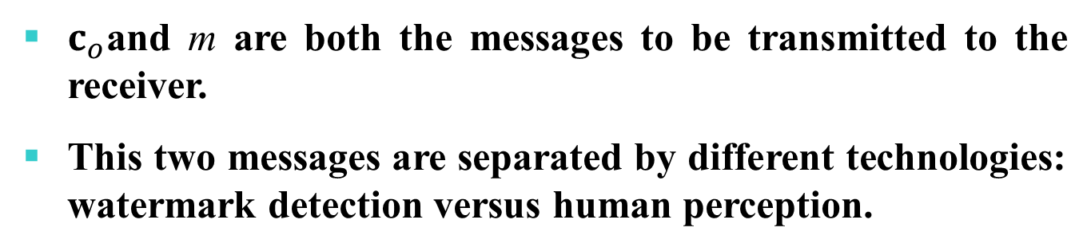
基于通信的水印模型
多重通信模型
$c_{o}$and m are both the messages to be transmitted to the receiver.
This two messages are separated by different technologies: watermark detection versus human perception.

Slide 26
基于通信的水印模型
多重通信模型
Two different usage of the term signal-to-noise ratio(SNR).
Effectiveness and robustness:
“signal” refers to the watermark and “noise” refers to the cover and/or any subsequent distortions
watermark-to-noise ratio (WNR)
Fidelity:
“signal” refers to the cover and “noise” refers to the watermark
document-to-noise ratio (DWR)

Slide 27
基于通信的水印模型
多重通信模型
Effectiveness and robustness:
Examine the cover Work and adjust the amplitude of the added pattern
Fidelity:
Use a perceptual model to examine the watermark interference with the Work

Slide 28
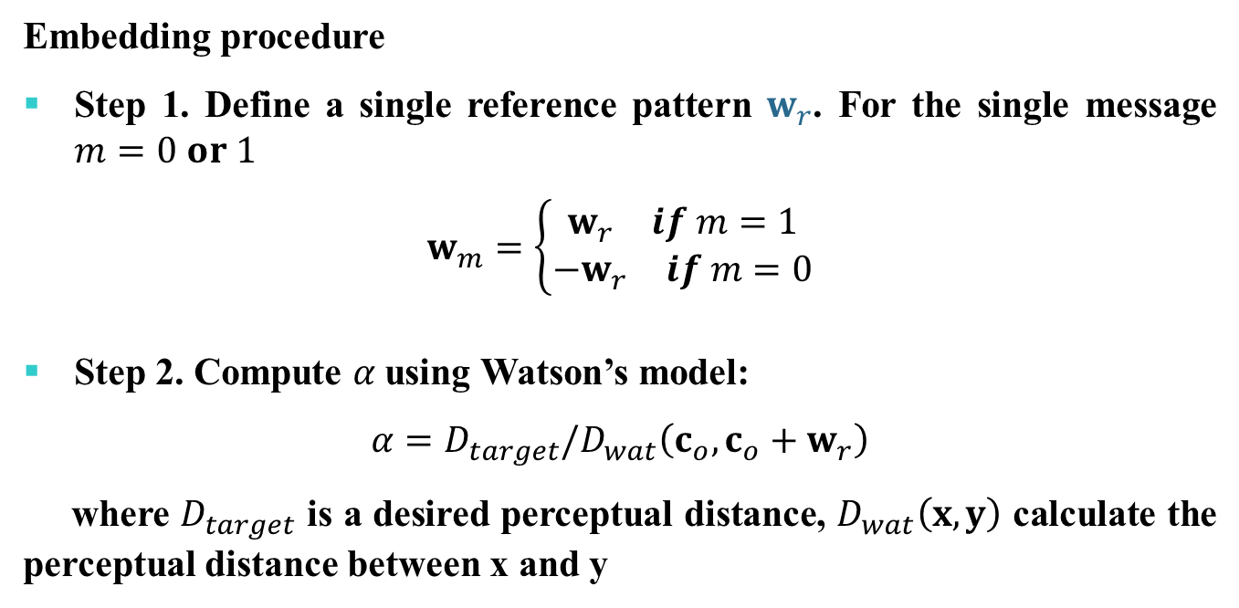
基于通信的水印模型
多重通信模型
例子：感知约束水印方案E_PERC_GSCALE /D_LC
Embedding procedure
Step 1. Define a single reference pattern $w_{r}$. For the single message $m=0 or 1$
$$w_{m}=\left\{\begin{aligned}\begin{matrix}w_{r} & if m=1\end{matrix} \\ \begin{matrix}−w_{r} & if m=0\end{matrix}\end{aligned}\right.$$
Step 2. Compute $α$using Watson’s model:
$$α=D_{target}/D_{wat}\left(c_{o},c_{o}+w_{r}\right)$$
where $D_{target}$ is a desired perceptual distance, $D_{wat}\left(x,y\right)$ calculate the perceptual distance between x and y

Slide 29
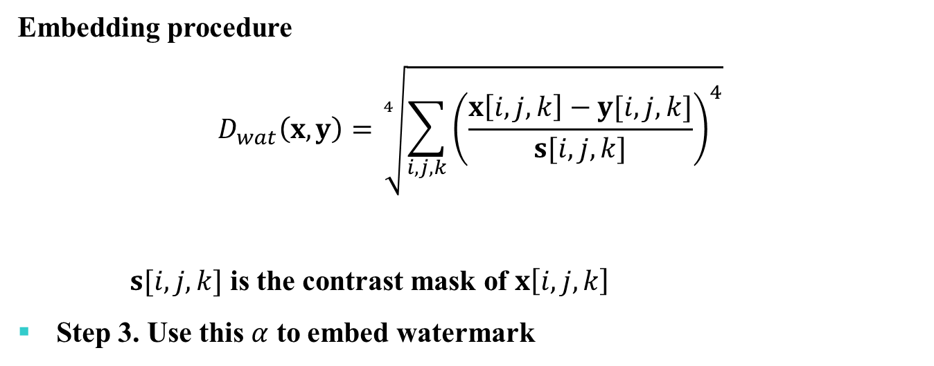
基于通信的水印模型
多重通信模型
例子：感知约束水印方案E_PERC_GSCALE /D_LC
Embedding procedure
$$D_{wat}\left(x,y\right)=\sqrt[4]{\sum_{i,j,k}{{\left(\frac{x\left[i,j,k\right]−y[i,j,k]}{s[i,j,k]}\right)}^{4}}}$$
$s[i,j,k]$ is the contrast mask of $x\left[i,j,k\right]$
Step 3. Use this $α$ to embed watermark

Slide 30
基于通信的水印模型
多重通信模型
Problem：
How to optimize the robustness and the fidelity simultaneously

Slide 31
水印的几何模型
Distribution of unwatermarked Works
描述每个载体的情况
Region of acceptable fidelity
描述各种处理后载体和一指定载体的接近程度
Detection region
描述水印提取算法的行为
Embedding distribution (embedding region)
描述水印嵌入算法的效果
Distortion distribution
描述正常应用中载体可能遭受何种扰动

Slide 32
水印的几何模型
Distribution of unwatermarked Works
不同类型的载体有不同的分布空间
在估计一个方案的属性时，必须对所有的载体有个先验分布
空间的维度是有限的（图像：像素的个数），空间的大小也是有限的（像素的取值范围）
典型的，可以采用椭圆高斯来描述这个分布
Unwatermarked Works
Notes:
之前的方案均采用高斯分布来模拟

Slide 33
水印的几何模型
Region of Acceptable Fidelity
原图C0周围的一个界限，界限中的每一个点表示一个和C0几乎不可区分的图像
可以选用一个简单的模型，例如mean squared error（MSE）来衡量，如果给MSE设定个阈值，此时这个界限是一个N维的球
实际上perceptual distance functions可以非常复杂的
Region of Acceptable Fidelity
Unwatermarked Works
Notes:
JND模型，图像平移造成的像素差别很大，但人类感知几乎没有影响

Slide 34
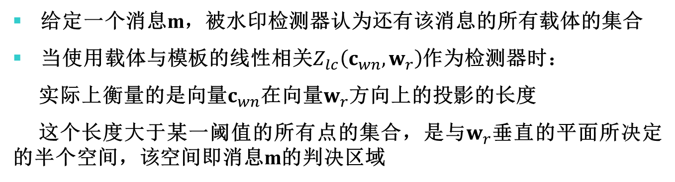
水印的几何模型
Detection Region
给定一个消息m，被水印检测器认为还有该消息的所有载体的集合
当使用载体与模板的线性相关$Z_{lc}\left(c_{wn},w_{r}\right)$作为检测器时：
实际上衡量的是向量$c_{wn}$在向量$w_{r}$方向上的投影的长度
这个长度大于某一阈值的所有点的集合，是与$w_{r}$垂直的平面所决定的半个空间，该空间即消息m的判决区域
Region of Acceptable Fidelity
Detection Region
Unwatermarked Works
Notes:
c ・ wr / N等于c和w的夹角的余弦乘以两个向量的长度，w的长度是固定的，因此等于c在w方向上的投影的长度

Slide 35
水印的几何模型
Detection Region
随机选取的高维空间中的向量，有很大的可能趋向于跟已知一向量垂直
所有同时在acceptable fidelity区域内的以及判决平面右侧的点都是水印可以被成功嵌入的载体
Region of Acceptable Fidelity
Detection Region
Points in this intersection represent successfully watermarked versions of c
Unwatermarked Works

Slide 36
水印的几何模型
Embedding Region
被嵌入后载体的分布
我们之前提出的方案E_BLIND给图像的每个点增加了一个非零值
这个方案既不满足Fidelity要求，也无法保证嵌入的100%有效
Region of Acceptable Fidelity
Detection Region
Embedding Region
Unwatermarked Works

Slide 37
水印的几何模型
Embedding Region
我们之前提出的方案E_FIXED_LC使得每个嵌入后图像落在了一个平面上
这个方案可以保证嵌入的100%有效
Region of Acceptable Fidelity
Detection Region
Embedding Region
Unwatermarked Works

Slide 38
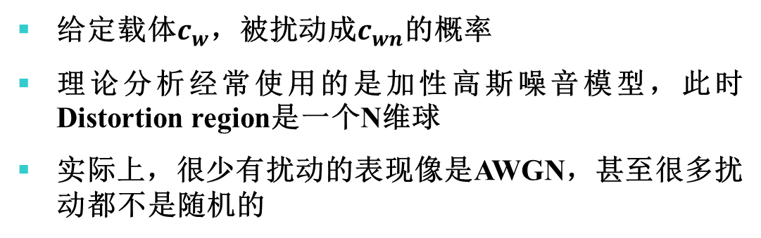
水印的几何模型
Distortion Region
给定载体$c_{w}$，被扰动成$c_{wn}$的概率
理论分析经常使用的是加性高斯噪音模型，此时Distortion region是一个N维球
实际上，很少有扰动的表现像是AWGN，甚至很多扰动都不是随机的
Detection Region
Region of Acceptable Fidelity
Distortion Region
Embedding Region
Unwatermarked Works

Slide 39
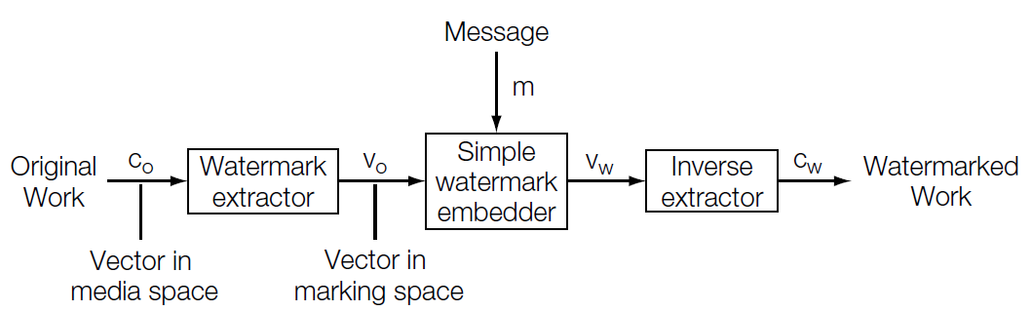
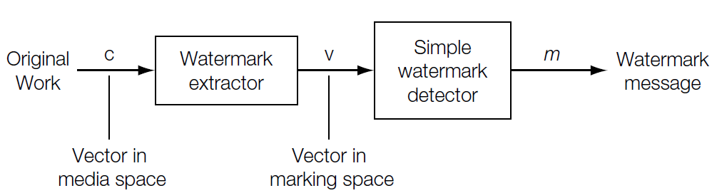
水印的几何模型
Marking Spaces
前面设计的方案都直接在媒体本来的像素空间进行
实际很多方案很难在像素空间分析，通常现将载体投影到一个Marking Space上，然后在这个投影空间上设计简单的方案
Watermark extraction：可以是频率域变换，滤波，特征提取等。
Watermark embedder
Watermark detector

Slide 40
水印的几何模型
Marking Spaces
采用extraction函数的目的：
降低嵌入和提取的消耗
简化载体的分布，例如通过每一块取平均值，载体的分布更接近高斯

Slide 41
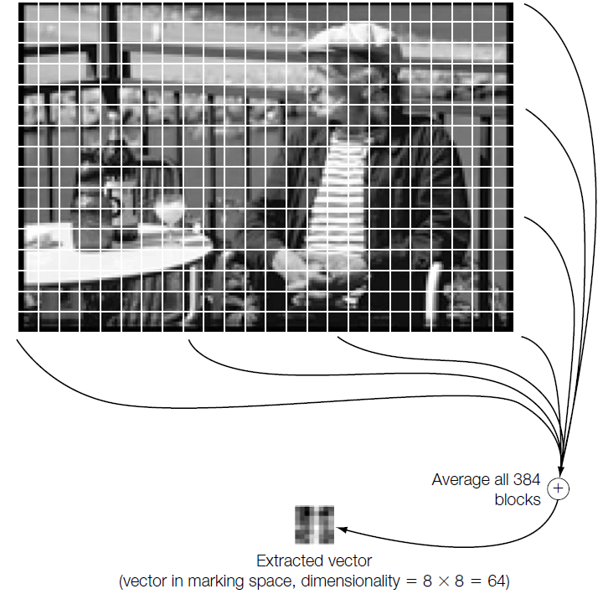
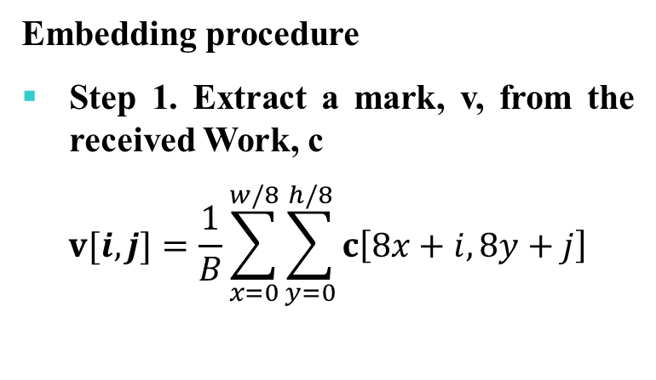
水印的几何模型
Marking Spaces
例子：基于块的水印方案E_BLK_BLIND/D_BLK_CC
Embedding procedure
Step 1. Extract a mark, v, from the received Work, c
$$v[i,j]=\frac{1}{B}\sum_{x=0}^{w/8}{\sum_{y=0}^{h/8}{c\left[8x+i,8y+j\right]}}$$

Slide 42
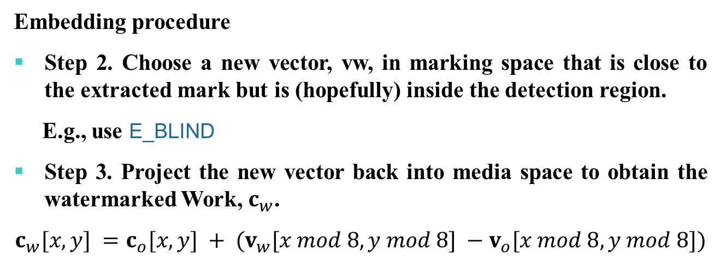
水印的几何模型
Marking Spaces
例子：基于块的水印方案E_BLK_BLIND/D_BLK_CC
Embedding procedure
Step 2. Choose a new vector, vw, in marking space that is close to the extracted mark but is (hopefully) inside the detection region.
E.g., use E_BLIND
Step 3. Project the new vector back into media space to obtain the watermarked Work, $c_{w}$.
$$c_{w}[x, y] =c_{o}[x, y] + (v_{w}[x mod 8, y mod 8] −v_{o}[x mod 8, y mod 8])$$
Notes:
将v上的改动平均的分摊到每个相关的像素上。

Slide 43
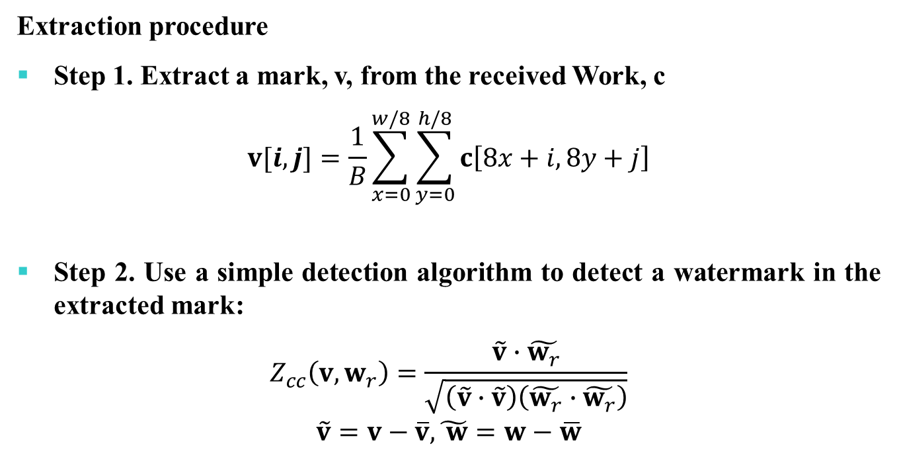
水印的几何模型
Marking Spaces
例子：基于块的水印方案E_BLK_BLIND/D_BLK_CC
Extraction procedure
Step 1. Extract a mark, v, from the received Work, c
$$v[i,j]=\frac{1}{B}\sum_{x=0}^{w/8}{\sum_{y=0}^{h/8}{c\left[8x+i,8y+j\right]}}$$
Step 2. Use a simple detection algorithm to detect a watermark in the extracted mark:
$$Z_{cc}\left(v,w_{r}\right)=\frac{\tilde{v}∙\tilde{w_{r}}}{\sqrt{\left(\tilde{v}∙\tilde{v}\right)\left(\tilde{w_{r}}∙\tilde{w_{r}}\right)}}$$
$$\tilde{v}=v−\overline{v},\tilde{ w}=w−\overline{w}$$
Notes:
这个提取器不会说亮度和对比度的影响

Slide 44

水印的几何模型
Marking Spaces
例子：基于块的水印方案E_BLK_BLIND/D_BLK_CC
Extraction procedure
Step 3. outputs
$$m_{n}=\left\{\begin{aligned}\begin{matrix}1 & if Z_{cc}\left(v,w_{r}\right)>τ_{cc}\end{matrix} \\ \begin{matrix}no watermark & if τ_{cc}≥Z_{lc}\left(v,w_{r}\right)≥−τ_{cc}\end{matrix} \\ \begin{matrix}0 & if Z_{cc}\left(v,w_{r}\right)<−τ_{cc}\end{matrix}\end{aligned}\right.$$

Slide 45
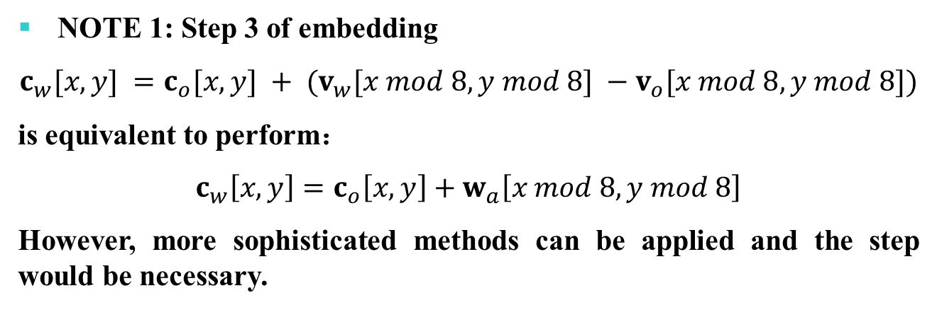
水印的几何模型
Marking Spaces
例子：基于块的水印方案E_BLK_BLIND/D_BLK_CC
NOTE 1: Step 3 of embedding
$$c_{w}[x, y] =c_{o}[x, y] + (v_{w}[x mod 8, y mod 8] −v_{o}[x mod 8, y mod 8])$$
is equivalent to perform：
$$c_{w}\left[x, y\right]=c_{o}\left[x, y\right]+w_{a}\left[x mod 8, y mod 8\right]$$
However, more sophisticated methods can be applied and the step would be necessary.

Slide 46
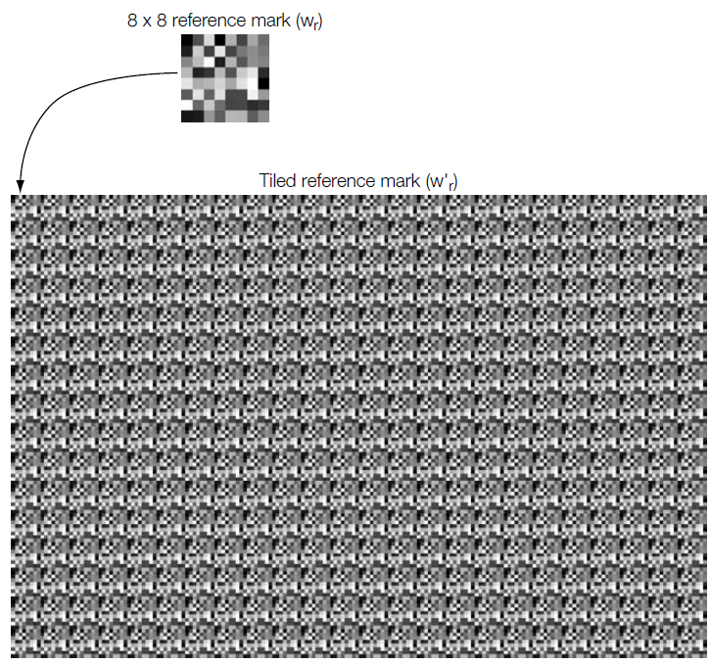
水印的几何模型
Marking Spaces
例子：基于块的水印方案E_BLK_BLIND/D_BLK_CC
NOTE 2: the performance of this watermarking system should be similar to that of the E_BLIND/D_LC system
Strengths:
1. Robust to certain changes in image brightness and contrast.
2. Computationally cheaper
Weaknesses
1. Much smaller watermark keyspace
2. randomly generated reference marks tend not to work well
Notes:
如果都用D_LC 提取算法，则表现应当完全相同

Slide 47
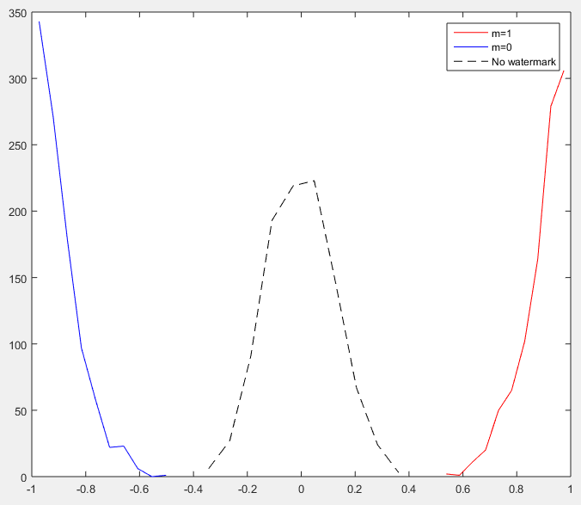

水印的几何模型
基本模型
例子：基于块的水印方案E_BLK_BLIND/D_BLK_CC
Experiments:
1000 images
$$α=1$$
$$w_{r}\sim N(0,1)$$

Slide 48
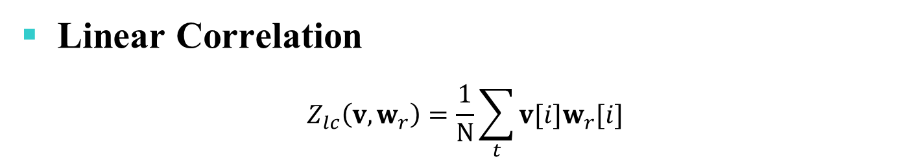
提取算法的模型
Linear Correlation
$$Z_{lc}\left(v,w_{r}\right)=\frac{1}{N}\sum_{t}{v[i]w_{r}[i]}$$
Geometric Interpretation
When a vector is corrupted by AWGN, the noise tends to be parallel to the detection planar
Notes:
向量在reference mask方向的投影，
随机添加的AWGN与w是不相干的，趋于垂直

Slide 49
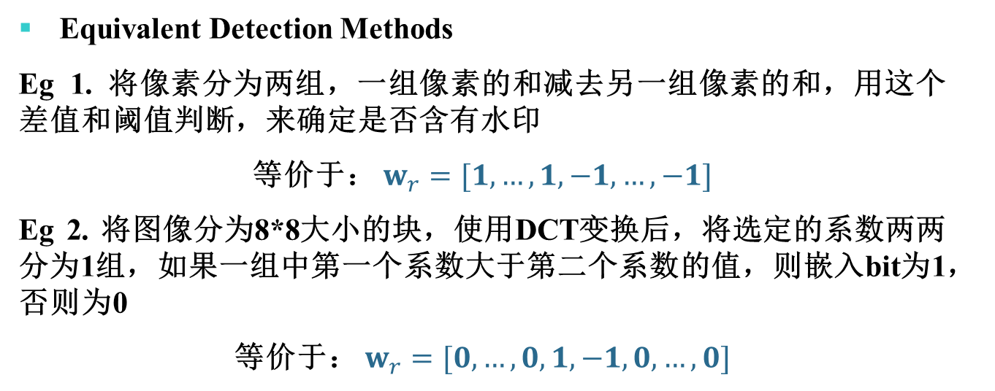
提取算法的模型
Linear Correlation
$$Z_{lc}\left(v,w_{r}\right)=\frac{1}{N}\sum_{t}{v[i]w_{r}[i]}$$
Equivalent Detection Methods
Eg 1. 将像素分为两组，一组像素的和减去另一组像素的和，用这个差值和阈值判断，来确定是否含有水印
等价于： $w_{r}=[1,…,1,−1,…,−1]$
Eg 2. 将图像分为8*8大小的块，使用DCT变换后，将选定的系数两两分为1组，如果一组中第一个系数大于第二个系数的值，则嵌入bit为1，否则为0
等价于： $w_{r}=[0,…,0,1,−1,0,…,0]$

Slide 50
提取算法的模型
Linear Correlation
Problem
The detection values are highly dependent on the magnitudes of vectors extracted
Sensitive to brightness changing of images, volume reducing of music.

Slide 51

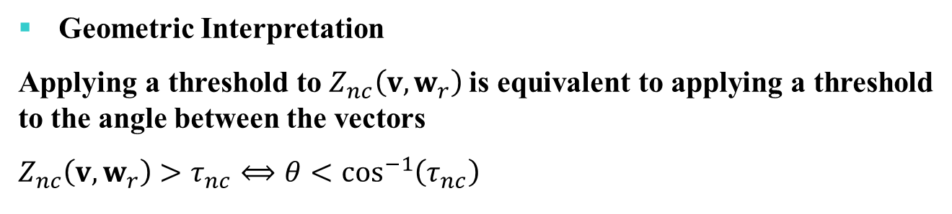
提取算法的模型
Normalized Correlation
$$Z_{nc}\left(v,w_{r}\right)=\frac{1}{N}\sum_{t}{\tilde{v} \left[i\right]{\tilde{w}}_{r} [i]}$$
$\tilde{v}=v/\left|v\right|$, ${\tilde{w}}_{r}=w_{r}/\left|w_{r}\right|$
Geometric Interpretation
Applying a threshold to $Z_{nc}\left(v,w_{r}\right)$is equivalent to applying a threshold to the angle between the vectors
$$Z_{nc}\left(v,w_{r}\right)>τ_{nc}⟺θ<\cos^{−1}\left(τ_{nc}\right)$$
Notes:
随机添加的AWGN与w垂直，相当于换了一个与x轴垂直的y轴，角度不会发生改变

Slide 52

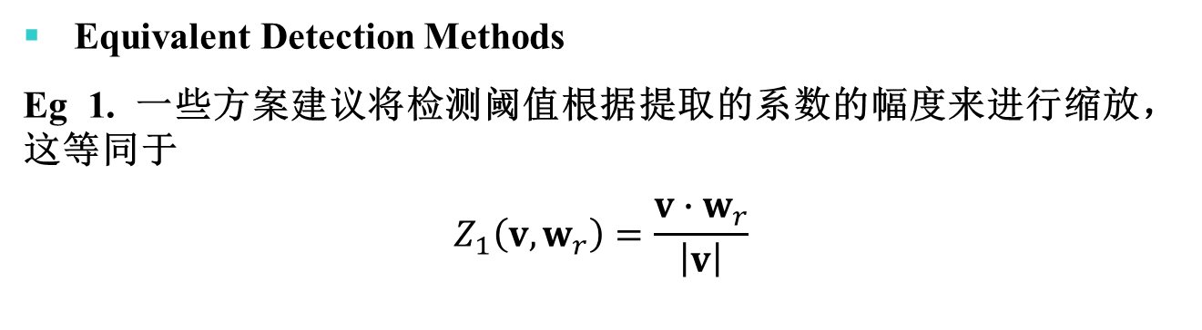
提取算法的模型
Normalized Correlation
$$Z_{nc}\left(v,w_{r}\right)=\frac{1}{N}\sum_{t}{\tilde{v} \left[i\right]{\tilde{w}}_{r} [i]}$$
$$\tilde{v}=v/\left|v\right|\text{, }{\tilde{w}}_{r}=w_{r}/\left|w_{r}\right|$$
Equivalent Detection Methods
Eg 1. 一些方案建议将检测阈值根据提取的系数的幅度来进行缩放，这等同于
$$Z_{1}\left(v,w_{r}\right)=\frac{v∙w_{r}}{\left|v\right|}$$
Notes:
随机添加的AWGN与w垂直，相当于换了一个与x轴垂直的y轴，角度不会发生改变

Slide 53
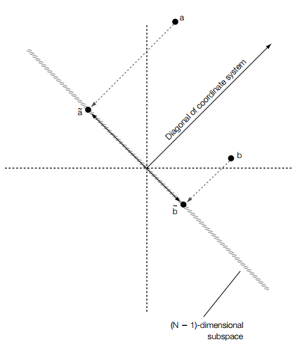
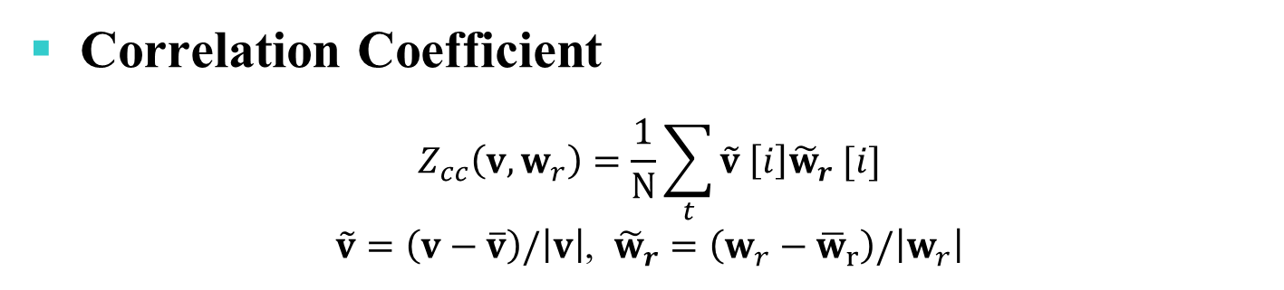
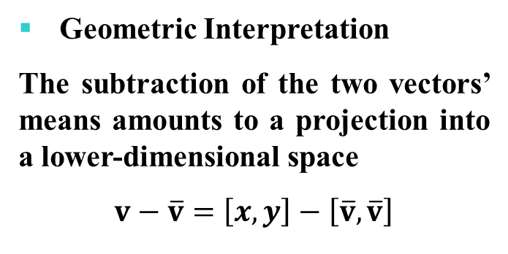
提取算法的模型
Correlation Coefficient
$$Z_{cc}\left(v,w_{r}\right)=\frac{1}{N}\sum_{t}{\tilde{v} \left[i\right]{\tilde{w}}_{r} [i]}$$
$\tilde{v}=\left(v−\overline{v}\right)/\left|v\right|$, ${\tilde{w}}_{r}=\left(w_{r}−{\overline{w}}_{r}\right)/\left|w_{r}\right|$
Geometric Interpretation
The subtraction of the two vectors’ means amounts to a projection into a lower-dimensional space
$$v−\overline{v}=\left[x,y\right]−\left[\overline{v},\overline{v}\right]$$
Notes:
减去$\overline{v}$，得到了一个垂直于$\overline{v}$的向量，因此所有的差值都落在一个平面上，这个平面垂直于N维空间的对角线$\overline{v}$，因此是N-1维度的

