Slide 1
Role of Load Balancers
Improves distribution of workloads across multiple computing resources such as computer cluster, network links
Aims to optimize resource use, maximize throughput, minimize response time and avoid overload any single resources.
Using multiple components with load balancing instead of a single component may increase reliability and availability through redundancy.

Slide 2
Example of Load Balancers
Popular websites, large Internet Relay Chat networks
High-bandwidth File Transfer Protocol sites, Network News Transfer Protocol (NNTP) servers.
Domain Name System (DNS) servers

Slide 3
Software and Hardware Load Balancers
Software load balancers installed on the servers and consumes processor and memory of servers.
Software load balancers generally implements a combination of one or more scheduling algorithms. e.g. Round Robin Scheduling
Hardware load balancers are specialized hardware deployed in-between server and the client. It can be switching/routing hardware.
It can be dedicated system running a load balancing software with specialized capabilities.

Slide 4
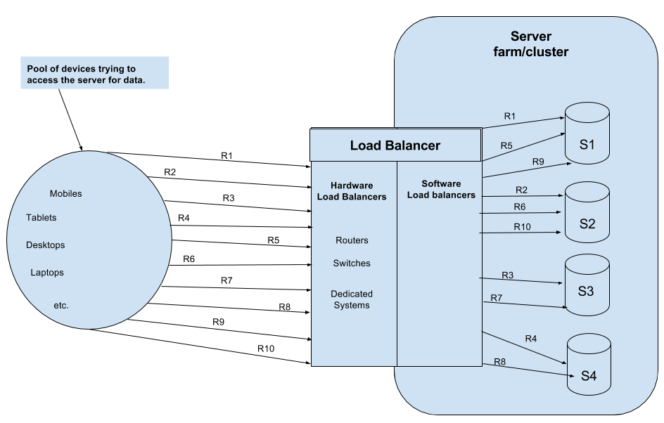
Round Robin Scheduling
Requests are served by the server sequentially one after another. After sending the request to the last server, it starts from the first server again.
The diagram below depicts this approach. Sequentially each request gets assigned to each server one by one and the round goes on.

