Slide 1
병원 개/폐업 분류 예측
수영이조
박정은 손다연 신선민 황수영

Slide 2




Contents
1. Introduction
2. Data
3. Analysis & Result
4. Conclusion

Slide 3





1. Introduction
1. 주제 및 목표
병원 폐업 여부를 예측하여 대출 승인여부 결정
2. 배경
한국 핀테크 기업 모우다(MOUDA)
: 상환기간 동안의 계속 경영 여부를 예측하여 병원들에게 금융 기회를 제공
일반적으로 병원 대출 시 신용점수 또는 담보물을 위주로 평가를 진행했던 기존 금융기관과의 차별점
신용 점수가 낮거나 담보를 가지지 못하는 우수 병원들에게도 금융 기회를 제공하자는 취지
3. 활용 데이터
의료기관의 폐업 여부가 포함된 최근 2개년의 재무정보와 병원 기본정보
(출처) Dacon 병원 개/폐업 분류 예측 경진대회 (https://dacon.io/competitions/official/9565/data/)

Slide 4

2. Data
[데이터 설명]
<병원 기본정보>
- inst_id: 병원 고유 번호 - OC: 영업/폐업 분류 - sido: 병원의 광역 지역 정보 - sgg: 병원의 시군구 자료 - openDate: 병원 설립일 - bedcount: 병원이 갖추고 있는 병상의 수 - instkind: 병원, 의원, 요양병원, 한의원, 종합병원 등 병원의 종류
- ctax1(2): 법인세비용
- Profit1(2): 당기순이익 - liquidAsset1(2): 유동자산 - quickAsset1(2): 당좌자산 - receivableS1(2): 미수금(단기) - inventoryAsset1(2): 재고자산 - nonCAsset1(2): 비유동자산 - tanAsset1(2): 유형자산 - OnonCAseet1(2): 기타 비유동자산 - receivableL1(2): 장기미수금 - debt1(2): 부채총계 - liquidLiabilities1(2): 유동부채 - shortLoan1(2): 단기차입금 - NCLiabilities1(2): 비유동부채 - longLoan1(2): 장기차입금 - netAsset1(2): 순자산총계 - surplus1(2): 이익잉여금
<재무정보> 1: 2017 회계년도, 2: 2016 회계년도 >
- revenue1(2): 매출액 - salescost1(2): 매출원가 - sga1(2): 판매비와 관리비 - salary1(2): 급여 - noi1(2): 영업외수익
- noe1(2): 영업외비용
- Interest1(2): 이자비용

Slide 5
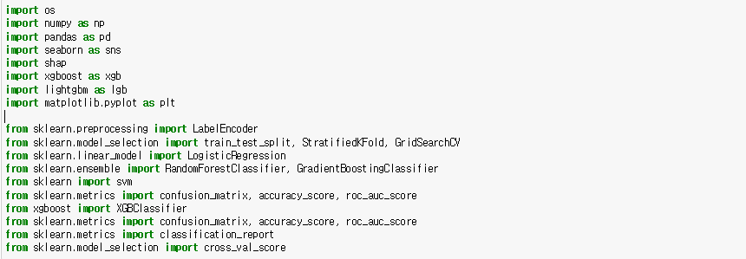
3. Analysis & Result
0. Import the necessary modules

Slide 6
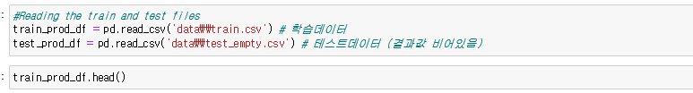
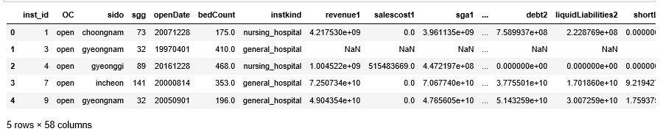
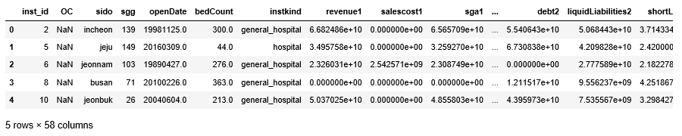
3. Analysis & Result
1. Preprocess the data

Slide 7
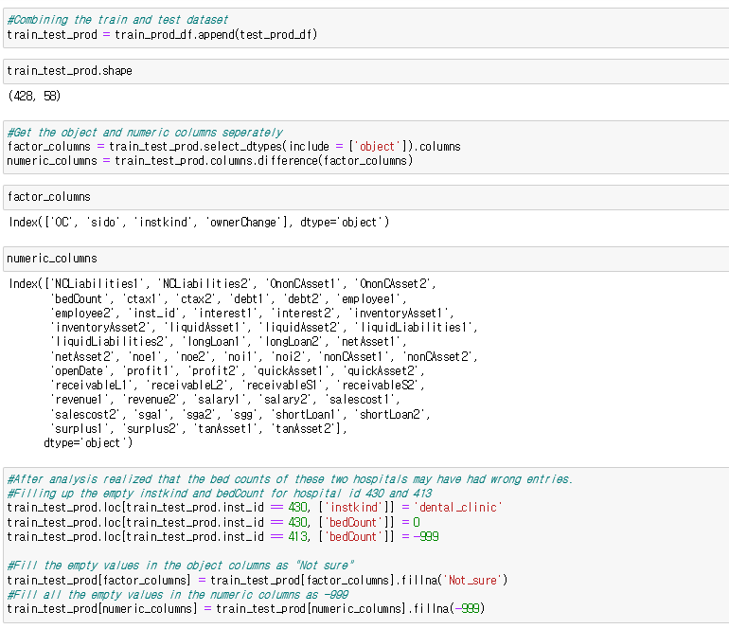
3. Analysis & Result
Fill the empty values
- Factor columns: Not_sure
- Numeric columns: -999

Slide 8
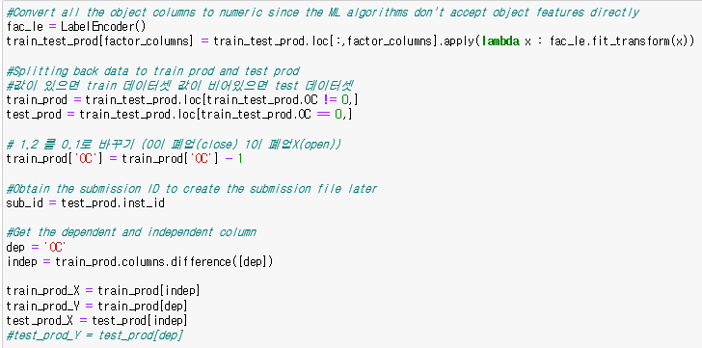
3. Analysis & Result
Split the whole data into train and test set
- dependent column: OC (0:close, 1:open)
- independent columns: others
- train_prod_X: train set with independent columns
- train_prod_Y: train set with dependent column
- test_prod_X: test set with independent columns
- test_prod_Y: the objective of prediction

Slide 9
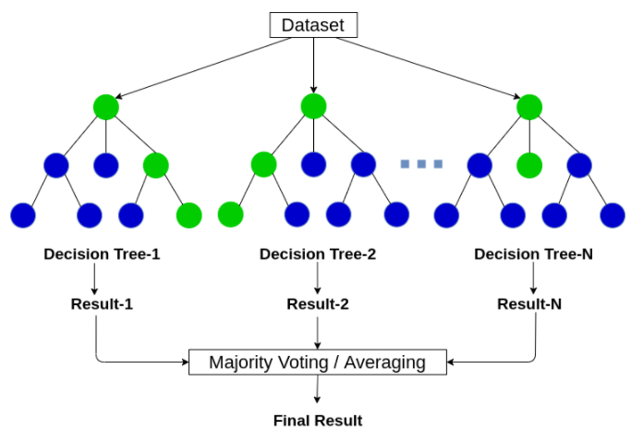
3. Analysis & Result
2. Classification Model(1) - Random Forest
Random Forest
- 분류/회귀예측에 이용되는 앙상블 기법 중 하나로, 대표적인 배깅 모형에 해당 - 다수의 결정 트리를 구성한 뒤 평균 또는 과반수 투표 등을 이용하여 하나의 랜덤 포레스트로 결합
A. Hyperparameter tuning of Random forest B. Check the over-fitting of tuned model C. Calculate the cut-off value for classification D. Compare default model to tuned model

Slide 10
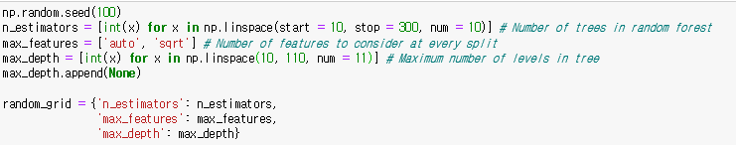
3. Analysis & Result
A. Hyperparameter tuning of Random forest (using 3-fold cross validation)
- n_estimators : The number of trees in the forest
- max_features : The number of features to consider when looking for the best split
- max_depth : The maximum depth of the tree

Slide 11

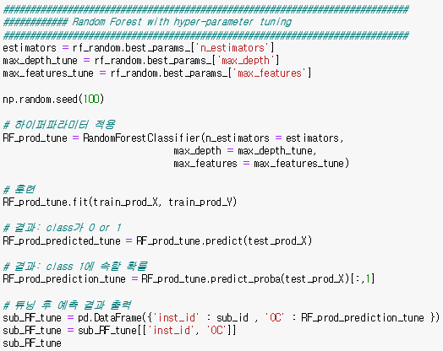
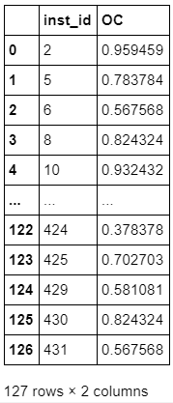
3. Analysis & Result
Check the best hyperparameter combination and train the Random forest model with it

Slide 12
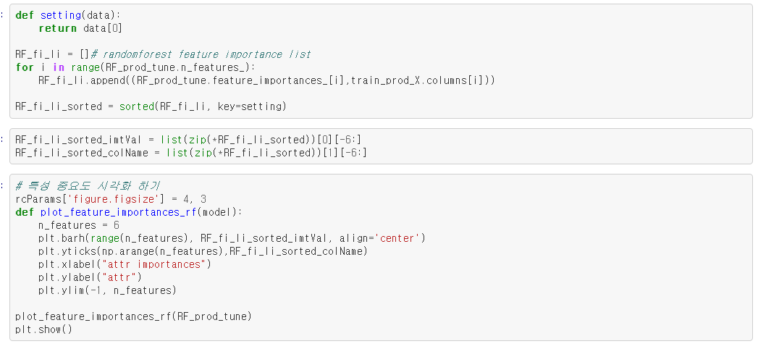
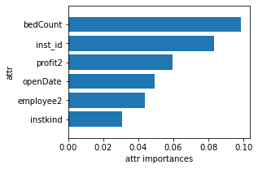
3. Analysis & Result
Check the best hyperparameter combination and train the Random forest model with it

Slide 13
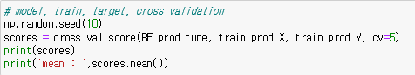
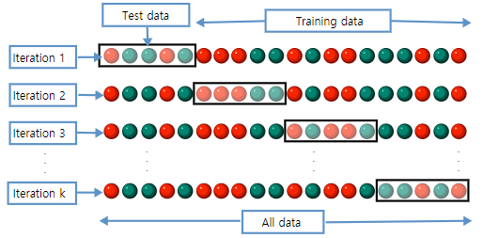

3. Analysis & Result
B. Check the over-fitting of tuned model (using 5-fold cross validation)
- 하이퍼파라미터 튜닝 범위가 무작위로 설정되었기 때문에 튜닝 결과가 훈련 데이터에 과대적합 되었을 가능성이 존재 - 교차 검증을 통해 과대적합 여부를 확인한 결과, 모든 fold에서 적절한 분류 성능을 보임
[ K-fold cross validation ]

Slide 14

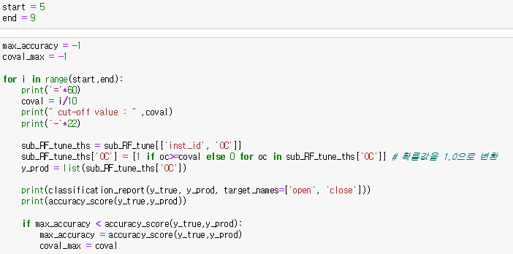
3. Analysis & Result
C. Calculate the cut-off value for classification
1) Construct the test set
with real answer
2) Examine the
optimal cut-off value
(0.5~0.8 by 0.1)

Slide 15
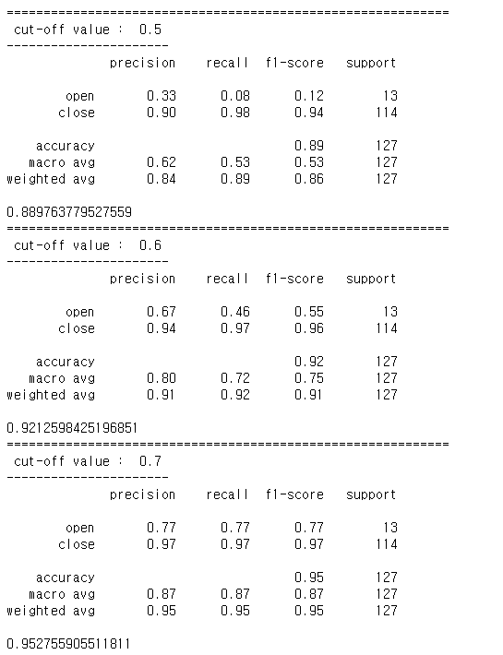
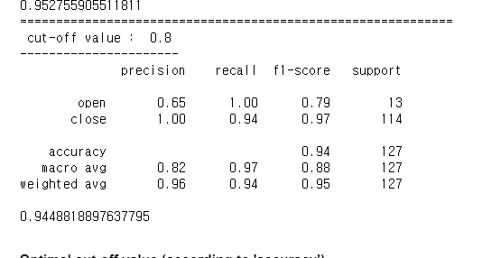
3. Analysis & Result
C. Calculate the cut-off value for classification

Slide 16
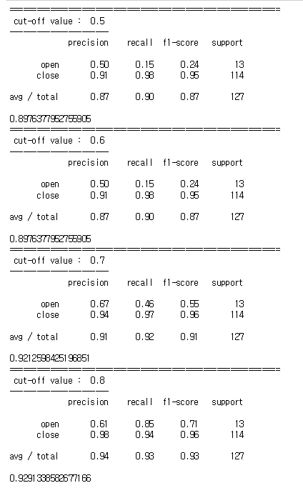
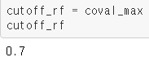
3. Analysis & Result
C. Calculate the cut-off value for classification
Optimal cut-off value
(according to 'accuracy')

Slide 17
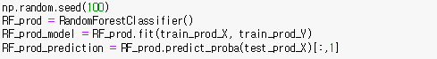
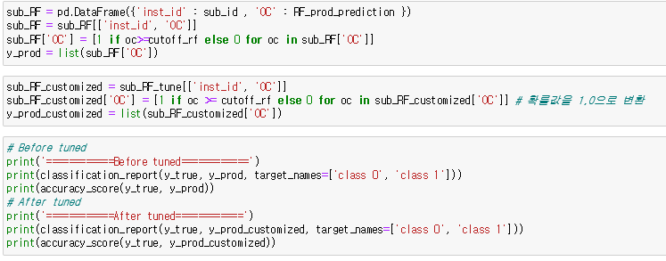
3. Analysis & Result
D. Compare default model to tuned model
< Defalut model >
n_estimators : default / max_features : default / max_depth : defalut
Compare 2 models with optimal cut-off value

Slide 18
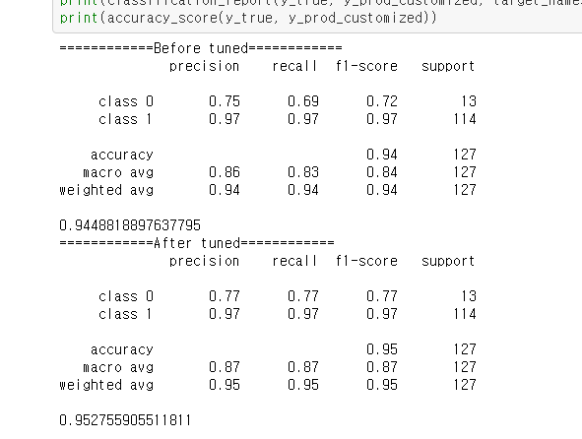
3. Analysis & Result

Slide 19
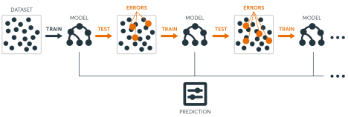
3. Analysis & Result
3. Classification Model(2) - GBM
GBM
분류/회귀예측에 이용되는 앙상블 기법 중 하나로, 대표적인 부스팅 모형에 해당
기존 타겟값과 그 residual을 예측하는 모형을 반복적으로 구성하고 결합함으로써 모형의 예측력을 높여가는 방법
A. Hyperparameter tuning of GBM B. Check the over-fitting of tuned model C. Calculate the cut-off value for classification D. Compare default model to tuned model

Slide 20
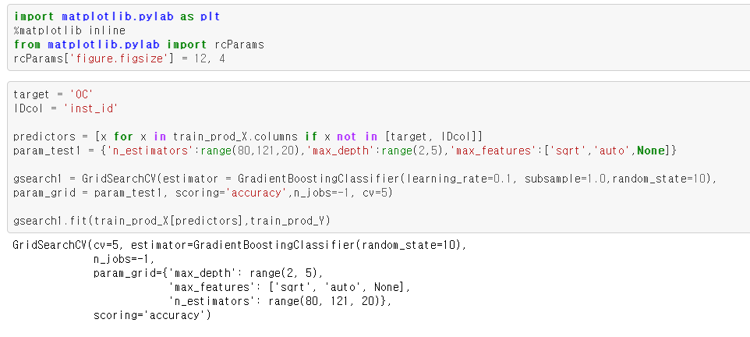
3. Analysis & Result
A. Hyperparameter tuning of GBM (using 3-fold cross validation)
- n_estimators : The number of boosting stages to perform
- max_features : The number of features to consider when looking for the best split
- max_depth : The maximum depth of the individual estimators
- min_sample_split : The minimum number of samples required to split an internal node

Slide 21
3. Analysis & Result
A. Hyperparameter tuning of GBM (using 5-fold cross validation)
- n_estimators : The number of boosting stages to perform
- max_features : The number of features to consider when looking for the best split
- max_depth : The maximum depth of the individual estimators
- min_sample_split : The minimum number of samples required to split an internal node

Slide 22

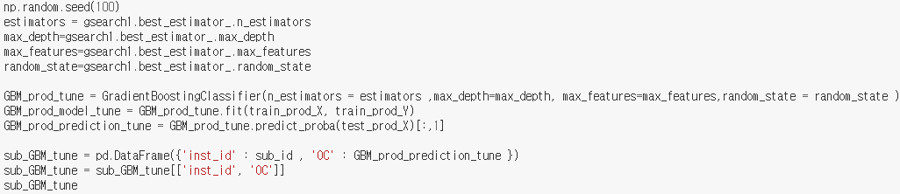
3. Analysis & Result
Check the best hyperparameter combination and train the GBM model with it
값 적용
…

Slide 23
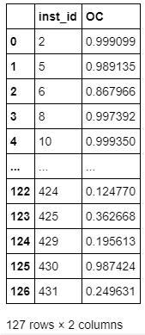
3. Analysis & Result
Check the best hyperparameter combination and train the GBM model with it
값 적용
…
result

Slide 24
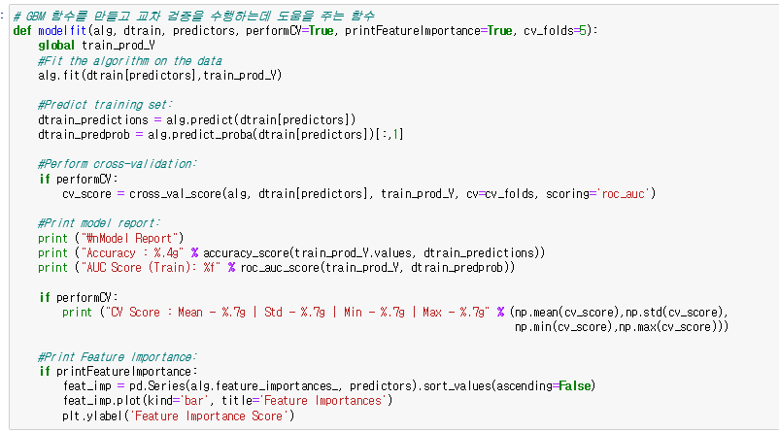
3. Analysis & Result
B. Check the over-fitting of tuned model (using 5-fold cross validation)

Slide 25
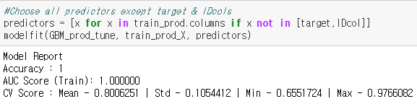
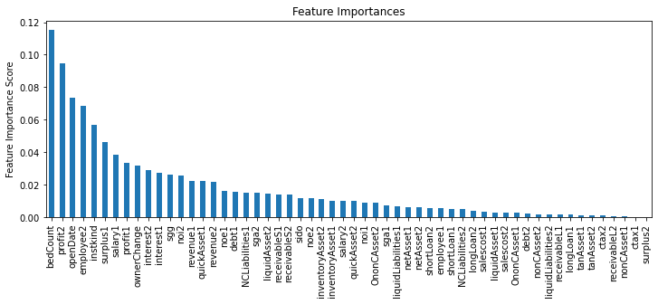
3. Analysis & Result
B. Check the over-fitting of tuned model (using 5-fold cross validation)

Slide 26
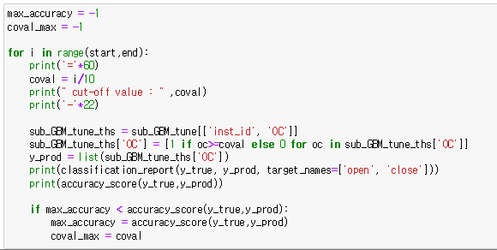
3. Analysis & Result
C. Calculate the cut-off value for classification
Examine the optimal cut-off value (0.5~0.8 by 0.1)

Slide 27
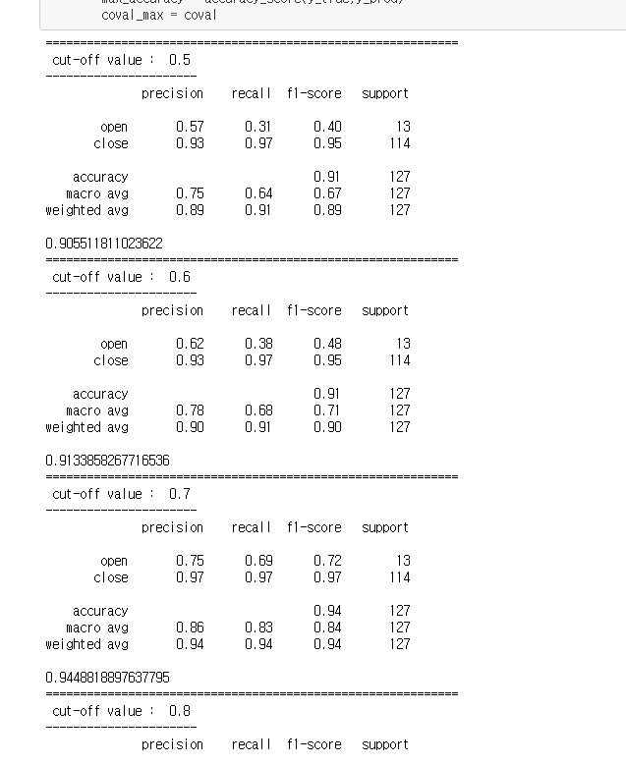
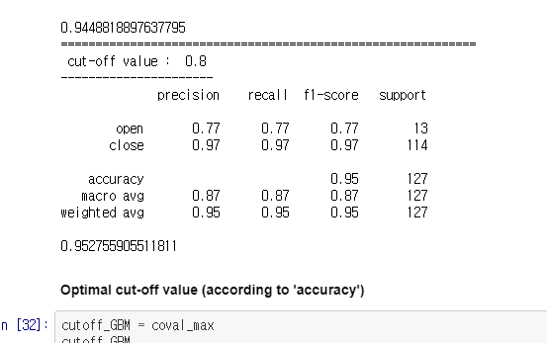
3. Analysis & Result
C. Calculate the cut-off value for classification

Slide 28
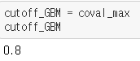
3. Analysis & Result
C. Calculate the cut-off value for classification
Optimal cut-off value
(according to 'accuracy')

Slide 29
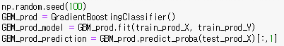
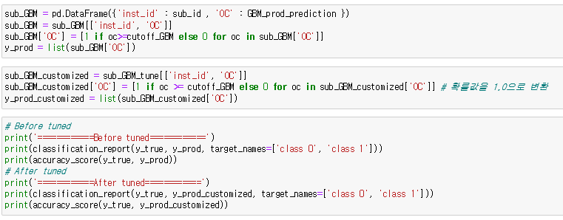
3. Analysis & Result
D. Compare default model to tuned model
< Defalut model >
n_estimators : default / max_features : default / max_depth : default / min_sample_split : default
Compare 2 models with optimal cut-off value

Slide 30
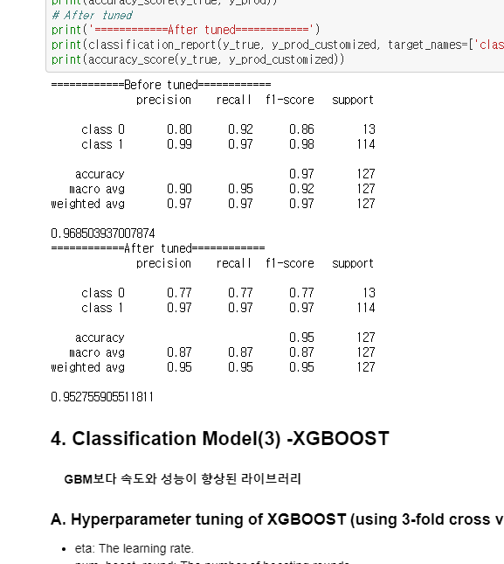
3. Analysis & Result

Slide 31
3. Analysis & Result
4. Classification Model(3) -XGBOOST
XGBOOST
GBM보다 속도와 성능이 향상된 라이브러리
Hyperparameter tuning of XGBOOST
B. Check the over-fitting of tuned model C. Calculate the cut-off value for classification D. Compare default model to tuned model

Slide 32
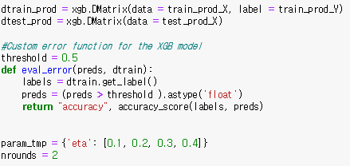
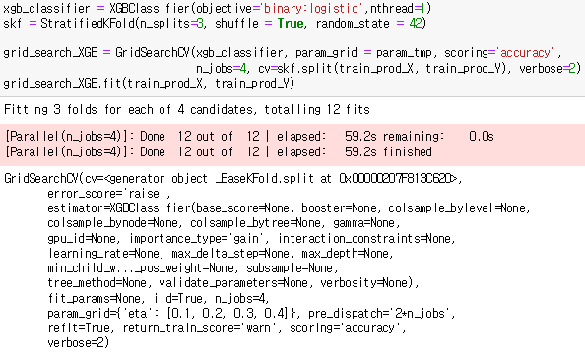
3. Analysis & Result
A. Hyperparameter tuning of XGBOOST (using 3-fold cross validation)
- eta : The learning rate
- num_boost_round : The number of boosting rounds

Slide 33

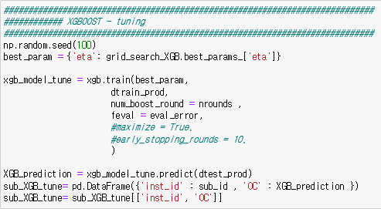
3. Analysis & Result
Check the best hyperparameter combination and train the XGB model with it

Slide 34
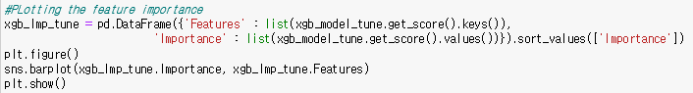
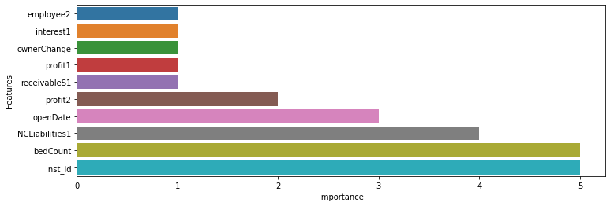
3. Analysis & Result
Check the best hyperparameter combination and train the XGB model with it

Slide 35
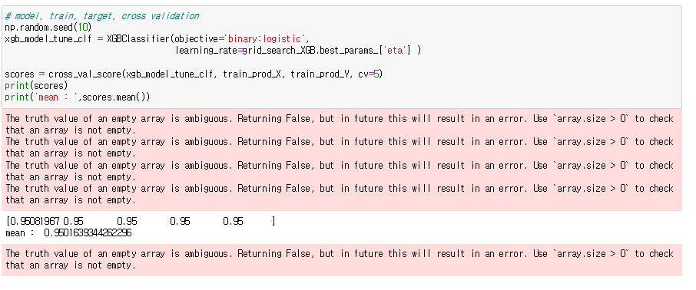
3. Analysis & Result
B. Check the over-fitting of tuned model (using 5-fold cross validation)

Slide 36
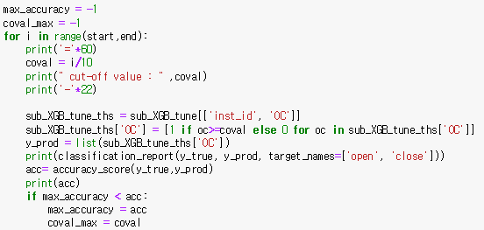
3. Analysis & Result
C. Calculate the cut-off value for classification
Examine the optimal cut-off value (0.5~0.8 by 0.1)

Slide 37
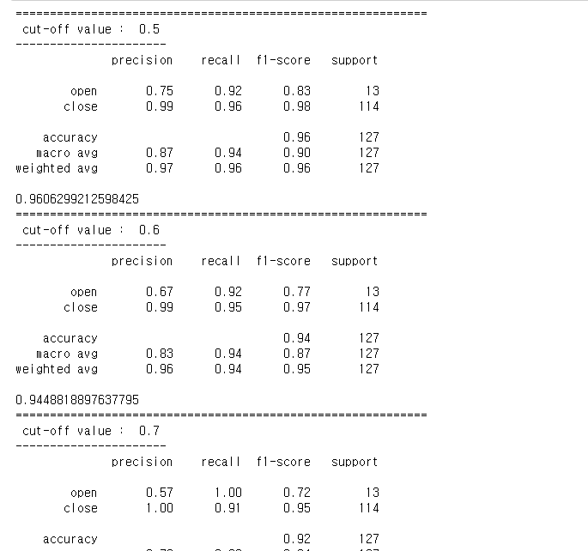
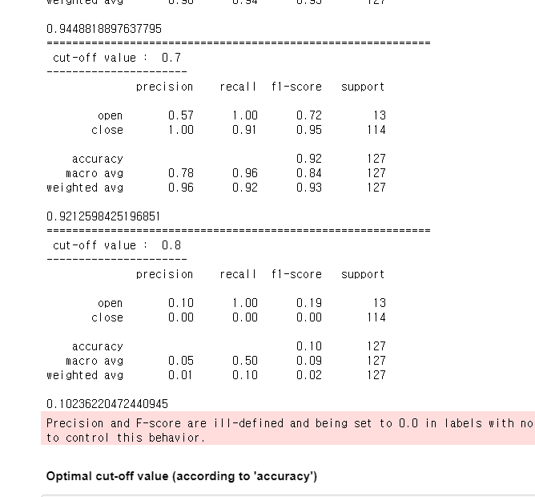
3. Analysis & Result
C. Calculate the cut-off value for classification

Slide 38
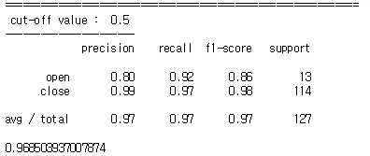
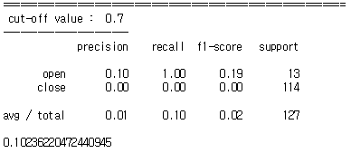
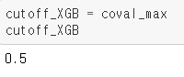
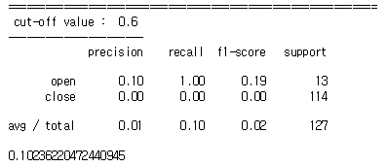
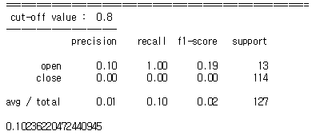
3. Analysis & Result
C. Calculate the cut-off value for classification
Optimal cut-off value
(according to 'accuracy')

Slide 39


3. Analysis & Result
D. Compare default model to tuned model
< Defalut model >
eta : default
Compare 2 models with optimal cut-off value

Slide 40


3. Analysis & Result

Slide 41
4. Conclusion
GBM
Random Forest
XGB

Slide 42
4. Conclusion
Final model → GBM
GBM
GBM
Random Forest
XGB

Slide 43

4. Conclusion
Final Model Review

Slide 44

4. Conclusion
Final Model Review
bedcount
opendate
profit2
interest2
employee2

Slide 45


4. Conclusion
Find the missing answer
Confusion matrix

Slide 46

Thank you
수영이조
박정은 손다연 신선민 황수영

