Slide 1

House price prediction
Wang, Shanyong

Slide 2

Contexts
Abstract
Introduction of the problem
Data preprocessing
Model building
Result comparing
Conclusions

Slide 3
Abstract
This study focuses on predicting house prices using various regression models. We explore multiple algorithms including Linear Regression, K-Nearest Neighbors (KNN), Support Vector Machine (SVM), Random Forest. The dataset consists of features relevant to house pricing, and the models are evaluated based on their Mean Squared Error (MSE) and R² score. The results indicate that ensemble methods, particularly Gradient Boosting and Random Forest, outperform other models in terms of prediction accuracy. The study concludes with a blended model approach that combines predictions from the best-performing models to achieve a robust final prediction.

Slide 4
Introduction of the problem
The problem lists some of the features of one house and its sale price. The aim is to predict the price of the houses that are in sale. The features have a lot to do with the price of the home. So it is necessary to build a series of models to find the relationship between the two.

Slide 5
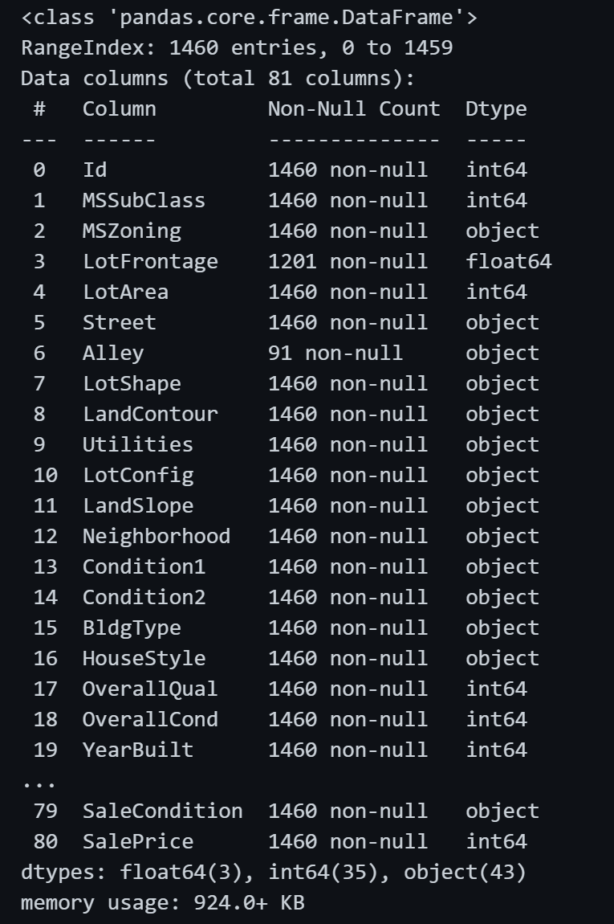
Data preprocessing
The train data size:(1460, 81)
The test data size:(1459, 80)

Slide 6
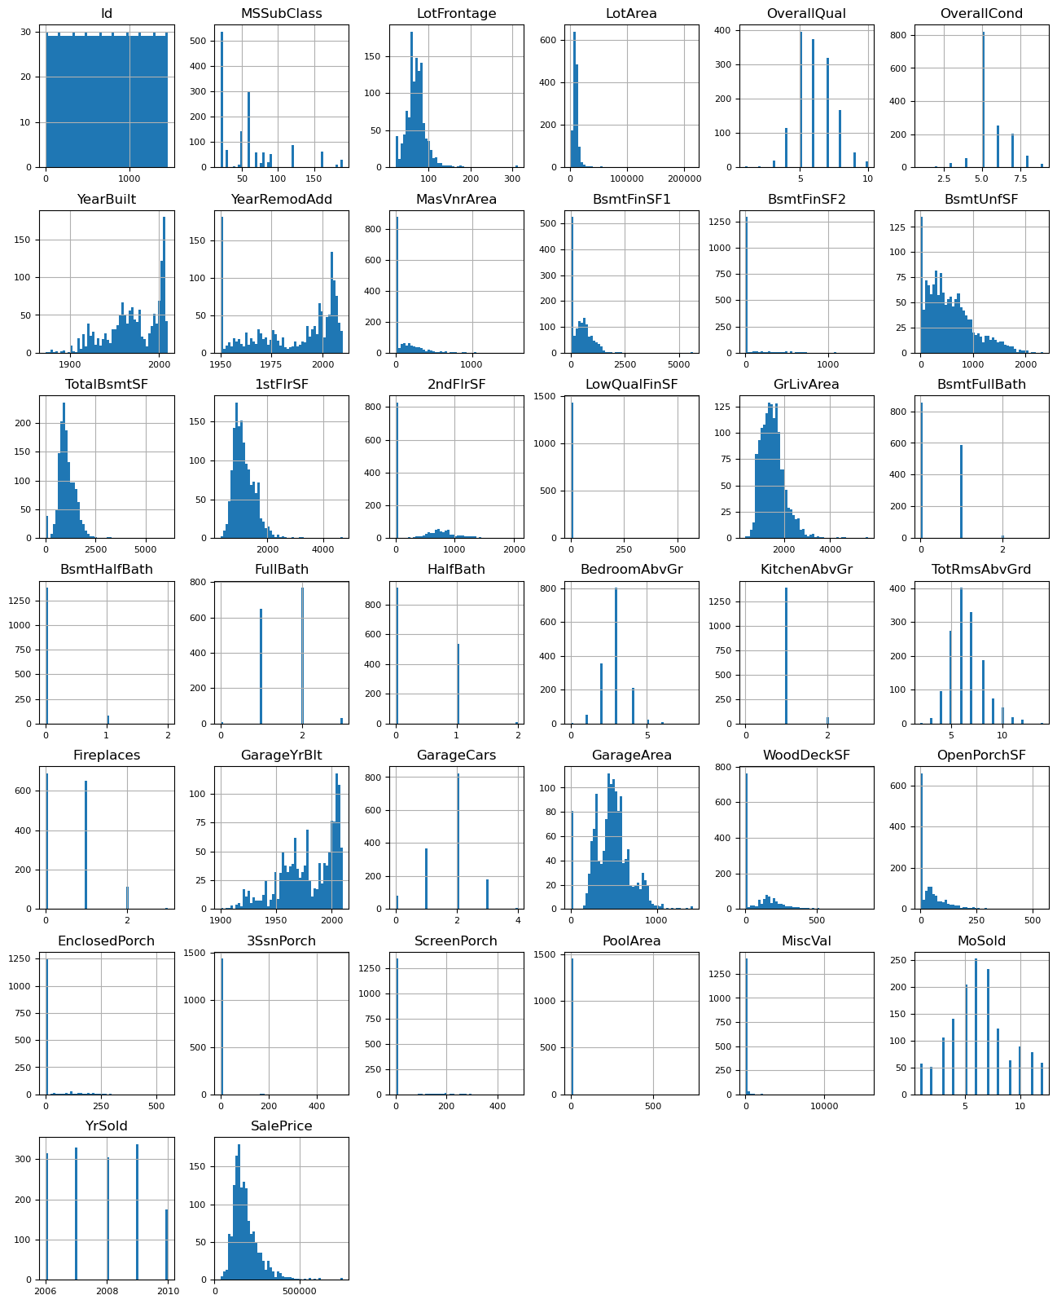
Data preprocessing

Slide 7
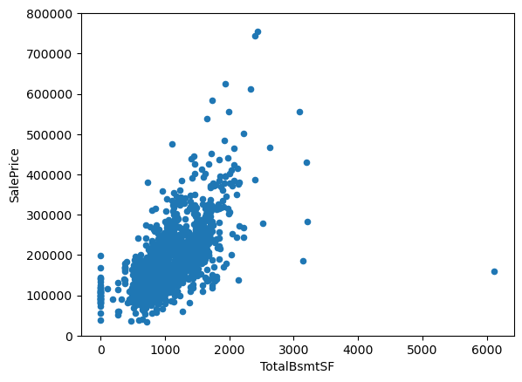
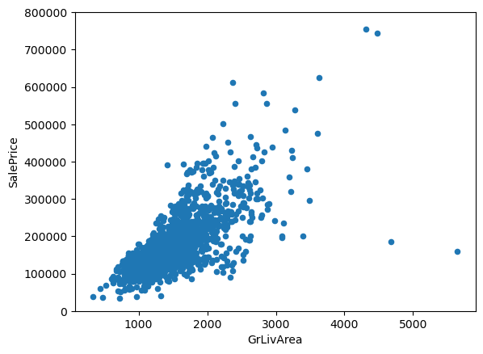
Data preprocessing
Drop out some data

Slide 8
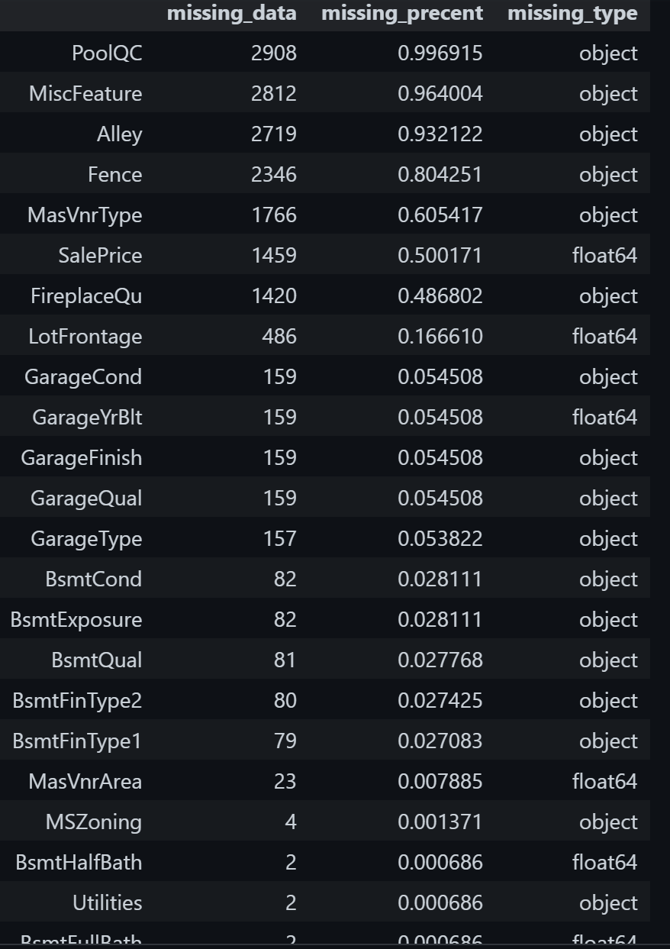
Data preprocessing
Missing data

Slide 9
Model Building
Linear Regression
KNN
Ridge Regression
Random Forest
Using 5–fold and mse(Mean Square Error）
)

Slide 10
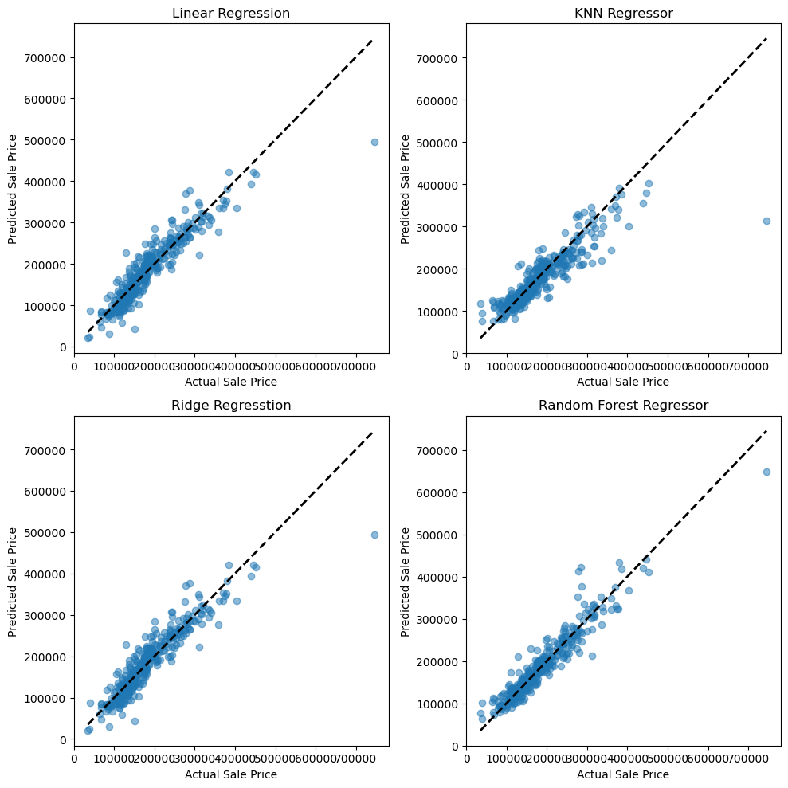
Result Comparing

Slide 11
Result comparing
Linear Regression CV Mean MSE: 855598374.95 ± 182871982.17
Linear Regression CV Mean R²: 0.86 ± 0.01
KNN Regressor CV Mean MSE: 1235660008.53 ± 365618891.94
KNN Regressor CV Mean R²: 0.81 ± 0.02
Ridge Regression CV Mean MSE: 855200592.05 ± 183040614.60
Ridge Regression CV Mean R²: 0.86 ± 0.01
Random Forest Regressor CV Mean MSE: 744477078.23 ± 191650121.61
Random Forest Regressor CV Mean R²: 0.88 ± 0.02

Slide 12
Conclusion
The result seems that random forest algorithm works well.
There are still weaknesses in my alanyls. The parameters of the models have not been trained yet. The result can be handled through ensemble learning.

Slide 13

Thank you for listening

