Slide 1


An Empirical Testing of Autonomous Vehicle Simulator System for Urban Driving
John Seymour, Dac-Thanh-Chuong Ho, Quang-Hung Luu
Department of Computer Science and Software Engineering
Swinburne University of Technology, Australia

Slide 2
Introduction
Our work presents new empirical evidence that it is feasible to
derive a good scenario diversity, and at the same time
detect AV problems in the simulation environment.

Slide 3
questions
RQ1: Are our test cases effective in mimicking hazardous situations and can the system capture them?
RQ2: What are critical factors that distinguish a scenario to be safe or unsafe?
RQ3: Does the environmental condition have any impact on the safety of the AV?
RQ4: Is the use of simulator-based systems helpful in understanding safety in reality

Slide 4
TESTING Method
Equivalent Partitioning
Metamorphic Testing

Slide 5
System under test
Apollo 6.0
SVL 2021.1

Slide 6
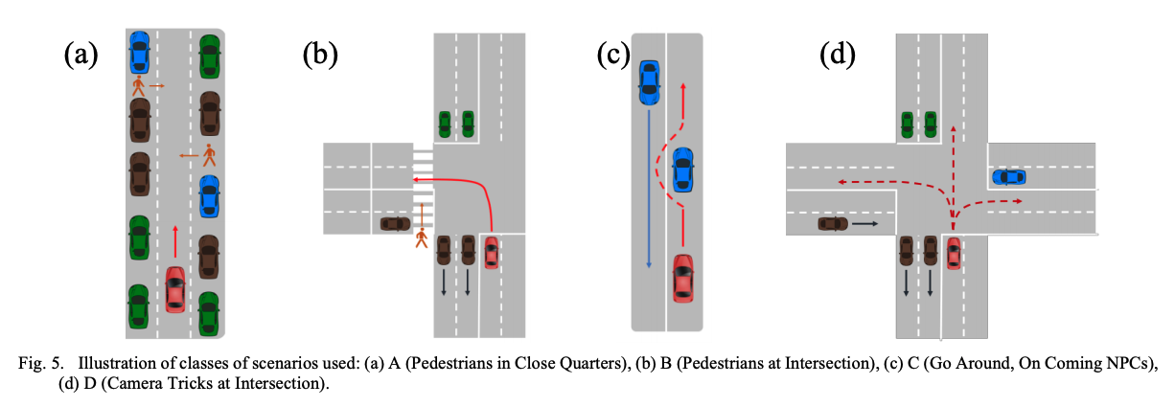
Test Scenarios

Slide 7
Test case execution & validation
Total test cases: 1062
For each scenario, we have coded a Python script and its associated Bash script to do automated testing.
For the metamorphic testing, we adopt two MRs, given a certain scenario during the daytime.
The condition in MR1 is that the AV decision is unchanged regardless of day or night-time.
For MR2, it requires the decision to be robust regardless of the time as well as the bad weather (intense rain and fog).

Slide 8
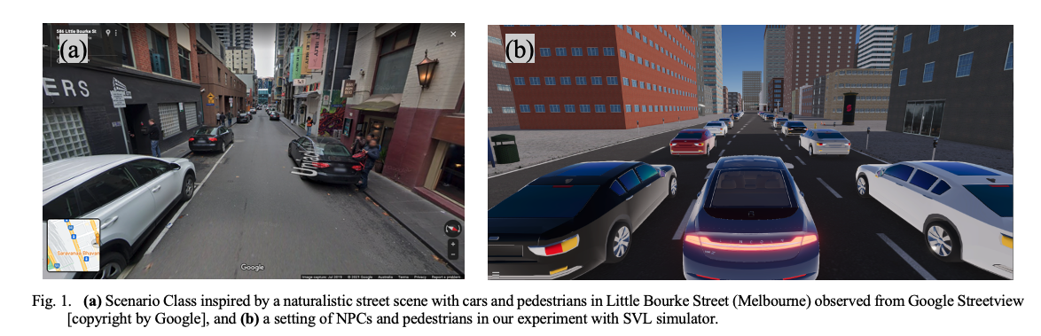
81 Scenarios for class A

Slide 9
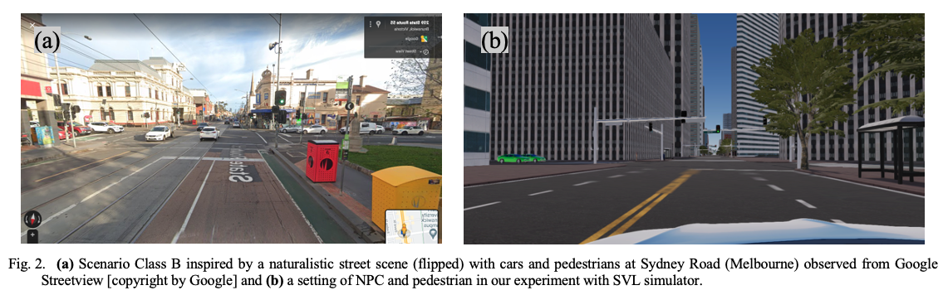
216 Scenarios for class B

Slide 10
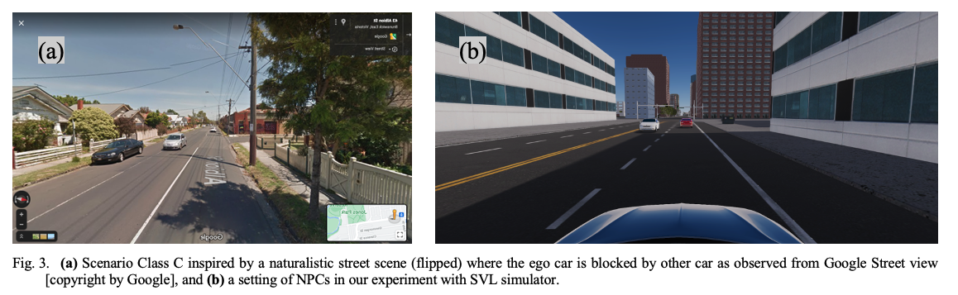
36 Scenarios for class C

Slide 11
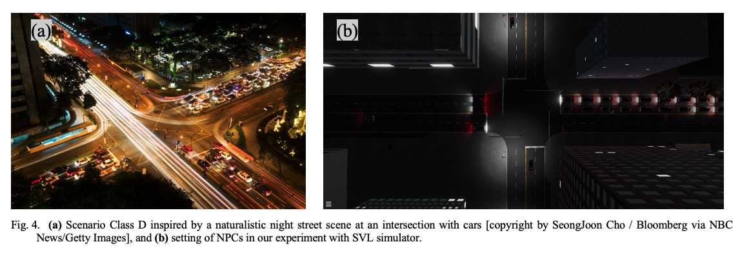
243 Scenarios for class D

Slide 12
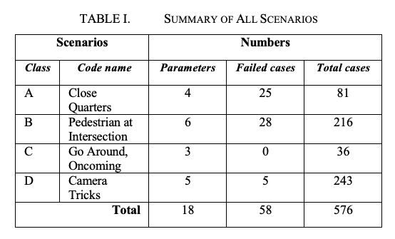
RQ1: Are our test cases effective in mimicking hazardous situations and can the system capture them?

Slide 13
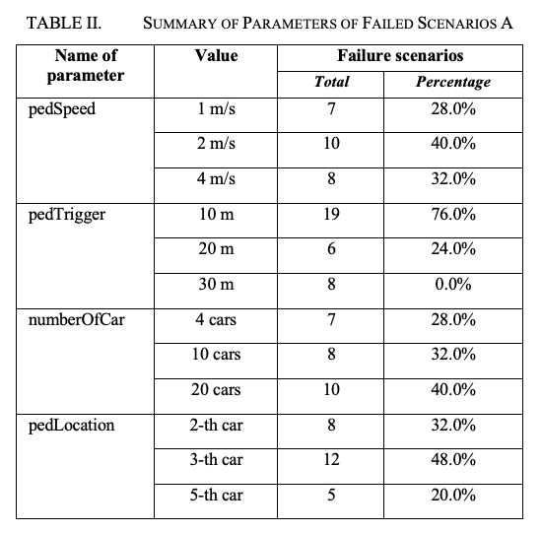
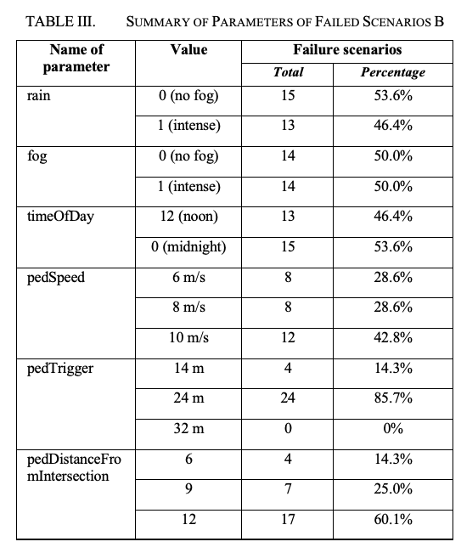
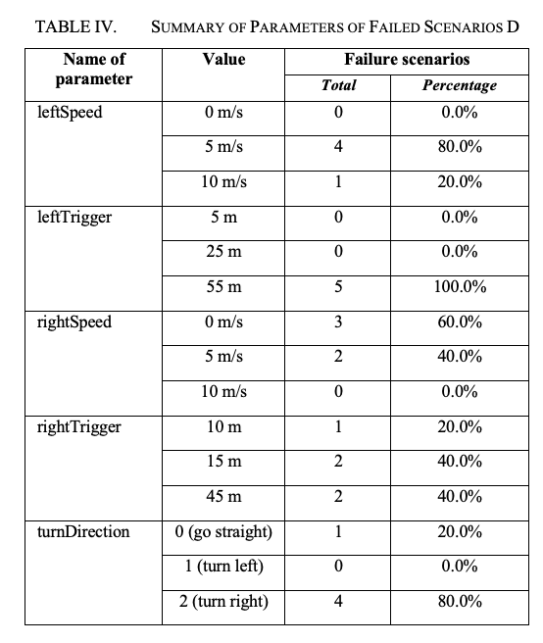
RQ2: What are critical factors that distinguish a scenario to be safe or unsafe?

Slide 14
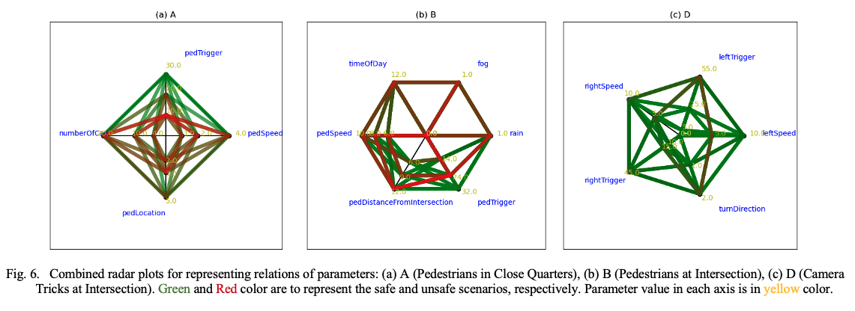
RQ2: What are critical factors that distinguish a scenario to be safe or unsafe? (2)

Slide 15
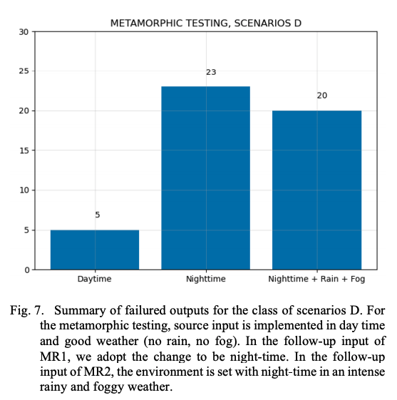
RQ3: Does the environmental condition have any impact on safety?

Slide 16
RQ4: Is the use of simulator-based systems helpful in understanding the safety of AVs in reality?
Our study demonstrates that the effectiveness of the SVL in simulating the driving scenarios are close to human intuition.
Weather and light condition do have an impact on safety.
It is reported in our study that collisions occur in 10% of all tested scenarios, double the ratio by human driving. Considering that there are many millions of people involved in the traffic every day, this ratio is large.

Slide 17
ANSWERS TO RQ
Answer to RQ1: The setup scenarios are effective in mimicking real-life situations; and at the same time, the system can capture collisions well.
Answer to RQ2: There are several critical factors distinguishing a scenario to be safe or unsafe.
Answer to RQ3: The environmental conditions do have an impact on the safety of Avs.
Answer to RQ4: The use of simulator-based system helps understand the safety in reality.

Slide 18
Remarks
Our study provides a new empirical evidence to support the argument that AV simulator systems can well represent real-life scenarios.
If the system performs similarly in reality, our study implies that state-of-the-art AVs should be tested thoroughly before deployment to reduce safety-critical problems.

