Slide 1

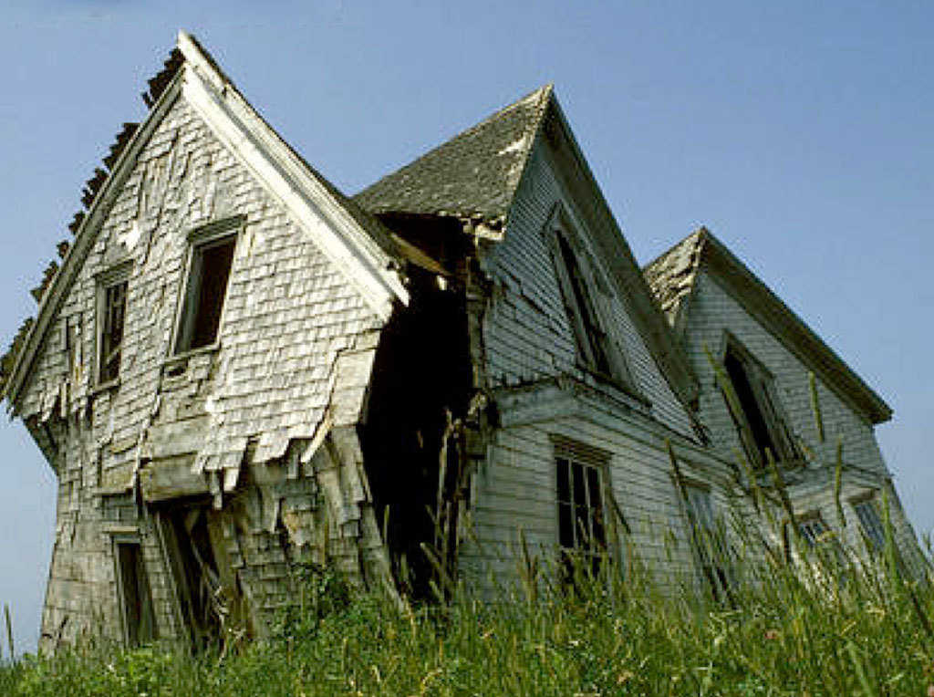
First Impressions are Important
Solomon Lennon

Slide 2
Important Information
We are looking for variables that predict whether the price of a house is above or below medium price for Ames, Iowa
After processing 80 variables, 15 appear significant.
After much trail and error graphing, the most significant variable is found.

Slide 3
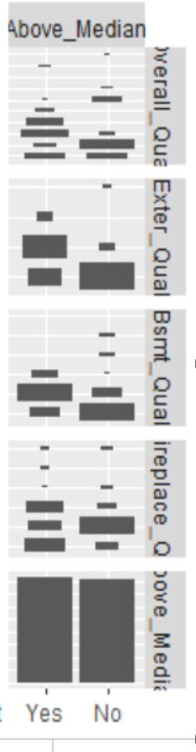
What to look for?
Overall Quality
- 10 levels
External Quality
-4 levels
Basement Quality
Fireplace quality
Above or below median
Each box represents a variable's level.
They are split into Yes and No.
When the yes and no boxes are different sizes, it means the variable is significant.

Slide 4
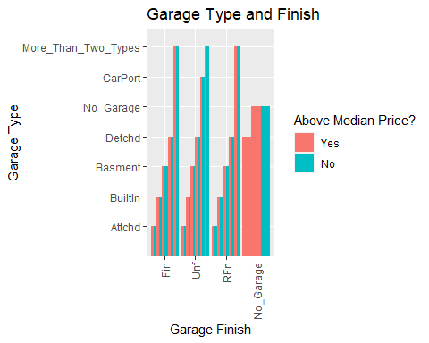
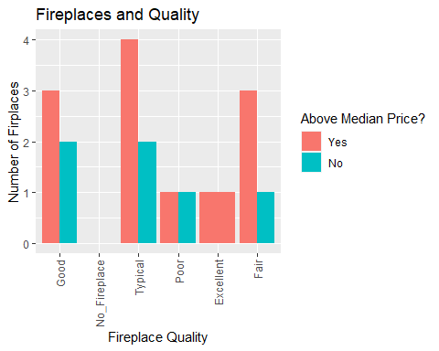
Pattern between related items?
Not Very Much

Slide 5
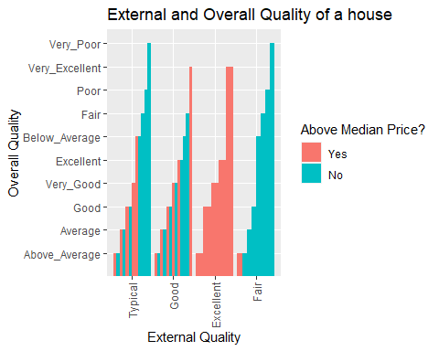
The discovery
External Quality is very well correlated.
The highest level (Excellent) and lowest level (Fair) produce obvious results.

Slide 6
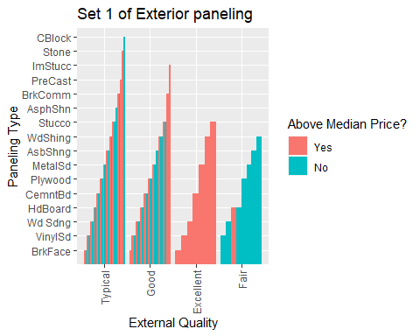
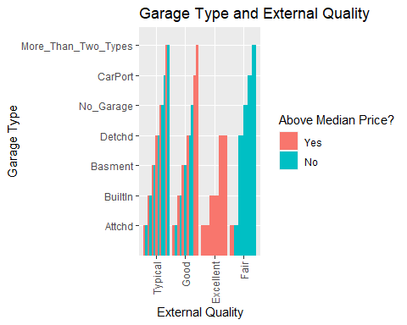
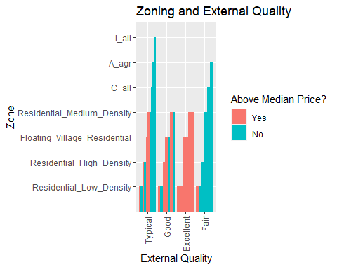
External Quality is King
External Quality is very consistent across multiple variables.
This is a good predictor of the house price being above or below the medium price.

