Slide 1
PERSPECTIVE
ISSUE 004
LESSONS WORTH TALKING ABOUT
Fast Fashion
How can clothes be so cheap?
Notes:
Welcome the class. This is Issue 004 of Perspective. Today's topic is Fast Fashion. Aim: read a short article, learn five useful words, and give a simple opinion with a reason.

Slide 2
PERSPECTIVE
ISSUE 004
LESSON OVERVIEW
What we’ll do today
01
Warm-up & vocabulary
02
Read & listen
Start talking and learn five useful words.
The article, with the audio.
03
Check & discuss
04
Think & write
True or False, then talk together.
Take the price test, then write your opinion.
perspectiveenglish.com
45–60 minutes
Notes:
Set expectations. 45–60 minutes. Warm-up, vocabulary, article with audio, True or False, then plenty of discussion and a short writing task. Allow extra thinking time before every speaking stage.

Slide 3
PERSPECTIVE
ISSUE 004
WARM-UP
Talk with a partner
1
When did you last buy clothes? What did you buy?
2
What is more important: price, quality or style?
USEFUL LANGUAGE
Last month I bought… · For me,… is more important.
perspectiveenglish.com
Notes:
Books closed. Pairs answer both questions for 3–4 minutes, then share. Model one answer yourself first: Last month I bought a jacket. The USEFUL LANGUAGE box on the worksheet gives them the frames.

Slide 4
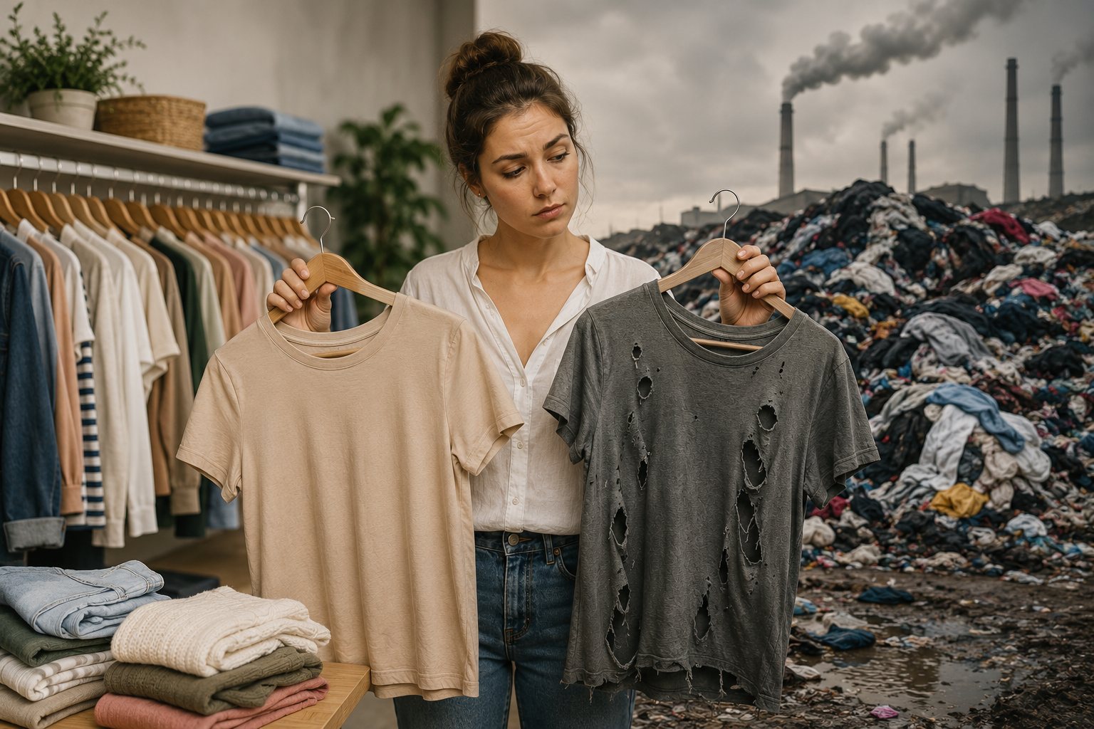
PERSPECTIVE
ISSUE 004
BEFORE YOU READ
Look and predict
The article is called “Fast Fashion.”
Look at the photo. What can you see? Where do these clothes come from?
Cheap clothes wear out quickly and end up on big piles of waste.
perspectiveenglish.com
Notes:
Show the photo and the title. Students predict what the article will say. Accept single words and build them into sentences: Clothes. → Somebody threw these clothes away. Vocabulary comes next.

Slide 5
PERSPECTIVE
ISSUE 004
VOCABULARY
Match the words to their meanings
1
brand
A
not new; someone used it before
2
quality
B
a building where people make things
3
last
C
to stay good for a long time
4
factory
D
the name of a company that makes something
5
second-hand
E
how good or bad something is
perspectiveenglish.com
Notes:
Students match each word (1–5) to its meaning (A–E), in pairs. All five words are in bold in the article, so they can check as they read. Last is a verb here, not

Slide 6
PERSPECTIVE
ISSUE 004
VOCABULARY
ANSWERS
How did you do?
1–D brand
2–E quality
3–C last
4–B factory
5–A second-hand
perspectiveenglish.com
Notes:
Reveal answers: 1-D, 2-E, 3-C, 4-B, 5-A. Drill the five words for pronunciation. Watch cheaper, not more cheap.

Slide 7

PERSPECTIVE
ISSUE 004
THE ARTICLE
Fast Fashion
How can clothes be so cheap?
A five-dollar T-shirt looks cheap. But somebody, or something, pays the rest.
A new T-shirt for the price of a cup of coffee. It sounds like a very good deal. In fast-fashion shops, new clothes arrive almost every week, and the prices are very low. But that five-dollar shirt has another cost, and it is not on the price tag.
The numbers are surprising. One cotton T-shirt can use about 2,700 liters of water. That is enough drinking water for one person for three years. And every second, somewhere in the world, a truck full of old clothes is burned or buried. Fashion is now one of the dirtiest industries on the planet.
Fast fashion means clothes that are designed, made and sold very quickly. To keep the price low, a factory must work fast and pay small wages. The cloth is cheap, so the quality is low. A shirt can lose its shape after five washes, and then it does not last another season.
But this can change. More people now buy second-hand clothes, or repair the clothes they already have. Some people ask a brand a simple question: who made this, and were they paid fairly? Ten shirts you love can be better than a hundred that fall apart.
If a T-shirt costs only five dollars, who is paying the rest?
perspectiveenglish.com
Notes:
Play the audio once with books closed, then students read in pairs, one paragraph each. Set a purpose: why are the clothes so cheap, and what is the hidden cost? End on the question in the box — it sets up the discussion. Give 5–6 minutes.

Slide 8
PERSPECTIVE
ISSUE 004
COMPREHENSION
True or False?
1
T F
A new T-shirt can cost the same as a cup of coffee.
2
T F
One cotton T-shirt can use about 2,700 liters of water.
3
T F
Fast-fashion clothes are made to last for many years.
4
T F
The article says nobody can change this problem.
5
T F
Some people buy second-hand clothes or repair old ones.
perspectiveenglish.com
Notes:
True or False. Students go back to the article to find the answer. Ask them to point at the line that proves it. Answers next.

Slide 9
PERSPECTIVE
ISSUE 004
COMPREHENSION
ANSWERS
True or False?
1
TRUE
A new T-shirt can cost the same as a cup of coffee.
2
TRUE
One cotton T-shirt can use about 2,700 liters of water.
3
FALSE
Fast-fashion clothes are made to last for many years. — a shirt can lose its shape after five washes.
4
FALSE
The article says nobody can change this problem. — it says this can change.
5
TRUE
Some people buy second-hand clothes or repair old ones.
perspectiveenglish.com
Notes:
Reveal: T, T, F, F, T. Number 3 is False — a fast-fashion shirt can lose its shape after five washes. Number 4 is False — the article says this can change.

Slide 10
PERSPECTIVE
ISSUE 004
DISCUSSION
Talk it through
1
Do you buy clothes often? Why do you buy something new?
2
Do you ever buy second-hand clothes? How do you feel about them?
3
Why do people buy clothes they do not really need?
4
Whose problem is fast fashion: the shops, or the shoppers?
5
Ten good shirts or a hundred cheap ones? Which do you choose?
USEFUL LANGUAGE
I think… · For me… · because… · It depends.
perspectiveenglish.com
Notes:
The heart of the lesson. Pairs or small groups, as many questions as time allows. Give one minute of silent thinking time first and let students write two words — the ideas come before the sentences. Encourage: I think… because…, For me…, It depends.

Slide 11
PERSPECTIVE
ISSUE 004
CRITICAL THINKING
THE PRICE TEST
Five white T-shirts. The same shirt. Only the price and the story are different.
Choose alone first. Mark every shirt BUY, NOT SURE or NO. Then compare in your group.
PRICE
WHAT YOU KNOW ABOUT IT
BUY
NOT SURE
NO
$4
Fast fashion, new styles every week. Nobody will tell you where it was made.
☐
☐
☐
$0
Your brother does not want it. It is free, but it is not new.
☐
☐
☐
$8
Second-hand, from an app. A stranger wore it twice.
☐
☐
☐
$28
Organic cotton, much less water. It costs more, but it lasts for years.
☐
☐
☐
$45
Fair trade. You can read what the workers were paid.
☐
☐
☐
YOUR NUMBER
The most you would really pay: $_____ Your group’s highest: $_____
DISCUSS
1
Is your number what you believe, or what you can pay?
2
Compare with another group. Would you pay more if the label named the factory?
perspectiveenglish.com
Notes:
The price test. Students choose alone first, then compare in groups of three or four. Give about ten minutes, then run YOUR NUMBER and both DISCUSS questions. Every shirt is the same shirt — only the price and the story change. The $0 row is the quiet one, and the $45 row usually divides a class hardest.

Slide 12
PERSPECTIVE
ISSUE 004
LANGUAGE IN CONTEXT
Complete the sentences
Complete the sentences with a word from the box.
factory
brand
last
second-hand
quality
1
This jacket is very good ______________ .
2
My shoes only ______________ for six months.
3
She bought a ______________ coat at a very low price.
4
My uncle works in a shoe ______________ .
5
That ______________ is very popular with young people.
perspectiveenglish.com
Notes:
Students complete each sentence with a word from the box, then read it aloud. One word per gap and no form changes needed at this level. Answers next.

Slide 13
PERSPECTIVE
ISSUE 004
LANGUAGE IN CONTEXT
ANSWERS
Complete the sentences
1
This jacket is very good quality.
2
My shoes only last for six months.
3
She bought a second-hand coat at a very low price.
4
My uncle works in a shoe factory.
5
That brand is very popular with young people.
perspectiveenglish.com
Notes:
Answers: quality, last, second-hand, factory, brand. Have students read the full sentences aloud so the words get into speech.

Slide 14
PERSPECTIVE
ISSUE 004
SPEAKING CHALLENGE
ROLE · TASK · PRESENT
You design the clothes
ROLE
You design clothes for a big shop. People say your clothes are too cheap.
TASK
Choose two changes for your shop. Decide who pays for each one.
PRESENT
Tell the class your two changes and say why they are good.
USEFUL LANGUAGE
Our first change is… · We can… This is better because… · We think… should pay.
perspectiveenglish.com
Notes:
Group role-play. Small groups design for a big clothing shop. About 8 minutes to choose their two changes and decide who pays, then each group presents. The USEFUL LANGUAGE box on Page 2 gives them the opening phrases: Our first change is… We can…

Slide 15
PERSPECTIVE
ISSUE 004
WRITING · YOUR OPINION
Is it better to have a few good clothes or many cheap ones?
Write 60–100 words. Use words from the article.
I think it is better to…
The first reason is… For example,…
But… So I think…
perspectiveenglish.com | Model answer in the Teacher Guide
Notes:
Final reflection. In class or as homework. 60–100 words. The sentence starters on the slide are the same ones on Page 2 — have students say their first sentence aloud before writing. A model answer is in the Teacher Guide.

Slide 16
PERSPECTIVE
THAT’S A WRAP
One fact. One perspective. Endless discussion.
Thanks for a great lesson.
perspectiveenglish.com
© 2026 Perspective English. All rights reserved.
Notes:
Wrap up. Thank the class. Preview that Issue 005 continues the series. The worksheet, audio and teacher guide all live at perspectiveenglish.com.

