Slide 1
PERSPECTIVE
ISSUE 001
LESSONS WORTH TALKING ABOUT
Overtourism
Can a city have too many visitors?
Notes:
Welcome the class. This is Issue 001 of Perspective. Today's topic is Overtourism. Aim: read a short article, learn five useful words, and give a simple opinion with a reason.

Slide 2
PERSPECTIVE
ISSUE 001
LESSON OVERVIEW
What we’ll do today
01
Warm-up & vocabulary
02
Read & listen
Start talking and learn five useful words.
The article, with the audio.
03
Check & discuss
04
Think & write
True or False, then talk together.
Choose your rules and write your opinion.
perspectiveenglish.com
45–60 minutes
Notes:
Set expectations. 45–60 minutes. Warm-up, vocabulary, article with audio, True or False, then plenty of discussion and a short writing task. Allow extra thinking time before every speaking stage.

Slide 3
PERSPECTIVE
ISSUE 001
WARM-UP
Talk with a partner
1
Do you like busy places or quiet places? Why?
2
Why do tourists come to your town or city?
USEFUL LANGUAGE
I like… because… · They come to see…
perspectiveenglish.com
Notes:
Books closed. Pairs answer both questions for 3–4 minutes, then share. Model one answer yourself first: I like quiet places, because… The USEFUL LANGUAGE box on the worksheet gives them the frames.

Slide 4
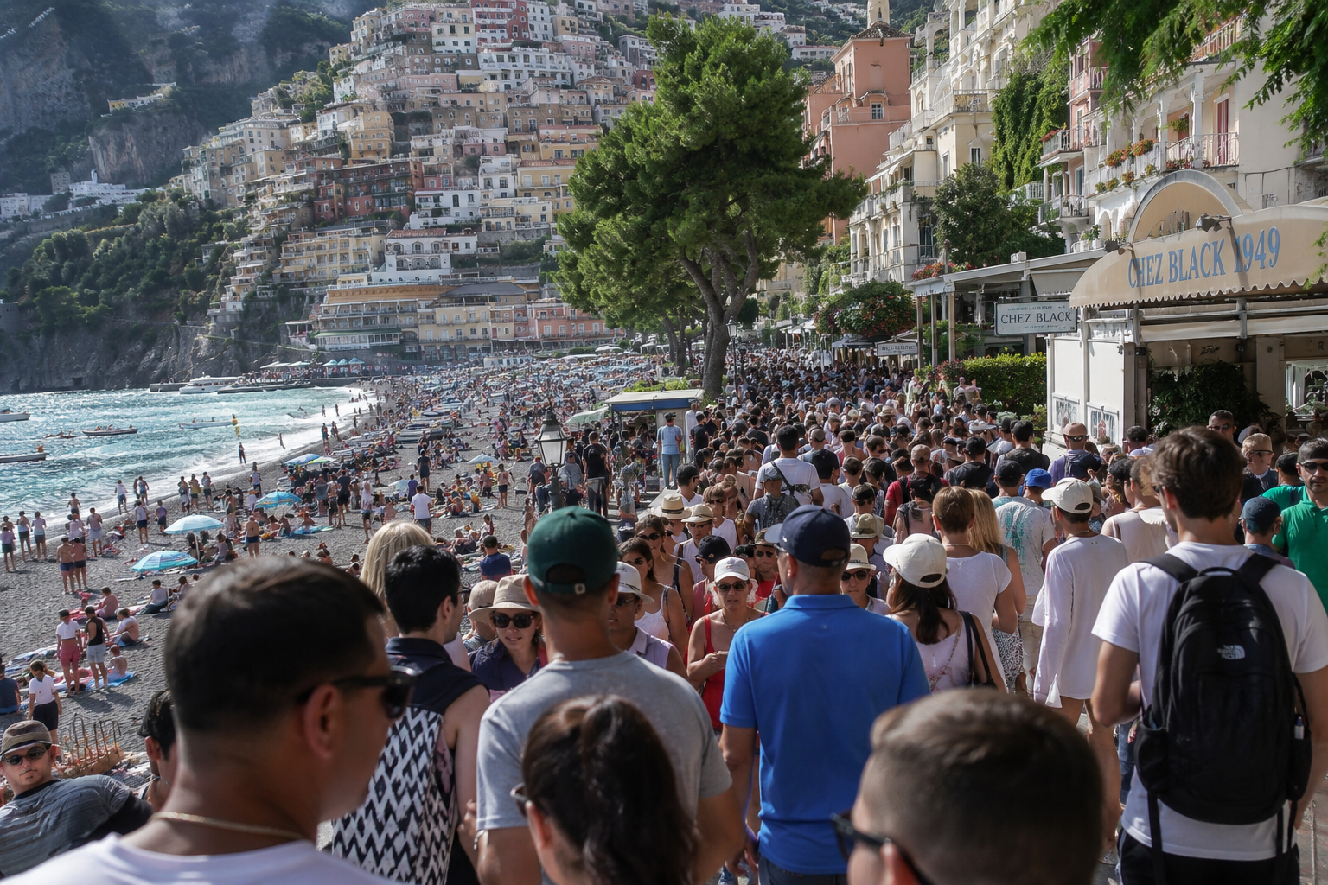
PERSPECTIVE
ISSUE 001
BEFORE YOU READ
Look and predict
The article is called “Overtourism.”
Look at the photo. What is the problem in this place? Why is it a problem?
Thousands of tourists crowd the streets and beach in Positano, Italy.
perspectiveenglish.com
Notes:
Show the photo and the title. Students predict the problem. Accept single words and build them into sentences: Too many people. → There are too many people. Vocabulary comes next.

Slide 5
PERSPECTIVE
ISSUE 001
VOCABULARY
Match the words to their meanings
1
residents
A
money that you pay to do something
2
crowded
B
the people who live in a place
3
local
C
to stop something getting bigger
4
fee
D
full of too many people
5
limit
E
from the same town or area
perspectiveenglish.com
Notes:
Students match each word (1–5) to its meaning (A–E), in pairs. All five words are in bold in the article, so they can check as they read. Fee and limit are usually the new ones — teach fee with a ticket price. Answers next.

Slide 6
PERSPECTIVE
ISSUE 001
VOCABULARY
ANSWERS
How did you do?
1–B residents
2–D crowded
3–E local
4–A fee
5–C limit
perspectiveenglish.com
Notes:
Reveal answers: 1-B, 2-D, 3-E, 4-A, 5-C. Drill the five words for pronunciation. Watch too many people, not too much people.

Slide 7

PERSPECTIVE
ISSUE 001
THE ARTICLE
Overtourism
Can a city have too many visitors?
More people travel today than ever before. For some beautiful places, that is a problem.
In Barcelona, some people who live in the city walked through the streets with water pistols. They sprayed a little water at tourists outside the cafés. It was a kind of joke, but the message was serious: “Tourists, go home.” Barcelona welcomes more than 30 million visitors a year. Many residents now feel that the city is not really theirs.
The numbers are surprising. Fewer than 50,000 people live in Venice, but 100,000 tourists can arrive there in a single day. Now Venice asks day visitors to pay a small fee of five euros. Amsterdam does not allow new hotels. On Mount Everest, climbers sometimes wait in a long line near the top.
This problem has a name: overtourism. It happens when a place gets more visitors than it can manage. The streets become very crowded. Prices go up. Small local shops close, and new shops open for tourists. Venice, Amsterdam and Kyoto all know this feeling well.
But tourism is not the enemy. It brings jobs and money, and it brings people from different countries together. Some cities want to limit the number of visitors. Other people say we need a better way to travel. Nobody has an easy answer yet.
Who does a city really belong to — the people who live there, or the people who visit?
perspectiveenglish.com
Notes:
Play the audio once with books closed, then students read in pairs, one paragraph each. Set a purpose: what is overtourism, and where is it happening? End on the question in the box — it sets up the discussion. Give 5–6 minutes.

Slide 8
PERSPECTIVE
ISSUE 001
COMPREHENSION
True or False?
1
T F
Some people in Barcelona sprayed water at tourists.
2
T F
More than 100,000 people live in Venice.
3
T F
Amsterdam does not allow new hotels.
4
T F
Climbers sometimes wait in a line on Mount Everest.
5
T F
The article says tourism only brings problems.
perspectiveenglish.com
Notes:
True or False. Students go back to the article to find the answer. Ask them to point at the line that proves it. Answers next.

Slide 9
PERSPECTIVE
ISSUE 001
COMPREHENSION
ANSWERS
True or False?
1
TRUE
Some people in Barcelona sprayed water at tourists.
2
FALSE
More than 100,000 people live in Venice. — fewer than 50,000 live there.
3
TRUE
Amsterdam does not allow new hotels.
4
TRUE
Climbers sometimes wait in a line on Mount Everest.
5
FALSE
The article says tourism only brings problems. — it also brings jobs and money.
perspectiveenglish.com
Notes:
Reveal: T, F, T, T, F. Number 2 is False — fewer than 50,000 people live in Venice. Number 5 is False — the article also says tourism brings jobs and money.

Slide 10
PERSPECTIVE
ISSUE 001
DISCUSSION
Talk it through
1
Have you visited a place with too many people? How did you feel?
2
Do many tourists come to your town or city? What do they come to see?
3
Why can tourists and residents feel differently about the same place?
4
Is it fair to ask tourists to pay a fee? Why or why not?
5
Who does a famous city belong to: the residents or the visitors?
USEFUL LANGUAGE
I think… · For me… · because… · It depends.
perspectiveenglish.com
Notes:
The heart of the lesson. Pairs or small groups, as many questions as time allows. Give one minute of silent thinking time first and let students write two words — the ideas come before the sentences. Encourage: I think… because…, For me…, It depends.

Slide 11
PERSPECTIVE
ISSUE 001
CRITICAL THINKING
YOU ARE THE TOWN COUNCIL
40,000 people live in your town. Three million tourists visit every year.
You are the town council. Choose your rules. Every rule helps someone and it costs someone. Work in a group and choose together.
THE RULE
IT HELPS
IT COSTS
YES
Tourists pay a small fee
The town gets money to clean and repair the streets.
Tourists with little money, and the cheap hotels.
☐
Fewer big ships each day
Thousands of people do not arrive at the same time.
Tour guides and the shops next to the port.
☐
No new hotels
Visitor numbers stop growing every year.
People who want new jobs in building and in hotels.
☐
Apartments only for residents
Rents go down, so local families can stay in the town.
Neighbors who rent their rooms to tourists for more money.
☐
Change nothing
The town keeps all the jobs and all the money.
The families who leave the town, one by one.
☐
YOUR CHOICE
Rules we say yes to: ______ of 5 The people who will not be happy:_______________________________
DISCUSS
1
Your job is in a hotel. Do you choose the same rules? Why or why not?
2
Compare with another group. Who helped the residents more? Who kept more jobs?
perspectiveenglish.com
Notes:
The council task. Groups of three or four. Read all five rules aloud with the IT COSTS column, then have them choose one rule at a time, yes or no. Give about ten minutes, then run YOUR CHOICE and both DISCUSS questions. The ships and the apartments are where the argument lives, because the people who pay are neighbors.

Slide 12
PERSPECTIVE
ISSUE 001
LANGUAGE IN CONTEXT
Complete the sentences
Complete the sentences with a word from the box.
limit
residents
crowded
fee
local
1
The beach was very ______________ in August.
2
Many ______________ want fewer tourists in their city.
3
We ate dinner in a small ______________ restaurant.
4
Visitors pay a small ______________ to enter the old town.
5
The city wants to ______________ the number of big ships.
perspectiveenglish.com
Notes:
Students complete each sentence with a word from the box, then read it aloud. One word per gap and no form changes needed at this level. Answers next.

Slide 13
PERSPECTIVE
ISSUE 001
LANGUAGE IN CONTEXT
ANSWERS
Complete the sentences
1
The beach was very crowded in August.
2
Many residents want fewer tourists in their city.
3
We ate dinner in a small local restaurant.
4
Visitors pay a small fee to enter the old town.
5
The city wants to limit the number of big ships.
perspectiveenglish.com
Notes:
Answers: crowded, residents, local, fee, limit. Have students read the full sentences aloud so the words get into speech.

Slide 14
PERSPECTIVE
ISSUE 001
SPEAKING CHALLENGE
ROLE · TASK · PRESENT
You are the town council
ROLE
You are the town council. Your small town is now very popular with tourists.
TASK
Choose two rules for your town. Decide who pays for them.
PRESENT
Tell the class your two rules and say why they are fair.
USEFUL LANGUAGE
Our first rule is… · We chose it because… This is fair because… · We think… should pay.
perspectiveenglish.com
Notes:
Group role-play. Small groups are the town council. About 8 minutes to choose two rules and decide who pays, then each group presents. The USEFUL LANGUAGE box on Page 2 gives them the opening phrases: Our first rule is… We chose it because…

Slide 15
PERSPECTIVE
ISSUE 001
WRITING · YOUR OPINION
Should tourists pay a fee to visit a popular city?
Write 60–100 words. Use words from the article.
I think tourists should…
The first reason is… For example,…
But… So I think…
perspectiveenglish.com | Model answer in the Teacher Guide
Notes:
Final reflection. In class or as homework. 60–100 words. The sentence starters on the slide are the same ones on Page 2 — have students say their first sentence aloud before writing. A model answer is in the Teacher Guide.

Slide 16
PERSPECTIVE
THAT’S A WRAP
One fact. One perspective. Endless discussion.
Thanks for a great lesson.
perspectiveenglish.com
© 2026 Perspective English. All rights reserved.
Notes:
Wrap up. Thank the class. Preview that Issue 002 continues the series. The worksheet, audio and teacher guide all live at perspectiveenglish.com.

