Slide 1
PERSPECTIVE
ISSUE 003
LESSONS WORTH TALKING ABOUT
Food Waste
Why do we throw so much away?
Notes:
Welcome the class. This is Issue 003 of Perspective — today's topic is Food Waste. Aim: read a short article, learn key words, and discuss opinions.

Slide 2
PERSPECTIVE
ISSUE 003 · FOOD WASTE
LESSON OVERVIEW
What we’ll do today
01
Warm-up & vocabulary
02
Read & listen
Get talking and learn five key words.
The article, with optional audio.
03
Check & discuss
04
Think & write
Comprehension, then open discussion.
Rank ideas and share your opinion.
perspectiveenglish.com
45–60 minutes
Notes:
Set expectations. 45–60 minutes. We move top to bottom: warm-up, vocabulary, article + audio, comprehension, then lots of discussion and a short writing task.

Slide 3
PERSPECTIVE
ISSUE 003 · FOOD WASTE
WARM-UP
Talk with a partner
1
How much food do you think your household throws away each week?
2
Whose job is it to reduce the amount of food we waste?
perspectiveenglish.com
Notes:
Books closed. Pairs discuss both questions for 3–4 minutes, then share with the class. No right answers — the goal is to activate the topic and get them speaking.

Slide 4
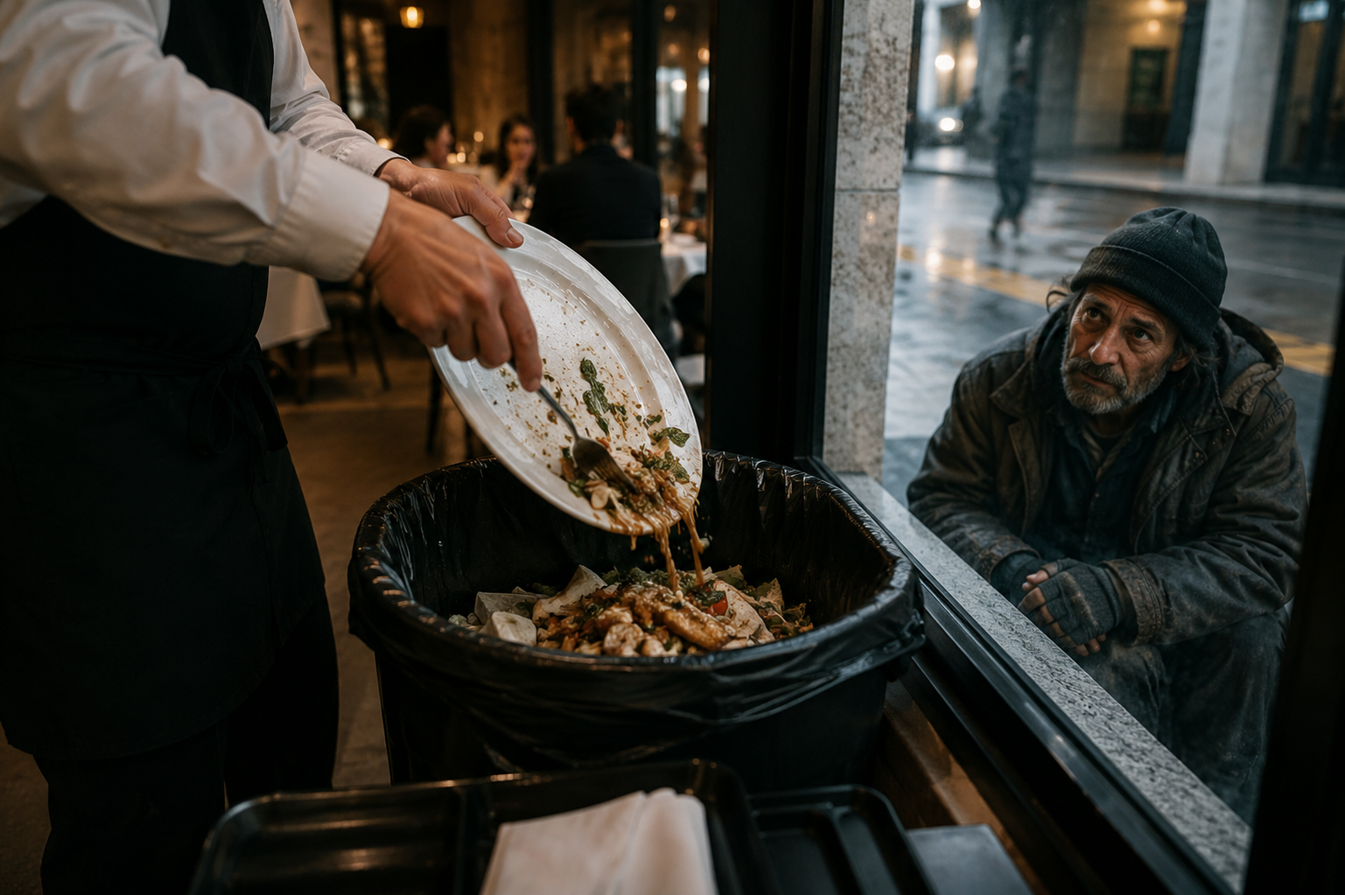
PERSPECTIVE
ISSUE 003 · FOOD WASTE
BEFORE YOU READ
Look and predict
The article is called “Food Waste.”
Looking at the photo and title, what problem do you think it describes? What might be the causes?
Perfectly good food is discarded daily while millions still experience hunger worldwide.
perspectiveenglish.com
Notes:
Show the photo and the headline. Before reading, students predict: what problem does this article describe? Elicit a few guesses. Pre-teach nothing — the vocabulary comes next.

Slide 5
PERSPECTIVE
ISSUE 003 · FOOD WASTE
VOCABULARY
Match the words to their meanings
1
perishable
A
more than is needed
2
discard
B
safe or good to eat
3
surplus
C
likely to go bad or rot quickly
4
D
decayed food and plants used to enrich soil
compost
E
to throw away something you no longer want
5
edible
perspectiveenglish.com
Notes:
Students match each word (1–5) to its meaning (A–E), alone or in pairs. These five words all appear in the article, so they can check as they read. Answers on the next slide.

Slide 6
PERSPECTIVE
ISSUE 003 · FOOD WASTE
VOCABULARY
ANSWERS
How did you do?
1–C perishable
2–E discard
3–A surplus
4–D compost
5–B edible
perspectiveenglish.com
Notes:
Reveal answers. Tip: in PowerPoint you can animate each answer chip to appear on click. Check pronunciation and drill the five words briefly.

Slide 7

PERSPECTIVE
ISSUE 003 · FOOD WASTE
THE ARTICLE
Food Waste
Why do we throw so much away?
A third of the world’s food is never eaten — and the cost is far greater than it seems.
Every evening, in kitchens and restaurants around the world, a quiet waste takes place. Perfectly good bread, bruised fruit, and half-eaten meals are scraped into the bin without a second thought. It feels harmless — but multiplied across billions of homes, it becomes one of the planet’s largest and most overlooked problems. Roughly a third of all the food grown for people is never eaten.
The costs reach far beyond the dinner table. When food rots in a landfill it releases methane, a gas far more powerful than carbon dioxide. If food waste were a country, it would be the third-largest source of greenhouse gases on Earth. It also throws away the water, land, and fuel used to grow it — a single wasted apple represents about 125 litres of water.
The scale is hard to picture. About 1.3 billion tonnes of food are lost or thrown away every year, while hundreds of millions of people go hungry. Some is lost on farms or in transport, especially perishable items like milk and vegetables that spoil quickly. But in wealthier countries, most waste happens at home, where families routinely discard food they simply forgot to eat.
Yet this is a problem almost anyone can help solve. Some shops now sell surplus stock cheaply instead of binning it. Restaurants donate leftovers, and many families turn scraps into compost that feeds a garden rather than a dump. Others simply plan meals and remember that a slightly ugly vegetable is still perfectly edible.
If a third of our food is wasted, how much could change if each of us wasted just a little less?
perspectiveenglish.com
Notes:
Students read the full article, or follow the audio. Set a purpose: what is food waste, why does it matter, and how can we reduce it? Point out the balanced view and the scale of the problem. End on the pull-quote about wasting a little less. Give 4–5 minutes.

Slide 8
PERSPECTIVE
ISSUE 003 · FOOD WASTE
COMPREHENSION
True or False?
1
T F
About a third of the food grown for people is never eaten.
2
T F
Food rotting in a landfill releases methane.
3
T F
In wealthier countries, most food waste happens on farms.
4
T F
Some shops sell surplus food cheaply instead of binning it.
5
T F
Food waste has almost no effect on the climate.
perspectiveenglish.com
Notes:
Comprehension check. Students decide True or False for each statement, referring back to the article. Answers on the next slide.

Slide 9
PERSPECTIVE
ISSUE 003 · FOOD WASTE
COMPREHENSION
ANSWERS
True or False?
1
TRUE
About a third of the food grown for people is never eaten.
2
TRUE
Food rotting in a landfill releases methane.
3
FALSE
In wealthier countries, most food waste happens on farms. — it happens at home.
4
TRUE
Some shops sell surplus food cheaply instead of binning it.
5
FALSE
Food waste has almost no effect on the climate. — it drives methane.
perspectiveenglish.com
Notes:
Reveal. Ask students to find the line in the article that proves each answer — good re-reading practice. 3 and 5 are False: in wealthier countries most waste happens at home (not on farms), and food waste has a major climate impact through methane.

Slide 10
PERSPECTIVE
ISSUE 003 · FOOD WASTE
DISCUSSION
Talk it through
1
Do you throw away much food at home? What kind, and why?
2
How was food treated in your home when you were growing up?
3
Why do you think people in wealthier countries waste more food?
4
Should supermarkets be allowed to throw away food that is still edible?
5
Is it ever acceptable to waste food? Where would you draw the line?
perspectiveenglish.com
Notes:
The heart of the lesson. Put students in pairs or small groups. Move through as many questions as time allows — don't rush. Encourage: ‘On the one hand… on the other…’, ‘It depends on…’, ‘I’d argue that…’

Slide 11
PERSPECTIVE
ISSUE 003 · FOOD WASTE
CRITICAL THINKING
THE FRIDGE TEST
Eight things in your fridge tonight. Which of them do you actually eat?
Decide alone first: mark EAT or THROW for each one. Then compare in your group and count how many you would throw away.
WHAT IS IN THE FRIDGE
EAT
THROW
WHAT IS IN THE FRIDGE
EAT
THROW
Yogurt, two days past the date on the lid.
☐
☐
Chicken on its use-by day. It looks and smells fine.
☐
☐
A loaf of bread with mold on one slice.
☐
☐
Cooked rice that sat out on the counter all night.
☐
☐
An apple with a large brown bruise.
☐
☐
A bag of salad with a few slimy leaves on top.
☐
☐
Milk one day over, and it smells completely normal.
☐
☐
Half a meal a guest left on their plate last night.
☐
☐
YOUR TOTAL
Items you would throw away: _______ of 8 How many were genuinely unsafe? ________
DISCUSS
1
Are you throwing away food, or throwing away a date printed on a label?
2
Compare with another group. Who threw away the most, and would your grandparents agree?
perspectiveenglish.com
Notes:
The fridge test. Students decide alone first, then compare in groups — the split inside the group is the lesson. Give about ten minutes and run the YOUR TOTAL line plus both DISCUSS questions. Only the overnight rice is genuinely risky; almost everything else students bin is safe, and that is the point.

Slide 12
PERSPECTIVE
ISSUE 003 · FOOD WASTE
LANGUAGE IN CONTEXT
Complete & say each line
Complete each sentence with a word from the box. Change the form if you need to.
surplus
edible
perishable
compost
discard
1
Milk and fresh vegetables are ________________ , so they spoil quickly.
2
The shop sold its ________________ stock at half price.
3
Please don’t ________________ bread that is still good to eat.
4
We turn our vegetable scraps into ________________ for the garden.
5
A bruised apple looks ugly but is still ________________ .
perspectiveenglish.com
Notes:
Speaking-focused language. Students complete each sentence so they can say it aloud — first person, useful for the discussion. Change the form if needed. Answers next slide (some are flexible).

Slide 13
PERSPECTIVE
ISSUE 003 · FOOD WASTE
LANGUAGE IN CONTEXT
SUGGESTED ANSWERS
Complete & say each line
1
Milk and fresh vegetables are perishable, so they spoil quickly.
2
The shop sold its surplus stock at half price.
3
Please don’t discard bread that is still good to eat.
4
We turn our vegetable scraps into compost for the garden.
5
A bruised apple looks ugly but is still edible.
perspectiveenglish.com
Notes:
Suggested answers — accept sensible variations. The goal is that students can say each line aloud and use the words in the discussion.

Slide 14
PERSPECTIVE
ISSUE 003 · FOOD WASTE
SPEAKING CHALLENGE
ROLE · TASK · PRESENT
You run a busy café
ROLE
You run a busy café that throws away food every night.
TASK
Agree on three ways to cut your waste without losing money.
PRESENT
Share your plan and explain how it helps people and the planet.
perspectiveenglish.com
Notes:
Group task. In small groups, students run a busy café that throws away food every night. Give ~8 minutes to agree on three ways to cut waste without losing money, then each group presents and explains how it helps people and the planet.

Slide 15
PERSPECTIVE
ISSUE 003 · FOOD WASTE
WRITING · YOUR OPINION
Should supermarkets be banned from throwing away food that is still edible?
Write 150–200 words, using ideas and vocabulary from the article.
Give your opinion clearly
Support it with reasons
Use the key vocabulary
perspectiveenglish.com | Model answer in the Teacher Guide
Notes:
Final reflection. Set as in-class writing or homework. 150–200 words. Remind students to use the vocabulary and ideas from the article. A model answer is in the Teacher Guide (Page 3).

Slide 16
PERSPECTIVE
THAT’S A WRAP
One fact. One perspective. Endless discussion.
Thanks for a great lesson. See you in the next issue.
perspectiveenglish.com
© 2026 Perspective English. All rights reserved.
Notes:
Wrap up. Thank the class. Preview that Issue 004 continues the series. Reminder: the worksheet, audio and teacher guide all live at perspectiveenglish.com.

