Slide 1
PERSPECTIVE
ISSUE 004
LESSONS WORTH TALKING ABOUT
Fast Fashion
How can clothes be so cheap?
Notes:
Welcome the class. This is Issue 004 of Perspective — today's topic is Fast Fashion. Aim: read a short article, learn key words, and discuss opinions.

Slide 2
PERSPECTIVE
ISSUE 004 · FAST FASHION
LESSON OVERVIEW
What we’ll do today
01
Warm-up & vocabulary
02
Read & listen
Get talking and learn five key words.
The article, with optional audio.
03
Check & discuss
04
Think & write
Comprehension, then open discussion.
Rank ideas and share your opinion.
perspectiveenglish.com
45–60 minutes
Notes:
Set expectations. 45–60 minutes. We move top to bottom: warm-up, vocabulary, article + audio, comprehension, then lots of discussion and a short writing task.

Slide 3
PERSPECTIVE
ISSUE 004 · FAST FASHION
WARM-UP
Talk with a partner
1
How many items of clothing do you own? Do you wear them all?
2
What matters more to you when buying clothes — price, quality, or style?
perspectiveenglish.com
Notes:
Books closed. Pairs discuss both questions for 3–4 minutes, then share with the class. No right answers — the goal is to activate the topic and get them speaking.

Slide 4
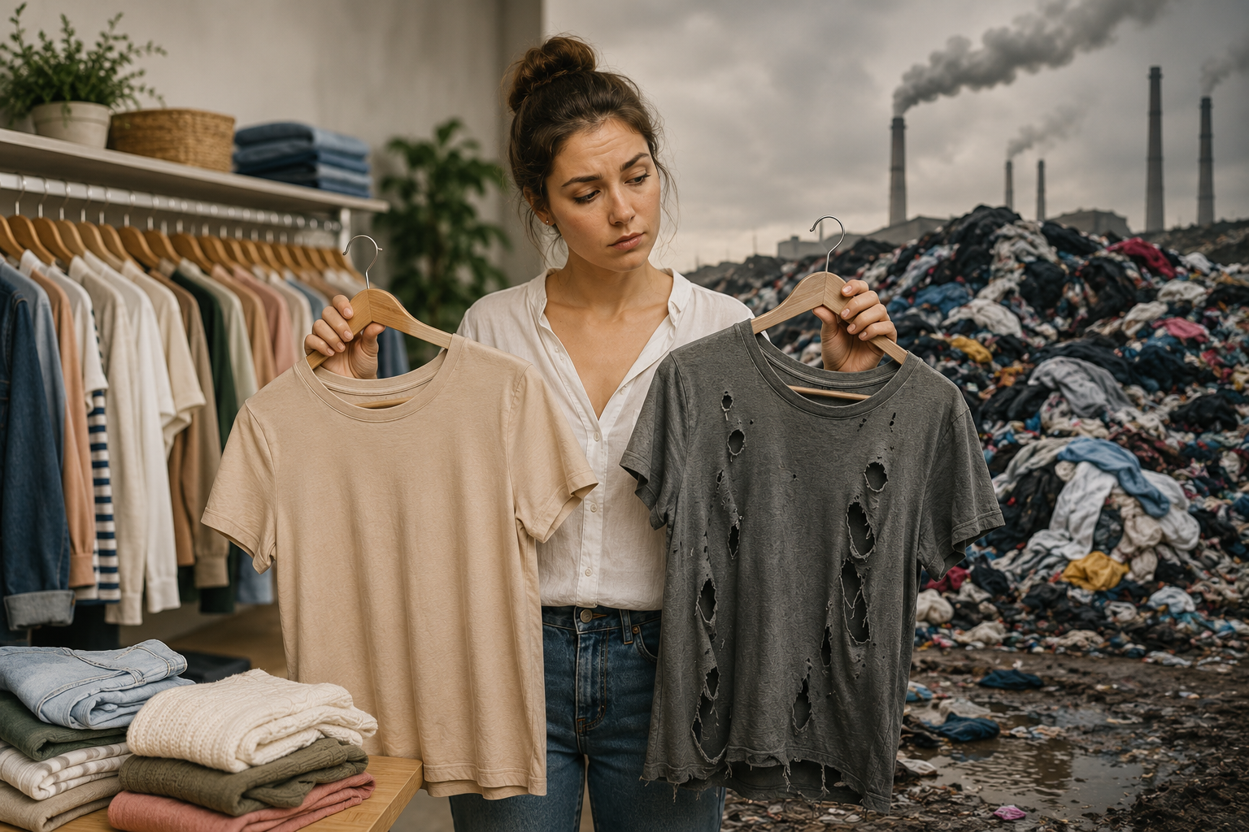
PERSPECTIVE
ISSUE 004 · FAST FASHION
BEFORE YOU READ
Look and predict
The article is called “Fast Fashion.”
Looking at the photo and title, what problem do you think it describes? What might be the causes?
Cheap clothes are quickly worn out and thrown onto growing textile waste piles.
perspectiveenglish.com
Notes:
Show the photo and the headline. Before reading, students predict: what problem does this article describe? Elicit a few guesses. Pre-teach nothing — the vocabulary comes next.

Slide 5
PERSPECTIVE
ISSUE 004 · FAST FASHION
VOCABULARY
Match the words to their meanings
1
garment
A
tough and long-lasting
2
textile
B
to get rid of or throw away
3
durable
C
a piece of clothing
4
D
cloth or woven fabric
consumption
E
the buying and using of goods
5
dispose
perspectiveenglish.com
Notes:
Students match each word (1–5) to its meaning (A–E), alone or in pairs. These five words all appear in the article, so they can check as they read. Answers on the next slide.

Slide 6
PERSPECTIVE
ISSUE 004 · FAST FASHION
VOCABULARY
ANSWERS
How did you do?
1–C garment
2–D textile
3–A durable
4–E consumption
5–B dispose
perspectiveenglish.com
Notes:
Reveal answers. Tip: in PowerPoint you can animate each answer chip to appear on click. Check pronunciation and drill the five words briefly.

Slide 7

PERSPECTIVE
ISSUE 004 · FAST FASHION
THE ARTICLE
Fast Fashion
How can clothes be so cheap?
A five-dollar T-shirt looks like a bargain — but someone, or something, pays the difference.
A brand-new T-shirt for the price of a coffee sounds like a bargain. In fast-fashion stores, shelves are refilled with cheap new garments almost every week, and shoppers are encouraged to buy far more than they need. But behind that five-dollar price tag lies a hidden cost that never appears on the receipt.
The numbers are staggering. Making a single cotton T-shirt can use around 2,700 litres of water — enough for one person to drink for years. Around the world, a rubbish truck full of clothing is burned or buried every second. This constant consumption has made fashion one of the most polluting industries on Earth.
Fast fashion means clothing designed, made, and sold at astonishing speed. To keep prices low, factories use cheap textiles and rushed labour, often where wages are small. The clothes are rarely durable ; a shirt worn a few times may lose its shape and be thrown out within a single season.
Change, though, is within reach. A growing number of shoppers now dispose of far less by buying second-hand, repairing what they own, or simply choosing fewer, better-made pieces. Owning ten quality items you love may bring more satisfaction than a hundred that fall apart.
If a T-shirt costs only five dollars, who — or what — is paying the difference?
perspectiveenglish.com
Notes:
Students read the full article, or follow the audio. Set a purpose: what is fast fashion, what are its hidden costs, and how can we shop better? Point out the balanced view and the striking facts. End on the pull-quote about who pays for a five-dollar T-shirt. Give 4–5 minutes.

Slide 8
PERSPECTIVE
ISSUE 004 · FAST FASHION
COMPREHENSION
True or False?
1
T F
Fast-fashion clothes are usually made to last for many years.
2
T F
Making one cotton T-shirt can use around 2,700 litres of water.
3
T F
Fast fashion is one of the world’s cleanest industries.
4
T F
A truckload of clothing is thrown away or burned every second.
5
T F
Buying second-hand is one way to waste less.
perspectiveenglish.com
Notes:
Comprehension check. Students decide True or False for each statement, referring back to the article. Answers on the next slide.

Slide 9
PERSPECTIVE
ISSUE 004 · FAST FASHION
COMPREHENSION
ANSWERS
True or False?
1
FALSE
Fast-fashion clothes are usually made to last for many years. — rarely durable.
2
TRUE
Making one cotton T-shirt can use around 2,700 litres of water.
3
FALSE
Fast fashion is one of the world’s cleanest industries. — one of the most polluting.
4
TRUE
A truckload of clothing is thrown away or burned every second.
5
TRUE
Buying second-hand is one way to waste less.
perspectiveenglish.com
Notes:
Reveal. Ask students to find the line in the article that proves each answer — good re-reading practice. 1 and 4 are False: fast-fashion clothes are rarely durable, and fashion is one of the most polluting (not cleanest) industries.

Slide 10
PERSPECTIVE
ISSUE 004 · FAST FASHION
DISCUSSION
Talk it through
1
Do you buy clothes often? What makes you decide to buy something new?
2
How has the way you shop for clothes changed over your life?
3
Why do you think people keep buying clothes they don’t really need?
4
Is it fair to blame shoppers for the problems of fast fashion?
5
Is it better to own ten good items or a hundred cheap ones? Why?
perspectiveenglish.com
Notes:
The heart of the lesson. Put students in pairs or small groups. Move through as many questions as time allows — don't rush. Encourage: ‘On the one hand… on the other…’, ‘It depends on…’, ‘I’d argue that…’

Slide 11
PERSPECTIVE
ISSUE 004 · FAST FASHION
CRITICAL THINKING
THE PRICE TEST
Six identical white T-shirts. Only the story and the price are different.
Mark BUY for every shirt you would genuinely buy, and NO for the ones you would walk past. Decide alone first, then compare.
THE SHIRT
WHAT YOU KNOW ABOUT IT
BUY
NO
$4
Fast fashion. New styles every week. Nobody will say where it was sewn.
☐
☐
$0
A hand-me-down from your sibling. Slightly faded, perfectly fine.
☐
☐
$8
Secondhand, from a resale app. Worn twice by a stranger.
☐
☐
$12
A well-known brand. Thicker cotton. No information about the factory.
☐
☐
$28
Organic cotton, far less water used. Only three colors, and it lasts years.
☐
☐
$45
Fair-trade certified. You can read the wages of the people who made it.
☐
☐
YOUR NUMBER
The most you would actually pay for this shirt: $_______ Your group’s highest: $_______
DISCUSS
1
Is your number what you believe, or what you can afford?
2
Compare with another group. Would you pay more if the label named the factory?
perspectiveenglish.com
Notes:
The price test. Students decide alone first, then compare in groups. Give about ten minutes and run the YOUR NUMBER line plus both DISCUSS questions. The gap between what students say they value and the number they write down is the lesson — collect the numbers on the board.

Slide 12
PERSPECTIVE
ISSUE 004 · FAST FASHION
LANGUAGE IN CONTEXT
Complete & say each line
Complete each sentence with a word from the box. Change the form if you need to.
dispose
garment
consumption
durable
textile
1
A well-made _______________ can last for many years.
2
Cheap _______________ often wear out very quickly.
3
Our _______________ of new clothes keeps rising every year.
4
This coat is so _______________ that I have worn it for ten years.
5
Please _______________ of old clothes responsibly.
perspectiveenglish.com
Notes:
Speaking-focused language. Students complete each sentence so they can say it aloud — first person, useful for the discussion. Change the form if needed. Answers next slide (some are flexible).

Slide 13
PERSPECTIVE
ISSUE 004 · FAST FASHION
LANGUAGE IN CONTEXT
SUGGESTED ANSWERS
Complete & say each line
1
A well-made garment can last for many years.
2
Cheap textiles often wear out very quickly.
3
Our consumption of new clothes keeps rising every year.
4
This coat is so durable that I have worn it for ten years.
5
Please dispose of old clothes responsibly.
perspectiveenglish.com
Notes:
Suggested answers — accept sensible variations. The goal is that students can say each line aloud and use the words in the discussion.

Slide 14
PERSPECTIVE
ISSUE 004 · FAST FASHION
SPEAKING CHALLENGE
ROLE · TASK · PRESENT
You design for a fashion brand
ROLE
You design clothes for a popular fashion brand.
TASK
Agree on three changes to make your brand less wasteful.
PRESENT
Share your plan and explain how it helps people and the planet.
perspectiveenglish.com
Notes:
Group task. In small groups, students design clothes for a popular fashion brand. Give ~8 minutes to agree on three changes that make the brand less wasteful, then each group presents and explains how it helps people and the planet.

Slide 15
PERSPECTIVE
ISSUE 004 · FAST FASHION
WRITING · YOUR OPINION
Is it better to own a few good clothes or many cheap ones?
Write 150–200 words, using ideas and vocabulary from the article.
Give your opinion clearly
Support it with reasons
Use the key vocabulary
perspectiveenglish.com | Model answer in the Teacher Guide
Notes:
Final reflection. Set as in-class writing or homework. 150–200 words. Remind students to use the vocabulary and ideas from the article. A model answer is in the Teacher Guide (Page 3).

Slide 16
PERSPECTIVE
THAT’S A WRAP
One fact. One perspective. Endless discussion.
Thanks for a great lesson. See you in the next issue.
perspectiveenglish.com
© 2026 Perspective English. All rights reserved.
Notes:
Wrap up. Thank the class. Preview that Issue 005 continues the series. Reminder: the worksheet, audio and teacher guide all live at perspectiveenglish.com.

