Slide 1
PERSPECTIVE
ISSUE 001
LESSONS WORTH TALKING ABOUT
Overtourism
Can tourism become too successful?
Notes:
Welcome the class. This is Issue 001 of Perspective — today's topic is Overtourism. Aim: read a short article, learn key words, and discuss opinions.

Slide 2
PERSPECTIVE
ISSUE 001 · OVERTOURISM
LESSON OVERVIEW
What we’ll do today
01
Warm-up & vocabulary
02
Read & listen
Get talking and learn five key words.
The article, with optional audio.
03
Check & discuss
04
Think & write
Comprehension, then open discussion.
Rank ideas and share your opinion.
perspectiveenglish.com
45–60 minutes
Notes:
Set expectations. 45–60 minutes. We move top to bottom: warm-up, vocabulary, article + audio, comprehension, then lots of discussion and a short writing task.

Slide 3
PERSPECTIVE
ISSUE 001 · OVERTOURISM
WARM-UP
Talk with a partner
1
Have you ever visited a place that felt too crowded or too busy? How did it feel?
2
What benefits does tourism bring to a city or a country?
perspectiveenglish.com
Notes:
Books closed. Pairs discuss both questions for 3–4 minutes, then share with the class. No right answers — the goal is to activate the topic and get them speaking.

Slide 4
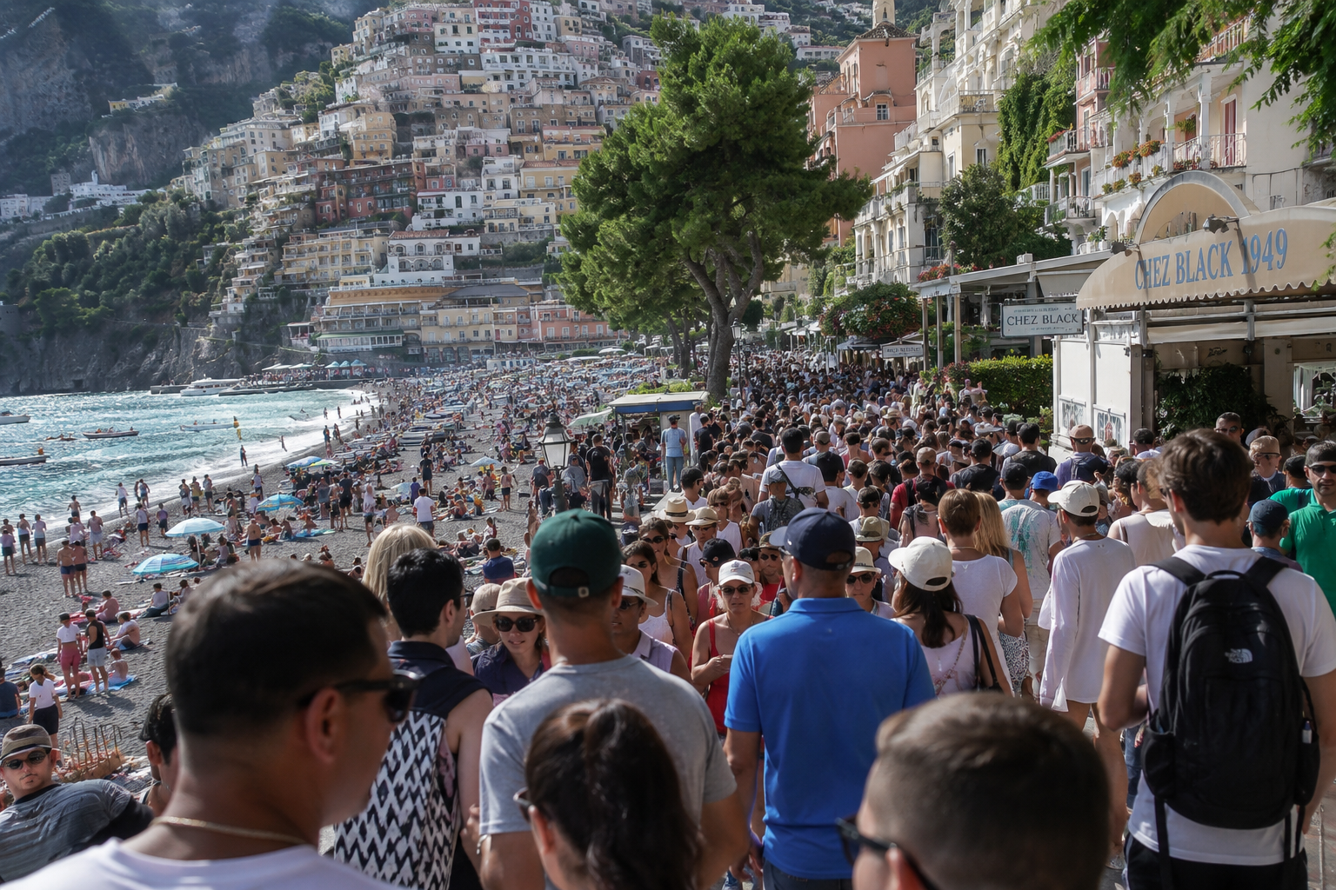
PERSPECTIVE
ISSUE 001 · OVERTOURISM
BEFORE YOU READ
Look and predict
The article is called “Overtourism.”
Looking at the photo and title, what problem do you think it describes? What might be the causes?
Thousands of tourists crowd the streets and beach in Positano, Italy.
perspectiveenglish.com
Notes:
Show the photo and the headline. Before reading, students predict: what problem does this article describe? Elicit a few guesses. Pre-teach nothing — the vocabulary comes next.

Slide 5
PERSPECTIVE
ISSUE 001 · OVERTOURISM
VOCABULARY
Match the words to their meanings
1
surge
A
a person who lives in a particular place
2
strain
B
able to continue for a long time without causing harm
3
resident
C
a sudden, large increase
4
regulate
D
pressure caused by too much demand
5
sustainable
E
to control an activity using rules
perspectiveenglish.com
Notes:
Students match each word (1–5) to its meaning (A–E), alone or in pairs. These five words all appear in the article, so they can check as they read. Answers on the next slide.

Slide 6
PERSPECTIVE
ISSUE 001 · OVERTOURISM
VOCABULARY
ANSWERS
How did you do?
1–C surge
2–D strain
3–A resident
4–E regulate
5–B sustainable
perspectiveenglish.com
Notes:
Reveal answers. Tip: in PowerPoint you can animate each answer chip to appear on click. Check pronunciation and drill the five words briefly.

Slide 7

PERSPECTIVE
ISSUE 001 · OVERTOURISM
THE ARTICLE
Overtourism
Can tourism become too successful?
As more people travel than ever before, some beautiful places are paying the price.
In recent years, the city of Barcelona has seen something strange. Frustrated locals walked through crowded tourist districts carrying water pistols, gently spraying surprised visitors at sidewalk cafés. The playful protest carried a serious message: “Tourists go home.” For a city that welcomes more than 30 million visitors a year, the moment revealed a growing tension between those who live in a place and those who simply pass through.
The numbers are striking. Venice, a city of fewer than 50,000 residents, can receive up to 100,000 tourists in a single day. Recently it introduced a five-euro entry fee for day-trippers — the first of its kind in the world. Amsterdam has frozen new hotel construction, and even Mount Everest now sees traffic jams of climbers waiting near the summit.
Still, tourism is not the enemy. It creates jobs, supports small businesses, and connects cultures. The real question is balance. Some call for stricter rules to regulate visitor numbers; others believe the answer is smarter, more sustainable travel. As the backlash grows louder, no easy answer is in sight.
The problem has a name: overtourism. It happens when a destination attracts more visitors than it can comfortably handle. Cities like Venice, Amsterdam, and Kyoto have all felt the strain. A sudden surge in arrivals can crowd the streets, push up prices, and slowly change a neighborhood until it no longer feels like home to its residents.
Who really owns a city — the people who live there, or the millions who come to see it?
perspectiveenglish.com
Notes:
Students read the full article, or follow the audio. Set a purpose: what is overtourism, where is it happening, and what are the possible solutions? End on the pull-quote question — it sets up the discussion. Give 4–5 minutes.

Slide 8
PERSPECTIVE
ISSUE 001 · OVERTOURISM
COMPREHENSION
True or False?
1
T F
Too many visitors can overwhelm a place.
2
T F
Venice charges day-trippers a five-euro fee.
3
T F
The article says tourism is only harmful.
4
T F
Everest has seen crowds near the summit.
5
T F
There is one simple solution to overtourism.
perspectiveenglish.com
Notes:
Comprehension check. Students decide True or False for each statement, referring back to the article. Answers on the next slide.

Slide 9
PERSPECTIVE
ISSUE 001 · OVERTOURISM
COMPREHENSION
ANSWERS
True or False?
1
TRUE
Too many visitors can overwhelm a place.
2
TRUE
Venice charges day-trippers a five-euro fee.
3
FALSE
The article says tourism is only harmful. — it brings jobs & culture too.
4
TRUE
Everest has seen crowds near the summit.
5
FALSE
There is one simple solution. — “no easy answer is in sight.”
perspectiveenglish.com
Notes:
Reveal. Ask students to find the line in the article that proves each answer — good re-reading practice. 3 and 5 are False because the article is balanced and says there is no easy answer.

Slide 10
PERSPECTIVE
ISSUE 001 · OVERTOURISM
DISCUSSION
Talk it through
1
Have you ever visited a place that felt too crowded? What was it like?
2
Has tourism changed a place you know well? How?
3
Why might residents and tourists see the same city so differently?
4
Do you think entry fees or visitor limits are fair? Why or why not?
5
Who do you think a famous city really belongs to — its residents or its visitors?
perspectiveenglish.com
Notes:
The heart of the lesson. Put students in pairs or small groups. Move through as many questions as time allows — don't rush. Encourage: ‘On the one hand… on the other…’, ‘It depends on…’, ‘I’d argue that…’

Slide 11
PERSPECTIVE
ISSUE 001 · OVERTOURISM
CRITICAL THINKING
YOU ARE THE COUNCIL
Your town has 40,000 residents and three million visitors a year.
Choose the measures you will pass. Every one of them costs somebody something, and you must reach one decision as a council.
MEASURE
WHAT IT FIXES
WHO PAYS FOR IT
PASS
A tourist tax
Raises money to repair the damage crowds cause.
Budget travelers, and the cheap hotels they use.
☐
Cap the cruise ships
Removes the daily surge of thousands at once.
Port workers, guides, and every shop near the harbor.
☐
Ban new hotels
Stops visitor numbers climbing every year.
Construction jobs now, and hotel jobs later.
☐
Rent only to residents
Brings rents down so local families can stay.
Owners who rent short-term — some of them your neighbors.
☐
Timed entry to the old town
Spreads crowds across the day; streets stay walkable.
Anyone who arrives without booking — residents included.
☐
Change nothing
Keeps every job and every euro the visitors bring.
The residents who leave, quietly, one family at a time.
☐
YOUR VOTE
Measures passed: ______ of 6 The group you have decided to disappoint: _____________________________
DISCUSS
1
Would you still vote this way if your own job depended on tourism?
2
Compare with another council. Who protected residents most, and who kept the most jobs?
perspectiveenglish.com
Notes:
The council task. Groups of three or four. Read all six measures aloud with their cost column, then make them vote one measure at a time. Give about ten minutes and run the YOUR VOTE line plus both DISCUSS questions — the cruise cap and the rental rule are where the argument lives, because the people who pay are neighbors.

Slide 12
PERSPECTIVE
ISSUE 001 · OVERTOURISM
LANGUAGE IN CONTEXT
Complete & say each line
Complete each sentence with a word from the box. Change the form if you need to.
surge
strain
residents
regulate
sustainable
1
A sudden ______________ in tourists can change a city overnight.
2
Too many visitors put a real ______________ on local life.
3
I think ______________ should matter more than tourists.
4
Cities should ______________ tourism before it gets out of control.
5
For me, ______________ travel is the only kind worth doing.
perspectiveenglish.com
Notes:
Speaking-focused language. Students complete each sentence so they can say it aloud — first person, useful for the discussion. Change the form if needed. Answers next slide (some are flexible).

Slide 13
PERSPECTIVE
ISSUE 001 · OVERTOURISM
LANGUAGE IN CONTEXT
SUGGESTED ANSWERS
Complete & say each line
1
A sudden surge in tourists can change a city overnight.
2
Too many visitors put a real strain on local life.
3
I think residents should matter more than tourists.
4
Cities should regulate tourism before it gets out of control.
5
For me, sustainable travel is the only kind worth doing.
perspectiveenglish.com
Notes:
Suggested answers — accept sensible variations, especially in 3 (residents / local people). The goal is that students can use the words in speech.

Slide 14
PERSPECTIVE
ISSUE 001 · OVERTOURISM
SPEAKING CHALLENGE
ROLE · TASK · PRESENT
You are the town council
ROLE
You are the local council of a town that has suddenly become a tourist hotspot.
TASK
Agree on two rules to manage visitors and protect residents.
PRESENT
Share your plan with the class and explain why it is fair to everyone.
perspectiveenglish.com
Notes:
Group role-play. Small groups act as a town council. Give ~8 minutes to agree on two rules, then each group presents. Encourage persuasive, balanced language.

Slide 15
PERSPECTIVE
ISSUE 001 · OVERTOURISM
WRITING · YOUR OPINION
Should popular cities limit the number of tourists they allow?
Write 150–200 words, using ideas and vocabulary from the article.
Give your opinion clearly
Support it with reasons
Use the key vocabulary
perspectiveenglish.com | Model answer in the Teacher Guide
Notes:
Final reflection. Set as in-class writing or homework. 150–200 words. Remind students to use the vocabulary and ideas from the article. A model answer is in the Teacher Guide (Page 3).

Slide 16
PERSPECTIVE
THAT’S A WRAP
One fact. One perspective. Endless discussion.
Thanks for a great lesson. See you in Issue 002.
perspectiveenglish.com
© 2026 Perspective English. All rights reserved.
Notes:
Wrap up. Thank the class. Preview that Issue 002 continues the series. Reminder: the worksheet, audio and teacher guide all live at perspectiveenglish.com.

