Slide 1
PERSPECTIVE
SPECIAL EDITION
ISSUE 005
LESSONS WORTH TALKING ABOUT
The World Cup
More than just football?
Notes:
Welcome the class. This is Issue 005 of Perspective — today's topic is The World Cup. Aim: read a short article, learn key words, and discuss opinions.

Slide 2
PERSPECTIVE
ISSUE 005 · THE WORLD CUP
LESSON OVERVIEW
What we’ll do today
01
Warm-up & vocabulary
02
Read & listen
Get talking and learn five key words.
The article, with optional audio.
03
Check & discuss
04
Think & write
Comprehension, then open discussion.
Rank ideas and share your opinion.
perspectiveenglish.com
45–60 minutes
Notes:
Set expectations. 45–60 minutes. We move top to bottom: warm-up, vocabulary, article + audio, comprehension, then lots of discussion and a short writing task.

Slide 3
PERSPECTIVE
ISSUE 005 · THE WORLD CUP
WARM-UP
Talk with a partner
1
Do you watch the World Cup or other big sporting events? Who do you support?
2
Why do you think sport can bring people together?
perspectiveenglish.com
Notes:
Books closed. Pairs discuss both questions for 3–4 minutes, then share with the class. No right answers — the goal is to activate the topic and get them speaking.

Slide 4
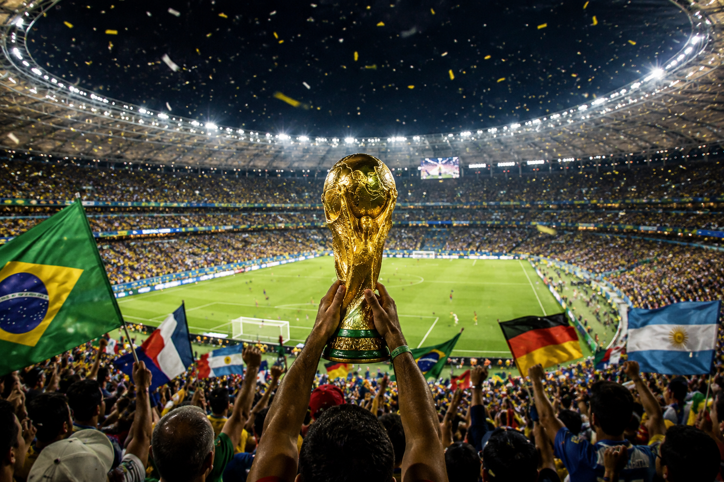
PERSPECTIVE
ISSUE 005 · THE WORLD CUP
BEFORE YOU READ
Look and predict
The article is called “The World Cup.”
Looking at the photo and title, what problem do you think it describes? What might be the causes?
Fans celebrate as the World Cup trophy is lifted in front of a packed stadium.
perspectiveenglish.com
Notes:
Show the photo and the headline. Before reading, students predict: what problem does this article describe? Elicit a few guesses. Pre-teach nothing — the vocabulary comes next.

Slide 5
PERSPECTIVE
ISSUE 005 · THE WORLD CUP
VOCABULARY
Match the words to their meanings
1
spectacle
A
strong competition between two sides
2
tournament
B
something left behind that lasts
3
rivalry
C
a competition with many teams or games
4
host
D
to hold and organize an event
5
legacy
E
an impressive public show or sight
perspectiveenglish.com
Notes:
Students match each word (1–5) to its meaning (A–E), alone or in pairs. These five words all appear in the article, so they can check as they read. Answers on the next slide.

Slide 6
PERSPECTIVE
ISSUE 005 · THE WORLD CUP
VOCABULARY
ANSWERS
How did you do?
1–E spectacle
2–C tournament
3–A rivalry
4–D host
5–B legacy
perspectiveenglish.com
Notes:
Reveal answers. Tip: in PowerPoint you can animate each answer chip to appear on click. Check pronunciation and drill the five words briefly.

Slide 7

PERSPECTIVE
ISSUE 005 · THE WORLD CUP
THE ARTICLE
The World Cup
More than just football?
Every four years, one tournament stops the world — and it means far more than the score.
Every four years, something remarkable happens. For one month, people who have never kicked a ball gather around screens in homes, cafés, and public squares, united by a single tournament . Strangers hug after a goal; entire nations hold their breath together. The World Cup is football, but it is also something much larger.
Hosting the World Cup is a huge undertaking. Countries spend billions of dollars building stadiums, hotels, and transport, hoping the world’s attention will boost tourism and pride. Yet the results are mixed. Some new stadiums are used for years; others sit empty once the crowds go home. The legacy of hosting can be a gift or a costly burden.
No other event draws an audience like it. Around half the planet watches some part of the competition, and more than a billion people may see a single final. Part of the appeal is the sheer spectacle — the color, the noise, the drama of a penalty shoot-out. But it is also the rivalry between nations that, for ninety minutes, matters more than almost anything else.
Critics argue the tournament has become too commercial, and that the cost of hosting often falls on ordinary people. Supporters reply that few things unite the world so powerfully — that for a few weeks, borders seem to matter a little less.
For one month every four years, the whole world seems to watch the same thing. Why does that still matter?
perspectiveenglish.com
Notes:
Students read the full article, or follow the audio. Set a purpose: why do billions watch, what does hosting cost, and does the World Cup still unite the world? Point out the balanced view. End on the pull-quote about why it still matters. Give 4–5 minutes.

Slide 8
PERSPECTIVE
ISSUE 005 · THE WORLD CUP
COMPREHENSION
True or False?
1
T F
About half the planet watches some part of the World Cup.
2
T F
Every new World Cup stadium is used for many years afterwards.
3
T F
Hosting the World Cup costs billions of dollars.
4
T F
Some critics say the tournament has become too commercial.
5
T F
The article says the World Cup is only about football.
perspectiveenglish.com
Notes:
Comprehension check. Students decide True or False for each statement, referring back to the article. Answers on the next slide.

Slide 9
PERSPECTIVE
ISSUE 005 · THE WORLD CUP
COMPREHENSION
ANSWERS
True or False?
1
TRUE
About half the planet watches some part of the World Cup.
2
FALSE
Every new World Cup stadium is used for many years afterwards. — some sit empty.
3
TRUE
Hosting the World Cup costs billions of dollars.
4
TRUE
Some critics say the tournament has become too commercial.
5
FALSE
The article says the World Cup is only about football. — it is much larger.
perspectiveenglish.com
Notes:
Reveal. Ask students to find the line in the article that proves each answer — good re-reading practice. 4 and 2 are False: the World Cup is much more than football (not merely a match), and some new stadiums sit empty afterwards rather than being reused for many years.

Slide 10
PERSPECTIVE
ISSUE 005 · THE WORLD CUP
DISCUSSION
Talk it through
1
Do you enjoy watching the World Cup or big sporting events? Why or why not?
2
Has a sporting event ever brought your country or family together?
3
Why do people feel such strong emotions about their national team?
4
Is spending billions to host the World Cup worth it? Why or why not?
5
Does the World Cup still bring the world together, or divide it?
perspectiveenglish.com
Notes:
The heart of the lesson. Put students in pairs or small groups. Move through as many questions as time allows — don't rush. Encourage: ‘On the one hand… on the other…’, ‘It depends on…’, ‘I’d argue that…’

Slide 11
PERSPECTIVE
ISSUE 005 · THE WORLD CUP
CRITICAL THINKING
WAS IT WORTH IT?
Six things a country buys when it hosts a World Cup. Which were worth the money?
Mark each one WORTH IT or NOT. You have to agree as a group, and be ready to say who paid.
WHAT THEY GOT
WHAT IT LOOKS LIKE FIVE YEARS LATER
WORTH IT
NOT
A $200M stadium
Beautiful, and now home to a third-division team who fill a tenth of it.
☐
☐
A new metro line
Built for the fans. Used every morning by people who never bought a ticket.
☐
☐
A month of attention
The whole world learned the country’s name. Tourism rose, then settled back.
☐
☐
40,000 jobs
Real wages for two years. Almost all of them ended the week after the final.
☐
☐
The debt
Still being repaid by people who were children during the tournament.
☐
☐
One national memory
A goal the whole country watched together. Nobody can put a price on it.
☐
☐
YOUR VERDICT
Worth it overall? ___________ Would you vote yes for your own city? ___________
DISCUSS
1
Can a memory be worth a debt your children pay?
2
Compare with another group. Who said yes to their own city, and why?
perspectiveenglish.com
Notes:
The host's bill. Groups of three or four. Read all six rows aloud, then make them agree on every line. Give about ten minutes and run the YOUR VERDICT line plus both DISCUSS questions — the debt row and the memory row are the ones that split a room.

Slide 12
PERSPECTIVE
ISSUE 005 · THE WORLD CUP
LANGUAGE IN CONTEXT
Complete & say each line
Complete each sentence with a word from the box. Change the form if you need to.
host
legacy
tournament
rivalry
spectacle
1
The final was an amazing ________________ that no one will forget.
2
There is a fierce ________________ between the two teams.
3
Our country hopes to ________________ the next World Cup.
4
A great event can leave a lasting ________________ .
5
A knockout ________________ can be decided by a single goal.
perspectiveenglish.com
Notes:
Speaking-focused language. Students complete each sentence so they can say it aloud — first person, useful for the discussion. Change the form if needed. Answers next slide (some are flexible).

Slide 13
PERSPECTIVE
ISSUE 005 · THE WORLD CUP
LANGUAGE IN CONTEXT
SUGGESTED ANSWERS
Complete & say each line
1
The final was an amazing spectacle that no one will forget.
2
There is a fierce rivalry between the two teams.
3
Our country hopes to host the next World Cup.
4
A great event can leave a lasting legacy.
5
A knockout tournament can be decided by a single goal.
perspectiveenglish.com
Notes:
Suggested answers — accept sensible variations. The goal is that students can say each line aloud and use the words in the discussion.

Slide 14
PERSPECTIVE
ISSUE 005 · THE WORLD CUP
SPEAKING CHALLENGE
ROLE · TASK · PRESENT
Bid to host the World Cup
ROLE
You are on your city’s committee bidding to host the World Cup.
TASK
Agree on three reasons your city would be a great host.
PRESENT
Present your bid and explain why your city deserves it.
perspectiveenglish.com
Notes:
Group role-play. Small groups act as a town council. Give ~8 minutes to agree on two rules, then each group presents. Encourage persuasive, balanced language.

Slide 15
PERSPECTIVE
ISSUE 005 · THE WORLD CUP
WRITING · YOUR OPINION
Should countries spend billions of dollars to host the World Cup?
Write 150–200 words, using ideas and vocabulary from the article.
Give your opinion clearly
Support it with reasons
Use the key vocabulary
perspectiveenglish.com | Model answer in the Teacher Guide
Notes:
Final reflection. Set as in-class writing or homework. 150–200 words. Remind students to use the vocabulary and ideas from the article. A model answer is in the Teacher Guide (Page 3).

Slide 16
PERSPECTIVE
THAT’S A WRAP
One fact. One perspective. Endless discussion.
Thanks for a great lesson. See you in the next issue.
perspectiveenglish.com
© 2026 Perspective English. All rights reserved.
Notes:
Wrap up. Thank the class. Preview that Issue 002 continues the series. Reminder: the worksheet, audio and teacher guide all live at perspectiveenglish.com.

