Slide 1
PERSPECTIVE
SPECIAL EDITION
ISSUE 005
LESSONS WORTH TALKING ABOUT
The World Cup
More than just football?
Notes:
Welcome the class. This is Issue 005 of Perspective. Today's topic is the World Cup. This is a Perspective Special Edition. Aim: read a short article, learn five useful words, and give a simple opinion with a reason.

Slide 2
PERSPECTIVE
ISSUE 005
LESSON OVERVIEW
What we’ll do today
01
Warm-up & vocabulary
02
Read & listen
Start talking and learn five useful words.
The article, with the audio.
03
Check & discuss
04
Think & write
True or False, then talk together.
Decide if it was worth it, then write your opinion.
perspectiveenglish.com
45–60 minutes
Notes:
Set expectations. 45–60 minutes. Warm-up, vocabulary, article with audio, True or False, then plenty of discussion and a short writing task. Allow extra thinking time before every speaking stage.

Slide 3
PERSPECTIVE
ISSUE 005
WARM-UP
Talk with a partner
1
Do you watch the World Cup? Which team do you like?
2
Why can sport bring people together?
USEFUL LANGUAGE
I watch… with… · Sport brings people together because…
perspectiveenglish.com
Notes:
Books closed. Pairs answer both questions for 3–4 minutes, then share. Model one answer yourself first: I watch the World Cup with my family. The USEFUL LANGUAGE box on the worksheet gives them the frames.

Slide 4
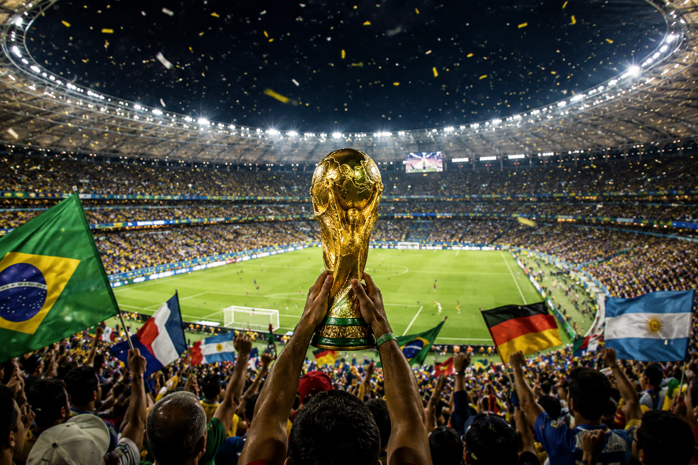
PERSPECTIVE
ISSUE 005
BEFORE YOU READ
Look and predict
The article is called “The World Cup.”
Look at the photo. How do these people feel? Why?
Fans celebrate as the World Cup trophy is lifted in a full stadium.
perspectiveenglish.com
Notes:
Show the photo and the title. Students predict what the article will say. Accept single words and build them into sentences: Happy. → They are happy because their team won. Vocabulary comes next.

Slide 5
PERSPECTIVE
ISSUE 005
VOCABULARY
Match the words to their meanings
1
host
A
to have a big event in your country
2
fans
B
the money you must pay for something
3
stadium
C
happy because you or your country did well
4
cost
D
people who love a team or a sport
5
proud
E
a big building where people watch sport
perspectiveenglish.com
Notes:
Students match each word (1–5) to its meaning (A–E), in pairs. All five words are in bold in the article, so they can check as they read. Host is a verb here, not a person at a party — show both. Proud takes of: proud of my city. Answers next.

Slide 6
PERSPECTIVE
ISSUE 005
VOCABULARY
ANSWERS
How did you do?
1–A host
2–D fans
3–E stadium
4–B cost
5–C proud
perspectiveenglish.com
Notes:
Reveal answers: 1-A, 2-D, 3-E, 4-B, 5-C. Drill the five words for pronunciation. Watch I agree, not I am agree.

Slide 7

PERSPECTIVE
ISSUE 005
THE ARTICLE
The World Cup
More than just football?
Every four years, one competition stops the world. It means more than the score.
Every four years, something strange happens. For one month, people who never play football sit in front of screens at home, in cafés and in city squares. Strangers hug after a goal. A whole country stops to watch one game. The World Cup is football, but it is also much more.
But to host the World Cup is very expensive. A country spends billions of dollars on a new stadium , hotels and trains. Sometimes this is good, and people use the new metro for years. Sometimes it is not, and the stadium is almost empty after the last game.
No other event is this big. About half the world watches some part of it, and more than a billion people may watch the final. Part of it is the show: the colors, the noise, the last-minute penalty. And part of it is that the fans care so much.
So who pays the cost ? Often it is ordinary people, and sometimes for many years. But others say the country feels proud , the world learns its name, and for one month borders seem a little smaller. Both of these things can be true at the same time.
For one month every four years, the whole world watches the same thing. Why does that still matter?
perspectiveenglish.com
Notes:
Play the audio once with books closed, then students read in pairs, one paragraph each. Set a purpose: what does the World Cup give a country, and what does it cost? End on the question in the box — it sets up the discussion. Give 5–6 minutes.

Slide 8
PERSPECTIVE
ISSUE 005
COMPREHENSION
True or False?
1
T F
About half the world watches some of the World Cup.
2
T F
Every new stadium is full after the tournament.
3
T F
The article says hosting is always a good idea.
4
T F
Hosting the World Cup costs billions of dollars.
5
T F
Some people say the World Cup brings the world together.
perspectiveenglish.com
Notes:
True or False. Students go back to the article to find the answer. Ask them to point at the line that proves it. Answers next.

Slide 9
PERSPECTIVE
ISSUE 005
COMPREHENSION
ANSWERS
True or False?
1
TRUE
About half the world watches some of the World Cup.
2
FALSE
Every new stadium is full after the tournament. — some are almost empty after the last game.
3
FALSE
The article says hosting is always a good idea. — sometimes it is good, sometimes it is not.
4
TRUE
Hosting the World Cup costs billions of dollars.
5
TRUE
Some people say the World Cup brings the world together.
perspectiveenglish.com
Notes:
Reveal: T, F, F, T, T. Number 2 is False — some stadiums are almost empty after the last game. Number 3 is False — the article says sometimes it is good and sometimes it is not.

Slide 10
PERSPECTIVE
ISSUE 005
DISCUSSION
Talk it through
1
Do you enjoy big sporting events? Why or why not?
2
Has a match ever brought your family or your country together?
3
Why do people feel so strongly about their national team?
4
Is it worth billions of dollars to host the World Cup?
5
Does the World Cup bring the world together, or divide it?
USEFUL LANGUAGE
I think… · For me… · because… · It depends.
perspectiveenglish.com
Notes:
The heart of the lesson. Pairs or small groups, as many questions as time allows. Give one minute of silent thinking time first and let students write two words — the ideas come before the sentences. Encourage: I think… because…, For me…, It depends.

Slide 11
PERSPECTIVE
ISSUE 005
CRITICAL THINKING
WAS IT WORTH IT?
Five things a country got when it hosted the World Cup. Was the money well spent?
Work in a group. Mark every line WORTH IT, NOT SURE or NOT. Your group must agree, and be ready to say who paid.
WHAT THEY GOT
FIVE YEARS LATER
WORTH IT
NOT SURE
NOT
A $200 million stadium
Beautiful. Now a small team plays there, and it is nearly empty.
☐
☐
☐
A new metro line
Built for the fans. Now local people use it every morning.
☐
☐
☐
40,000 jobs
Real work for two years. Most of the jobs ended after the final.
☐
☐
☐
The debt
People are still paying it. Some of them were children at the time.
☐
☐
☐
One national memory
A goal the whole country watched together. You cannot buy that.
☐
☐
☐
YOUR VERDICT
Worth it in total? ______ Would you say yes for your own city? __________________
DISCUSS
1
Can a memory be worth a debt that your children pay?
2
Compare with another group. Who said yes for their own city, and why?
perspectiveenglish.com
Notes:
Groups of three or four. Read all five lines aloud with the FIVE YEARS LATER column, then have them mark one line at a time. Give about ten minutes, then run YOUR VERDICT and both DISCUSS questions. The metro is the easy yes and the empty stadium the easy no — the argument lives in the debt and the memory, which are the same question asked twice.

Slide 12
PERSPECTIVE
ISSUE 005
LANGUAGE IN CONTEXT
Complete the sentences
Complete the sentences with a word from the box.
stadium
proud
fans
cost
host
1
Thousands of _____________ waited outside the ground.
2
Our city wants to _____________ the next World Cup.
3
The new _____________ can hold 60,000 people.
4
The _____________ of the new trains was very high.
5
My parents were very _____________ of me.
perspectiveenglish.com
Notes:
Students complete each sentence with a word from the box, then read it aloud. One word per gap and no form changes needed at this level. Answers next.

Slide 13
PERSPECTIVE
ISSUE 005
LANGUAGE IN CONTEXT
ANSWERS
Complete the sentences
1
Thousands of fans waited outside the ground.
2
Our city wants to host the next World Cup.
3
The new stadium can hold 60,000 people.
4
The cost of the new trains was very high.
5
My parents were very proud of me.
perspectiveenglish.com
Notes:
Answers: fans, host, stadium, cost, proud. Have students read the full sentences aloud so the words get into speech.

Slide 14
PERSPECTIVE
ISSUE 005
SPEAKING CHALLENGE
ROLE · TASK · PRESENT
Your city wants the World Cup
ROLE
You are a committee. Your city wants to host the World Cup.
TASK
Choose two reasons your city is a good host. Decide who pays for the stadium.
PRESENT
Tell the class your two reasons and say why your city should win.
USEFUL LANGUAGE
Our first reason is… · Our city has… This is good because… · We think… should pay.
perspectiveenglish.com
Notes:
Group role-play. Small groups are a city committee bidding for the World Cup. About 8 minutes to choose their two reasons and decide who pays for the stadium, then each group presents. The USEFUL LANGUAGE box on Page 2 gives them the opening phrases: Our first reason is… Our city has…

Slide 15
PERSPECTIVE
ISSUE 005
WRITING · YOUR OPINION
Should a country spend billions of dollars to host the World Cup?
Write 60–100 words. Use words from the article.
I think a country should…
The first reason is… For example,…
But… So I think…
perspectiveenglish.com | Model answer in the Teacher Guide
Notes:
Final reflection. In class or as homework. 60–100 words. The sentence starters on the slide are the same ones on Page 2 — have students say their first sentence aloud before writing. A model answer is in the Teacher Guide.

Slide 16
PERSPECTIVE
THAT’S A WRAP
One fact. One perspective. Endless discussion.
Thanks for a great lesson. See you in Issue 006.
perspectiveenglish.com
© 2026 Perspective English. All rights reserved.
Notes:
Wrap up. Thank the class. Preview that Issue 006 continues the series. The worksheet, audio and teacher guide all live at perspectiveenglish.com.

