Slide 1
PERSPECTIVE
SPECIAL EDITION
ISSUE 005
LESSONS WORTH TALKING ABOUT
The World Cup
More than just football?
Notes:
Welcome the class. This is Issue 005 of Perspective, a Special Edition of the advanced series. Topic: The World Cup. Aim: read for implication, test a principle against hard cases, and defend a position under challenge.

Slide 2
PERSPECTIVE
ISSUE 005 · THE WORLD CUP
LESSON OVERVIEW
What we’ll do today
01
Warm-up & vocabulary
02
Read & listen
Open the debate; learn five advanced expressions.
The article, with optional audio.
03
Check & discuss
04
Challenge & defend
Read for implication, then debate.
Test a principle, defend a condition, write.
perspectiveenglish.com
60–75 minutes
Notes:
Set expectations. 60–75 minutes. Warm-up, five expressions, article + audio, an inference check, then critical thinking, discussion, a defended proposal and a written argument.

Slide 3
PERSPECTIVE
ISSUE 005 · THE WORLD CUP
WARM-UP
Talk with a partner
1
Think of a sporting moment you still remember. What made it matter beyond the result?
2
Is cheering for your national team patriotism? When does it become something else?
perspectiveenglish.com
Notes:
Books closed. Pairs discuss both questions for 4–5 minutes. Push on question 2: ask students to name the exact point where support becomes nationalism.

Slide 4
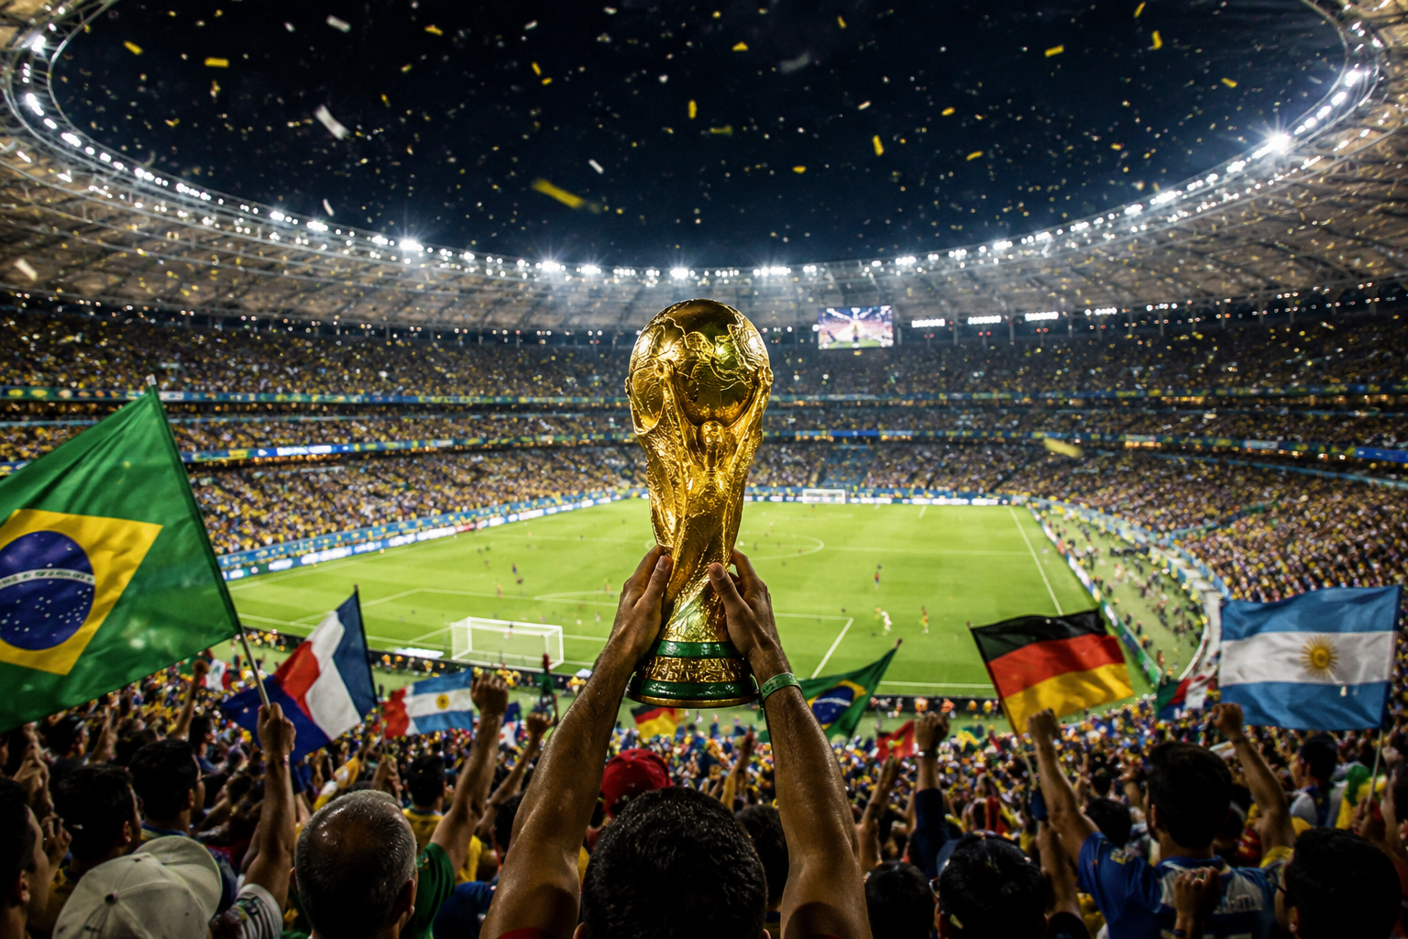
PERSPECTIVE
ISSUE 005 · THE WORLD CUP
BEFORE YOU READ
Look and predict
The article is called “The World Cup.”
The subtitle asks: more than just football? What else might the tournament be about, and who might disagree?
Fans celebrate as the World Cup trophy is lifted in front of a packed stadium.
perspectiveenglish.com
Notes:
Show the photo and the subtitle. Students list what the World Cup means beyond football: money, pride, politics. Return to the list after reading: the article adds costs and controversies most fans never see.

Slide 5
PERSPECTIVE
ISSUE 005 · THE WORLD CUP
VOCABULARY
Match the expressions to their meanings
1
a double-edged sword
A
to be examined critically
2
rally behind
B
to unite in support of
3
a white elephant
C
to hide problems, not fix them
4
come under scrutiny
D
helpful and harmful at once
5
paper over the cracks
E
a costly project of little use
perspectiveenglish.com
Notes:
Students match each expression (1–5) to its meaning (A–E). All five appear in the article; ask students to use the context to confirm each match, not just memory. Answers on the next slide.

Slide 6
PERSPECTIVE
ISSUE 005 · THE WORLD CUP
VOCABULARY
ANSWERS
How did you do?
1–D
2–B
3–E
4–A
5–C
a double- edged sword
rally behind
a white elephant
come under scrutiny
paper over the cracks
perspectiveenglish.com
Notes:
Reveal answers. Then ask for a fresh example of each from sport, work or the news: a project that became a white elephant, a decision that came under scrutiny.

Slide 7

PERSPECTIVE
ISSUE 005 · THE WORLD CUP
THE ARTICLE
The World Cup
More than just football?
One tournament stops the world every four years. Not everything it brings shows up on the scoreboard.
For ninety minutes, a nation can forget almost everything else. Streets empty, strangers embrace, and people who never watch football find themselves shouting at a screen. No other event gathers so much of humanity around a single game. Yet the World Cup has always been about more than football, and what exactly it is about depends on who is watching, and who is paying.
The economic case is shakier than it looks. Several hosts are left with near-empty stadiums, each a white elephant that taxpayers go on funding. Football’s governing body has repeatedly come under scrutiny over how hosting rights are awarded, amid corruption scandals at the very top. For fans, too, the tournament can be a double-edged sword : the passion that unites a country can turn ugly, spilling into nationalism.
For a host country, the tournament is a chance to present itself to billions. Governments spend enormous sums on stadiums, transport, and security, hoping for tourism, investment, and national pride. Critics call this “sportswashing”: using the glamour of a global event to paper over the cracks at home, from the treatment of migrant workers to limits on free speech. The charge is hard to dismiss, though it is applied selectively; democratic hosts with controversies of their own rarely face the same criticism.
And yet the unity is real. A diverse national team can make citizens who rarely agree rally behind a shared symbol, and a small nation’s unlikely victory can shape how its people see themselves for a generation. Some argue that sport should simply stay out of politics. Others reply that an event this large is always political; the only question is whose politics it serves.
Can a game that unites billions ever be truly neutral?
perspectiveenglish.com
Notes:
Students read the full article, or follow the audio. Set a purpose: what does the writer accept, and what does the writer doubt? Point out ‘hard to dismiss’ and ‘applied selectively’ in paragraph 2, and the turn in paragraph 4: the unity is real. End on the pull-quote question. Give 5–6 minutes.

Slide 8
PERSPECTIVE
ISSUE 005 · THE WORLD CUP
COMPREHENSION
True or False?
Judge what the article states or implies. Circle T or F.
1
T F
The writer finds sportswashing credible.
2
T F
Some hosts face harsher criticism.
3
T F
Hosting reliably pays off economically.
4
T F
The writer dismisses national unity.
5
T F
Fan passion has a darker side.
perspectiveenglish.com
Notes:
Inference check. Several answers are implied rather than stated, so students must point to the words that justify their choice. Answers and evidence on the next slide.

Slide 9
PERSPECTIVE
ISSUE 005 · THE WORLD CUP
COMPREHENSION
ANSWERS
True or False?
1
TRUE
The writer finds sportswashing credible. — the charge is “hard to dismiss.”
2
TRUE
Some hosts face harsher criticism. — the charge is “applied selectively.”
3
FALSE
Hosting reliably pays off economically. — the case is “shakier than it looks.”
4
FALSE
The writer dismisses national unity. — “the unity is real.”
5
TRUE
Fan passion has a darker side. — passion “can turn ugly.”
perspectiveenglish.com
Notes:
Reveal with evidence. Pattern: T, T, F, F, T. On 1, ‘hard to dismiss’ signals the writer takes the charge seriously. On 2, democratic hosts with controversies of their own rarely face the same criticism, so others face more.

Slide 10
PERSPECTIVE
ISSUE 005 · THE WORLD CUP
DISCUSSION
Talk it through
1
Would you want your country to host the World Cup? What would worry you?
2
Can one tournament really change how a country is seen abroad?
3
Why might sportswashing criticism fall harder on some hosts than others?
4
Should players use the tournament to make political statements?
5
If a tournament leaves stadiums empty but a nation proud, was it worth it?
perspectiveenglish.com
Notes:
The heart of the lesson. Pairs or small groups. Don’t accept ‘it depends’ without asking: on what? Encourage: ‘That rests on the assumption that…’, ‘I’d concede that…, but…’, ‘The flaw in that argument is…’

Slide 11
PERSPECTIVE
ISSUE 005 · THE WORLD CUP
CRITICAL THINKING
KEEP POLITICS OUT?
The principle: “Sport and politics should be kept separate.”
Test it against each case. Does the principle give a clear answer? Then circle whether you would accept what happens.
CASE
CLEAR ANSWER?
ACCEPT IT?
1 A captain wears a rainbow armband where it is banned.
Yes
No
Yes
No
2 A country at war is banned from the tournament.
Yes
No
Yes
No
3 Fans boo the other team’s national anthem.
Yes
No
Yes
No
4 A team refuses to play in a host it calls oppressive.
Yes
No
Yes
No
5 A state-owned oil company becomes chief sponsor.
Yes
No
Yes
No
6 The host bans all protests near the stadiums.
Yes
No
Yes
No
YOUR VERDICT
Case that breaks the principle: No. _______ Your improved principle: ______________________________
DISCUSS
1
Did the principle ever point both ways at once? In which case?
2
Compare with another pair. Challenge one ruling that differs from yours.
3
Is “keeping politics out” itself a political choice? Who benefits from it?
perspectiveenglish.com
Notes:
Principle-testing task. Pairs. Read the principle aloud, then each case. For each, pairs decide whether the principle gives a clear answer, then whether they would accept what happens. Complete the YOUR VERDICT line and all three DISCUSS questions. About twelve minutes. Push pairs to notice that both acting and not acting can be political.

Slide 12
PERSPECTIVE
ISSUE 005 · THE WORLD CUP
LANGUAGE IN CONTEXT
Complete & say each line
Complete each sentence with an expression from the box. Change the form if you need to.
come under scrutiny
a white elephant
paper over the cracks
a double-edged sword
rally behind
1
Fame is _______________ for young players.
2
The whole town _______________ its local team.
3
The new airport is _______________ nobody uses.
4
His expenses _______________ after the leak.
5
A new logo can’t _______________ in a failing firm.
perspectiveenglish.com
Notes:
Students complete each sentence, changing the form where needed. Then have them say each line aloud and extend it with a reason. Answers next slide.

Slide 13
PERSPECTIVE
ISSUE 005 · THE WORLD CUP
LANGUAGE IN CONTEXT
ANSWERS
Complete & say each line
1
Fame is a double-edged sword for young players.
2
The whole town rallied behind its local team.
3
The new airport is a white elephant nobody uses.
4
His expenses came under scrutiny after the leak.
5
A new logo can’t paper over the cracks in a failing firm.
perspectiveenglish.com
Notes:
Answers. Check form: 2 needs the past tense “rallied behind”; 4 needs the past tense “came under scrutiny.” Ask students to reuse two of the expressions in the discussion that follows.

Slide 14
PERSPECTIVE
ISSUE 005 · THE WORLD CUP
SPEAKING CHALLENGE
ROLE · PROPOSE · DEFEND
Propose it. Defend it.
In small groups, build one position and hold it under pressure.
ROLE
You sit on the committee that chooses the next World Cup host.
PROPOSE
Set ONE condition every host must meet. Say which bids it would rule out.
DEFEND
Present in two minutes. A rejected bidder then calls it unfair. Answer them without abandoning your condition.
perspectiveenglish.com
Notes:
Groups get ~8 minutes to agree on one condition and prepare. Each presents for two minutes; a second group, speaking as a rejected bidder, rebuts for one minute; the first group answers. Keep the debate on principles, not particular countries. Judge on how well the answer meets the objection.

Slide 15
PERSPECTIVE
ISSUE 005 · THE WORLD CUP
WRITING · YOUR OPINION
“Hosting the World Cup does a country more harm than good.” To what extent do you agree?
Write 200–250 words. Address the strongest opposing view before you answer it.
Take a clear position
Answer the strongest objection
Use the key expressions
perspectiveenglish.com | Model answer in the Teacher Guide
Notes:
Set as in-class writing or homework. 200–250 words. The opposing view must be stated fairly before it is answered. A model answer is in the Teacher Guide (Page 3).

Slide 16
PERSPECTIVE
THAT’S A WRAP
One fact. One perspective. Endless discussion.
Thanks for a great lesson. See you in Issue 006.
perspectiveenglish.com
© 2026 Perspective English. All rights reserved.
Notes:
Wrap up. Thank the class. Preview that Issue 006 continues the advanced series. Reminder: the worksheet, audio and teacher guide all live at perspectiveenglish.com.

