Slide 1
PERSPECTIVE
ISSUE 003
LESSONS WORTH TALKING ABOUT
Food Waste
Why do we throw so much away?
Notes:
Welcome the class. This is Issue 003 of Perspective. Today's topic is Food Waste. Aim: read a short article, learn five useful words, and give a simple opinion with a reason.

Slide 2
PERSPECTIVE
ISSUE 003
LESSON OVERVIEW
What we’ll do today
01
Warm-up & vocabulary
02
Read & listen
Start talking and learn five useful words.
The article, with the audio.
03
Check & discuss
04
Think & write
True or False, then talk together.
Test your fridge, then write your opinion.
perspectiveenglish.com
45–60 minutes
Notes:
Set expectations. 45–60 minutes. Warm-up, vocabulary, article with audio, True or False, then plenty of discussion and a short writing task. Allow extra thinking time before every speaking stage.

Slide 3
PERSPECTIVE
ISSUE 003
WARM-UP
Talk with a partner
1
What food do you throw away most often at home?
2
Who should fix this problem: shops, or people at home?
USEFUL LANGUAGE
We often throw away… · I think… should…
perspectiveenglish.com
Notes:
Books closed. Pairs answer both questions for 3–4 minutes, then share. Model one answer yourself first: We often throw away bread. The USEFUL LANGUAGE box on the worksheet gives them the frames.

Slide 4
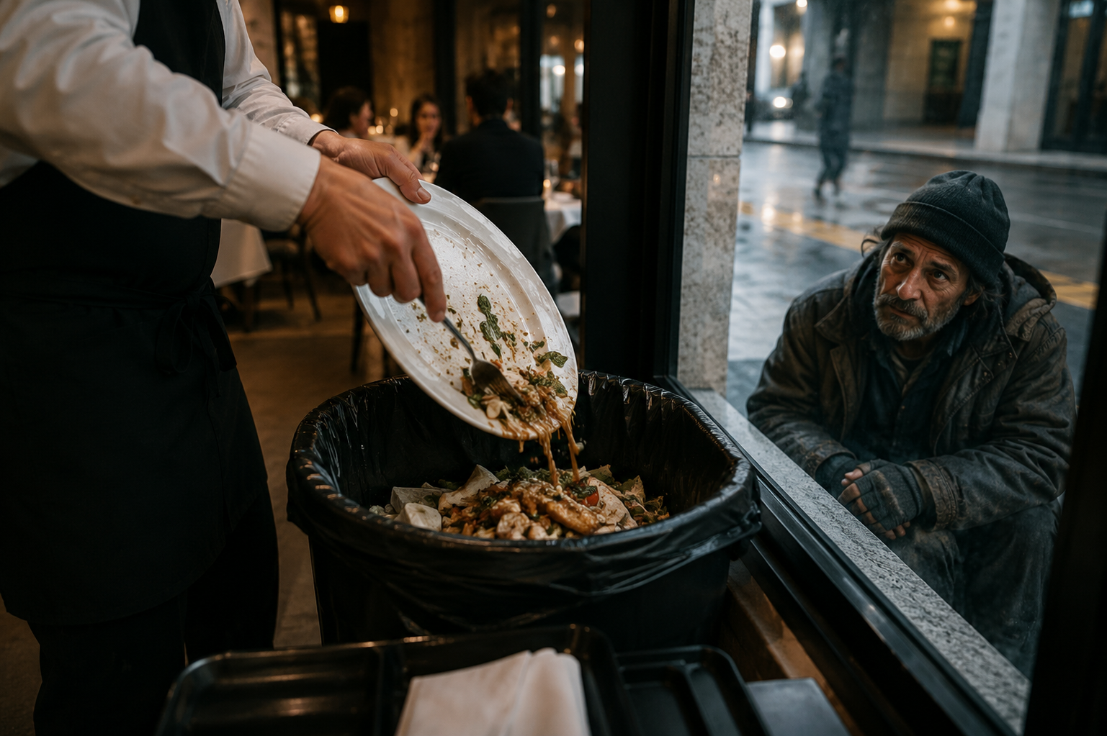
PERSPECTIVE
ISSUE 003
BEFORE YOU READ
Look and predict
The article is called “Food Waste.”
Look at the photo. What can you see? Why is this a problem?
Good food is thrown away every day, while millions of people go hungry.
perspectiveenglish.com
Notes:
Show the photo and the title. Students predict what the article will say. Accept single words and build them into sentences: Bread. → Someone threw away good bread. Vocabulary comes next.

Slide 5
PERSPECTIVE
ISSUE 003
VOCABULARY
Match the words to their meanings
1
waste
A
new, and not old
2
fresh
B
more than you need
3
spoil
C
safe to eat
4
extra
D
to throw away something you could use
5
edible
E
to go bad, so you cannot eat it
perspectiveenglish.com
Notes:
Students match each word (1–5) to its meaning (A–E), in pairs. All five words are in bold in the article, so they can check as they read. Waste works as a verb and a noun here — show both. Spoil is new for most classes: teach it with milk. Answers next.

Slide 6
PERSPECTIVE
ISSUE 003
VOCABULARY
ANSWERS
How did you do?
1–D waste
2–A fresh
3–E spoil
4–B extra
5–C edible
perspectiveenglish.com
Notes:
Reveal answers: 1-D, 2-A, 3-E, 4-B, 5-C. Drill the five words for pronunciation. Watch throw food away, not throw the food.

Slide 7

PERSPECTIVE
ISSUE 003
THE ARTICLE
Food Waste
Why do we throw so much away?
A third of the world’s food is never eaten. The real cost is much bigger.
Tonight, in kitchens all over the world, the same thing will happen. Some bread, a few vegetables, half a plate of dinner — into the bin. It feels like nothing. But do this in a billion homes, every day, and it becomes one of the biggest problems on the planet. About a third of all the food we grow is never eaten.
The problem is bigger than the bin. When old food sits in a landfill, it makes a gas that is very bad for the planet. If food waste was a country, it would be the third biggest polluter in the world. We also throw away the water and the land that grew it. One small apple needs about 125 liters of water.
The numbers are hard to imagine. Every year, people throw away about 1.3 billion tons of food. At the same time, millions of people do not have enough to eat. Milk and vegetables stay fresh for only a few days, and they spoil fast. But in rich countries, most of the waste happens at home.
But this is a problem we can all help with. Some shops now sell extra food at a low price. Restaurants give their food away. Families make a plan before they shop, and they remember that an ugly vegetable is still edible.
If a third of our food goes in the bin, what could change if each of us wasted a little less?
perspectiveenglish.com
Notes:
Play the audio once with books closed, then students read in pairs, one paragraph each. Set a purpose: how much food is wasted, and where does it happen? End on the question in the box — it sets up the discussion. Give 5–6 minutes.

Slide 8
PERSPECTIVE
ISSUE 003
COMPREHENSION
True or False?
1
T F
The article says we eat all the food we grow.
2
T F
Milk and vegetables stay fresh for only a few days.
3
T F
In rich countries, most food waste happens on farms.
4
T F
Old food in a landfill makes a gas that is bad for the planet.
5
T F
Some shops sell extra food at a low price.
perspectiveenglish.com
Notes:
True or False. Students go back to the article to find the answer. Ask them to point at the line that proves it. Answers next.

Slide 9
PERSPECTIVE
ISSUE 003
COMPREHENSION
ANSWERS
True or False?
1
FALSE
The article says we eat all the food we grow. — about a third is never eaten.
2
TRUE
Milk and vegetables stay fresh for only a few days.
3
FALSE
In rich countries, most food waste happens on farms. — most of it happens at home.
4
TRUE
Old food in a landfill makes a gas that is bad for the planet.
5
TRUE
Some shops sell extra food at a low price.
perspectiveenglish.com
Notes:
Reveal: F, T, F, T, T. Number 1 is False — about a third of our food is never eaten. Number 3 is False — in rich countries most waste happens at home.

Slide 10
PERSPECTIVE
ISSUE 003
DISCUSSION
Talk it through
1
Do you throw away much food at home? What kind?
2
What did your family teach you about wasting food?
3
Why do you think rich countries waste more food?
4
Should shops be allowed to throw away food that is still good?
5
Is it ever OK to waste food? When?
USEFUL LANGUAGE
I think… · For me… · because… · It depends.
perspectiveenglish.com
Notes:
The heart of the lesson. Pairs or small groups, as many questions as time allows. Give one minute of silent thinking time first and let students write two words — the ideas come before the sentences. Encourage: I think… because…, For me…, It depends.

Slide 11
PERSPECTIVE
ISSUE 003
CRITICAL THINKING
THE FRIDGE TEST
Five things in your fridge tonight. Do you eat them, or throw them away?
Choose alone first. Mark every line EAT, NOT SURE or THROW. Then compare in your group.
WHAT IS IN THE FRIDGE
THINK ABOUT THIS
EAT
NOT SURE
THROW
Yogurt, two days after the date.
The date says “best before,” not “dangerous.”
☐
☐
☐
Bread with mold on one slice.
You can see some mold. You cannot see all of it.
☐
☐
☐
An apple with a big brown mark.
The mark is ugly, but the rest is fine.
☐
☐
☐
Milk one day over. It smells normal.
Your nose knows more than the label does.
☐
☐
☐
Rice that sat on the counter all night.
It looks fine. Warm rice can still make people sick.
☐
☐
☐
YOUR TOTAL
Food you would throw away: _____ of 5 Food that was really not safe:____________________________________
DISCUSS
1
Are you throwing away the food, or the date on the label?
2
Compare with another group. Who threw away the most? Would your grandparents agree?
perspectiveenglish.com
Notes:
The fridge test. Students choose alone first, then compare in groups of three or four. Give about ten minutes, then run YOUR TOTAL and both DISCUSS questions. Only the rice is a real safety question — the other four are habit, and that gap is the point. Push on the yogurt and the milk: best before is about quality, not safety.

Slide 12
PERSPECTIVE
ISSUE 003
LANGUAGE IN CONTEXT
Complete the sentences
Complete the sentences with a word from the box.
edible
extra
fresh
spoil
waste
1
Milk and salad ______________ very quickly in summer.
2
Please do not ______________ food that is still good.
3
We bought ______________ bread, so we can freeze some.
4
An ugly apple is still ______________ .
5
This fish is very ______________ . It came in this morning.
perspectiveenglish.com
Notes:
Students complete each sentence with a word from the box, then read it aloud. One word per gap and no form changes needed at this level. Answers next.

Slide 13
PERSPECTIVE
ISSUE 003
LANGUAGE IN CONTEXT
ANSWERS
Complete the sentences
1
Milk and salad spoil very quickly in summer.
2
Please do not waste food that is still good.
3
We bought extra bread, so we can freeze some.
4
An ugly apple is still edible.
5
This fish is very fresh. It came in this morning.
perspectiveenglish.com
Notes:
Answers: spoil, waste, extra, edible, fresh. Have students read the full sentences aloud so the words get into speech.

Slide 14
PERSPECTIVE
ISSUE 003
SPEAKING CHALLENGE
ROLE · TASK · PRESENT
You run the café
ROLE
You work in a small café. Every night you throw food away.
TASK
Choose two ways to waste less. Decide who pays for each one.
PRESENT
Tell the class your two ideas and say why they will work.
USEFUL LANGUAGE
Our first idea is… · We can… This will work because… · We think… should pay.
perspectiveenglish.com
Notes:
Group role-play. Small groups run a small café. About 8 minutes to choose their two ideas and decide who pays, then each group presents. The USEFUL LANGUAGE box on Page 2 gives them the opening phrases: Our first idea is… We can…

Slide 15
PERSPECTIVE
ISSUE 003
WRITING · YOUR OPINION
Should shops be allowed to throw away food that is still good?
Write 60–100 words. Use words from the article.
I think shops should…
The first reason is… For example,…
But… So I think…
perspectiveenglish.com | Model answer in the Teacher Guide
Notes:
Final reflection. In class or as homework. 60–100 words. The sentence starters on the slide are the same ones on Page 2 — have students say their first sentence aloud before writing. A model answer is in the Teacher Guide.

Slide 16
PERSPECTIVE
THAT’S A WRAP
One fact. One perspective. Endless discussion.
Thanks for a great lesson.
perspectiveenglish.com
© 2026 Perspective English. All rights reserved.
Notes:
Wrap up. Thank the class. Preview that Issue 004 continues the series. The worksheet, audio and teacher guide all live at perspectiveenglish.com.

