Slide 1
PERSPECTIVE
ISSUE 003
LESSONS WORTH TALKING ABOUT
Food Waste
Whose problem is it, really?
Notes:
Welcome the class. This is Issue 003 of Perspective, the advanced edition. Topic: Food Waste. Aim: read for implication, trace responsibility across a system, and defend a policy under challenge.

Slide 2
PERSPECTIVE
ISSUE 003 · FOOD WASTE
LESSON OVERVIEW
What we’ll do today
01
Warm-up & vocabulary
02
Read & listen
Open the debate; learn five advanced expressions.
The article, with optional audio.
03
Check & discuss
04
Challenge & defend
Read for implication, then debate.
Weigh responsibility, defend a policy, write.
perspectiveenglish.com
60–75 minutes
Notes:
Set expectations. 60–75 minutes. Warm-up, five expressions, article + audio, an inference check, then critical thinking, discussion, a defended proposal and a written argument.

Slide 3
PERSPECTIVE
ISSUE 003 · FOOD WASTE
WARM-UP
Talk with a partner
1
When you throw food away, do you feel guilty, indifferent, or annoyed at whoever sold it to you?
2
Is wasting food morally different from wasting money or energy? Why might it feel different?
perspectiveenglish.com
Notes:
Books closed. Pairs discuss both questions for 4–5 minutes. Push on question 1: whoever sold it to you is a hint. Ask students whether their guilt or their annoyance is better aimed.

Slide 4
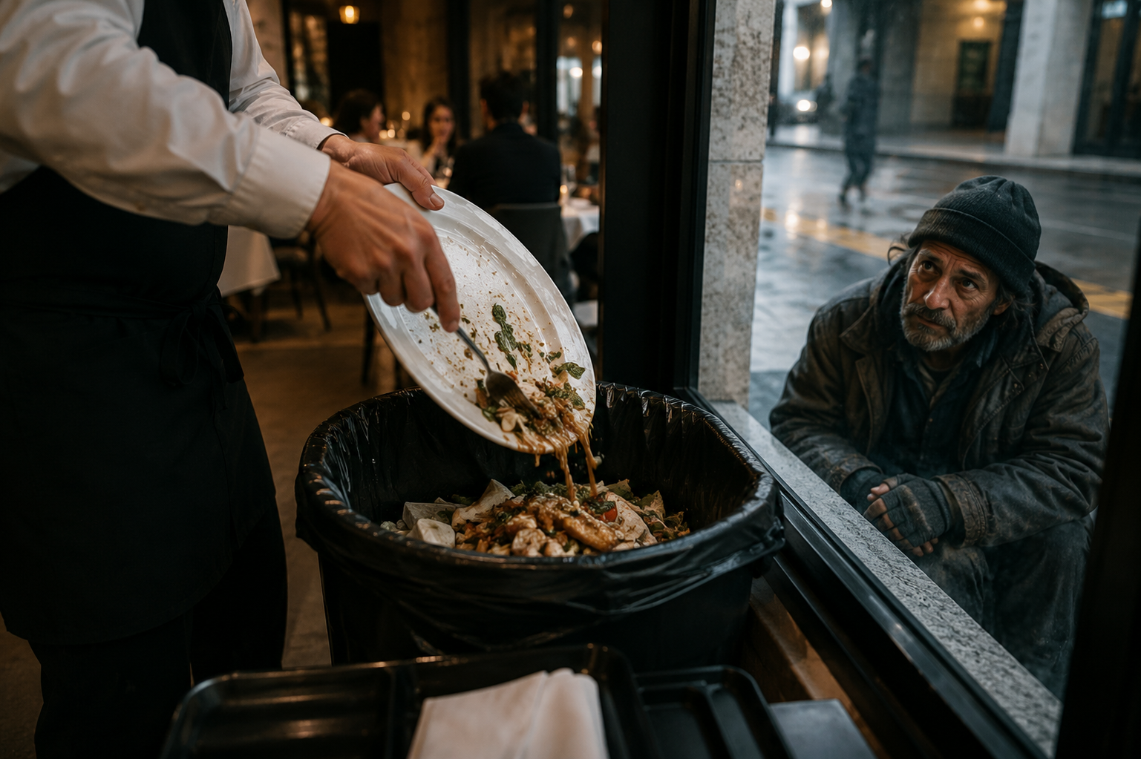
PERSPECTIVE
ISSUE 003 · FOOD WASTE
BEFORE YOU READ
Look and predict
The article is called “Food Waste.”
The subtitle asks: whose problem is it, really? Who might the article hold responsible, and who might disagree?
Perfectly good food is discarded daily while millions still experience hunger worldwide.
perspectiveenglish.com
Notes:
Show the photo and the subtitle. Students predict who the article will blame: households, shops, farms or governments. Return to their predictions after reading: the article spreads responsibility and warns against each side blaming the other.

Slide 5
PERSPECTIVE
ISSUE 003 · FOOD WASTE
VOCABULARY
Match the expressions to their meanings
1
shift the blame
A
to ignore on purpose
2
err on the side of caution
B
to blame someone else
3
turn a blind eye to
C
to make answerable
4
a drop in the ocean
D
to play it safe
5
hold (sb) accountable
E
too small to matter
perspectiveenglish.com
Notes:
Students match each expression (1–5) to its meaning (A–E). All five appear in the article; ask students to use the context to confirm each match, not just memory. Answers on the next slide.

Slide 6
PERSPECTIVE
ISSUE 003 · FOOD WASTE
VOCABULARY
ANSWERS
How did you do?
1–B
2–D
3–A
4–E
5–C
shift the blame
err on the side of caution
turn a blind eye to
a drop in the ocean
hold (sb) accountable
perspectiveenglish.com
Notes:
Reveal answers. Then ask for a fresh example of each from work or public life: a time someone shifted the blame, a problem officials turned a blind eye to.

Slide 7

PERSPECTIVE
ISSUE 003 · FOOD WASTE
THE ARTICLE
Food Waste
Whose problem is it, really?
We are told to clean our plates. The biggest losses happen long before food reaches them.
Somewhere in a supermarket’s back room, a pallet of yogurt is being tipped into a dumpster. Nothing is wrong with it; it simply reaches its “best before” date tomorrow, and tomorrow the shelf belongs to a fresher batch. Scenes like this rarely make the news. Instead, the public conversation about food waste tends to settle on our own fridges: the forgotten lettuce, the leftovers kept too long. It is a story that places the blame close to home, and perhaps conveniently so.
Much of the waste consumers never see. Farmers plow under crops too crooked or too small for supermarket specifications, and retailers can cancel orders at short notice when demand dips. Critics say the industry has long been content to turn a blind eye to these losses, since the cost is absorbed further down the line. Rotting in landfills, it releases methane, making waste a climate problem as well as a moral one.
Some governments now hold retailers accountable : France requires large supermarkets to donate unsold edible food rather than destroy it. Yet donation has limits: charities cannot absorb it all, and giving surplus away does not stop it being produced. Others insist individual effort matters, even if one household’s savings are a drop in the ocean . The risk is that each side simply shifts the blame onto the other.
Roughly a third of the world’s food is never eaten, and the losses occur at every stage. In poorer countries, much of it spoils before it reaches market, for lack of cold storage or decent roads. In wealthier ones, waste gathers at the end of the chain. Households do waste a great deal, but within a system that quietly encourages it: multi-buy offers, oversized portions, and date labels that many shoppers misread, preferring to err on the side of caution and bin food that is perfectly safe.
If everyone is partly responsible, is anyone truly accountable?
perspectiveenglish.com
Notes:
Students read the full article, or follow the audio. Set a purpose: who does the writer think is responsible, and how can you tell? Point out ‘perhaps conveniently so’ in paragraph 1 and the warning in the final sentence. End on the pull-quote question. Give 5–6 minutes.

Slide 8
PERSPECTIVE
ISSUE 003 · FOOD WASTE
COMPREHENSION
True or False?
Judge what the article states or implies. Circle T or F.
1
T F
Poor nations waste most food at home.
2
T F
The writer doubts the household focus.
3
T F
Donation laws fully solve the problem.
4
T F
Date labels can mislead shoppers.
5
T F
The writer dismisses individual effort.
perspectiveenglish.com
Notes:
Inference check. Several answers are implied rather than stated, so students must point to the words that justify their choice. Answers and evidence on the next slide.

Slide 9
PERSPECTIVE
ISSUE 003 · FOOD WASTE
COMPREHENSION
ANSWERS
True or False?
1
FALSE
Poor nations waste most food at home. — there, food “spoils before it reaches market.”
2
TRUE
The writer doubts the household focus. — blame close to home, “perhaps conveniently so.”
3
FALSE
Donation laws fully solve the problem. — “donation has limits.”
4
TRUE
Date labels can mislead shoppers. — labels “many shoppers misread.”
5
FALSE
The writer dismisses individual effort. — reported as others’ view; the writer warns against shifting blame.
perspectiveenglish.com
Notes:
Reveal with evidence. Pattern: F, T, F, T, F. On 2, ‘perhaps conveniently so’ signals doubt without stating it. On 5, the writer reports the view that individual effort matters and does not reject it; the final sentence warns that each side shifts the blame onto the other.

Slide 10
PERSPECTIVE
ISSUE 003 · FOOD WASTE
DISCUSSION
Talk it through
1
What food do you throw away most often, and whose decision really caused it?
2
Should supermarkets be allowed to reject food purely because of how it looks?
3
Why might it suit retailers for the public to focus on household waste?
4
If your effort is only a drop in the ocean, is it still an obligation?
5
Should wasting edible food ever be illegal? For whom, and why?
perspectiveenglish.com
Notes:
The heart of the lesson. Pairs or small groups. Don’t accept ‘it depends’ without asking: on what? Encourage: ‘That rests on the assumption that…’, ‘I’d concede that…, but…’, ‘The flaw in that argument is…’

Slide 11
PERSPECTIVE
ISSUE 003 · FOOD WASTE
CRITICAL THINKING
WHERE DOES THE BLAME LAND?
Days before harvest, a supermarket cancels an order. Twenty tonnes of edible carrots are plowed back into the soil.
Judge each defense first. Then divide 10 points of responsibility among the five. Your points must add up to 10.
WHO
THEIR DEFENSE
DOES IT HOLD?
SHARE
The farmer
“I grew exactly what was ordered, and I can’t store it.”
Yes
Partly
No
/10
The supermarket
“Shoppers won’t buy crooked carrots. We sell what they choose.”
Yes
Partly
No
/10
The shoppers
“We only pick what looks best. Nobody asked us.”
Yes
Partly
No
/10
The government
“It’s a private contract. We can’t run every business.”
Yes
Partly
No
/10
The food bank
“We can’t collect and store twenty tonnes at two days’ notice.”
Yes
Partly
No
/10
YOUR VERDICT
Largest share: _______ The defense your group found hardest to reject: ________________________________
DISCUSS
1
Did anyone score zero? What would it take to justify that?
2
Compare with another group. Challenge the actor they let off most lightly.
3
Is being responsible the same as being able to fix it? Who could fix this most cheaply?
perspectiveenglish.com
Notes:
Responsibility task. Groups of three or four. Read the carrot case aloud, then each defense. Groups judge each defense (Yes / Partly / No) before scoring, then divide exactly 10 points. Complete the YOUR VERDICT line and all three DISCUSS questions. About twelve minutes. Push any group that gives shoppers the largest share to explain how shoppers could have known.

Slide 12
PERSPECTIVE
ISSUE 003 · FOOD WASTE
LANGUAGE IN CONTEXT
Complete & say each line
Complete each sentence with an expression from the box. Change the form if you need to.
a drop in the ocean
hold accountable
shift the blame
turn a blind eye to
err on the side of caution
1
Managers often ________________ onto junior staff.
2
When in doubt, I ________________ and throw it out.
3
For years, inspectors ________________ the waste.
4
One family’s savings are just ________________ .
5
Retailers must be ________________ for what they discard.
perspectiveenglish.com
Notes:
Students complete each sentence, changing the form where needed. Then have them say each line aloud and extend it with a reason. Answers next slide.

Slide 13
PERSPECTIVE
ISSUE 003 · FOOD WASTE
LANGUAGE IN CONTEXT
ANSWERS
Complete & say each line
1
Managers often shift the blame onto junior staff.
2
When in doubt, I err on the side of caution and throw it out.
3
For years, inspectors turned a blind eye to the waste.
4
One family’s savings are just a drop in the ocean.
5
Retailers must be held accountable for what they discard.
perspectiveenglish.com
Notes:
Answers. Check form: 3 needs the past tense “turned a blind eye to”; 5 needs the past participle “held accountable.” Ask students to reuse two of the expressions in the discussion that follows.

Slide 14
PERSPECTIVE
ISSUE 003 · FOOD WASTE
SPEAKING CHALLENGE
ROLE · PROPOSE · DEFEND
Propose it. Defend it.
In small groups, build one position and hold it under pressure.
ROLE
You are a minister asked to cut national food waste in half.
PROPOSE
Choose ONE measure. Say which group will pay most for it, and why that is fair.
DEFEND
Present in two minutes. A group speaking for that sector then opposes you. Answer them without abandoning your measure.
perspectiveenglish.com
Notes:
Groups get ~8 minutes to choose one measure and prepare. Each presents for two minutes; a second group, speaking for the sector that pays most, rebuts for one minute; the first group answers. Judge on how well the answer meets the objection, not on the measure itself.

Slide 15
PERSPECTIVE
ISSUE 003 · FOOD WASTE
WRITING · YOUR OPINION
“Food waste is a failure of systems, not of individuals.” To what extent do you agree?
Write 200–250 words. Address the strongest opposing view before you answer it.
Take a clear position
Answer the strongest objection
Use the key expressions
perspectiveenglish.com | Model answer in the Teacher Guide
Notes:
Set as in-class writing or homework. 200–250 words. The opposing view must be stated fairly before it is answered. A model answer is in the Teacher Guide (Page 3).

Slide 16
PERSPECTIVE
THAT’S A WRAP
One fact. One perspective. Endless discussion.
Thanks for a great lesson. See you in Issue 004.
perspectiveenglish.com
© 2026 Perspective English. All rights reserved.
Notes:
Wrap up. Thank the class. Preview that Issue 004 continues the advanced series. Reminder: the worksheet, audio and teacher guide all live at perspectiveenglish.com.

