Slide 1
PERSPECTIVE
ISSUE 001
LESSONS WORTH TALKING ABOUT
Overtourism
Can a place be loved to death?
Notes:
Welcome the class. This is Issue 001 of Perspective, the advanced edition. Topic: Overtourism. Aim: read for implication, test the assumptions behind popular solutions, and defend a position under challenge.

Slide 2
PERSPECTIVE
ISSUE 001 · OVERTOURISM
LESSON OVERVIEW
What we’ll do today
01
Warm-up & vocabulary
02
Read & listen
Open the debate; learn five advanced expressions.
The article, with optional audio.
03
Check & discuss
04
Challenge & defend
Read for implication, then debate.
Test assumptions, defend a policy, write.
perspectiveenglish.com
60–75 minutes
Notes:
Set expectations. 60–75 minutes. Warm-up, five expressions, article + audio, an inference check, then critical thinking, discussion, a defended proposal and a written argument.

Slide 3
PERSPECTIVE
ISSUE 001 · OVERTOURISM
WARM-UP
Talk with a partner
1
Think of a place you love that has become popular. Has its popularity improved it or diminished it?
2
Is there a real difference between a “tourist” and a “traveler”, or is it a distinction we make to feel better about ourselves?
perspectiveenglish.com
Notes:
Books closed. Pairs discuss both questions for 4–5 minutes. Push on question 2: ask students to define the difference precisely, then test whether their own travel fits the definition.

Slide 4
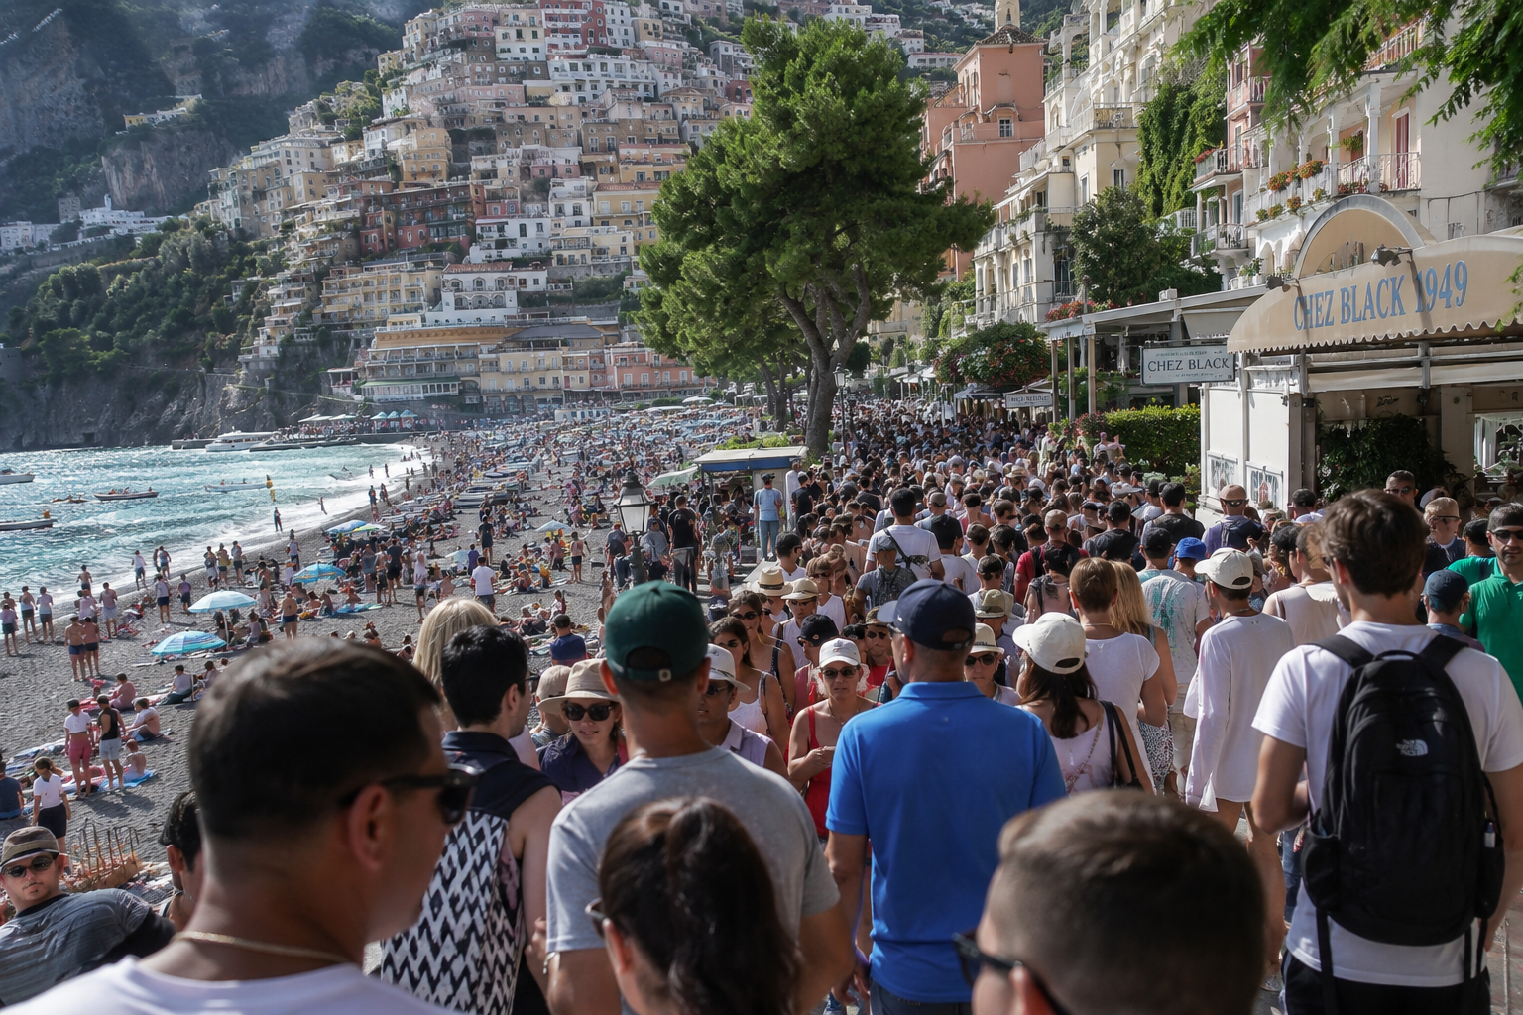
PERSPECTIVE
ISSUE 001 · OVERTOURISM
BEFORE YOU READ
Look and predict
The article is called “Overtourism.”
The subtitle asks: can a place be loved to death? What might that mean, and who might disagree?
Thousands of tourists crowd the streets and beach in Positano, Italy.
perspectiveenglish.com
Notes:
Show the photo and the subtitle. Students unpack the phrase “loved to death” and predict whose side the article takes. Return to their predictions after reading: the article deliberately refuses to take one.

Slide 5
PERSPECTIVE
ISSUE 001 · OVERTOURISM
VOCABULARY
Match the expressions to their meanings
1
a victim of its own success
A
to suffer the worst of it
2
bear the brunt of
B
a gain that involves a loss
3
hollow out
C
to make conflicting aims fit
4
D
hurt by what made it thrive
trade-off
5
E
to strip of its substance
reconcile
perspectiveenglish.com
Notes:
Students match each expression (1–5) to its meaning (A–E). All five appear in the article; ask students to use the context to confirm each match, not just memory. Answers on the next slide.

Slide 6
PERSPECTIVE
ISSUE 001 · OVERTOURISM
VOCABULARY
ANSWERS
How did you do?
1–D
2–A
3–E
4–B
5–C
a victim of its own success
bear the brunt of
hollow out
trade-off
reconcile
perspectiveenglish.com
Notes:
Reveal answers. Then ask for a fresh example of each from students’ own lives or news: a place that became a victim of its own success, a group that bears the brunt of a policy.

Slide 7

PERSPECTIVE
ISSUE 001 · OVERTOURISM
THE ARTICLE
Overtourism
Can a place be loved to death?
The world has never traveled more. For some of its most beloved places, that is precisely the trouble.
When Barcelona residents took water pistols to the streets, spraying bewildered visitors at sidewalk cafés, the protest looked playful. Its message was not. “Tourists go home,” read the banners, in a city whose economy leans heavily on the very people being soaked. It exposed an uncomfortable truth: some of the world’s most admired places have become victims of their own success . The harder question is who, exactly, the victims are.
Venice is the starkest example. Its historic center, home to fewer than 50,000 people, can receive twice that number of visitors on a single busy day. Venice has introduced an entry fee for some day-trippers, though critics argue a small charge is unlikely to deter anyone who has crossed an ocean. Amsterdam has restricted new hotels; on Mount Everest, climbers have queued for hours below the summit.
Yet every remedy involves trade-offs . Fees and caps may preserve a city’s character while turning it into a playground for the wealthy. Steering visitors toward lesser-known towns may simply spread the damage more thinly. Some argue the real task is to reconcile residents and visitors rather than choose between them. Whether that is achievable, or merely a comforting phrase, is far from clear.
The word “overtourism” suggests a simple problem of numbers, but numbers alone explain surprisingly little. What matters more is concentration, and who bears the brunt of it. The profits flow largely to airlines, hotel groups, and investors, while the costs—noise, congestion, soaring rents—fall on whoever happens to live nearby. As short-term rentals replace long-term tenants, historic centers can be quietly hollowed out , their bakeries and schools giving way to souvenir shops and luggage lockers.
If a city is shaped by everyone who passes through it, who should decide its future?
perspectiveenglish.com
Notes:
Students read the full article, or follow the audio. Set a purpose: where does the writer stand, and how can you tell? Point out that the final paragraph weighs remedies without endorsing one. End on the pull-quote question; it sets up the discussion. Give 5–6 minutes.

Slide 8
PERSPECTIVE
ISSUE 001 · OVERTOURISM
COMPREHENSION
True or False?
Judge what the article states or implies. Circle T or F.
1
T F
The protest had a built-in contradiction.
2
T F
Overtourism is mainly about numbers.
3
T F
Venice’s fee may be too small to work.
4
T F
The writer favors dispersing visitors.
5
T F
The article ultimately endorses reconciliation as the solution.
perspectiveenglish.com
Notes:
Inference check. Several answers are implied rather than stated, so students must point to the words that justify their choice. Answers and evidence on the next slide.

Slide 9
PERSPECTIVE
ISSUE 001 · OVERTOURISM
COMPREHENSION
ANSWERS
True or False?
1
TRUE
The protest had a built-in contradiction. — the economy “leans heavily on the very people being soaked.”
2
FALSE
Overtourism is mainly about numbers. — “numbers alone explain surprisingly little.”
3
TRUE
Venice’s fee may be too small to work. — a “small charge is unlikely to deter” visitors.
4
FALSE
The writer favors dispersing visitors. — it “may simply spread the damage more thinly.”
5
FALSE
The article ultimately endorses reconciliation as the solution. — whether it is achievable “is far from clear.”
perspectiveenglish.com
Notes:
Reveal with evidence. Pattern: T, F, T, F, F. On 3, note the doubt is attributed to critics, but the writer reports it without challenge. On 5, the writer presents reconciliation as one view and questions it.

Slide 10
PERSPECTIVE
ISSUE 001 · OVERTOURISM
DISCUSSION
Talk it through
1
Would you rather see a famous place packed with crowds, or not see it at all? Why?
2
Has a place you know been changed by outsiders? Who gained, who lost, and who decided?
3
Why do tourism’s profits and its costs so often land on different people?
4
Is Venice’s entry fee a sensible first step, or merely a symbolic gesture?
5
Should residents have the final say over their city’s future, even if visitors pay for it?
perspectiveenglish.com
Notes:
The heart of the lesson. Pairs or small groups. Don’t accept ‘it depends’ without asking: on what? Encourage: ‘That rests on the assumption that…’, ‘I’d concede that…, but…’, ‘The flaw in that argument is…’

Slide 11
PERSPECTIVE
ISSUE 001 · OVERTOURISM
CRITICAL THINKING
YOU ARE THE COUNCIL
Your town has 40,000 residents and three million visitors a year.
Test the assumption behind each measure. Pass only what you can defend, then identify the weakest assumption.
MEASURE
ITS SUPPORTERS SAY
BUT IT ASSUMES
PASS
A tourist tax
“Visitors should pay for the damage they cause.”
…the money will actually be spent repairing it.
☐
Cap the cruise ships
“Day-trippers bring crowds but spend little.”
…those visitors won’t simply arrive another way.
☐
Ban new hotels
“Fewer beds means fewer visitors.”
…visitors won’t just move into short-term rentals.
☐
Ban short-term tourist rentals
“Homes should house people, not tourists.”
…owners won’t simply sell or leave homes empty.
☐
Timed entry to the old town
“Spreading visitors out ends the overcrowding.”
…a ticketed old town is still a living neighborhood.
☐
Change nothing
“The market will find its own balance.”
…residents who leave can be replaced at no real cost.
☐
YOUR VOTE
Measures passed: _____ of 6 The assumption your council is least sure of: __________________________________
DISCUSS
1
Which measure you passed is most likely to backfire, and who would bear the brunt?
2
Compare with another council. Challenge their weakest assumption, then defend yours.
3
Which supporter’s claim is worded most persuasively? Does the framing hide a weak assumption?
perspectiveenglish.com
Notes:
The council task, advanced version. Groups of three or four. Read each claim and its hidden assumption aloud. Groups vote on each measure, then identify the weakest assumption. About twelve minutes, including the YOUR VOTE line and all three DISCUSS questions. Question 3 targets framing: the quoted claims use persuasive wording on purpose. Strong answers name what would prove an assumption wrong.

Slide 12
PERSPECTIVE
ISSUE 001 · OVERTOURISM
LANGUAGE IN CONTEXT
Complete & say each line
Complete each sentence with an expression from the box. Change the form if you need to.
reconcile
trade-off
hollow out
a victim of its own success
bear the brunt of
1
Every cap on visitors is a painful _______________ .
2
Local tenants usually _______________ rising rents.
3
Once a secret, the cove became _______________ .
4
Can a city ever _______________ the needs of residents and visitors?
5
Vacation rentals have _______________ the old town.
perspectiveenglish.com
Notes:
Students complete each sentence, changing the form where needed (5 needs a past participle). Then have them say each line aloud and extend it with a reason. Answers next slide.

Slide 13
PERSPECTIVE
ISSUE 001 · OVERTOURISM
LANGUAGE IN CONTEXT
ANSWERS
Complete & say each line
1
Every cap on visitors is a painful trade-off.
2
Local tenants usually bear the brunt of rising rents.
3
Once a secret, the cove became a victim of its own success.
4
Can a city ever reconcile the needs of residents and visitors?
5
Vacation rentals have hollowed out the old town.
perspectiveenglish.com
Notes:
Answers. Check form: 2 keeps “of”; 5 changes to the past participle “hollowed out.” Ask students to reuse two of the expressions in the discussion that follows.

Slide 14
PERSPECTIVE
ISSUE 001 · OVERTOURISM
SPEAKING CHALLENGE
ROLE · PROPOSE · DEFEND
Propose it. Defend it.
In small groups, build one position and hold it under pressure.
ROLE
You advise the mayor of a city that has become a victim of its own success.
PROPOSE
Recommend ONE policy. Say who will bear the brunt of it, and why that trade-off is worth making.
DEFEND
Present in two minutes. Another group then makes the strongest case against you. Answer it without abandoning your policy.
perspectiveenglish.com
Notes:
Groups get ~8 minutes to choose one policy and prepare. Each presents for two minutes; a second group rebuts for one minute; the first group answers. Judge on how well the answer meets the objection, not on the policy itself.

Slide 15
PERSPECTIVE
ISSUE 001 · OVERTOURISM
WRITING · YOUR OPINION
“The cure for overtourism is worse than the disease.” To what extent do you agree?
Write 200–250 words. Address the strongest opposing view before you answer it.
Take a clear position
Answer the strongest objection
Use the key expressions
perspectiveenglish.com | Model answer in the Teacher Guide
Notes:
Set as in-class writing or homework. 200–250 words. The opposing view must be stated fairly before it is answered. A model answer is in the Teacher Guide (Page 3).

Slide 16
PERSPECTIVE
THAT’S A WRAP
One fact. One perspective. Endless discussion.
Thanks for a great lesson. See you in Issue 002.
perspectiveenglish.com
© 2026 Perspective English. All rights reserved.
Notes:
Wrap up. Thank the class. Preview that Issue 002 continues the advanced series. Reminder: the worksheet, audio and teacher guide all live at perspectiveenglish.com.

