Slide 1
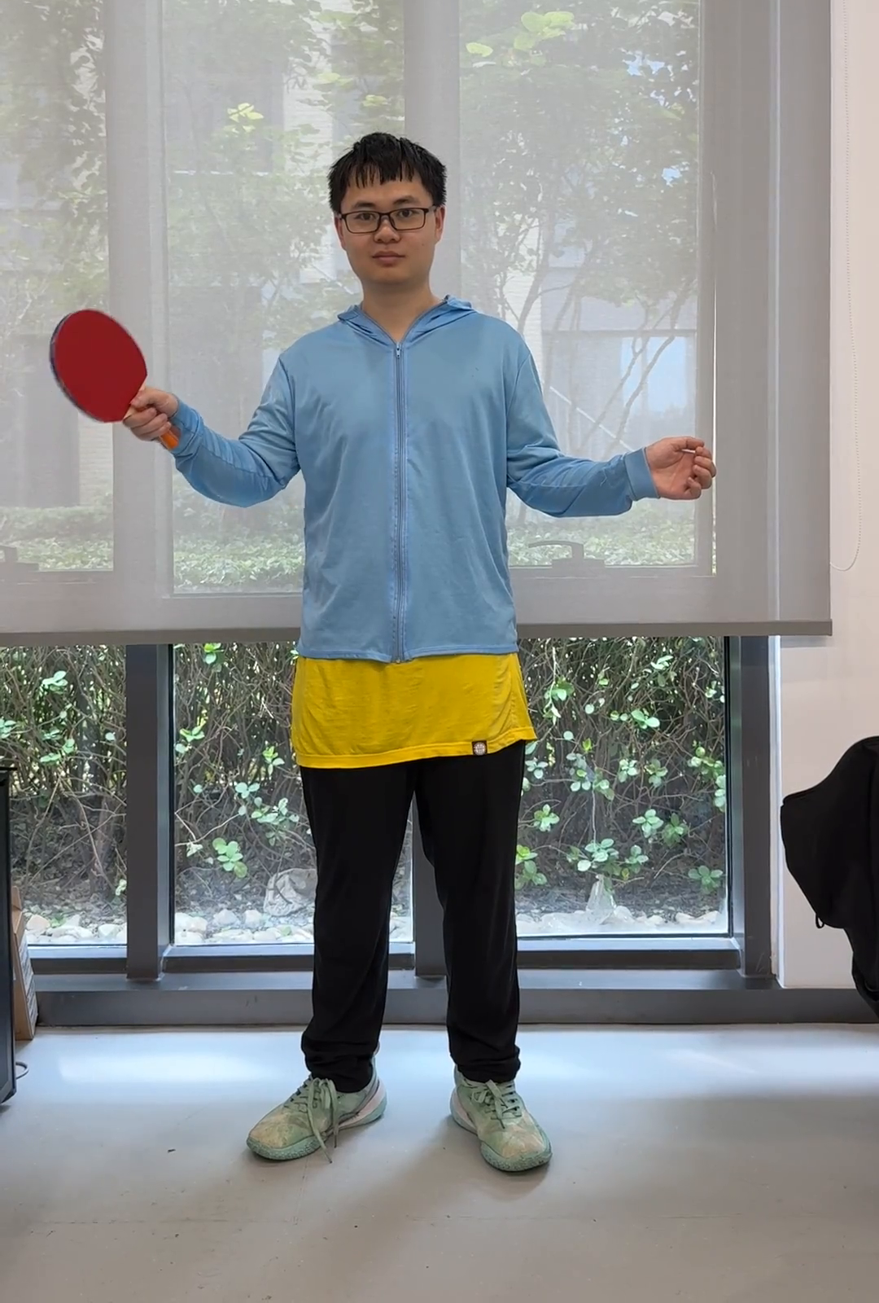
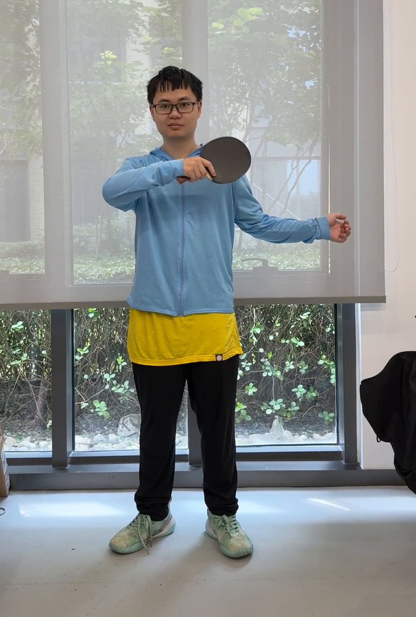
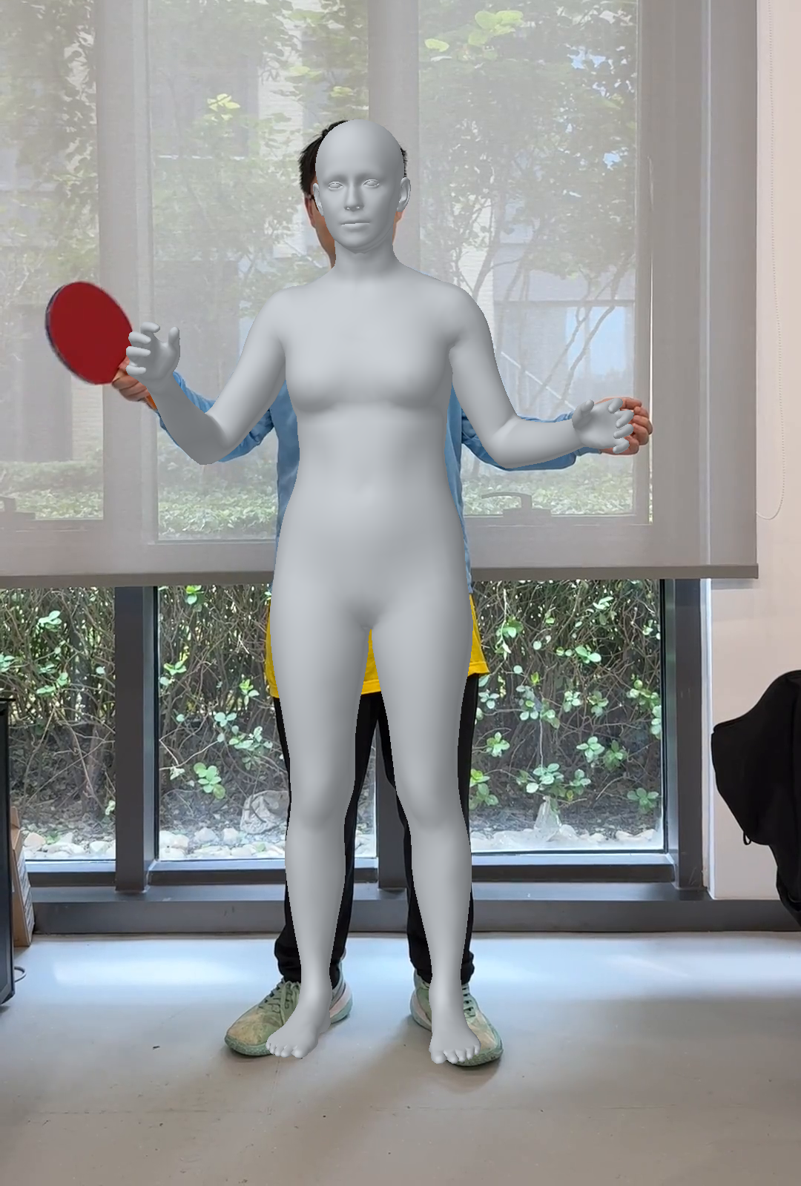
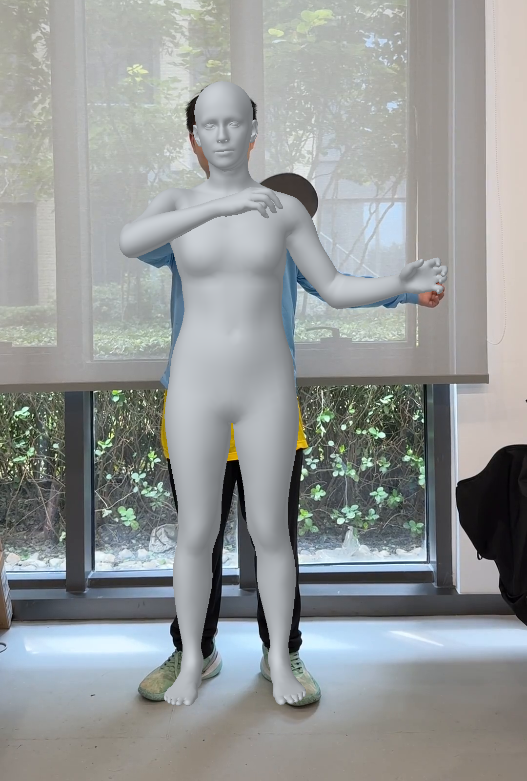
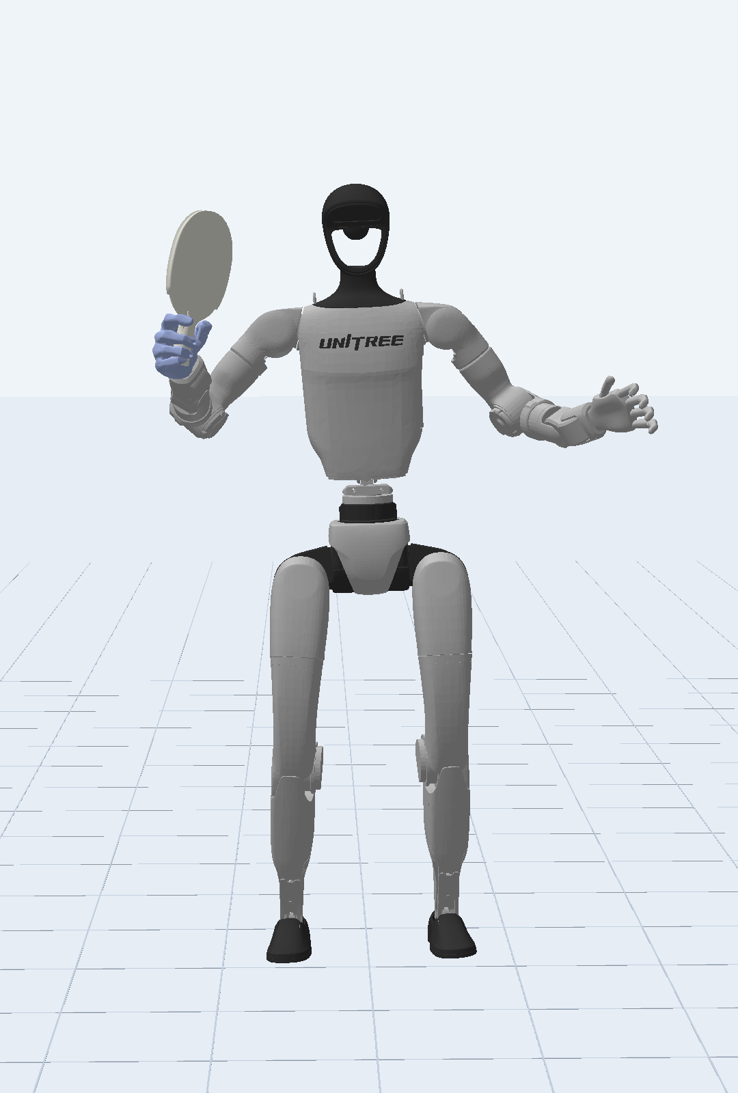
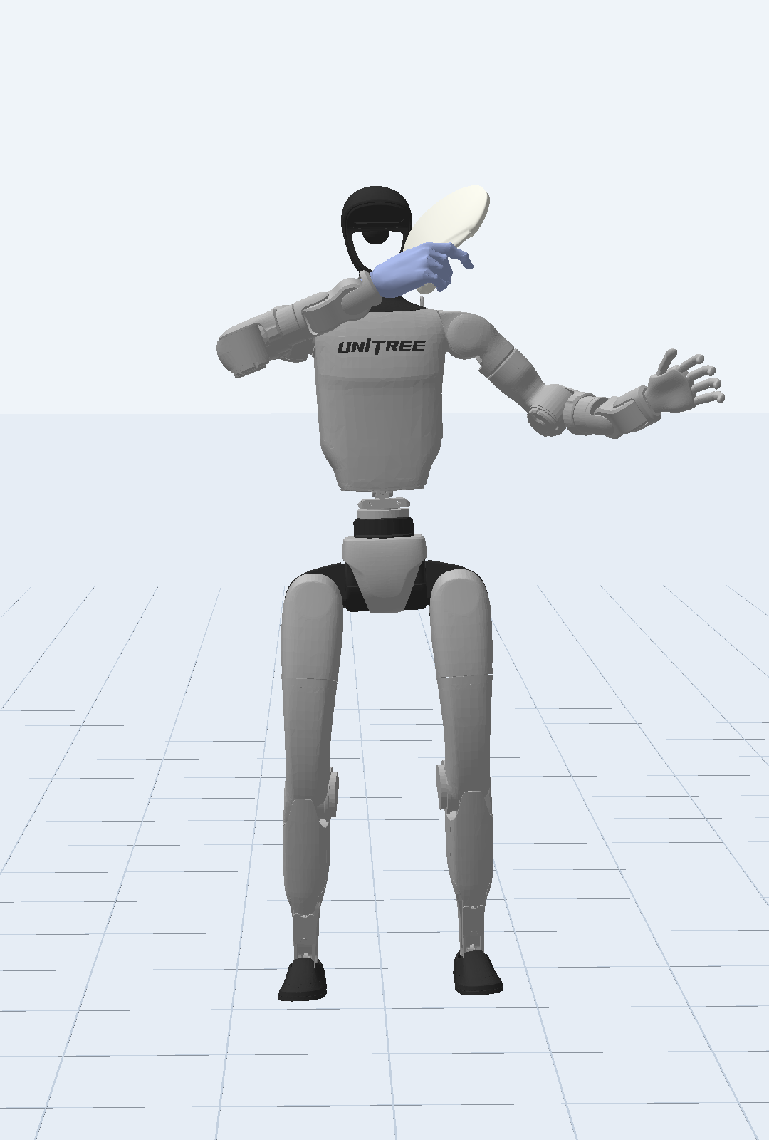
Reference Motion Processing
Human demonstrations to robot reference motion
Human Video
Reconstructed Human
Retargeted Robot
Reconstruction
Retargeting
GVHMR
GMR
Forehand
Backhand
Forehand
Backhand
Forehand
Backhand
Post-processing & alignment → Reference NPZ
Notes:
Editable version for YHL. Six separate PNG pictures are embedded without changing their bytes. All 16 labels are native text boxes; the 3 panels and 2 arrows are native PowerPoint shapes. Use the Selection Pane to select objects by their descriptive names. To insert the complete diagram into another presentation: select all slide objects, copy and paste, then group and resize proportionally if needed. Ungroup to edit individually. This slide retains the original 10:3 figure aspect ratio. Dataset: 20260806_mqy_capture. F7: forehand clip 010, video/SMPL-X/pre-align frame 34, aligned frame 31. B7: backhand clip 011, video/SMPL-X/pre-align frame 35, aligned frame 31. Robot panels are PyBullet renders of the matching NPZ poses.

