Slide 1
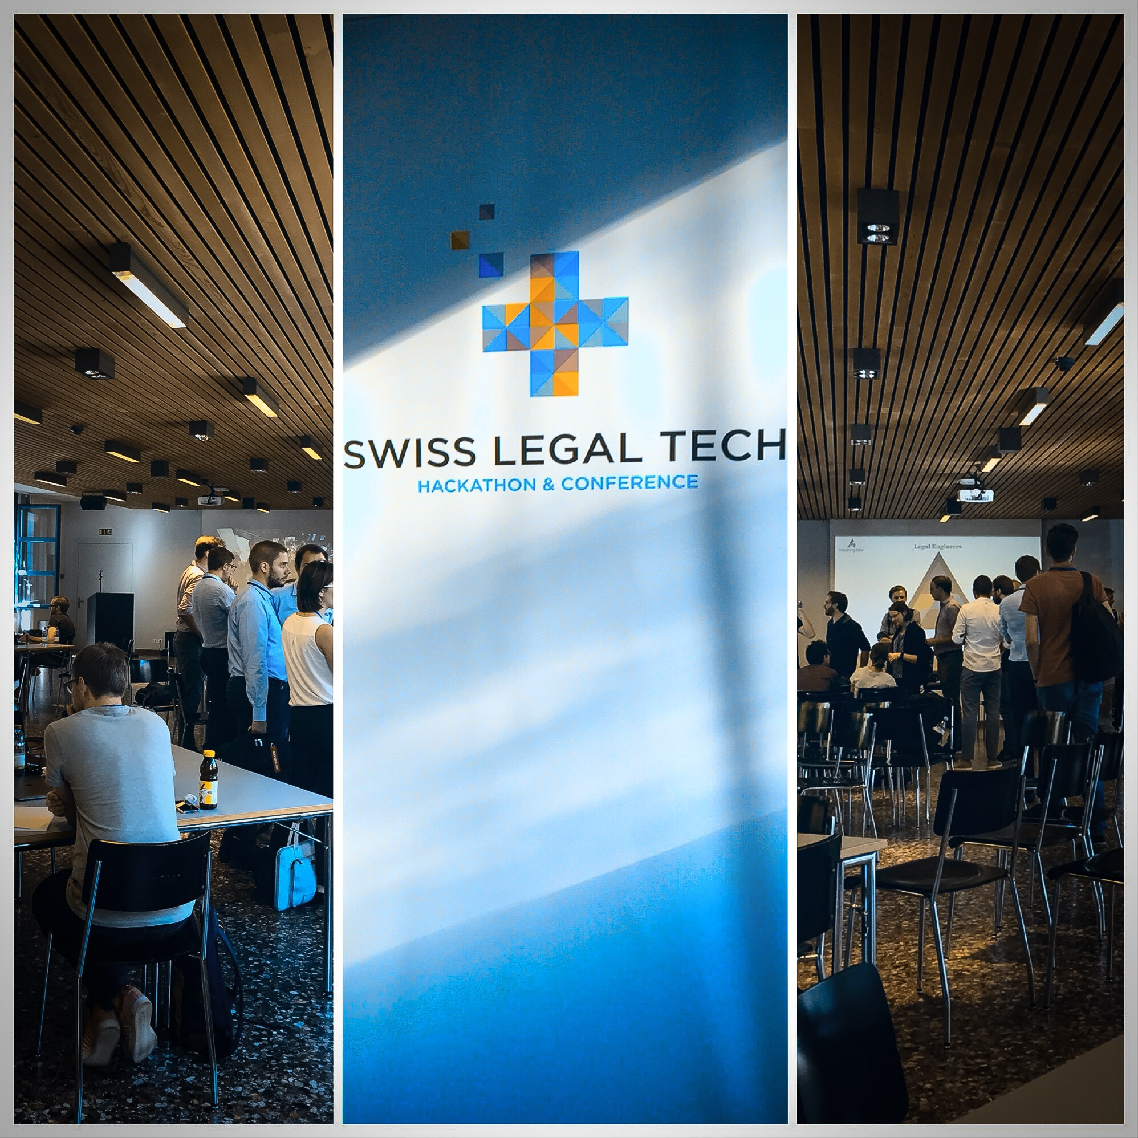

Slide 2
Dealing with
large & long-term cases

Slide 3





Case file

Slide 4


CaseTravel
your timeline for
smart navigation
in legal cases

Slide 5



Minimum viable product features
Upload a case and get a timeline as smart overview
Look for data categories & their values
Tag important keywords

Slide 6



Forecast
Automatic trigger of further events (e.g. generation of documents)
Point to potential deadlines & automatic calculation
Open laws and decisions in the web by click
Adding personal notes to events & sharing them

Slide 7
CaseTravel
your timeline for
smart navigation
in legal cases

