Slide 1


Slide 2


Slide 3
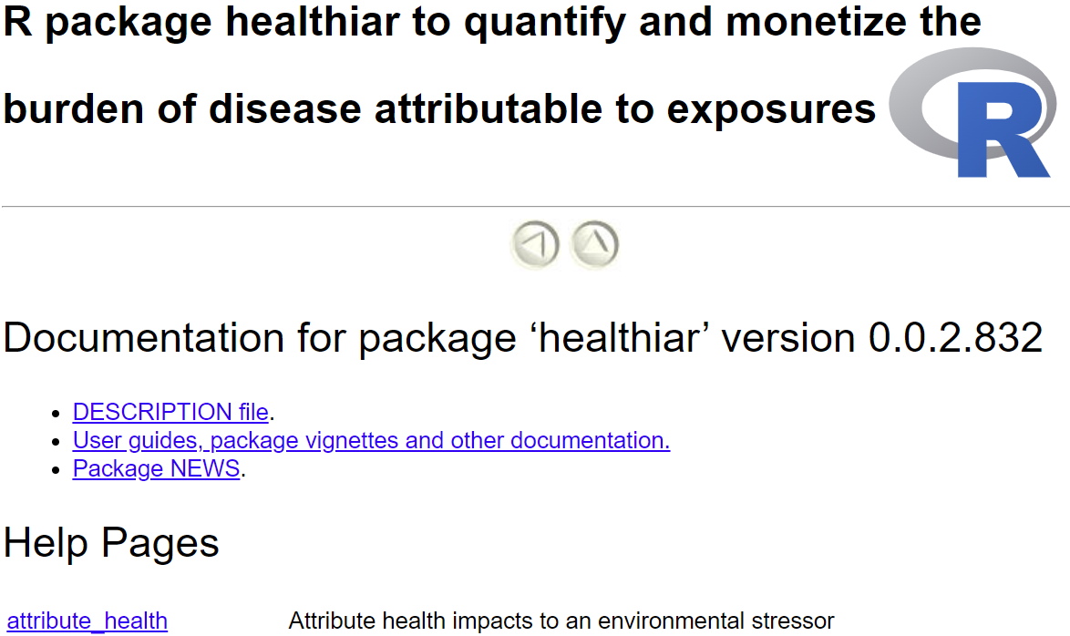
Find here the intro vignette
= Function documentations
…
…

Slide 4
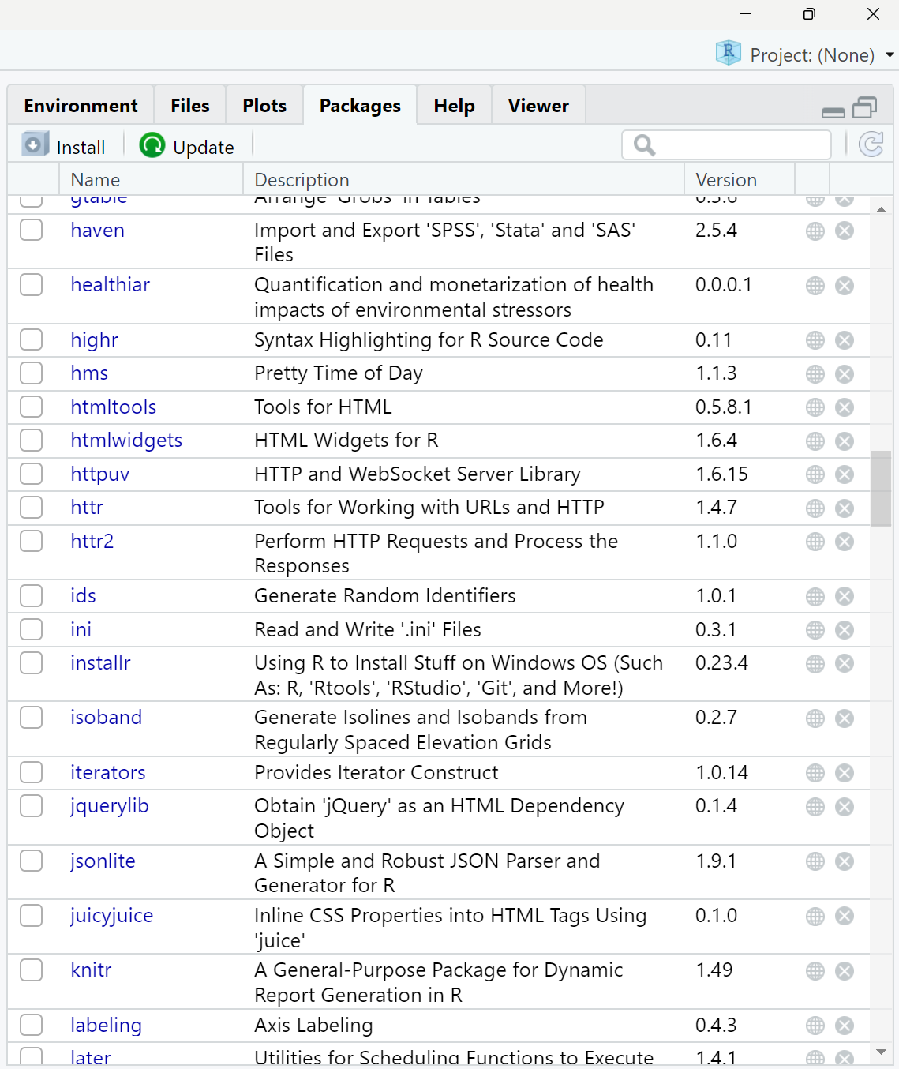
1
2

Slide 5
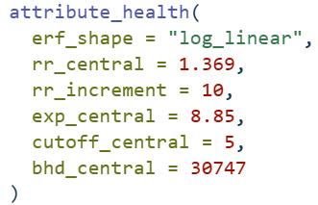
results_pm_copd
function call
function name
function
arguments
argument names
input values

Slide 6
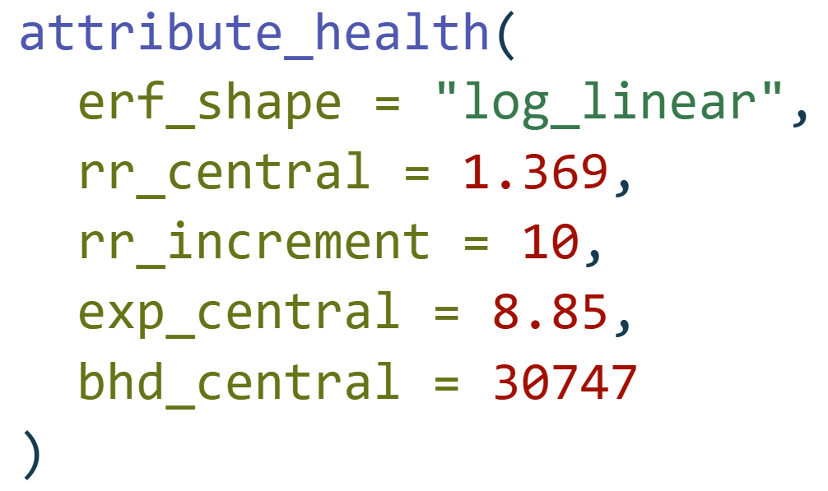
Function call
Function name
attribute_health(
erf_shape = "log_linear",
rr_central = 1.369,
rr_increment = 10,
exp_central = 8.85,
bhd_central = 30747
)
Function arguments
Input values

Slide 7



Exposure response function
Population exposure
D
Population attributable fraction
Disease-specific burden of disease*
* YLL, YLD, DALY, # deaths, # cases, …
Attributable
burden of disease

Slide 8
Exposure response function
Population exposure
Number of cases due to exposure

