Slide 1


Slide 2


Slide 3
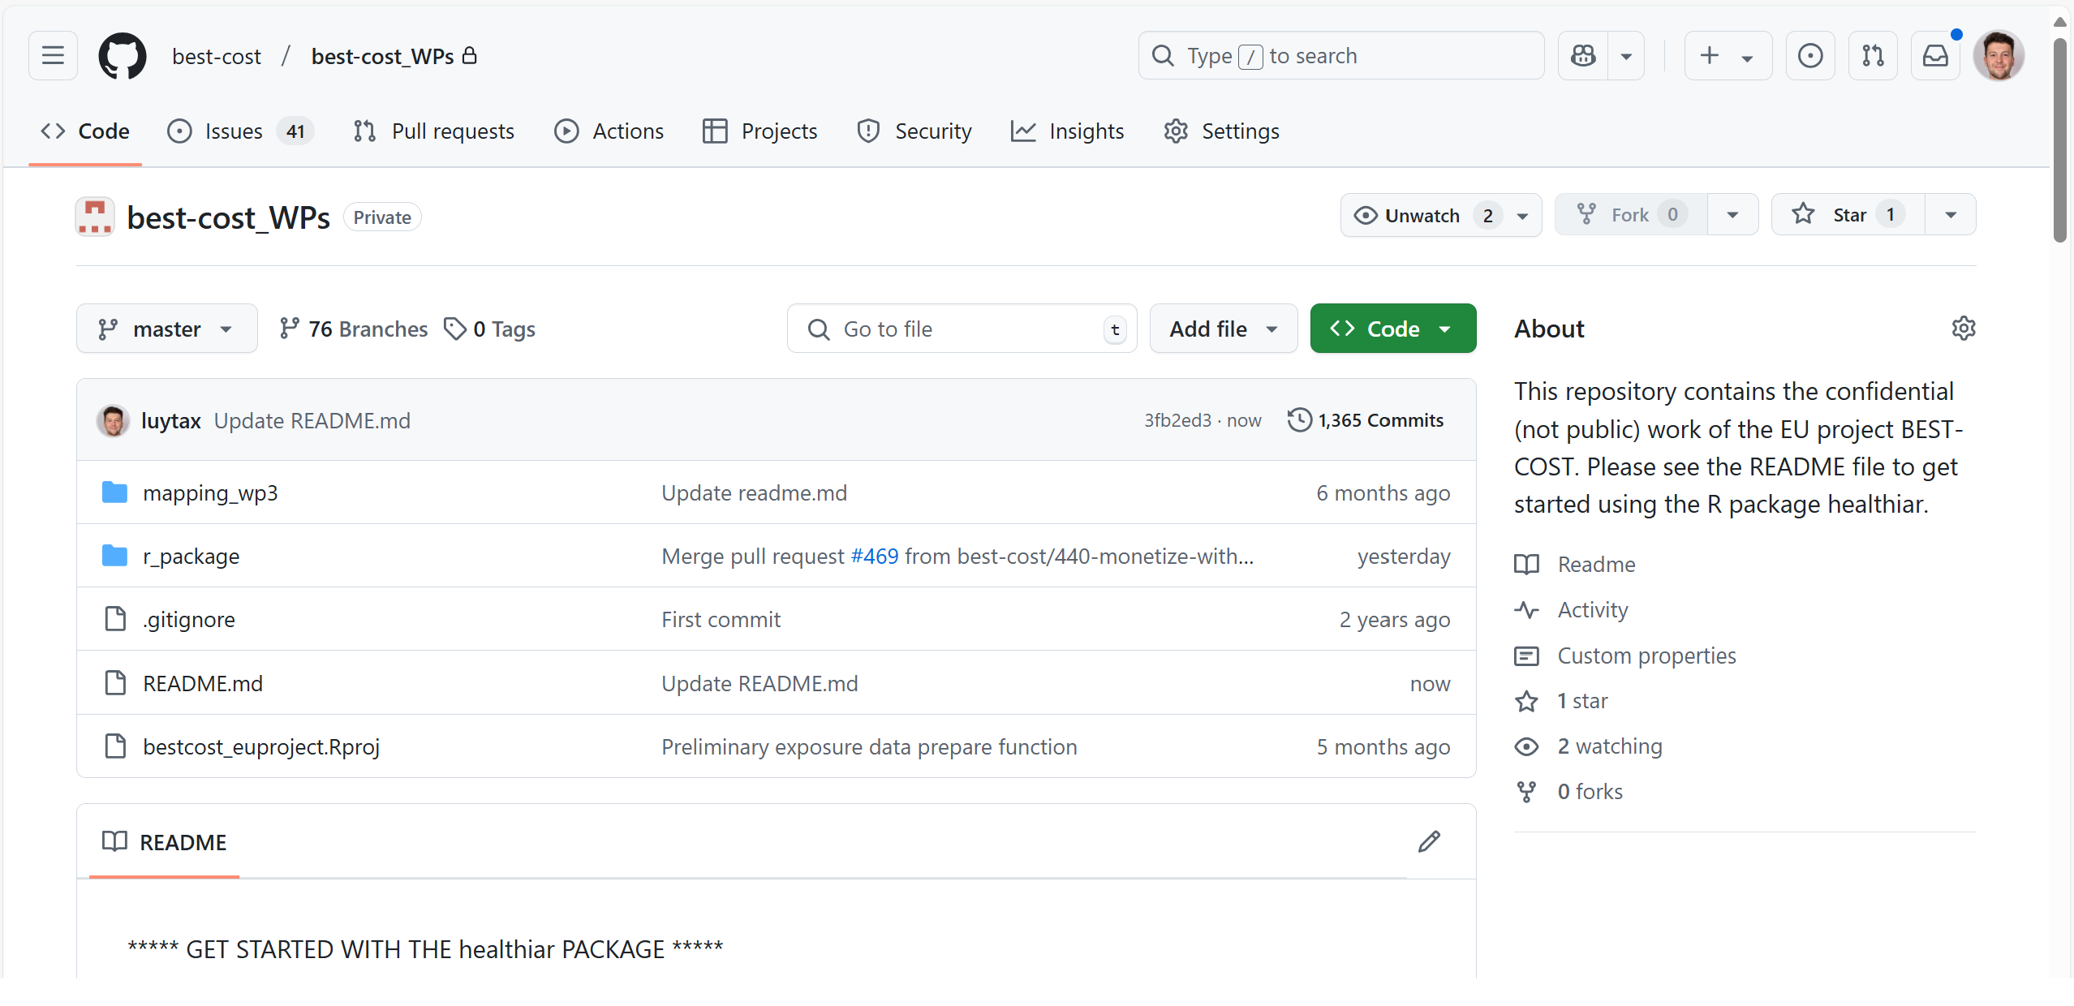

Slide 4
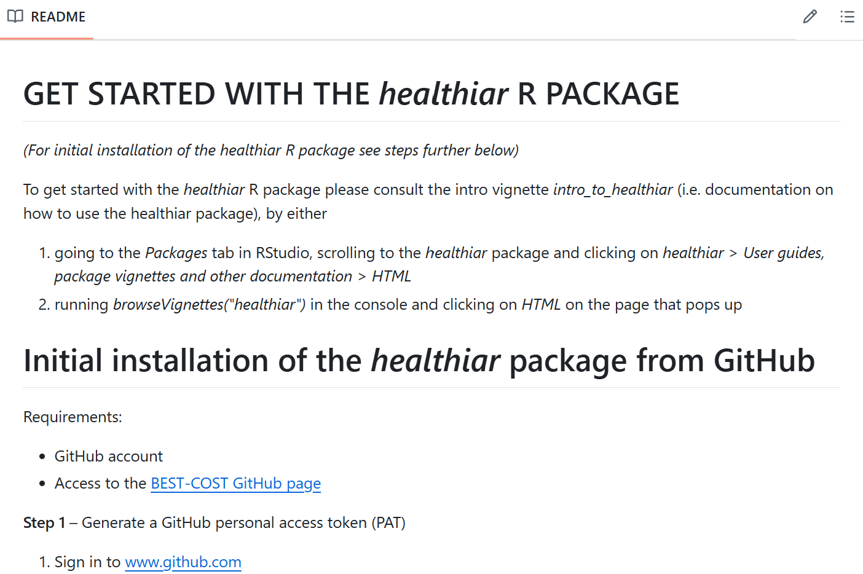
…

Slide 5
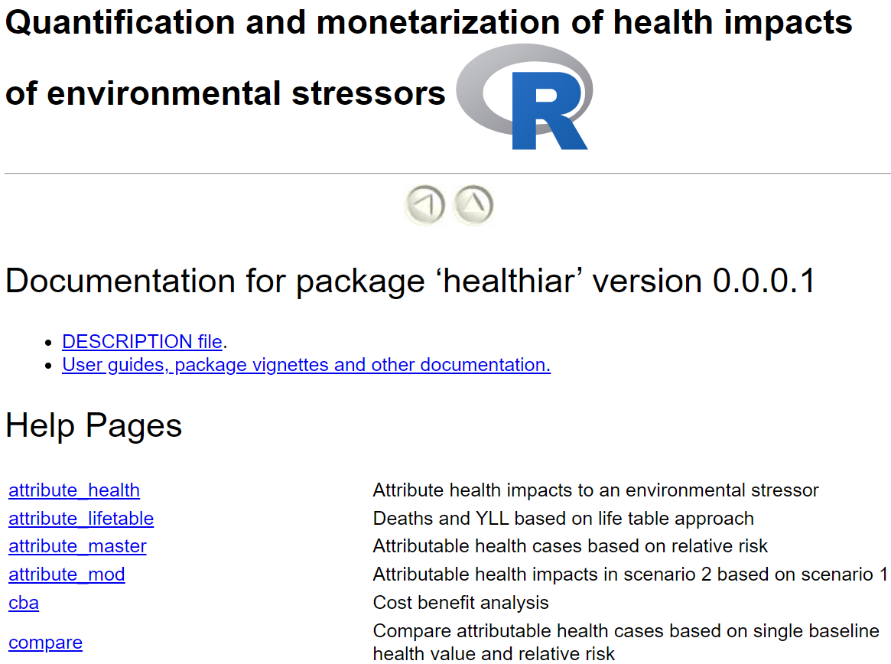
Find here the intro vignette
= Function documentations
…
…

Slide 6
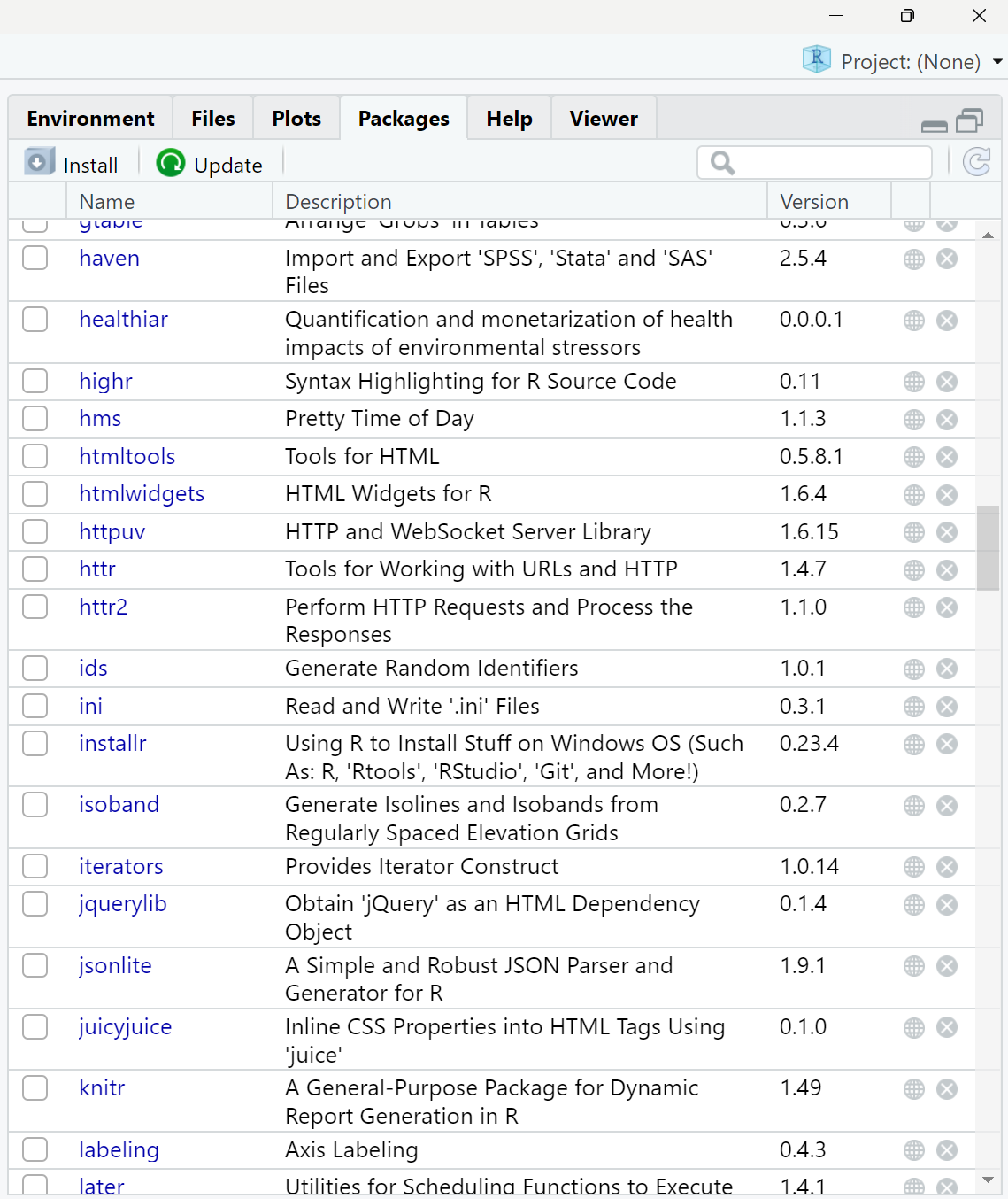
1
2

Slide 7
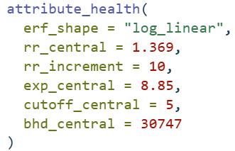
function call
function name
function
arguments
argument names
input values

Slide 8



Exposure response function
Population exposure
D
Population attributable fraction
Disease-specific burden of disease*
* YLL, YLD, DALY, # deaths, # cases, …
Attributable
burden of disease

Slide 9
Exposure response function
Population exposure
Number of cases due to exposure

