Slide 1
External services integration
Marco Pereira

Slide 2
District Health Information Software 2 (DHIS2) as the largest Health management information system
Platform for collecting, analyzing, visualizing and sharing data
Improve tracking and reporting responding to disease outbreaks
National real-time perfomance monitoring e.g. for nationwide immunization program

Slide 3
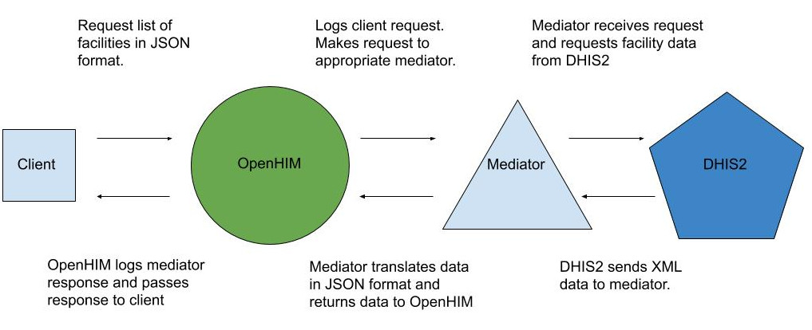
DHIS2 integration with open Health Information Mediator (openHIM)
Mediator receives request and posts data to DHIS2
Open Function (OpenFN)
Image altered from: http://openhim.org/docs/tutorial/mediators/orchestrator

Slide 4
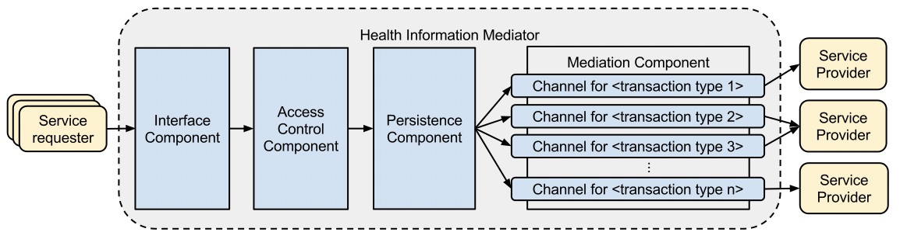

OpenHIM consists of following components
Crichton et al. (2013) An Architecture and Reference Implementation of an Open Health Information Mediator: Enabling Interoperability in the Rwandan Health Information Exchange

Slide 5
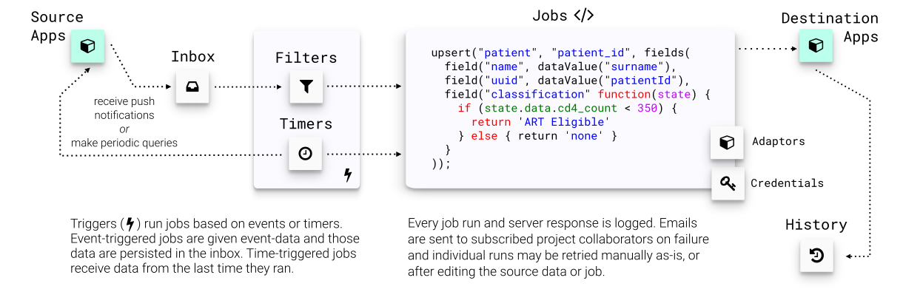
How the Open function (OpenFN) platform works
Image altered from https://www.openfn.org/how

Slide 6
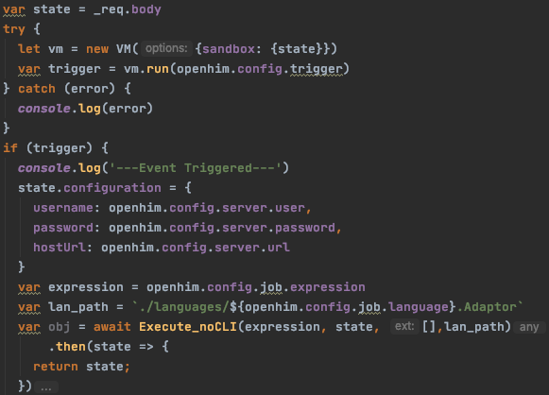
Manipulate incoming message to be on openFN terms
Modify incoming message to include credentials for the endserver as expected by openFN functions. Check whether the given trigger by the user is true to procceed with the call.

Slide 7
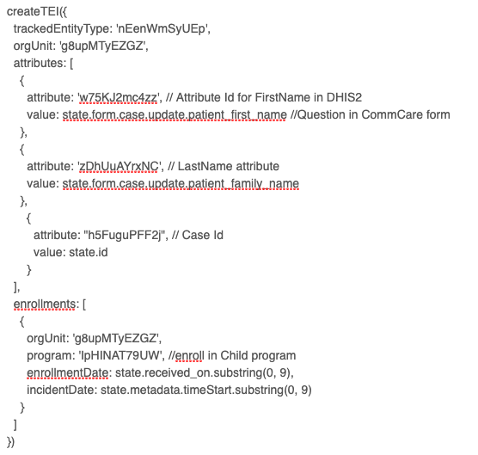
Performing an action in the end server
Use function specific to the end server e.g. dhis2 to perform an action in the same and the expression provided by the user. This is the corresponding of using the expression, language adaptor and credentials for a job in the OpenFN platform

Slide 8
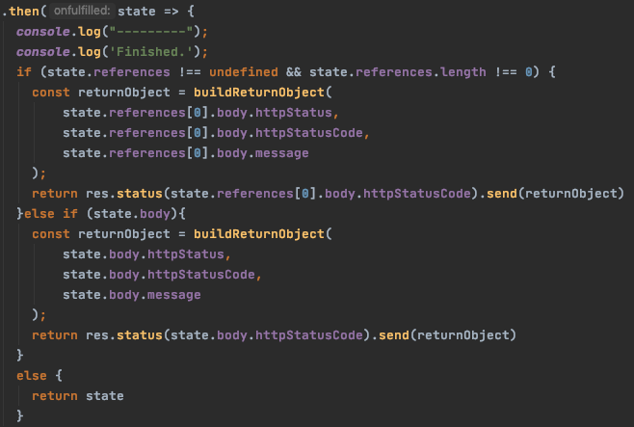
Send response after action was performed
After performing the request to the external service, the reponse is sent back.
In case an error occurs, the error is logged and the corresponding reason for the error is sent as respond.

Slide 9
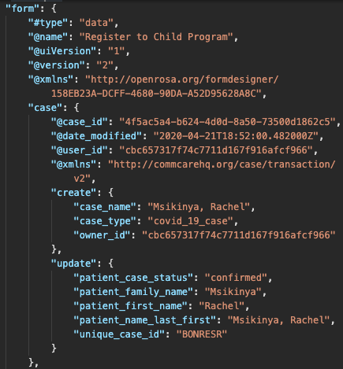
Mockup data to be imported to the server
@name
Patient_family_name
Patient_first_name
https://github.com/OpenFn/dhis2-demo/blob/master/sample_data/commcare_form.json

Slide 10
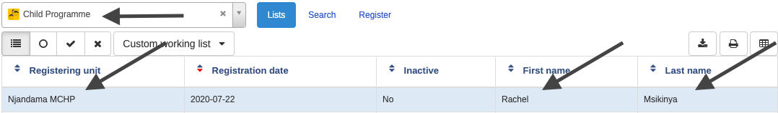
Entry example in DHIS2 as the result

Slide 11
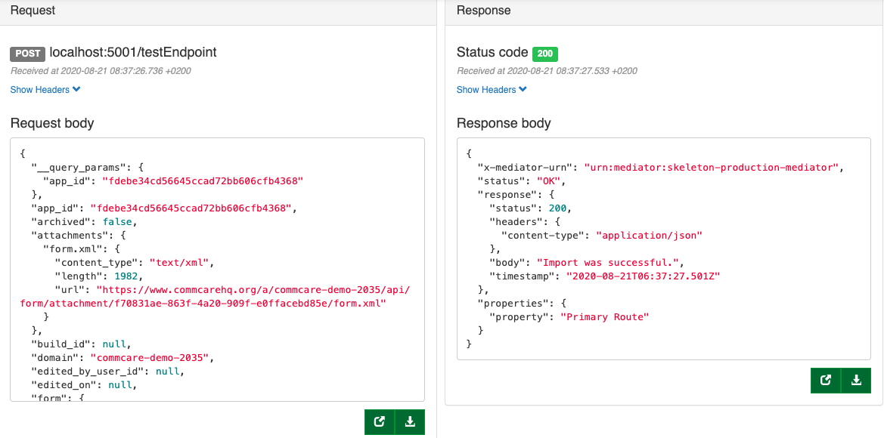
Transaction in the OpenHIM platform

Slide 12
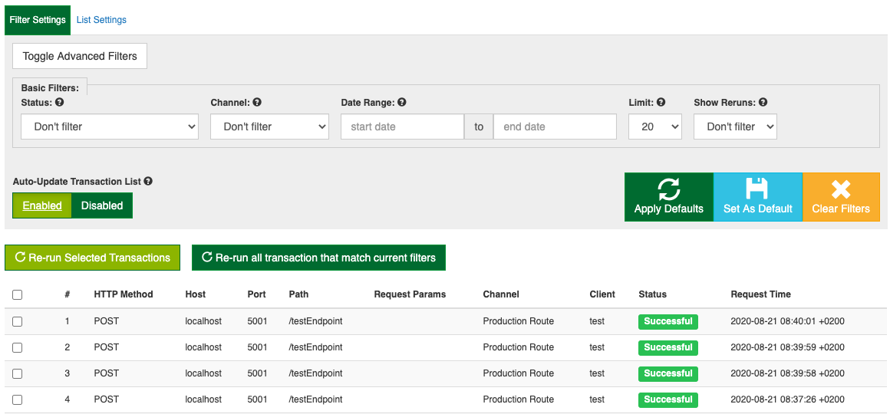
Every transaction is stored in the platform

Slide 13
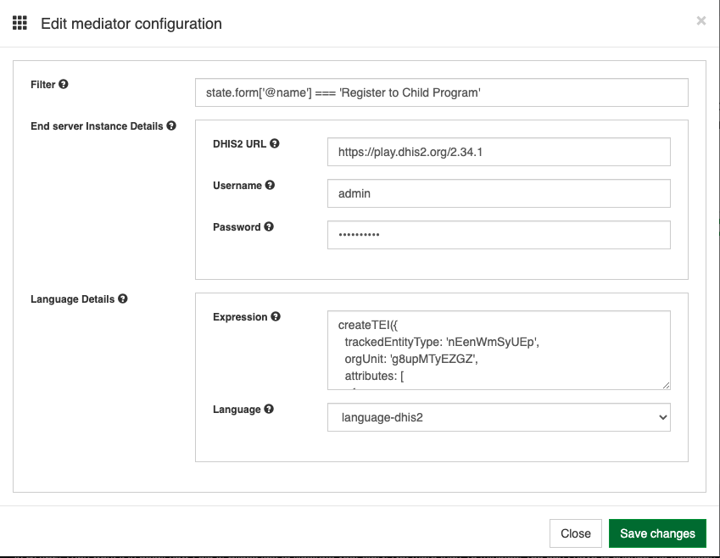
Generalisation of the mediator for other tasks
Credentials provided in platform
Multiple languages
Expression
Drop-down: Names of the languages in the language folder

Slide 14
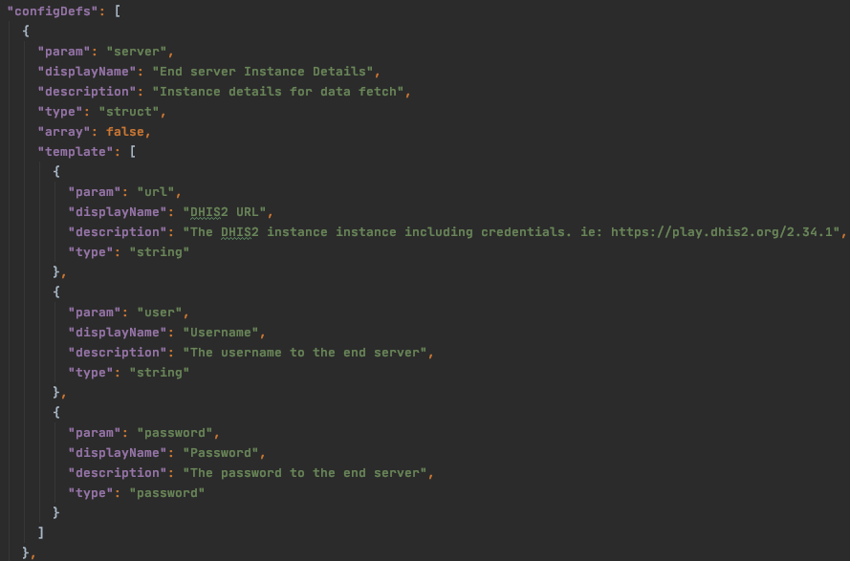
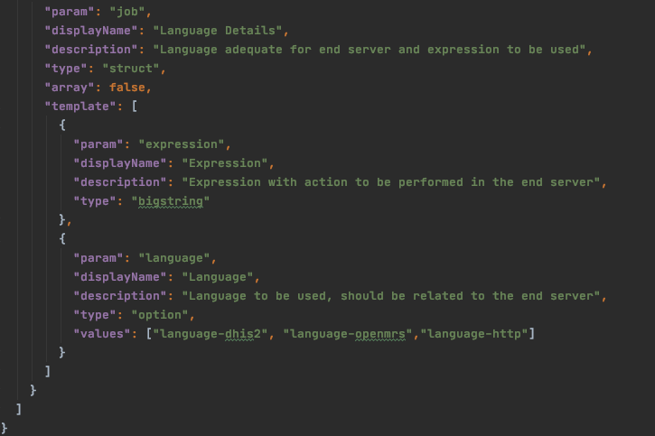
Configuring the mediator

Slide 15
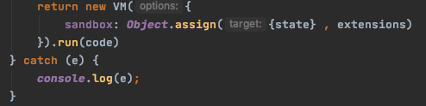
Using the execute function from the language adaptor
Uses most of the original OpenFN function “execute”, without CLI
Uses languages e.g. language-dhis2 as extension
Creates virtual machine with only state and extensions in the environment to reduce risks

