Slide 1
External services integration
Marco Pereira

Slide 2
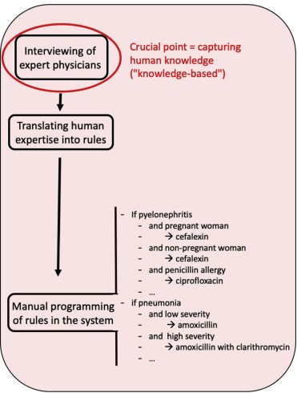
Clinical decision support systems to guide clinicians
Expert systems
Requires rules
Very strict
Improve diagnosis and treatment

Slide 3
Moving towards an open source mediator
Open Function (OpenFn)
Used by many organisations
Ideally:
Cost burden for Low and Middle Income Countries (LMIC)
No flexible open-source solution
Generalization

Slide 4
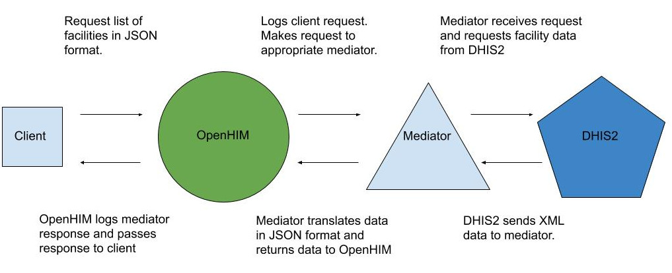
DHIS2 integration with open Health Information Mediator (openHIM)
Mediator receives request and posts data to DHIS2
Open Function (OpenFN)
Image altered from: http://openhim.org/docs/tutorial/mediators/orchestrator

Slide 5
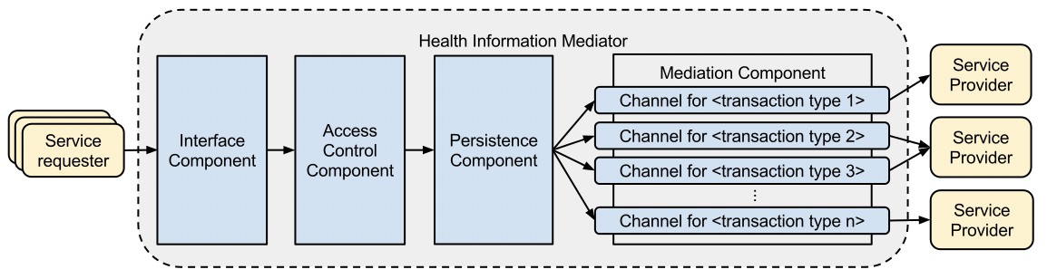

OpenHIM consists of following components
Crichton et al. (2013) An Architecture and Reference Implementation of an Open Health Information Mediator: Enabling Interoperability in the Rwandan Health Information Exchange

Slide 6
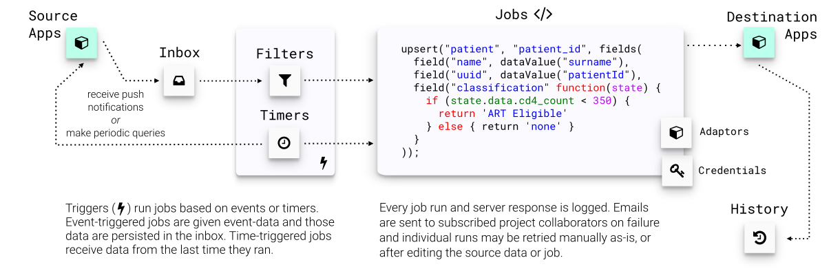
How the Open function (OpenFN) platform works
Image altered from https://www.openfn.org/how

Slide 7
District Health Information Software 2 (DHIS2) as Health management information system
Platform for collecting, analyzing, visualizing and sharing data
Management of education
Logistics
Improve tracking and reporting responding to disease outbreaks
National real-time perfomance monitoring e.g. for nationwide immunization program

Slide 8
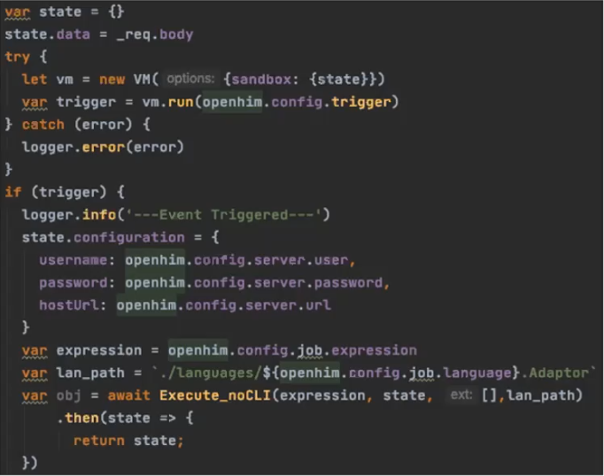
Manipulate incoming message to be on openFN terms
Wrap the incoming message with data to integrate OpenFn functions. Check whether the given trigger by the user is true to procceed with the call. Modify incoming message to include credentials for the end server as expected by OpenFn functions

Slide 9
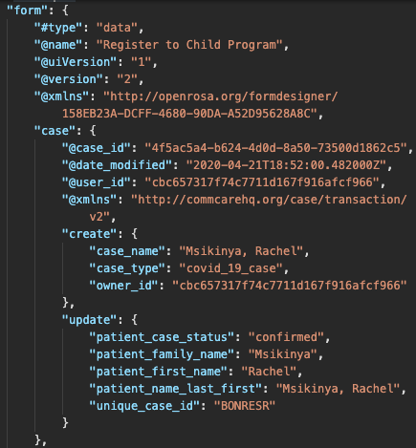
Mockup data to be imported to the server
@name
Patient_family_name
Patient_first_name
https://github.com/OpenFn/dhis2-demo/blob/master/sample_data/commcare_form.json

Slide 10
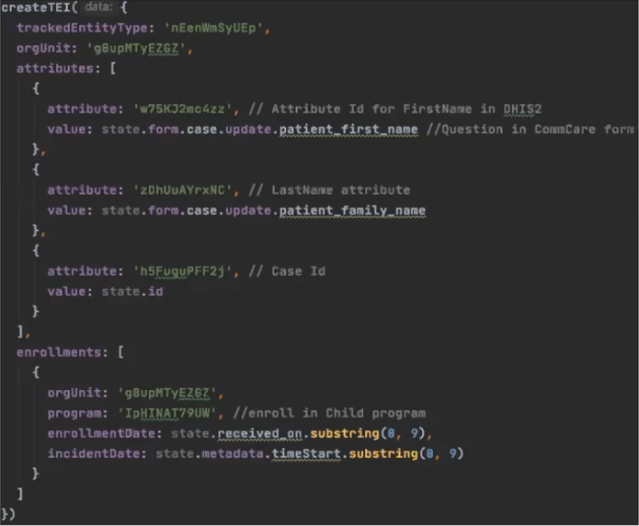
Defining what to perform in the end server
Use function specific to the end server e.g. dhis2 to perform an action in the same and the expression provided by the user. This is the corresponding of using the expression, language adaptor and credentials for a job in the OpenFN platform

Slide 11
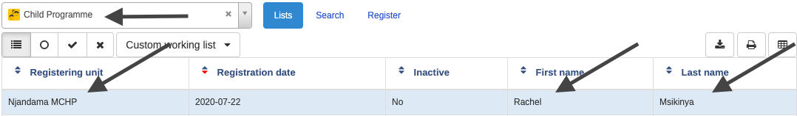
Entry example in DHIS2 as the result

Slide 12
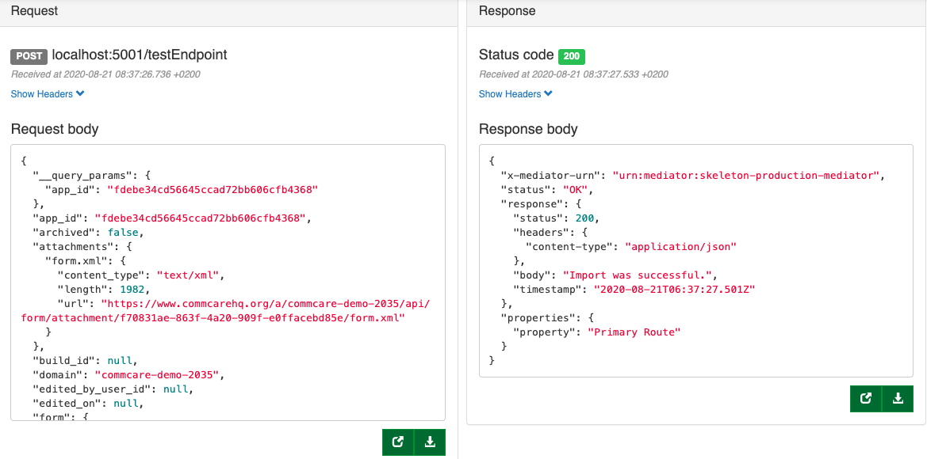
Transaction in the OpenHIM platform

Slide 13
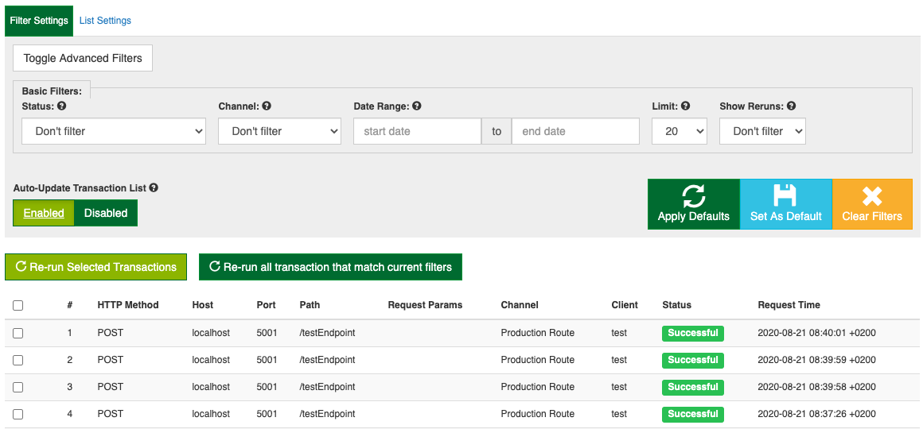
Every transaction is stored in the platform

Slide 14
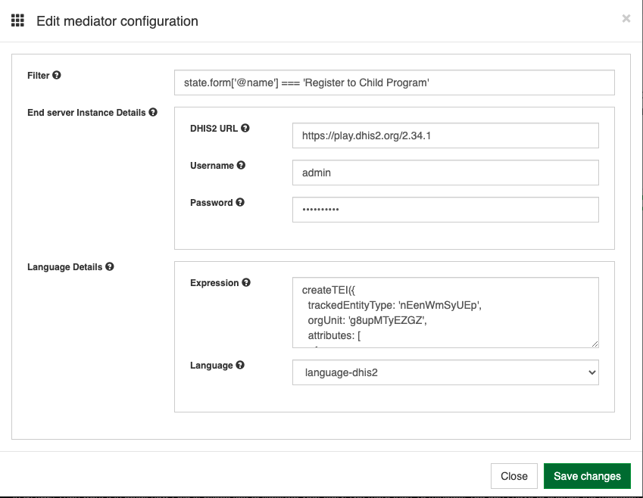
Generalisation of the mediator for other tasks
Filter
Credentials provided in platform
Multiple languages
Expression

Slide 15
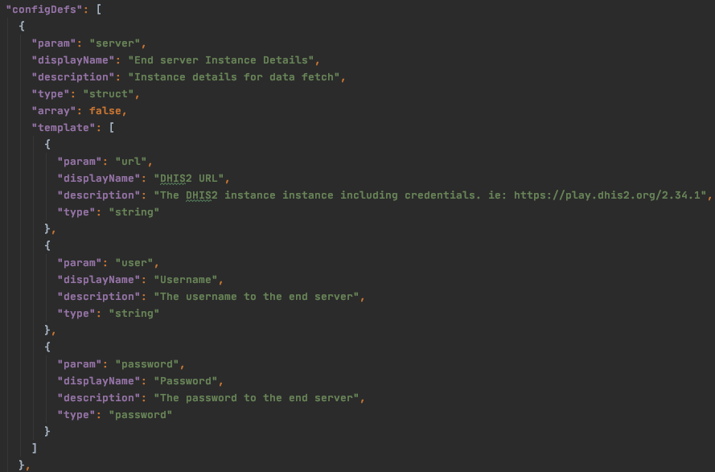
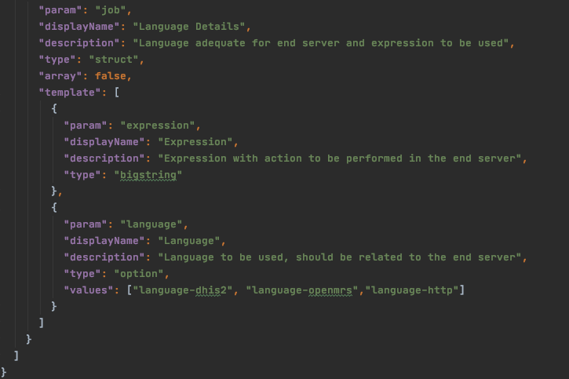
Configuring the mediator

Slide 16
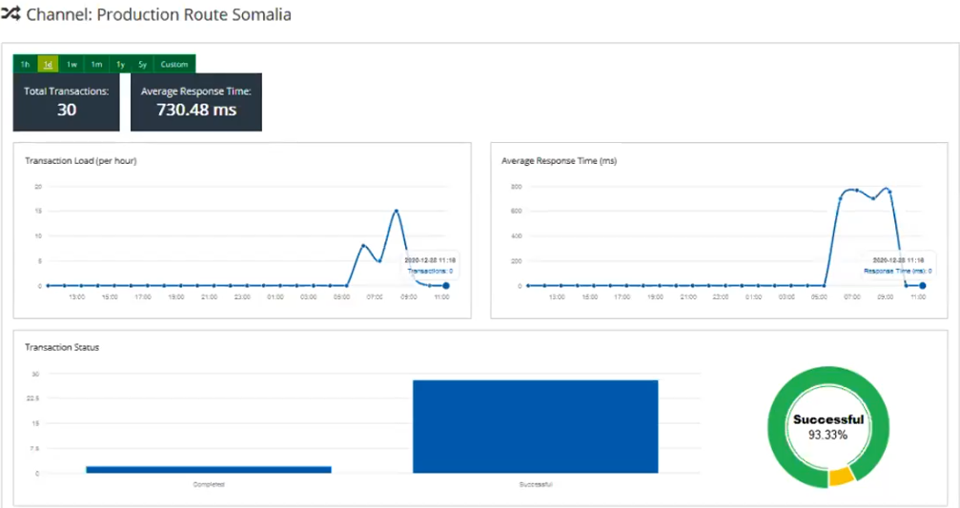
Mediator is being used in production

Slide 17
EHR systems evaluation
Eight assessed in total
Six were discarded based on defined criteria
Two were deployed
Select the best fit with less migration steps

Slide 18
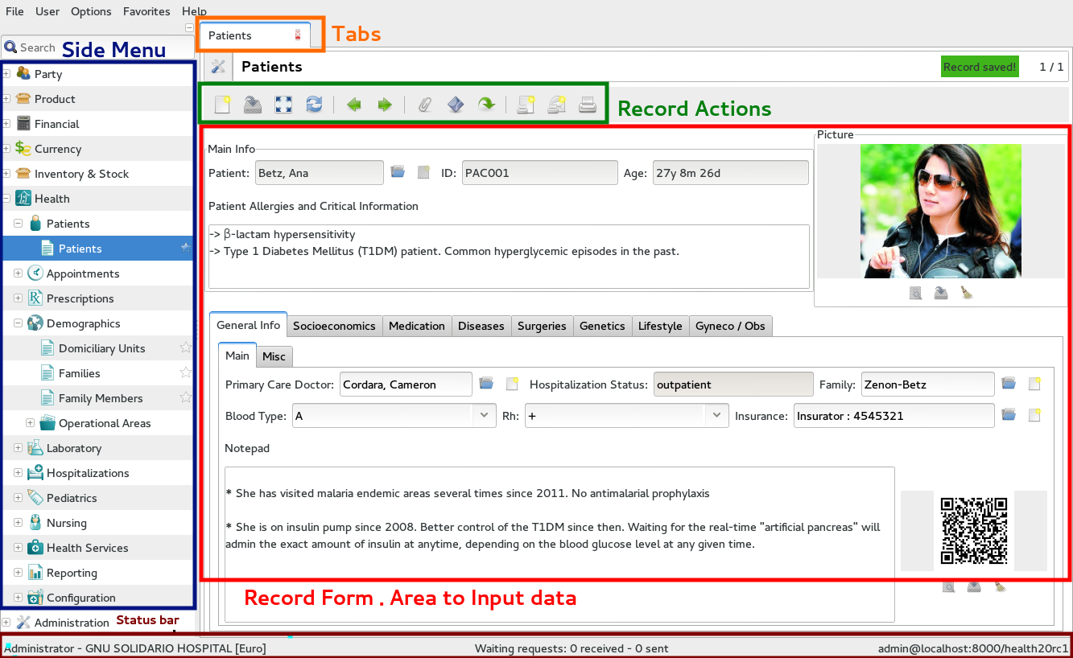
Gnu assumes internet connection
Large amounts of data collected
Multiple health records open
LIMS
Offline with workaround
Genetic data
Neglected Tropical diseases
Stock management
Modular
https://en.wikibooks.org/wiki/GNU_Health/First_Steps

Slide 19
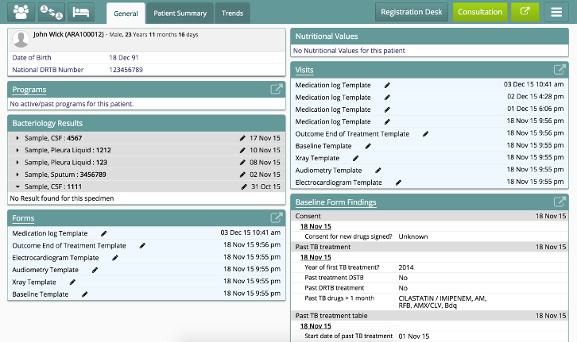
Bahmni as a hospital system
Has OpenMRS, Odoo and OpenELIS as components
Can integrate PACS
Modular
Offline mode with module

Slide 20
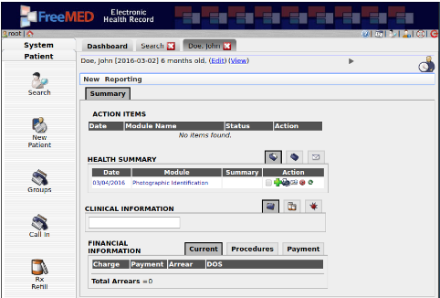
Low development activity on Freemed
Seems abandoned
Lack of documentation
Modular
No offline possibility
A. Syzdykova et al. (2017), ‘Open-Source Electronic Health Record Systems for Low-Resource Settings: Systematic Review’

Slide 21
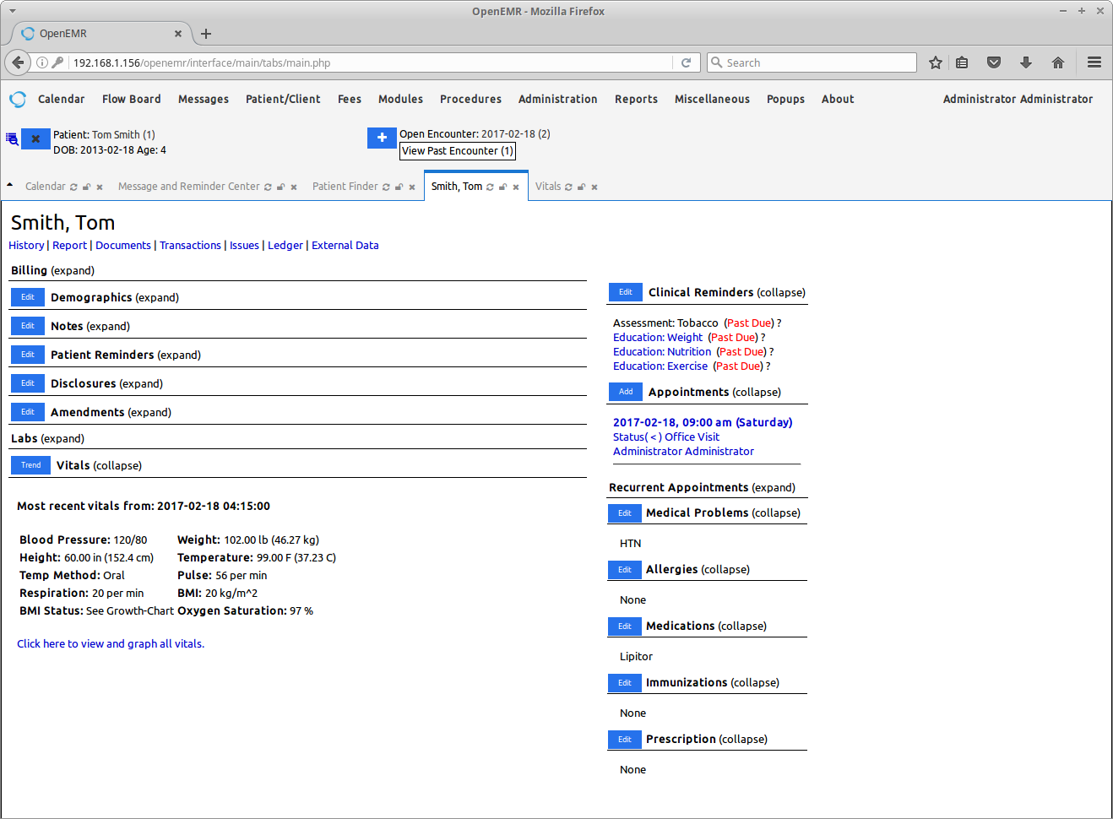
OpenEMR system without offline capability
Easy to install and off-the-shelf solution
Low flexibility
Modular
No offline capability

Slide 22
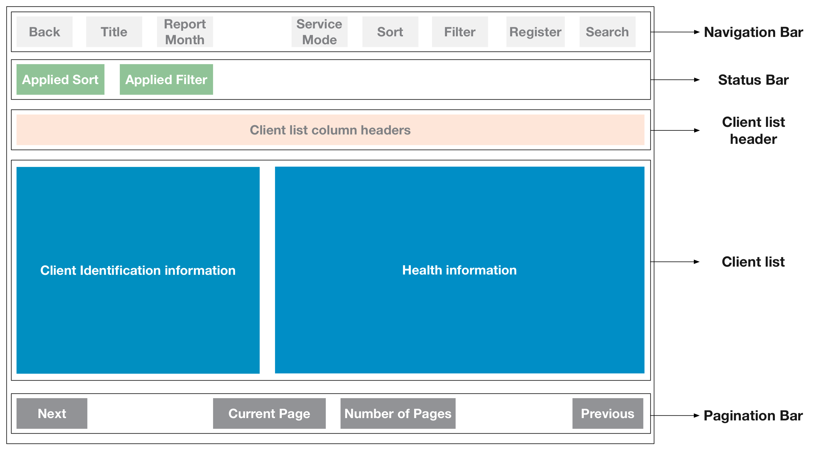
OpenSRP for internet scarcity
Complete offline functionality
Modular
New APK every time there is a change and need to be distributed
Integrates DHIS2 and OpenMRS
https://smartregister.atlassian.net/wiki/spaces/Documentation/pages/7274503/Smart+Registers

Slide 23
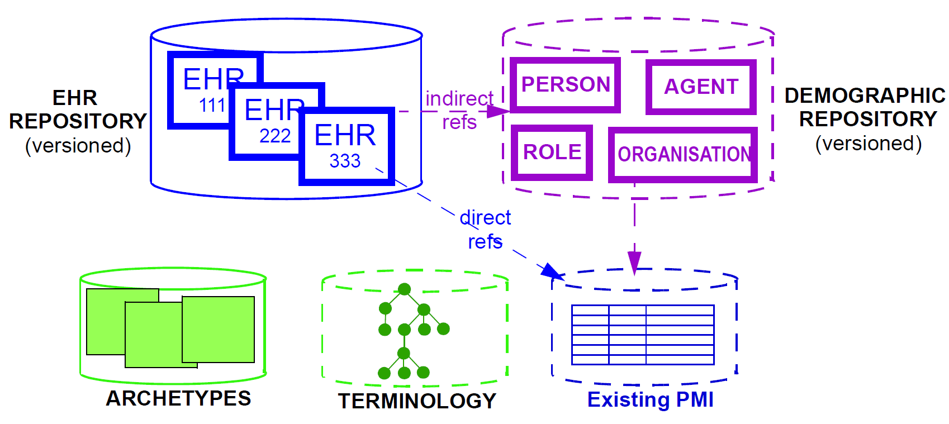
OpenEHR provides specifications and standards
Not off-the- shelf solution
Separates technical and domain expert
Supports interoperability
Based on archetypes and forms
https://www.openehr.org/

Slide 24
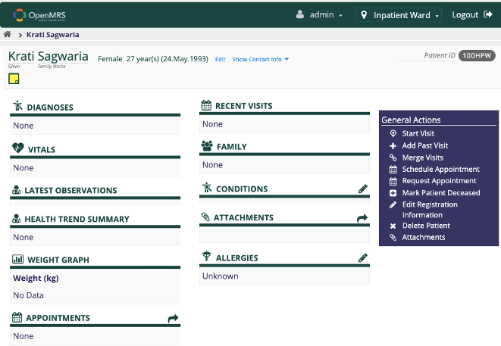
OpenMRS as an established system
Flexible
Used by many other systems
Modular
Patients can log in, if configured
Offline android client
Stock Management

Slide 25
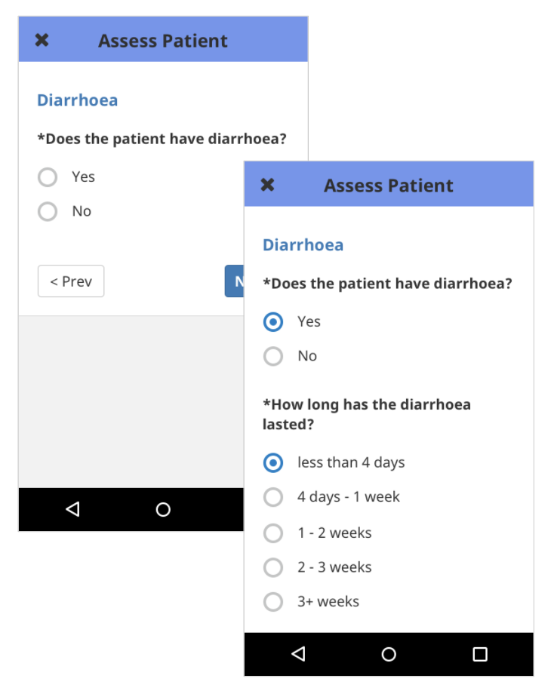
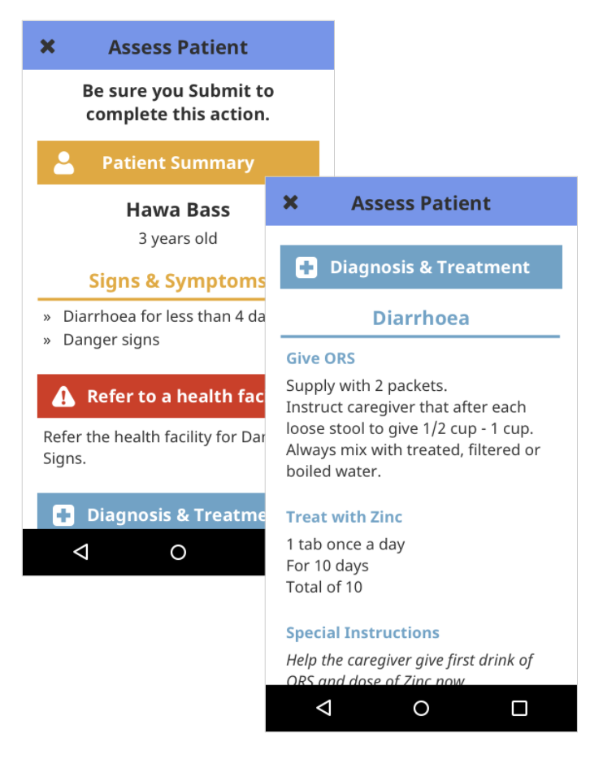
Community Health Toolkit to easily develop applications
Offline first apps
Decision support focused
Can be integrated with DHIS2
Modular
https://docs.communityhealthtoolkit.org/apps/concepts/care-guides/

Slide 26
Conclusion
Building a mediator to integrate external services is possible using OpenHIM and OpenFn together. A similar platform to the proprietary solution was achieved and was welcomed by both teams.
Out of all the assessed systems, the CHT application seems to fit the SwissTPH needs better than all of the others. If there would have been more time, OpenSRP could have been deployed as well. Nevertheless the CHT application can be used with little migration steps.

