Slide 1
repvisforODK
An R Package + Web App to Visualize ODK Data
27th January 2021

Slide 2
Agenda
Presentation Part I
What problem does repvisforODK address?
How does repvisforODK solve the problem?
Live Demo
Functions in action (code solution)
Web App (no-code solution)
3. Presentation Part II
How to get started?
How to contribute?

Slide 3
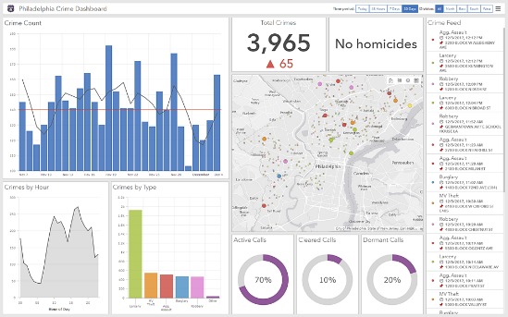
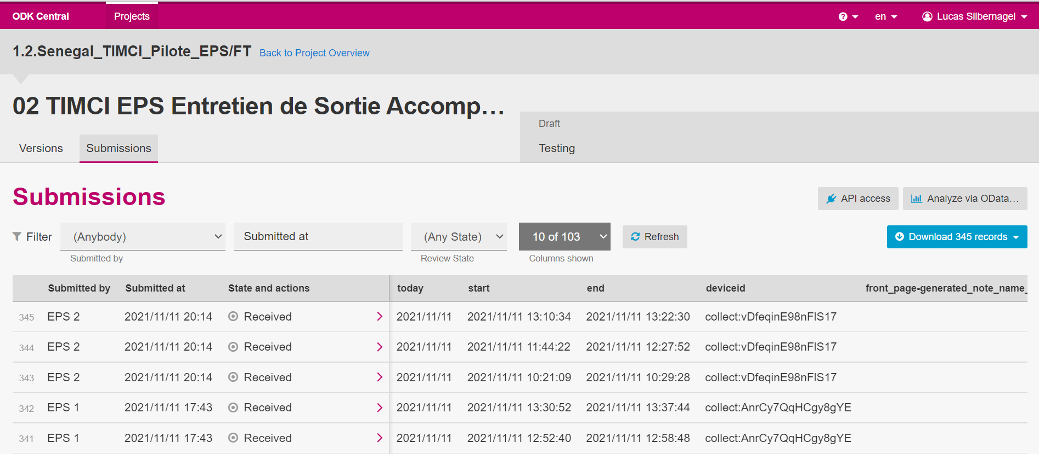

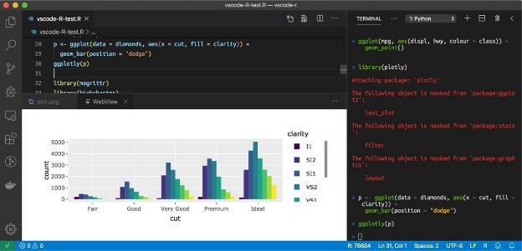
What problem does repvisforODK address?
Part I
Dashboarding/Reporting Tool
ODK Data
Quick, basic data visualization
Write Code

Slide 4
What problem does repvisforODK address?
Part I
Dashboarding/Reporting Tool
Requires coding skills
Takes a long time(!)
Requires costly software
Requires software skills
Takes quite some time
Write Code

Slide 5

What problem does repvisforODK address?
Part I
repvisforODK
Requires coding skills
Takes a long time(!)
Requires costly software
Requires software skills
Takes quite some time
Easy to use
Fast results
Freely accessible

Slide 6
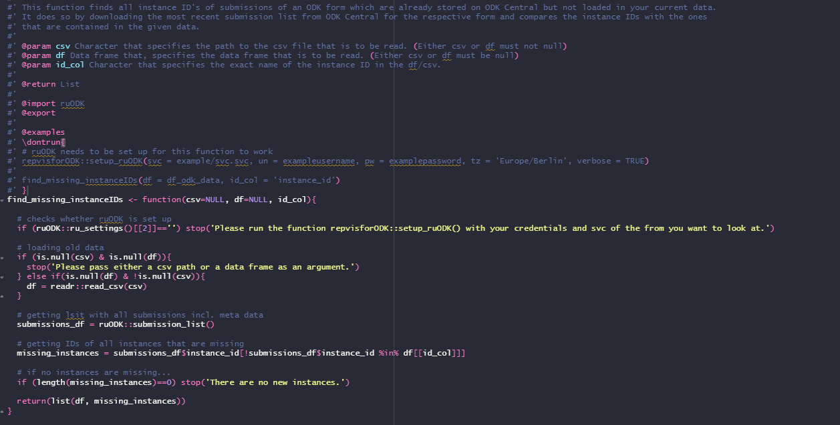
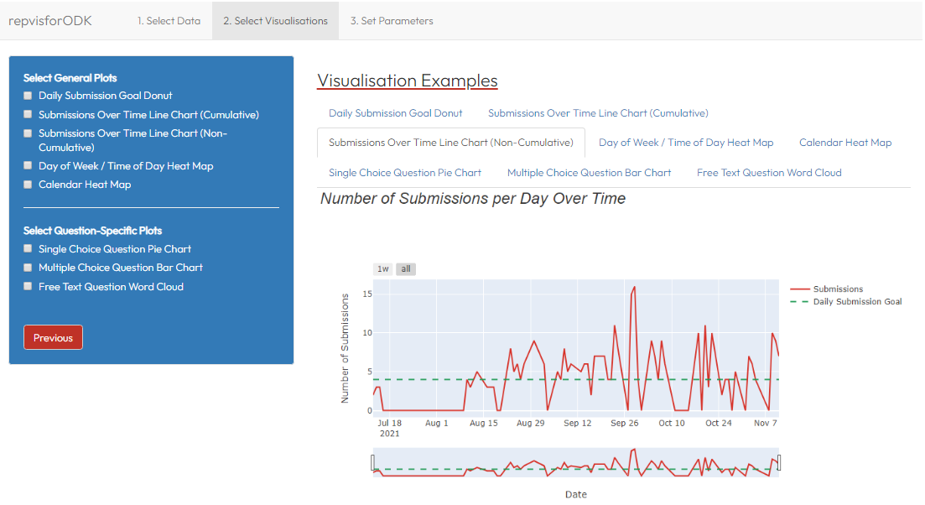
How does repvisforODK solve the problem?
Part I
A two-way solution
Set of functions that generate Plots
Web App (No-Code Solution)
Adds a layer of abstraction and allows usage in a customizable environment: → Visualize data on the fly → Integrate in already existing code → Build new reports from scratch
Makes most repvisforODK functionalities accessible through an UI:
→ Generate reports within a few minutes
→ Does not require coding skills
Disclaimer: As of now, the web app is not deployed on a server and
can only be launched locally. To do so, R as well as shiny and
repvisforODK have to be installed.

Slide 7

Part II
Live Demo

Slide 8




How to Get Started?
Part III
Install package
Not released on CRAN yet → install development version from GitHub
require(“devtools”); devtools::install_github(“swisstph/repvisforODK”)
Read vignette(s)
Vignettes are R-specific long-form guides to packages
2 starter vignettes available: “Intro and Function Overview” + “App”
Read function documentation
Each function in repvisforODK is documented
Documentation can be accessed by executing ?[FUNCTION NAME]
Ask remaining questions in the forum
Forum is integrated in the GitHub repository under “Discussions”
Link
Notes:
Update with image brochure info – send to

Slide 9

How to Contribute?
Part III
Read vignette
1 contributor vignettes available: “Contributor Guide”
Check reported issues
Reported issues can be found in the GitHub repository under “Issues”
Link
Notes:
Update with image brochure info – send to

Slide 10
Thank you for your attention!

