Slide 1
repvisforODK
An R Package + Web App to Visualize ODK Data
27th January 2021

Slide 2
Agenda
Presentation Part I
What problem does repvisforODK address?
How does repvisforODK solve the problem?
Live Demo
Functions in action (code solution)
Web App (no-code solution)
3. Presentation Part II
How to get started?
How to contribute?
Limitations and Issues

Slide 3
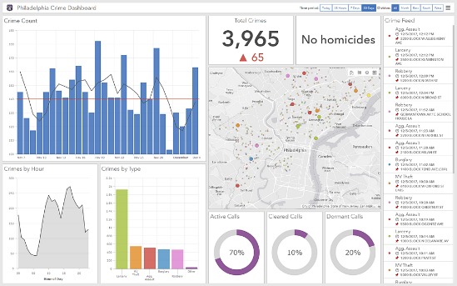
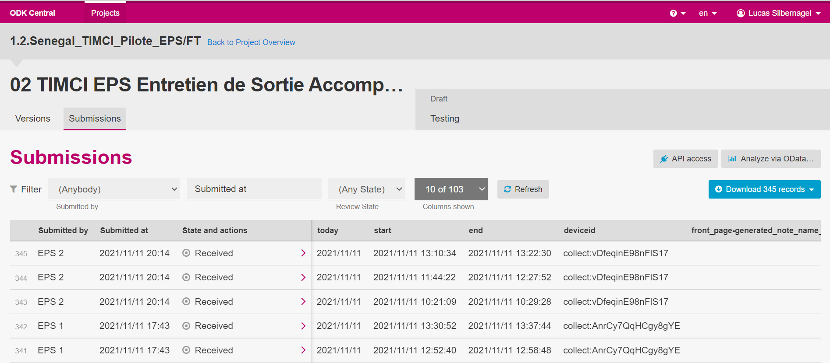

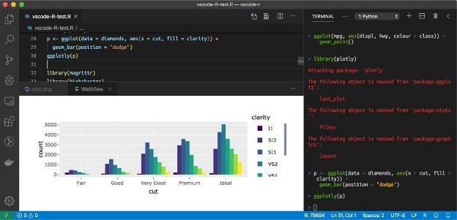
What problem does repvisforODK address?
Part I
Dashboarding/Reporting Tool
ODK Data
Quick, basic data visualization
Write Code

Slide 4
What problem does repvisforODK address?
Part I
Dashboarding/Reporting Tool
Requires coding skills
Takes a long time(!)
Requires costly software
Requires software skills
Takes quite some time
Write Code

Slide 5

What problem does repvisforODK address?
Part I
repvisforODK
Requires coding skills
Takes a long time(!)
Requires costly software
Requires software skills
Takes quite some time
Easy to use
Fast results
Freely accessible

Slide 6
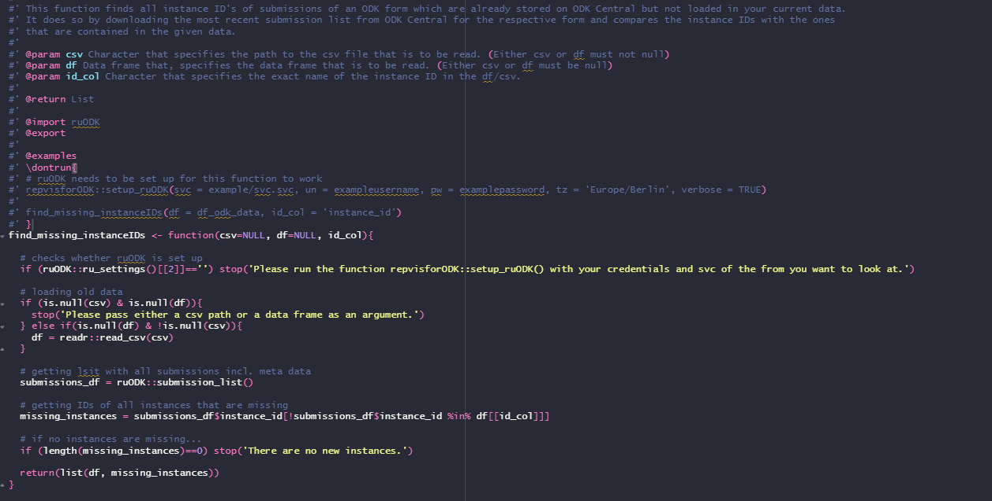
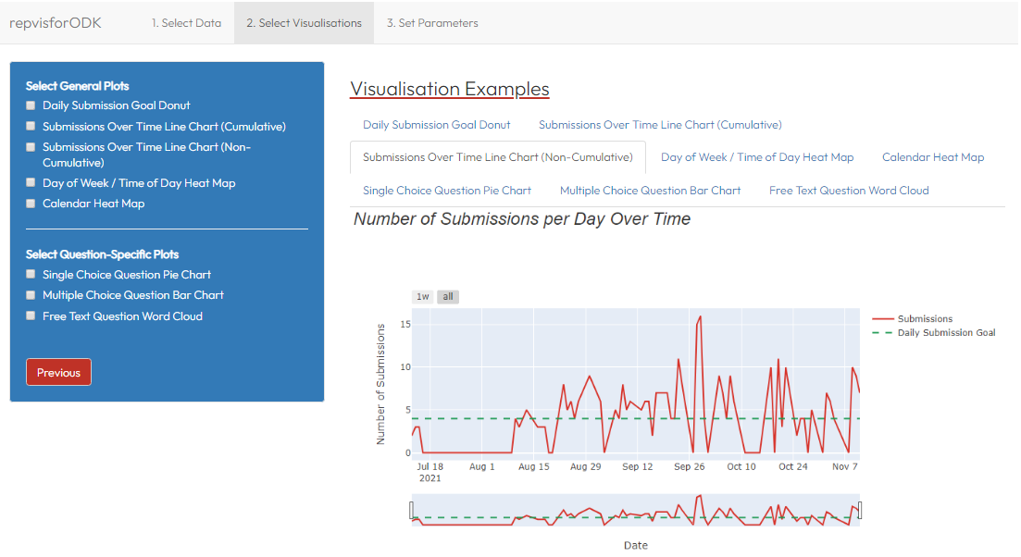
How does repvisforODK solve the problem?
Part I
A two-way solution
Set of functions that generate Plots
Web App (No-Code Solution)
Adds a layer of abstraction and allows usage in a customizable environment: → Visualize data on the fly → Integrate in already existing code → Build new reports from scratch
Makes most repvisforODK functionalities accessible through an UI:
→ Generate reports within a few minutes
→ Does not require coding skills
Disclaimer: As of now, the web app is not deployed on a server and
can only be launched locally. To do so, R as well as shiny and
repvisforODK have to be installed.

Slide 7

Part II
Live Demo

Slide 8




How to Get Started?
Part III
Install package
Not released on CRAN yet → install development version from GitHub
Follow-along code here: Link
Follow-along video here: Link
Read vignette(s)
Vignettes are R-specific long-form guides to packages
2 starter vignettes available: “Intro and Function Overview” + “App”
Read function documentation
Each function in repvisforODK is documented
Documentation can be accessed by executing ?[FUNCTION NAME]
Ask remaining questions in the forum
Forum is integrated in the GitHub repository under “Discussions”
Link
Notes:
Update with image brochure info – send to

Slide 9

How to Contribute?
Part III
Read vignette
1 contributor vignettes available: “Contributor Guide”
Check reported issues
Reported issues can be found in the GitHub repository under “Issues”
Link
Notes:
Update with image brochure info – send to

Slide 10


Limitations and Issues
Part III
Limitations
Issues
App doesn’t support encrypted forms
Multiple-choice question answers have to be stored in one column
No support of repeat groups
Error handling
Only one word cloud per report is rendered
Column filter inputs don’t always show inserted text
Notes:
Update with image brochure info – send to

Slide 11
Thank you for your attention!

