Slide 1
Visual Authoring
Current pain point: code mapping
Notes:
<number>

Slide 2
context of code mapping issue
Implementers are facing a issue to map WHO IG concept code toward external concept code systems
Implementers are facing a issue to map WHO concept IG code toward their own concept IG codes

Slide 3
code mapping
Code mapping is linking concepts from one data dictionnary to equivalent elements form other data dicitonnaries
Therefore it requires
data dictionnary definition
concept mapping definition
Notes:
<number>

Slide 4
Data dictionnary definition
Possibility to use CodeSystem or OCL for DAK Data Dictionary Storage
Support additional information
properties allow for a flexible and extensible structure. e.g.
Add more details on the concept such as Datatypes, binding etc
Add some data mining / FHIR mapping information such as archetypes what are FHIR archetypes, constraints
Support concept hierarchy,
Facilitates organized and relational data representation. e.g.
enabling "valueSet" references and
enabling parent-child relations.
"date of Measles dose 1 immunization" could be a child of "Measles dose 1 immunization"
"With Wheezing" postcoorditation could be a child of "Pnemonia" with a binding property towards the "Wheezing" concept
--> Implementations can generate their own data dictionaries using this method.
Notes:
<number>

Slide 5
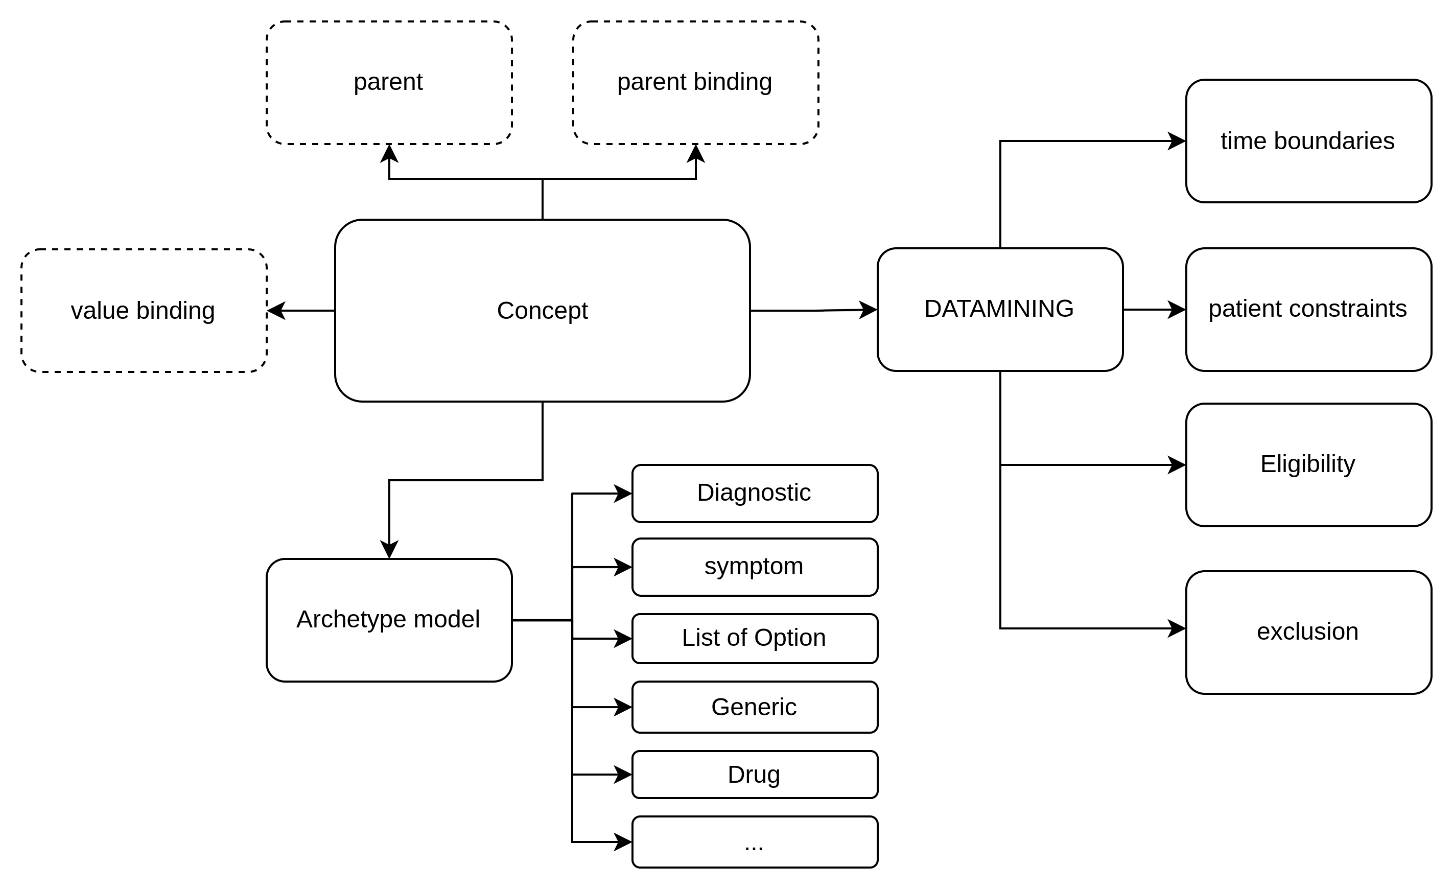
possible additionnal information on the concept level
see example on next slide
Notes:
<number>

Slide 6
Data dictionnary definition fsh modified example
CodeSystem: IMMZConcepts
Title: "Immunizations Concepts CodeSystem"
Description: "This code system defines concepts used in SMART Immunizations"
* ^meta.profile[+] = "http://hl7.org/fhir/uv/crmi/StructureDefinition/crmi-shareablecodesystem"
* ^meta.profile[+] = "http://hl7.org/fhir/uv/crmi/StructureDefinition/crmi-publishablecodesystem"
* ^experimental = true
* ^caseSensitive = false
* #C.DE1 "Unique identifier" "Unique identifier for the client, according to the policies applicable to each country. There can be more than one unique identifier used to link records (e.g. national ID, health ID, immunization information system ID, medical record ID)."
* ^property[+].code = #archetype
* ^property[=].valueCode = #identifier
* ^property[+].code = #parent
* ^property[=].valueString = "Patient"
* ^property[+].code = #parentbinding
* ^property[=].valueCode = #id
* #C.DE2 "Name" "The full name of the client"
* ^property[+].code = #archetype
* ^property[=].valueCode = #string
* ^property[+].code = #parent
* ^property[=].valueString = "Patient"
* ^property[+].code = #parentbindingpath
* ^property[=].valueString = "name['use'].text"
* ^property[+].code = #parentbinding
* ^property[=].valueCode = #attribute
Notes:
<number>

Slide 7
code mapping definition
By using codesystem as data dictionary, it allows utilization of ConceptMap for the code mapping
--> This can be use to map implementation data dictionary to reference data dictionary or directly to external systems
Notes:
<number>

Slide 8
code mapping definition fsh unmodified example
Instance: IMMZCConceptMap
InstanceOf: ConceptMap
Description: "Mapping to and from IMMZ.C Data Dictionary to other codesystems."
Usage: #definition
* name = "IMMZ_C_ConceptMap"
* title = "ConceptMap to and from IMMZ.C DataElements"
* status = #active
* experimental = false
* date = "2023-08-04"
* group[+]
* source = Canonical(IMMZ.C)
* target = $ICD11
* insert ElementMap(DE6, XX2UQ8, equivalent)
* insert ElementMap(DE7, XX2V25, equivalent)
* insert ElementMap(DE8, XX2PX3, equivalent)
* insert ElementMap(DE9, XX45B7, equivalent)
Notes:
<number>

Slide 9
Using OCL or FHIR as reference
OCL concept could be aligned with the need described before
OCL FHIR API is not mature yet
Serves the same purpose of CodeSystem/Concept Map
Have a nice UX for none IT
IT specialist might prefer fsh editing
neither OCL nor FHIR have to my knowledge a way to inject mapping in the IG (to be developped in both case)
--> What is the preferred reference FHIR or OCL models ?
Notes:
<number>

Slide 10
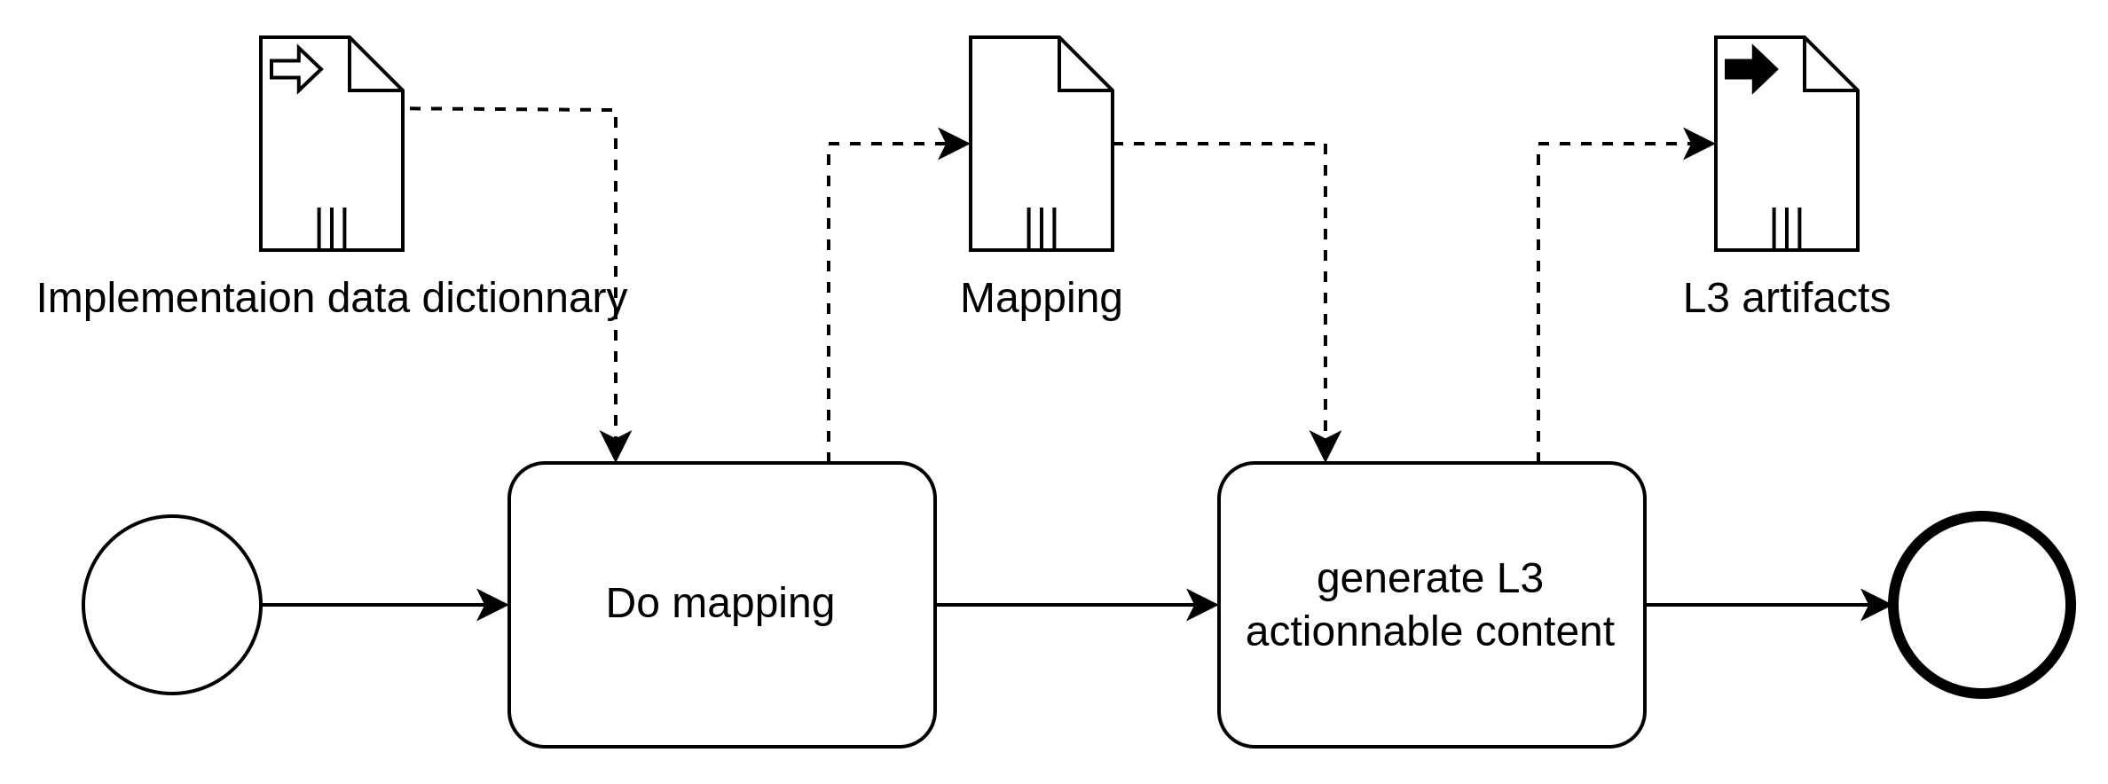
Updating concept code mapping process

Slide 11
Pain point potential solutions
Regenerate the IG that will use the new mapping
Replace the ValueSet used in IG's CQL with new ones generated from the ConceptMaps
Using a terminology server in the CQL to use natively the ConceptMap
Notes:
<number>

Slide 12
Visual Authoring
Possible approach for visual authoring
Notes:
<number>

Slide 13
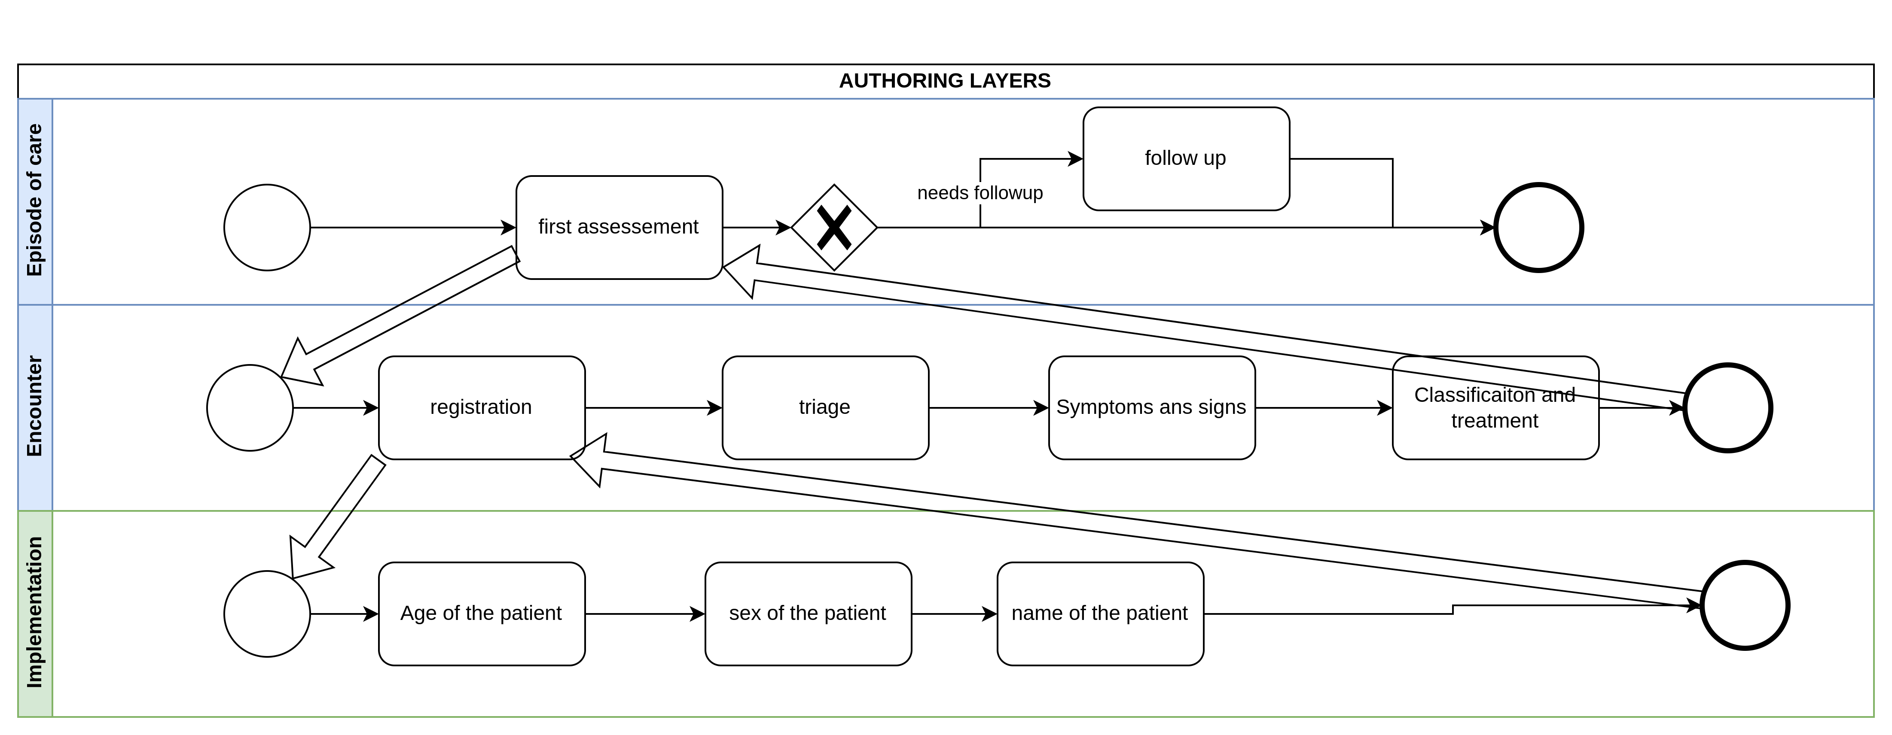
Layered approach
Notes:
<number>

Slide 14
Layered approach mapping to FHIR
Scheduling (Episode of care) will generate main planDefinition
Abstract (Encounter) will generate one planDefinition and activityDefinitions and LogicalModels
each "Abstract tasks and activities" needs at least one "Implementation" but may have severals to covers different implementations context (Hospital, CHW ...)
Implementations will generate the resource used in the fields such as Questionnaire ...
--> all logical gateway should refers to DMN/Decision logic table; ideally editable on the spot so user won't have to leave the diagram to see/edit DMN
Notes:
<number>

Slide 15
Logical model as interface reference
Logical model will be the key for compliance between the "Abstract task and activities" and the "implementation" versions
Implementation may need more or less information that was foreseen by the LM but it should be able to respect the cardinality (Abstract LM could enforce some elements)
Notes:
<number>

Slide 16
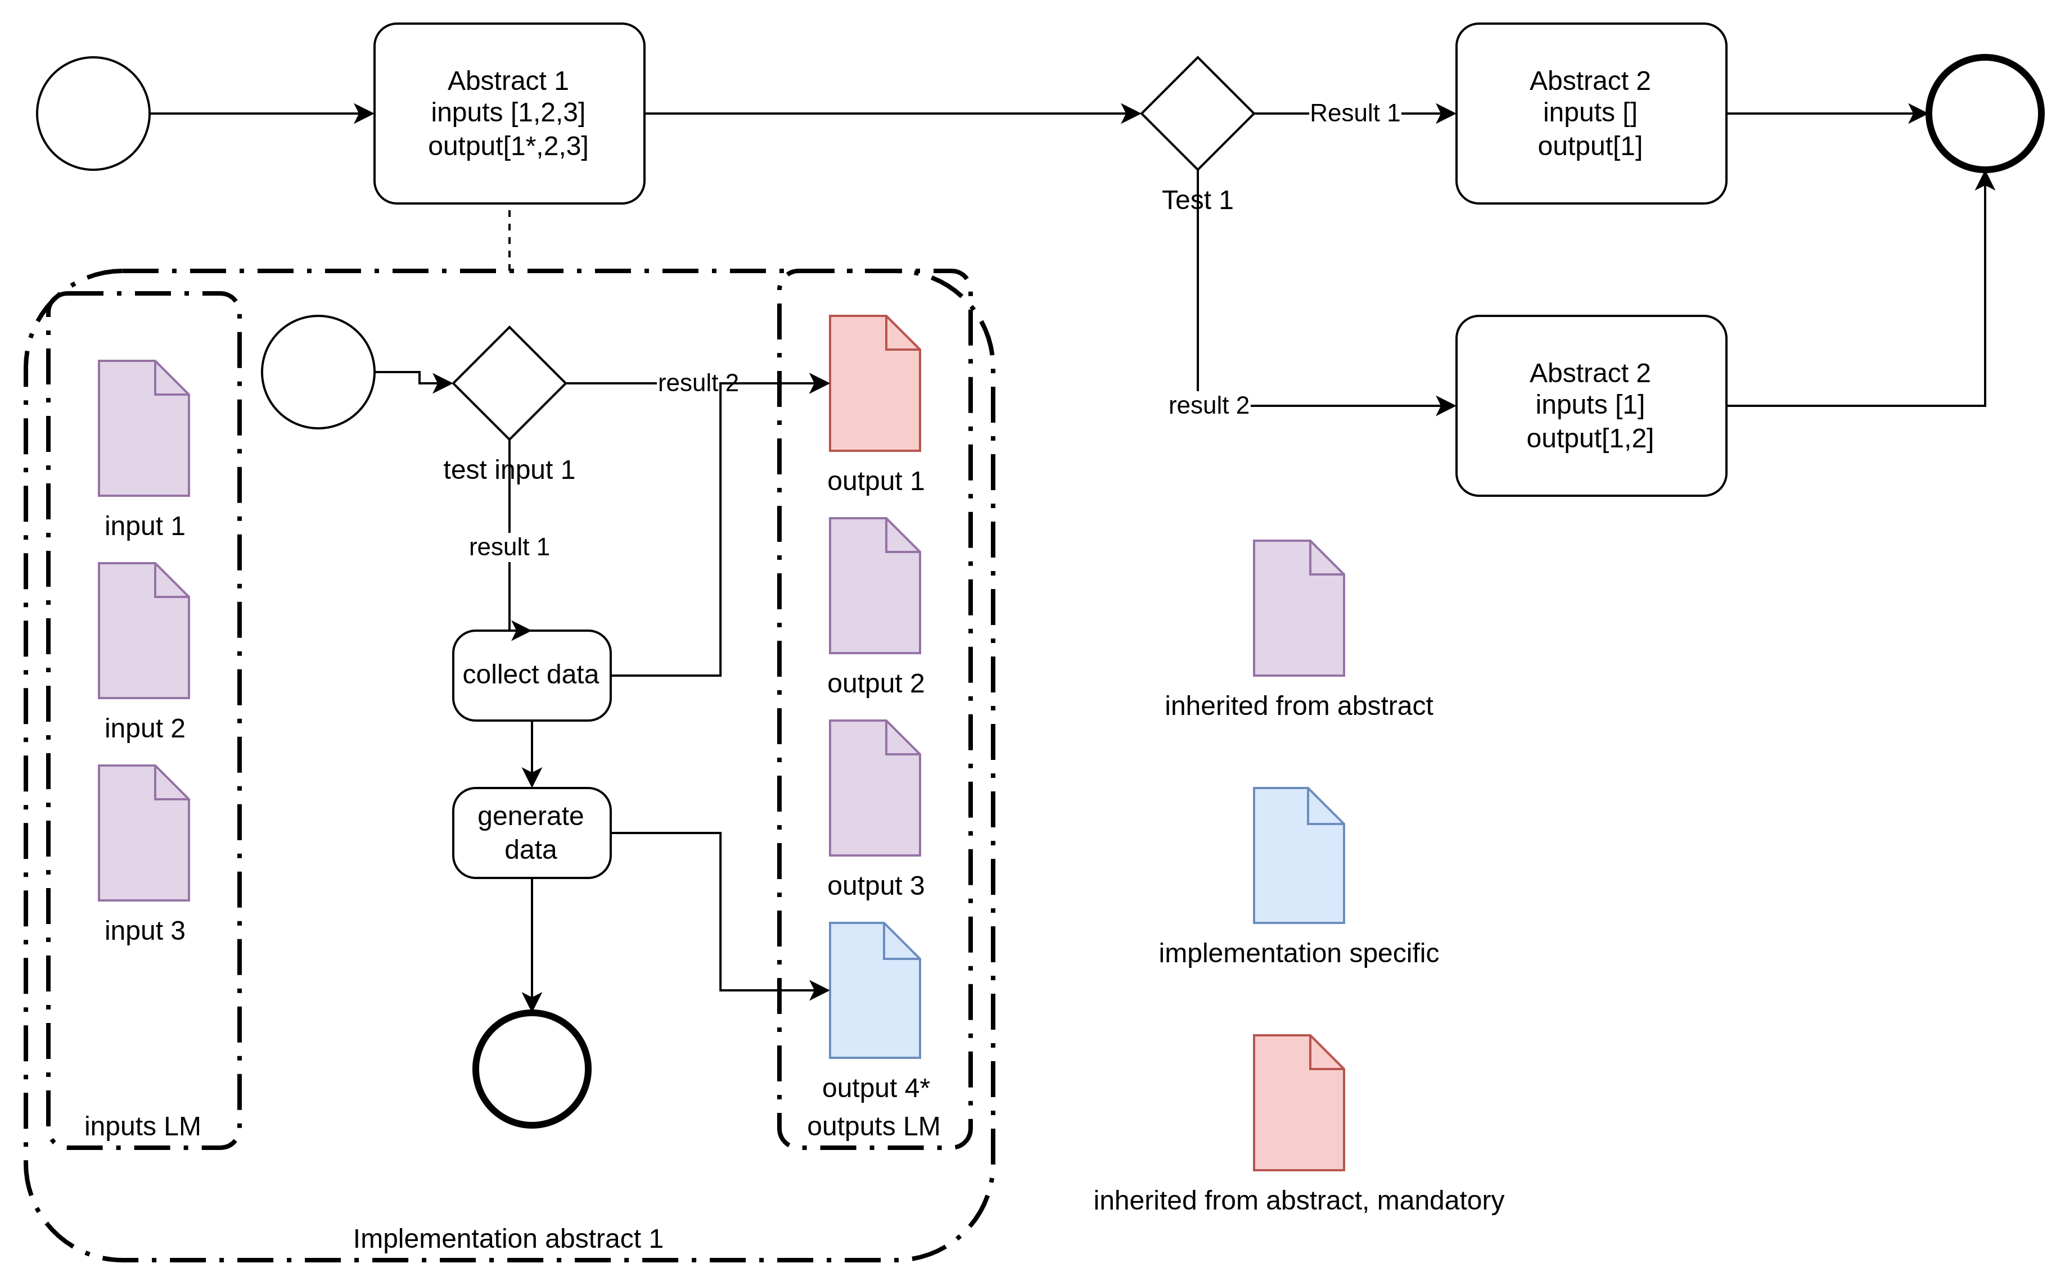
Logical model as interface reference
Notes:
<number>

Slide 17
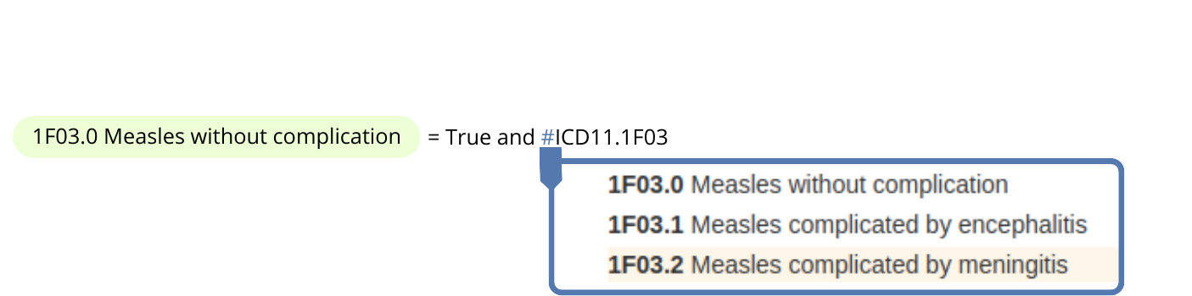
Leveraing data dictionnary
- In order to avoid errors such as typos, writing decision logic should be assisted in the tooling.
- The tooling should be able to search in the data dictionary included in the project to retrieve the right elements (see illustration below)
- With additional information on the concept level, the technical expression to retrieve the data (e.g. CQL) should be generated automatically
Notes:
<number>

