Slide 1
DESIGN PATTERN OVERVIEW
KAZI MAHBUBUR RAHMAN

Slide 2
WHAT IS DESIGN PATTERN
A contextual programming problem and solution pair
Proven solution for the contextual software development problem
Interestingly borrowed from Civil and Electrical Engineering Domain

Slide 3
WHY DESIGN PATTERN
Why should we use design patterns in programming? Our code can work just fine without it. Counter question would be "Would you rather live in a luxurious home, or in simple establishment with four walls.”
Code Modification: Easy to modify business logic without much effort.
Code Extensibility: New features can be implemented by only writing new code and minimal change in existing code.
Code Reusability: Others programmer can understand code easily and can reuse existing code into another project.
Programmer Communication: Design pattern made communication between programmers more efficient.

Slide 4
GANG OF FOUR
The book "Design Pattern: Elements of Reusable Object Oriented Software" started design pattern at first.
Authors are: Erich Gamma, Richard Helm, Ralph Johnsonn, John Vlissides. The authors are often referred to as the Gang of Four (GoF).
Published in 1994

Slide 5
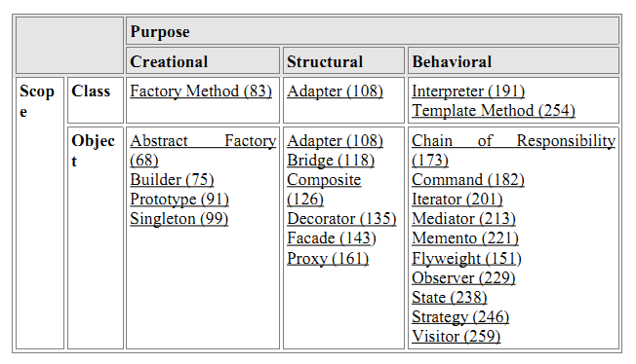
TYPES OF PATTERNS
Creational: Concern the process of creating an object in a flexible way.
Structural: Composing class and object with proper inheritance.
Behavioral: Ways in which different classes and objects can interact and communicate.

Slide 6
CREATIONAL PATTERNS
Abstract Factory: Provide an interface for creating families of related or dependent objects without specifying their concrete classes.
Builder: Separate the construction of a complex object from its representation so that the same construction process can create different representations.
Factory Method: Define an interface for creating an object, but let subclasses decide which class to instantiate. Factory Method lets a class defer instantiation to subclass.
Prototype: Specify the kinds of objects to create using a prototypical instance, and create new objects by copying this prototype.
Singleton: Ensure a class only has one instance, and provide a global point of access to it.

Slide 7
STRUCTURAL PATTERNS
Adapter: Convert the interface of a class into another interface clients expect. Adapter lets classes work together that couldn't otherwise because of incompatible interfaces.
Bridge: Decouple an abstraction from its implementation so that the two can vary independently.
Composite: Compose objects into tree structures to represent part-whole hierarchies. Composite lets clients treat individual objects and compositions of objects uniformly.
Decorator: Attach additional responsibilities to an object dynamically. Decorators provide a flexible alternative to subclassing for extending functionality.

Slide 8
STRUCTURAL PATTERNS
Facade: Provide a unified interface to a set of interfaces in a subsystem. Facade defines a higher-level interface that makes the subsystem easier to use.
Flyweight: Use sharing to support large numbers of fine-grained objects efficiently.
Proxy: Provide a surrogate or placeholder for another object to control access to it.

Slide 9
BEHAVIORAL PATTERNS
Chain of Responsibility: Avoid coupling the sender of a request to its receiver by giving more than one object a chance to handle the request. Chain the receiving objects and pass the request along the chain until an object handles it.
Command: Encapsulate a request as an object, thereby letting you parameterize clients with different requests, queue or log requests, and support undoable operations.
Interpreter: Given a language, define a representation for its grammar along with an interpreter that uses the representation to interpret sentences in the language.

Slide 10
BEHAVIORAL PATTERNS
Iterator: Provide a way to access the elements of an aggregate object sequentially without exposing its underlying representation.
Mediator: Define an object that encapsulates how a set of objects interact. Mediator promotes loose coupling by keeping objects from referring to each other explicitly, and it lets you vary their interaction independently.
Memento: Without violating encapsulation, capture and externalize an object's internal state so that the object can be restored to this state later.
Observer: Define a one-to-many dependency between objects so that when one object changes state, all its dependents are notified and updated automatically.

