Slide 1

Middleware in a Service-oriented World:
Enabling software application architectures from embedded sensor networks to distributed enterprise computing
Hans-Arno Jacobsen
University of Toronto

Slide 2
How I See Our Research Fit In
Data Management
Distributed Systems
Middleware Research
@
MSRG
Networking
Software Engineering

Slide 3
Research Scope and Methodology
Middleware systems comprise a set of services and abstractions that facilitate the design, development, integration and deployment of distributed applications in heterogeneous, distributed environments.
Research methodology
  We build systems, applications, and algorithms
  Measure, analyse and improve systems and algorithms
  Mostly above the transport layer and below the application
Current focus
  Service-oriented Architectures
  Event-driven Architectures
  Model-driven development
  Enabling software product families

Slide 4
MicroToPSS
code available under BSD
http://microToPSS.msrg.utoronto.ca/
A middleware for sensor networks enabling
  Sense-and-response applications
  Data management in RFID-based environments
  Factory floor automation
Web
service
Web
service
Application
MicroToPSS Middleware Abstraction
query()
subscribe()
notify()
sensor
Environment (e.g., factory production floor)

Slide 5
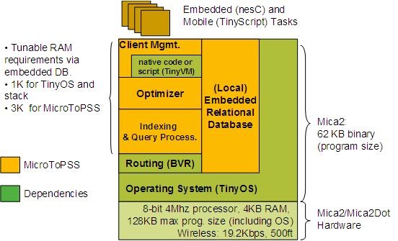
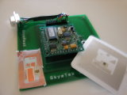
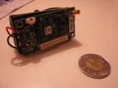
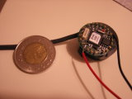
MicroToPSS Details

Slide 6
Middleware for Enterprise Computing
Towards an event-driven real-time enterprise
Enable decentralized business process execution (based on BPEL & Web services)
Provide business activity monitoring and tracking of KPIs across distributed enterprise
Based on flexible content-based routing messaging substrate
Offers a data-centric networking abstraction

Slide 7
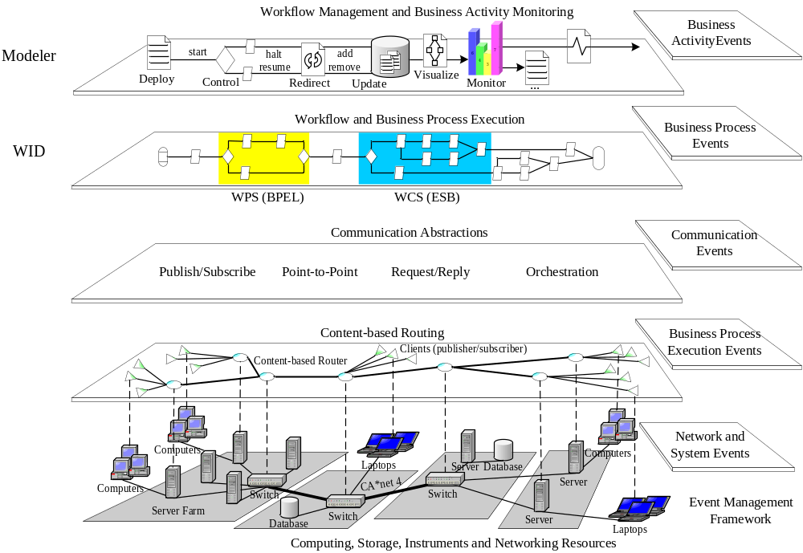
Data-centric Networking
An Event-driven Architecture for a Real-time Enterprise

Slide 8
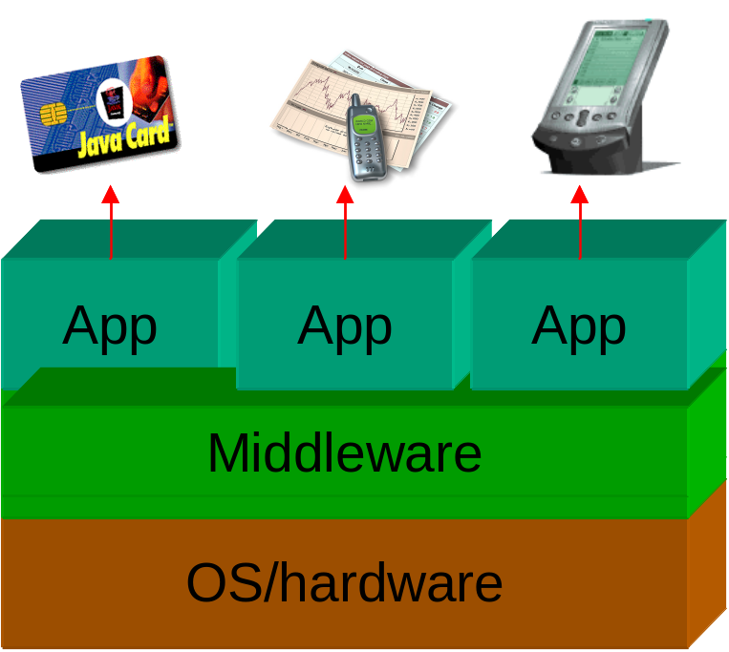

Customizable Middleware Product Families for Embedded Devices et al.
Middleware product families reduce development cost
Proven concepts on Java Card & J2ME
Based on Aspect Orientation
Prove for C-based systems in progress
  Ethernut embedded OS
  www.AspectC.net
Aspect-oriented Programming

Slide 9
Middleware Systems Research Group
Selected links and projects
  Middleware for sensor networks
    http://microToPSS.msrg.utoronto.ca/
  Middleware for enterprise computing & business process management
    http://padres.msrg.utoronto.ca
  Modularity, customization, and software product families
    http://www.AspectC.net
MSRG group web site
  http://www.msrg.utoronto.ca

