Slide 1

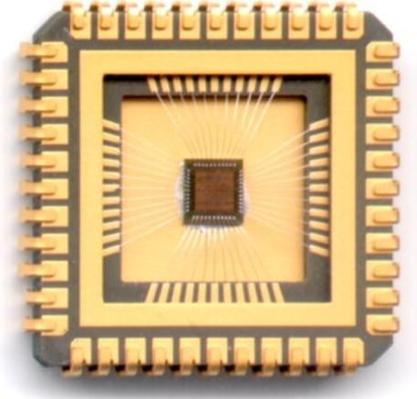
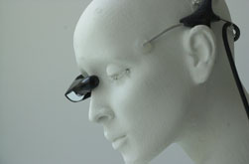
The Computer Group:
Who We Are and What We Do
ECE Department
University of Toronto
Notes:
My name is Greg Steffan
I’m an assistant professor in the ECE department.
My interests are in compilers and architecture
I’d like to start by talking a little bit about what current research in this area is about.

Slide 2
Computer Group: Who We Are
Established ~30 years ago
Largest group in ECE
  25 Faculty
  ~90 graduate students
Diverse research areas
  From Biomedical Cybernetics to Asynchronous Circuits
Diverse locations on campus
  5 different buildings, numerous labs & office spaces

Slide 3
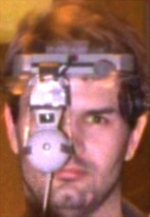
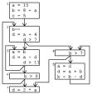
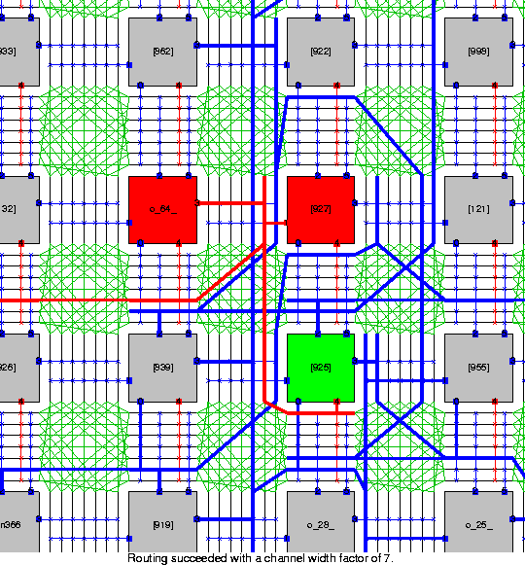
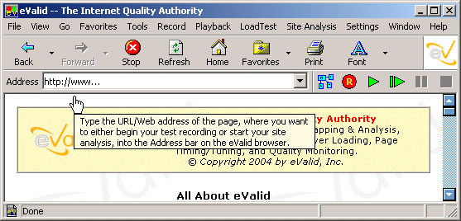
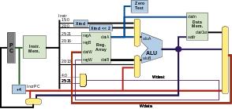
What We Do
Human Computer Interaction
VLSI CAD
Compilers
System Software
Computer Architecture
Computer Hardware
a broad spectrum of computer research

Slide 4




Human Computer Interaction
Wearable Computing
Computer Vision
Biomedical Cybernetics
Multi-Sensor Information Systems
Mann
Maclean
Wong
Aarabi

Slide 5






Systems Software
Operating Systems
Secure Systems
Distributed Systems
Data Mgnt Systems
QoS Provisioning
Middleware & Info Systems
Goel
Stumm
Lie
Amza
Jacobsen
Li

Slide 6


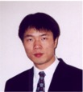
Compilers
Parallelizing Compilers
Retargetable Compilation
Graduate Coordinator
Steffan
Abdelrahman
Zhu

Slide 7



Computer Architecture
Parallel Architecture
Microarchitecture
Support for Security
Vranesic
Steffan
Moshovos
Graduate Operations
Chow
Lie

Slide 8




VLSI CAD
for Low Power & Reliability
for FPGAs
Synthesis
Testing, Diagnosis, Verification
Department Vice Chair
Vranesic
Najm
Department Chair
Brown
Rose
Veneris
Zhu

Slide 9

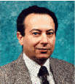
Computer Hardware
FPGA architecture
Custom Processors
VLSI for Signal Processing
Asynchronous Logic
Rose
Chow
Computer Group Chair
Gulak
Vice Provost, Planning & Budget
Aarabi
Zaky

