Slide 1
Computer Architecture and Compilers
Greg Steffan
ECE Department
University of Toronto
Notes:
My name is Greg Steffan
I’m an assistant professor in the ECE department.
My interests are in compilers and architecture
I’d like to start by talking a little bit about what current research in this area is about.

Slide 2
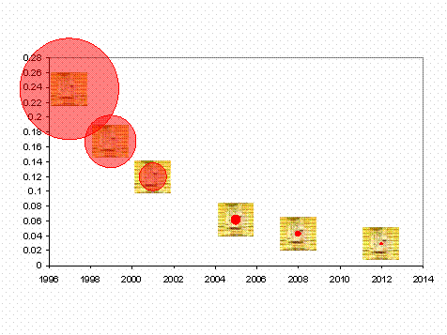
Trend1: Range of a Wire in One Clock Cycle
We are here!
having one big processor soon infeasible
this motivates distributed processing on a chip

Slide 3
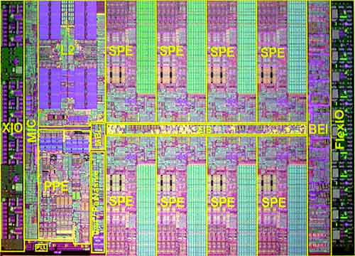
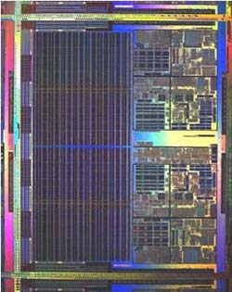
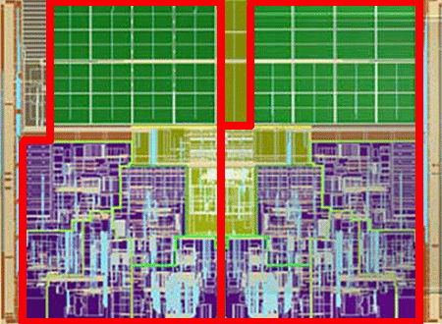
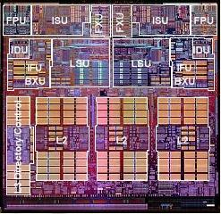
Some Current Chip Multiprocessors
PE
PE
PE
PE
CPU
CPU
CPU
CPU
PE
PE
PE
PE
CPU
IBM Cell
Intel Yonah
AMD Opteron
CPU
CPU
Improved throughput is straightforward
How can these run one program faster?
IBM Power4

Slide 4


The Dream: Automatic Parallelization
CPU
CPU
User writes a
sequential program
Compiler and Runtime
System Parallelize it
Multiple CPUs
Execute the Program
easily exploit chip multiprocessors

Slide 5
My Research (Part1)
Making parallelization easier
  For desktop apps, scientific simulations, databases…
New chip multiprocessor architectures
New compiler technologies
towards automatic parallelization

Slide 6


Trend2: Power Density
Sun's
Surface
1000
Rocket
Nozzle
Nuclear Reactor
2
100
Pentium® 4
Watts/cm
Hot plate
Pentium® III
10
Pentium® II
Pentium® Pro
i386
Pentium®
i486
1
1.5μ
1μ
0.7μ
0.5μ
0.35μ
0.25μ
0.18μ
0.13μ
0.1μ
0.07μ

Slide 7
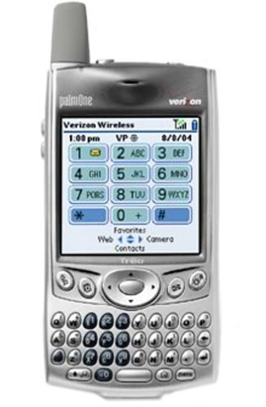
The Dream: Doing More with Less Power
cell phone + PDA + MP3 player + digital camera + TV + ?
Ultra-Efficient Systems: Chameleon Computing
Hardware that can be reconfigured
  To exactly match application requirements
Design custom systems automatically
  To enable really fast time-to-market

Slide 8
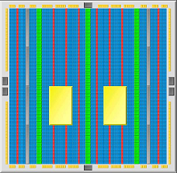
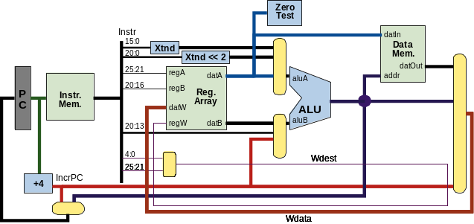
My Research (Part2)
FPGA
Processor
Understanding “soft processor” architecture
  A processor built out of an FPGA’s reconfigurable logic
  Revisit processor architecture in this new context
“Soft Systems” that target FPGAs
  New processors, compilers, OSs, platforms, applications

Slide 9
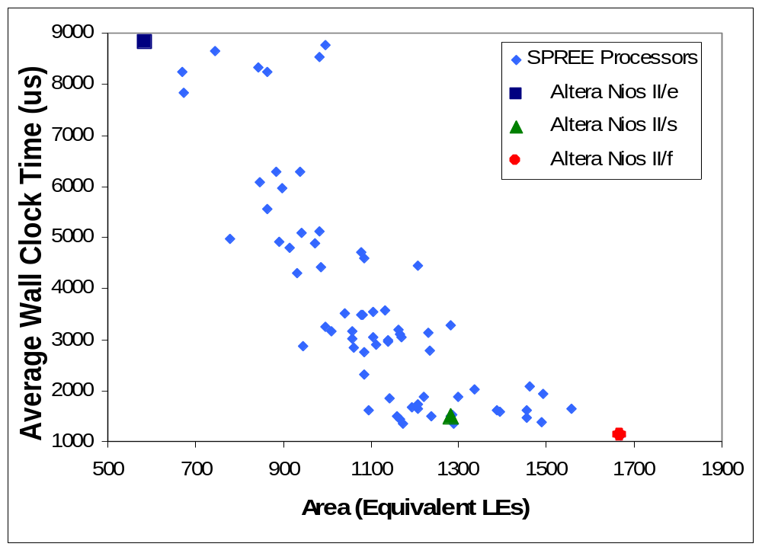

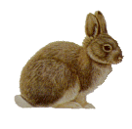
Our Soft Processors vs Altera Nios II Variants
better
faster
smaller
Competitive and can dominate (9% smaller, 11% faster)

Slide 10

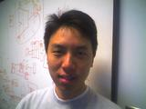
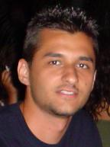


The PaCRaT Team
Parallelization and Customization Research at U of Toronto

