Slide 1
FPGA Research:
Architecture, CAD, Soft Processors and Systems
Jonathan Rose
Computer Engineering Group
and Electronics Group

Slide 2
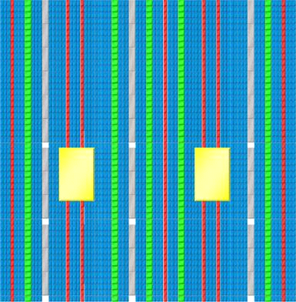
Field-Programmable Gate Arrays
Are pre-fabricated digital chips
  Programmed to become anything
  Including large systems!

Slide 3
FPGAs vs. Custom Silicon (ASICs)
Advantages of FPGAs
  Instant fabrication: Seconds vs. Months
  Low cost prototyping; $100 vs. $1M
  Cheaper at low volume
  Don’t need to sweat deep-submicron issues!
Disadvantages of FPGAs
  20-30x more area
  3-4x slower
  10x more power consumption

Slide 4
If VLSI is the Technology of Our Time …
FPGAs Democratize Technology of Our Time
Make it accessible to everyone
  Not just the rich who can afford ASICs
  The small outfit in Singapore, Texas, Winnipeg
  Small parts of large companies
Notes:
[ICK Comment] I don’t find the title reads well (or maybe I just don’t like abbreviations in titles)

Slide 5
My Goal
To replace all digital silicon with FPGAs!
  By making them better (architecture, CAD, ease of creation)
  And using them in new ways for new applications
The score so far:
  $4B FPGA, $31B Custom Silicon (ASICs)
  But 99% of all design is done with FPGAs!
  Very few ASICs gather most of the market

Slide 6
How: FPGA Research: Architecture
Make better FPGAs by improving their architecture
  What is the logic
  How to make the routing better
Central Question of FPGA Architecture:
What logic should be made “hard”?
Where can we reduce the costly flexibility?
  Deep question with interesting theoretical & practical branches

Slide 7
How: Computer-Aided Design
Better tools make FPGAs faster, smaller, lower power
High Level Synthesis
Logic Synthesis
Packing (memory, special structures, logic)
Placement
Routing
To optimize: area, speed, power (dynamic and static)

Slide 8
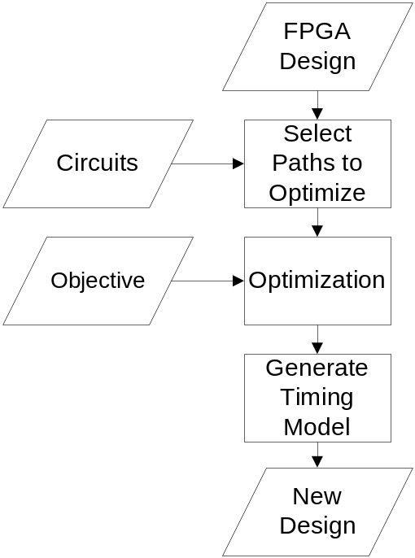
How: The Creation of FPGAs Themselves
Automated Layout of FPGAs themselves
Automated Circuit Design of FPGAs
Current Project:
  Automating the transistor-level design of FPGAs

Slide 9
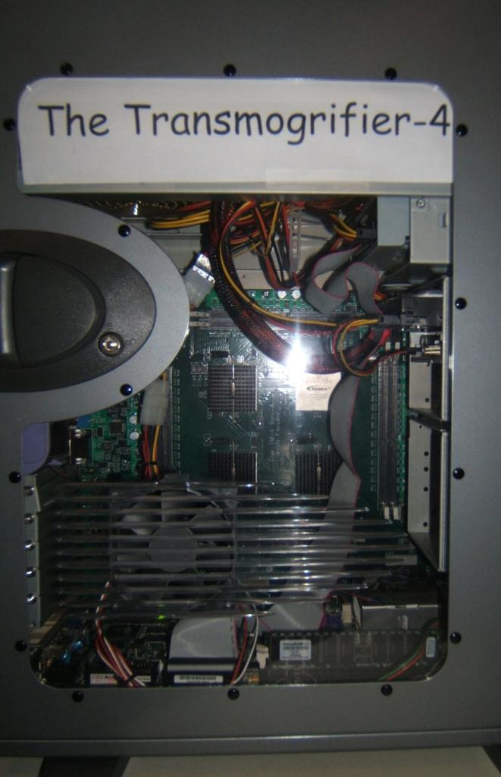
Systems & Applications
The Transmogrifier Project
  Creation of programmable systems
New System: The Transmogrifier-4:
Interested in applications on
  Vision
  Graphics
  Bioinformatics – simulation
Next Generation: Transmogrifier-5
  Super cheap
  Portable – wireless/full system

Slide 10
Soft Processors
For FPGAs to conquer, they must have good processors
Soft processors are processors built on FPGA fabric
  Fabric makes them slower, bigger than hard processors
  Must use FPGA’s flexibility to get this back!
Example Projects:
  Exploration of Soft Processor Micro-architecture
  Super Small Soft Processor
  Super Fast Soft Processor

Slide 11


Soft Processor Rapid Exploration (SPREE)
Processor
Description
ISA
Datapath
Input: Processor Description
  Hand-coded components, Datapath
SPREE
CAD/Compiler:
  Verifies ISA against datapath
  Instantiates Datapath
  Generates Control
RTL
Output: Synthesizable Verilog
Notes:
Exports to synthesizable Verilog RTL

Slide 12
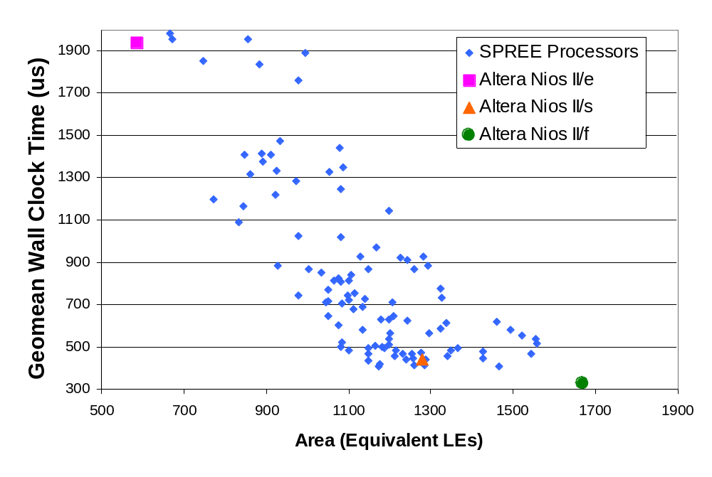
Spanning the Area/Speed Space
3-stage pipe
HW multiply
Multiply-based
shifter
faster
smaller
Notes:
EXCITEMENT HERE – this graph should be burned in people’s memory

Slide 13
FPGAs: Poised To Conquer!

