Slide 1
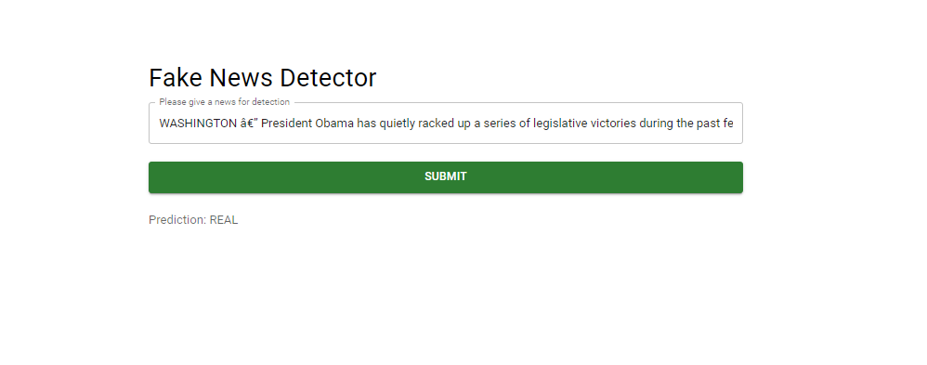
Fake News Detector using Machine Learning
Figure: Front-end

Slide 2
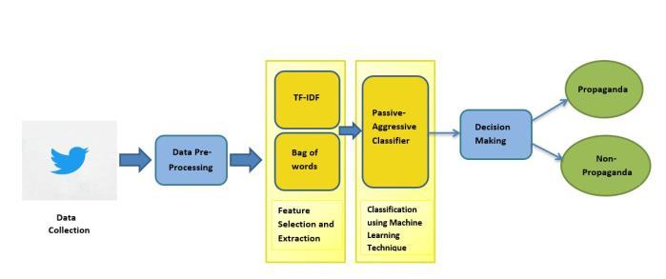

Use of Machine Learning

Slide 3
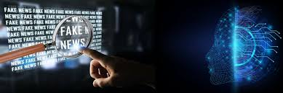
Implementation Areas
Media and Journalism
Social Media Platforms
Fact-Checking Organizations
Educational Institutions
Public Health

