Slide 1

Data structure and algorithm
Term project
Students:
Mirakhmedov A || 17012687
Umarov D || 15012773

Slide 2
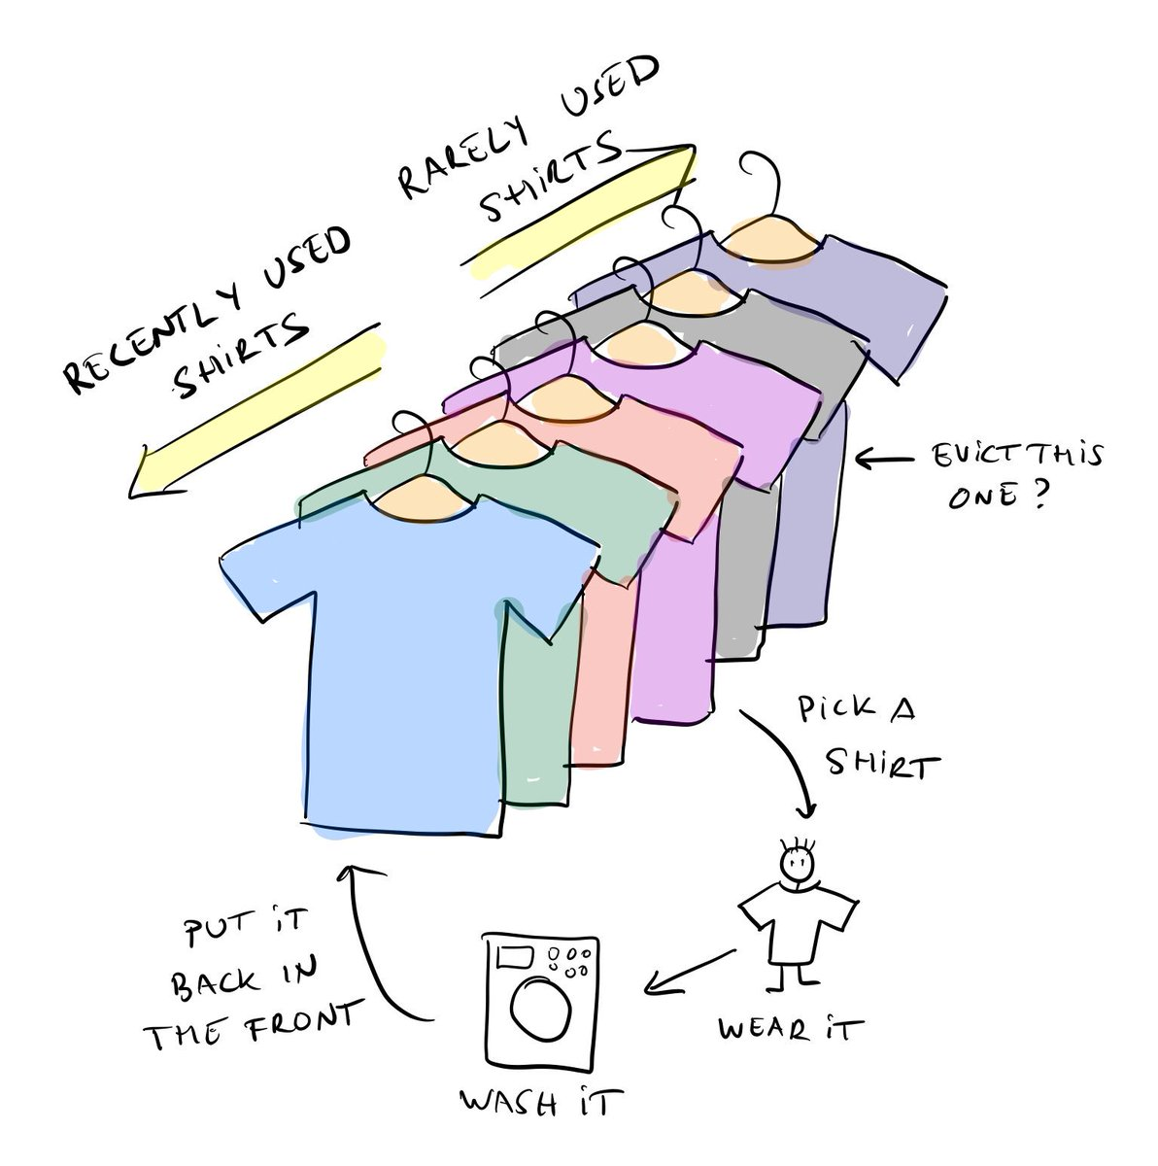
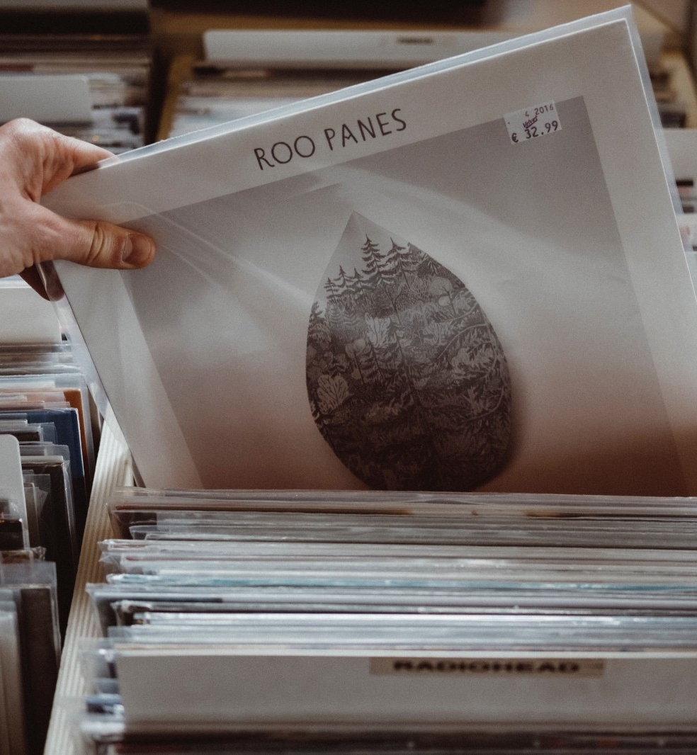
LRU Cache
Least Recently Used

Slide 3
Lru cache && Why use a cache?
A Least Recently Used (LRU) Cache organizes items in order of use, allowing you to quickly identify which item hasn't been used for the longest amount of time.
An LRU cache is often implemented by pairing a doubly linked list with a hash map.
A cache is just fast storage. Reading data from a cache takes less time than reading it from something else (like a hard disk).

Slide 4
Strengths & weaknesses
Strengths:
Super fast accesses. LRU caches store items in order from most-recently used to least-recently used. That means both can be accessed in O(1) time.
Super fast updates. Each time an item is accessed, updating the cache takes O(1) time.
Weaknesses:
Space heavy. An LRU cache tracking n items requires a linked list of length n, and a hash map holding n items. That's O(n) space, but it's still two data structures (as opposed to one).

Slide 5

Lru eviction (example)

Slide 6
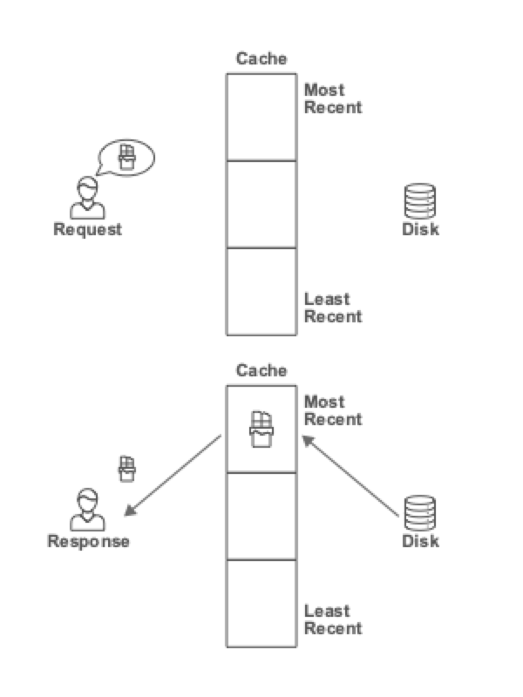
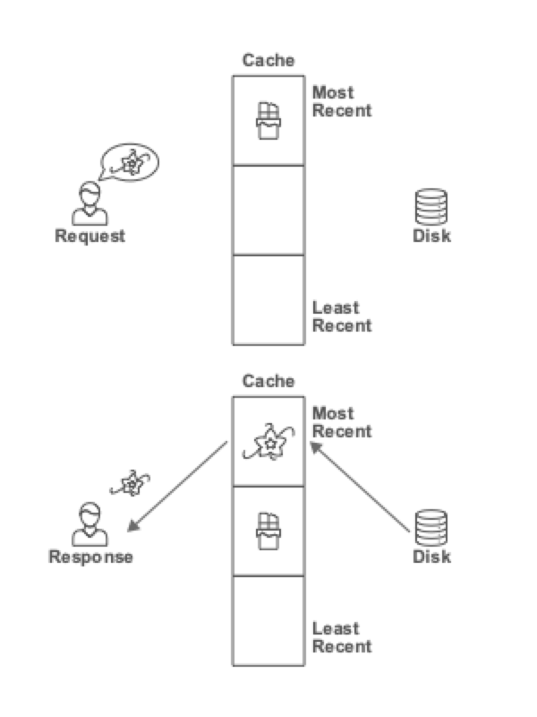
Lru eviction (example)

Slide 7
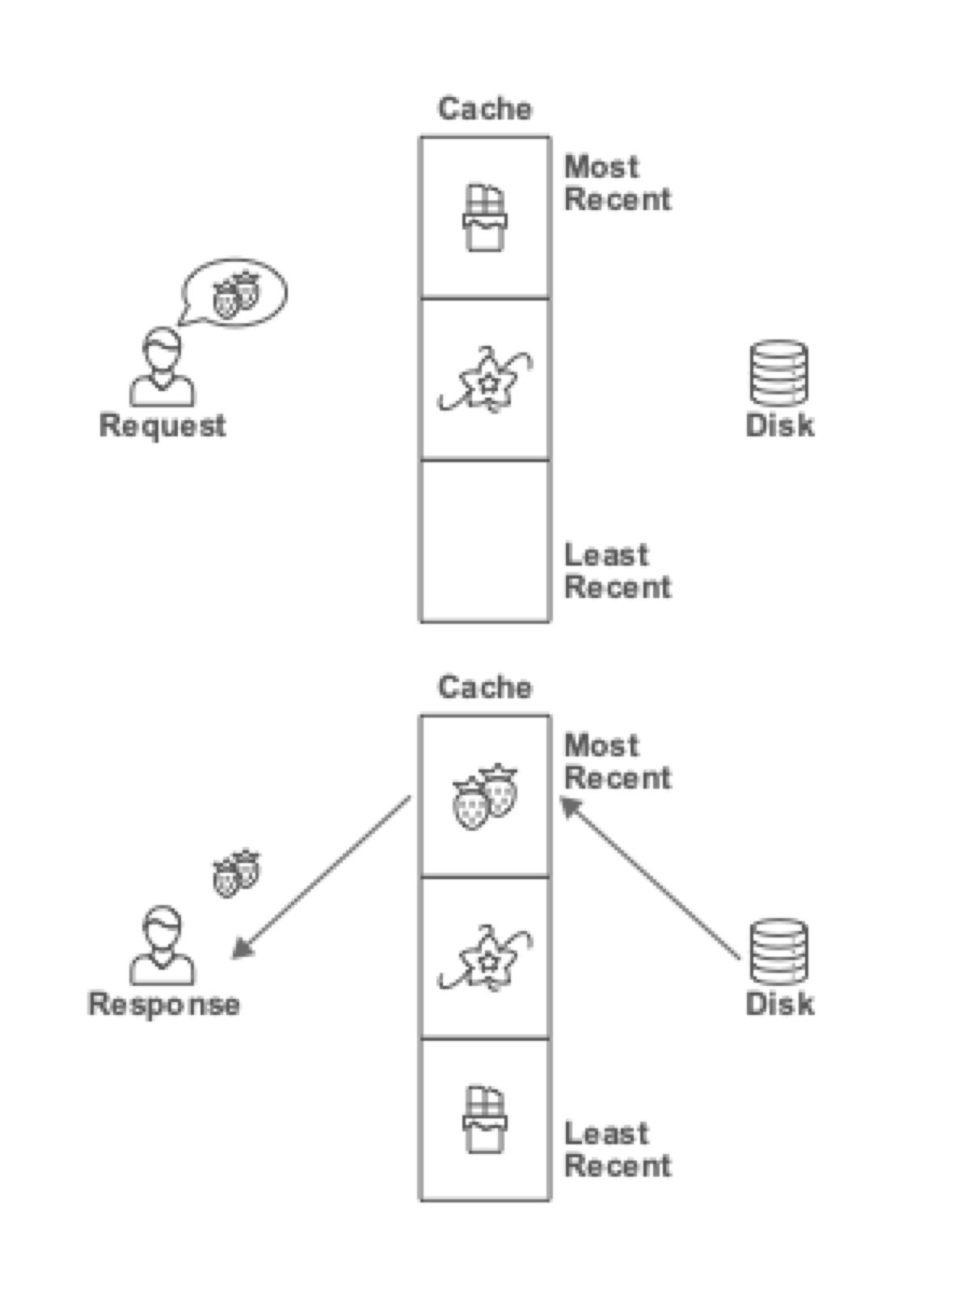
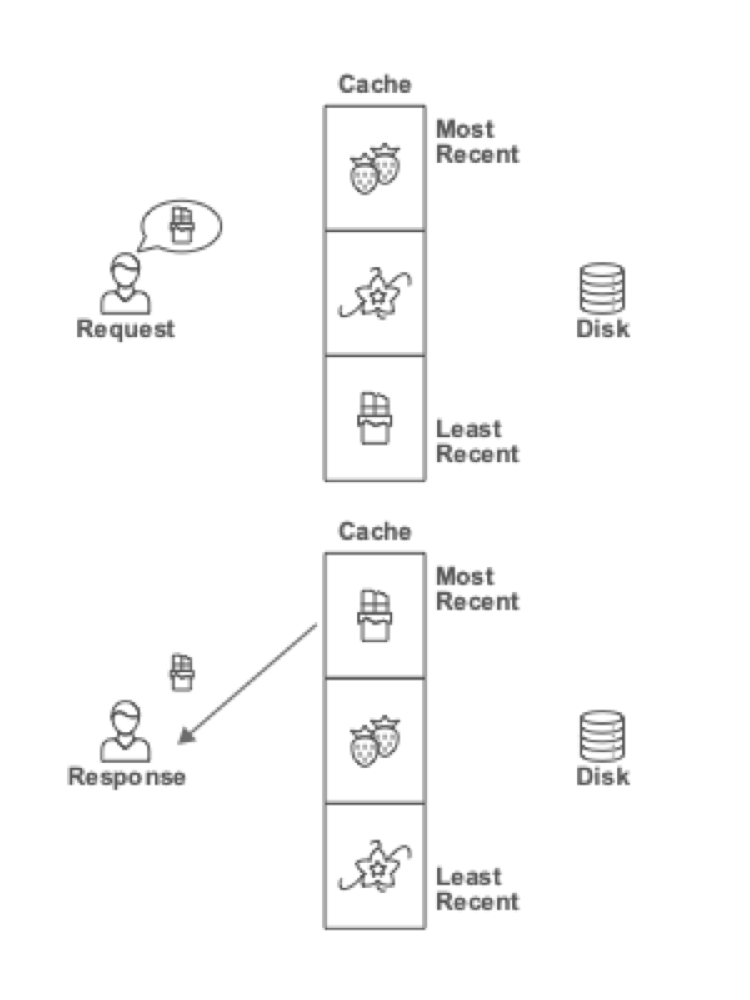
Lru eviction (example)

Slide 8
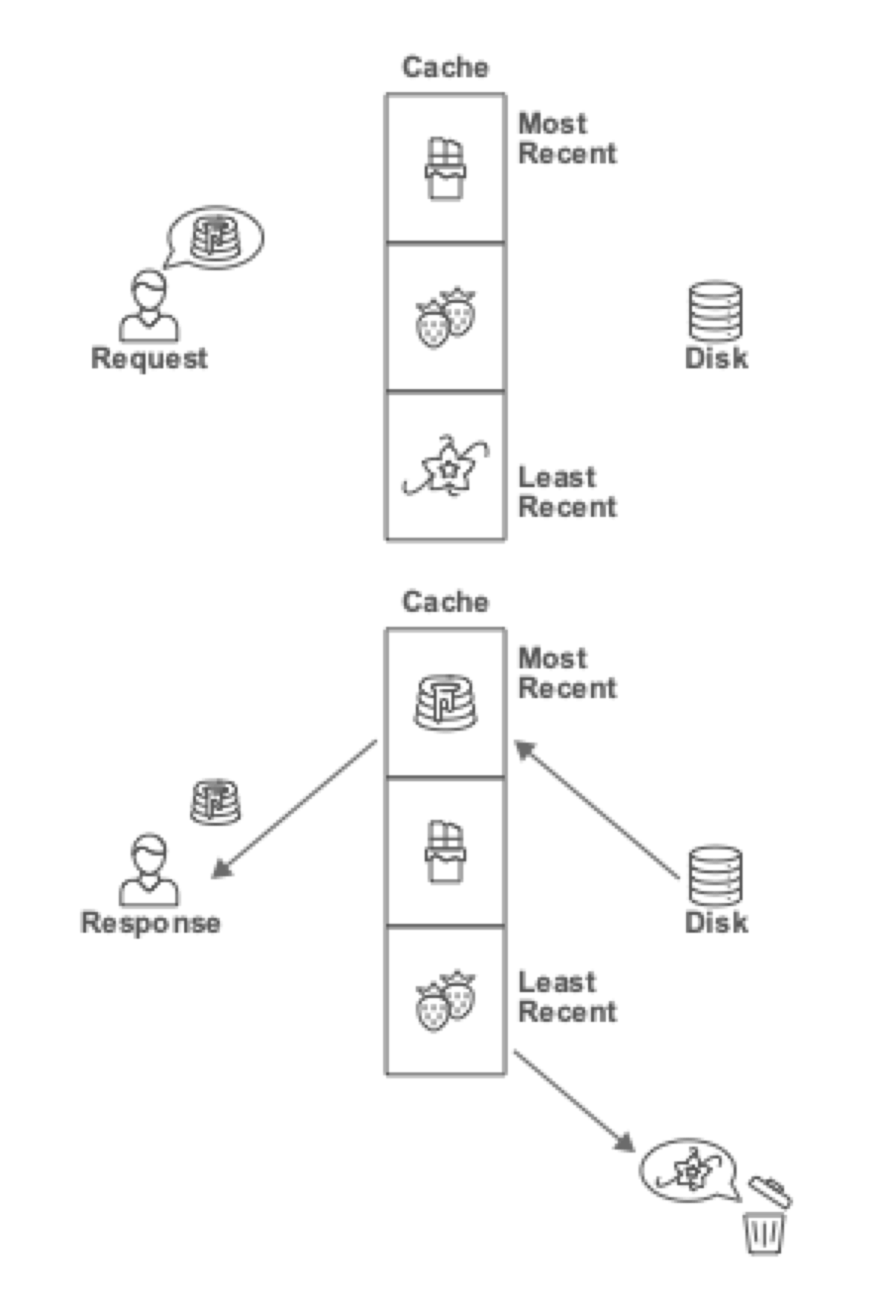
Lru eviction (example)

