Slide 1

BAGANETIC
A more meaningful
way to explore Bagan
A working mobile companion for heritage discovery, trip planning, and local travel context.
HERITAGE TRAVEL COMPANION • 10-MINUTE PITCH
Notes:
Open with the promise: Baganetic helps a visitor move from curiosity to a better-planned day in Bagan. This is a working Android app, not only a concept.
[Sources]
- Project asset: assets/images/stitch/bagan_sunrise.jpg (Baganetic workspace).
[/Sources]

Slide 2

THE PROBLEM
02
Planning Bagan
still means
switching tools.
Travellers move between maps, search, saved notes, and social advice—without one connected journey.
01
Discovery
Finding the right site often starts with scattered searches.
02
Planning
Routes, timing, and transport sit outside the heritage context.
Context
More effort.
Less meaning.
03
Stories and traveller advice are hard to carry into the visit.
BAGANETIC • EXPLORE WITH CONTEXT
Notes:
State the traveller problem clearly: planning a Bagan day often means jumping between maps, web searches, saved notes, and social advice. The issue is not a lack of information; it is that the journey is disconnected.
[Sources]
- Project asset: assets/images/stitch/shwesandaw_postcard.jpg (Baganetic workspace).
[/Sources]

Slide 3
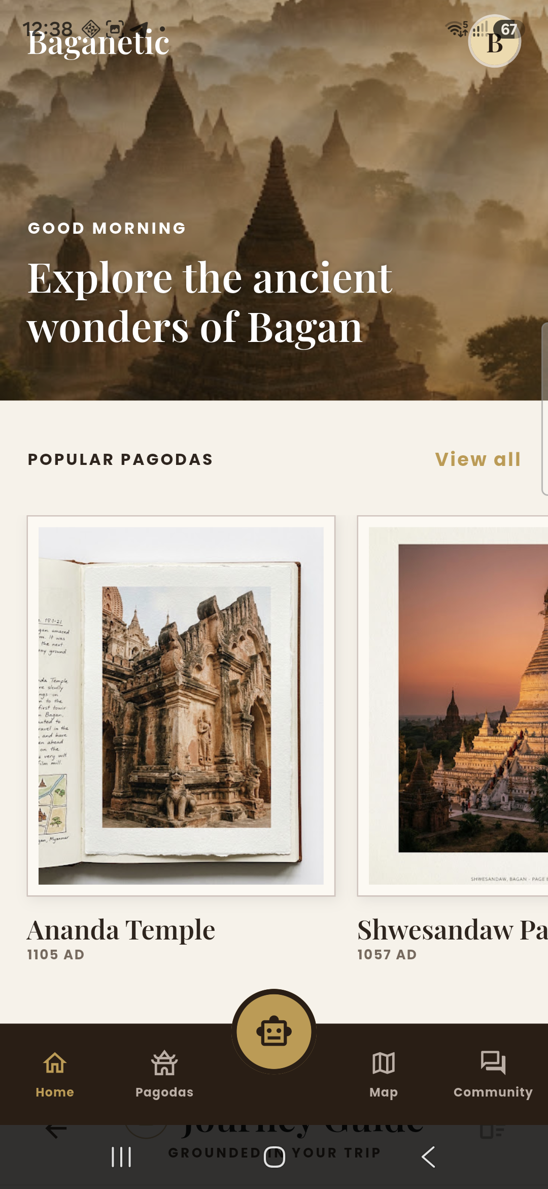
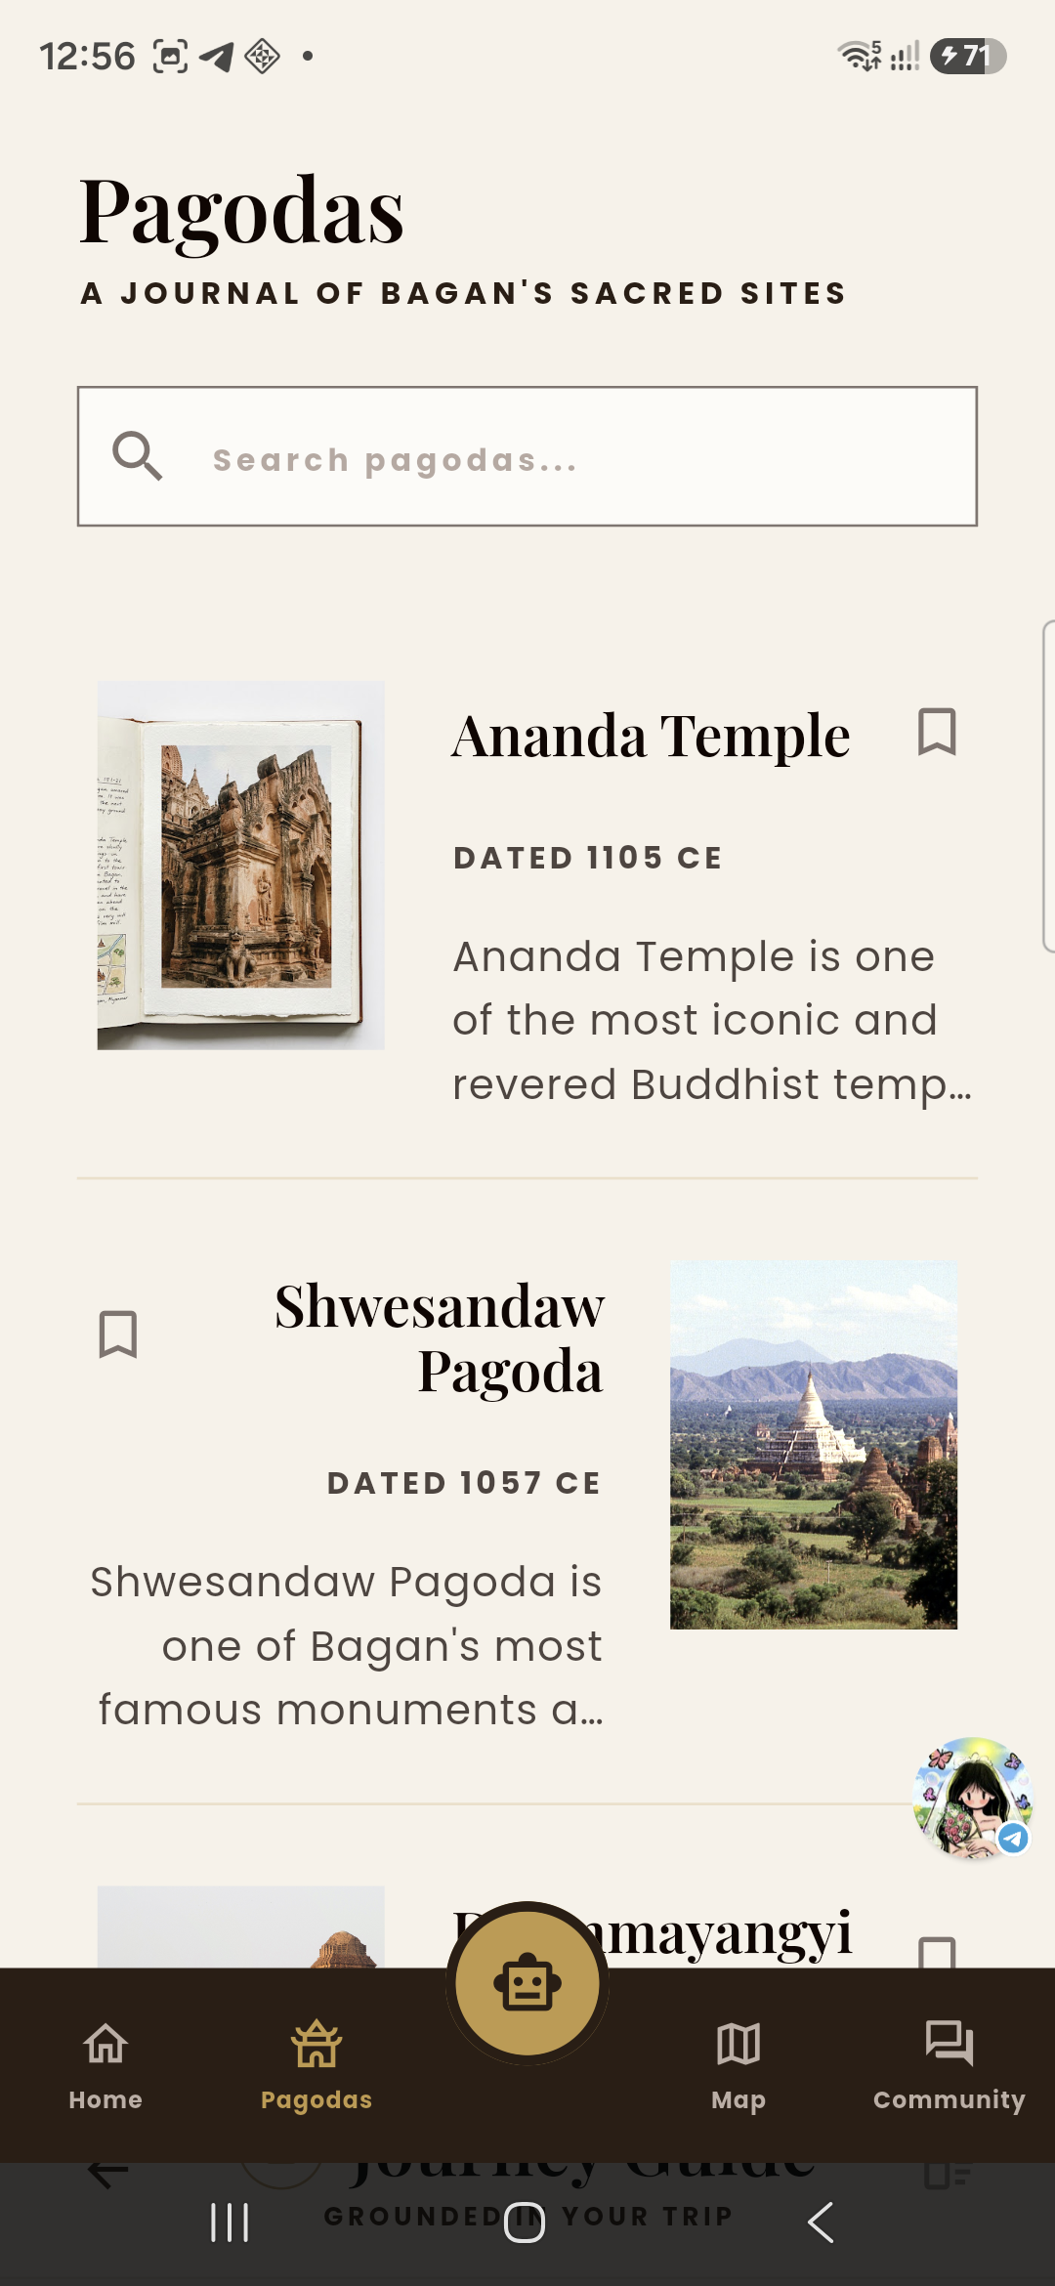
THE SOLUTION
03
One app.
One Bagan journey.
Baganetic brings discovery, saved places, routes, and local travel context into one clear mobile experience.
From curiosity to a well-planned day—without leaving the app.
DISCOVER
EXPLORE SITES
BAGANETIC • EXPLORE WITH CONTEXT
Notes:
Introduce Baganetic as the answer: one place to discover heritage, save meaningful sites, and move into practical planning. The next two slides show the main feature groups.
[Sources]
- Android screenshots: self-captured from the Baganetic running build on a Galaxy A56, 12 Aug 2026.
[/Sources]

Slide 4
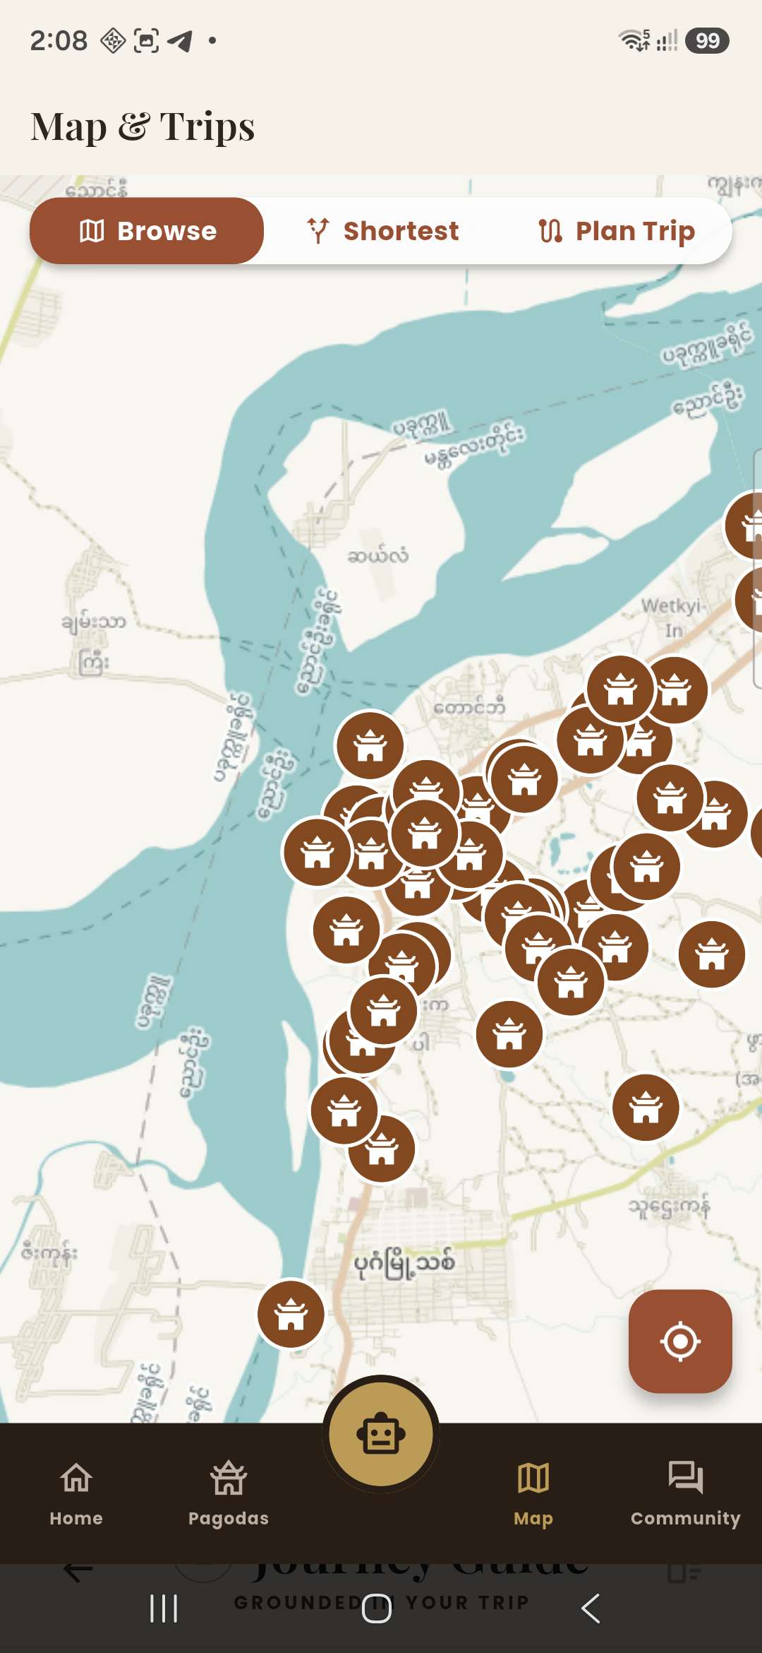
Features that
turn intent
into a journey.
Explore pagodas, compare routes, and build a trip directly inside the app.
FEATURE • MAP & TRIPS
Interactive markers, trip-planning modes, and a map fallback keep the route useful while travelling.
WORKING ON A PHYSICAL ANDROID DEVICE
Notes:
Feature one is practical planning. Point out the map markers, Browse, Shortest, and Plan Trip modes. Emphasize that the same app that inspires discovery also helps the traveller act on it.
[Sources]
- Android screenshot: self-captured from the Baganetic running build on a Galaxy A56, 12 Aug 2026.
- Map tiles: OpenStreetMap-compatible public tile services, rendered in the app.
[/Sources]

Slide 5
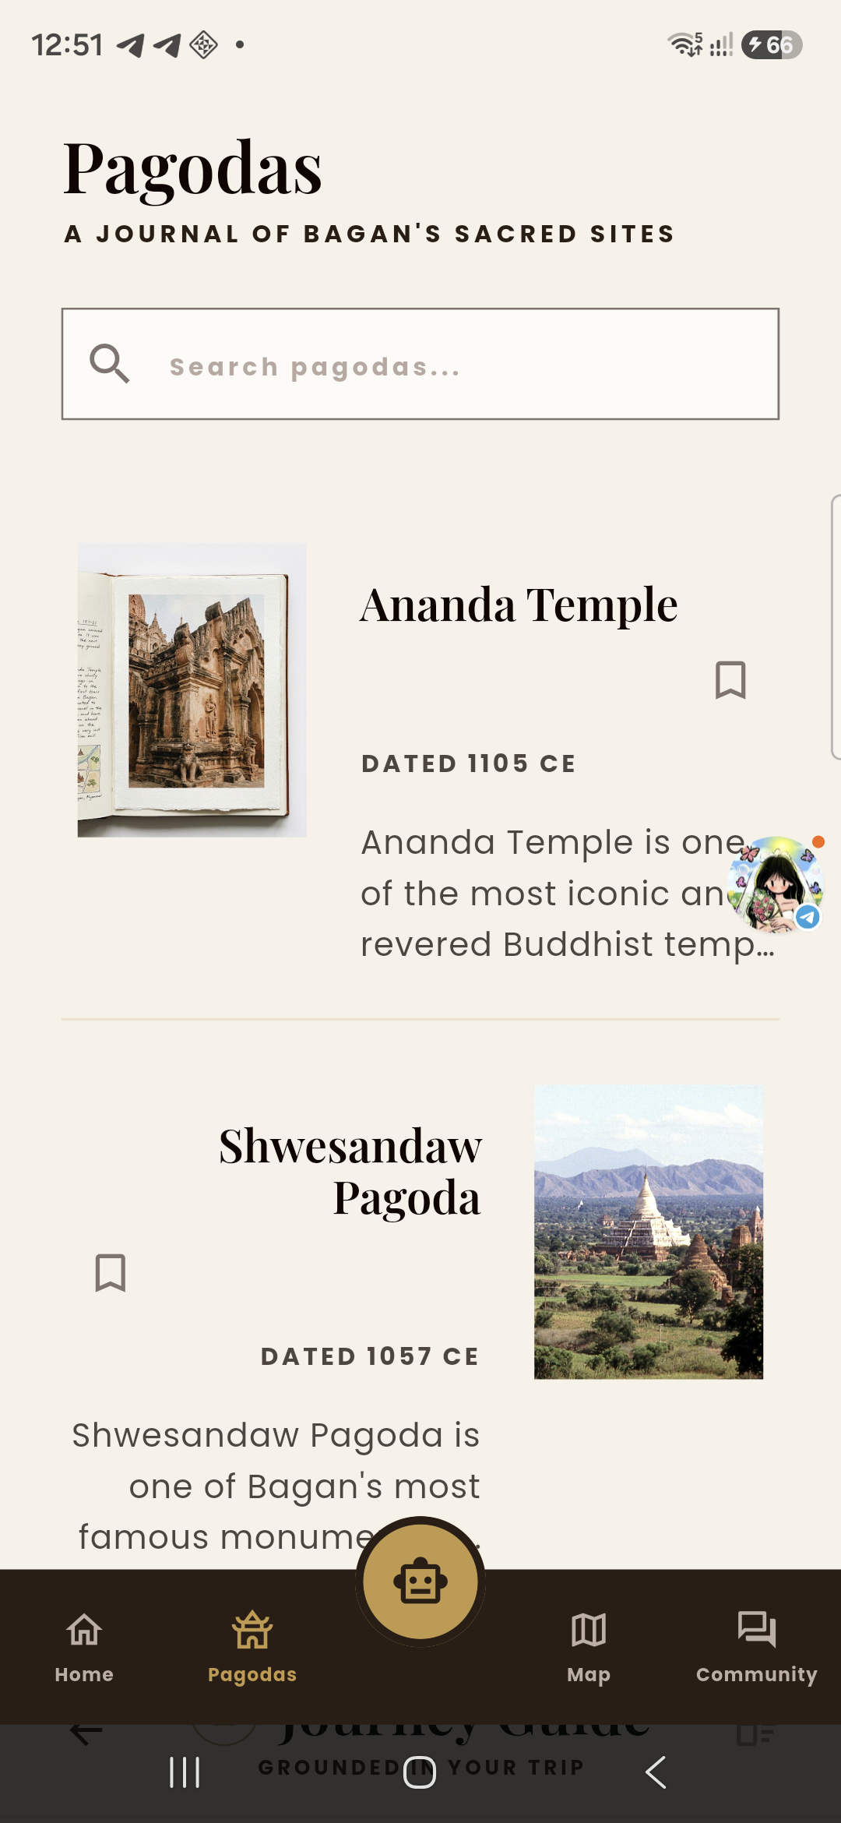
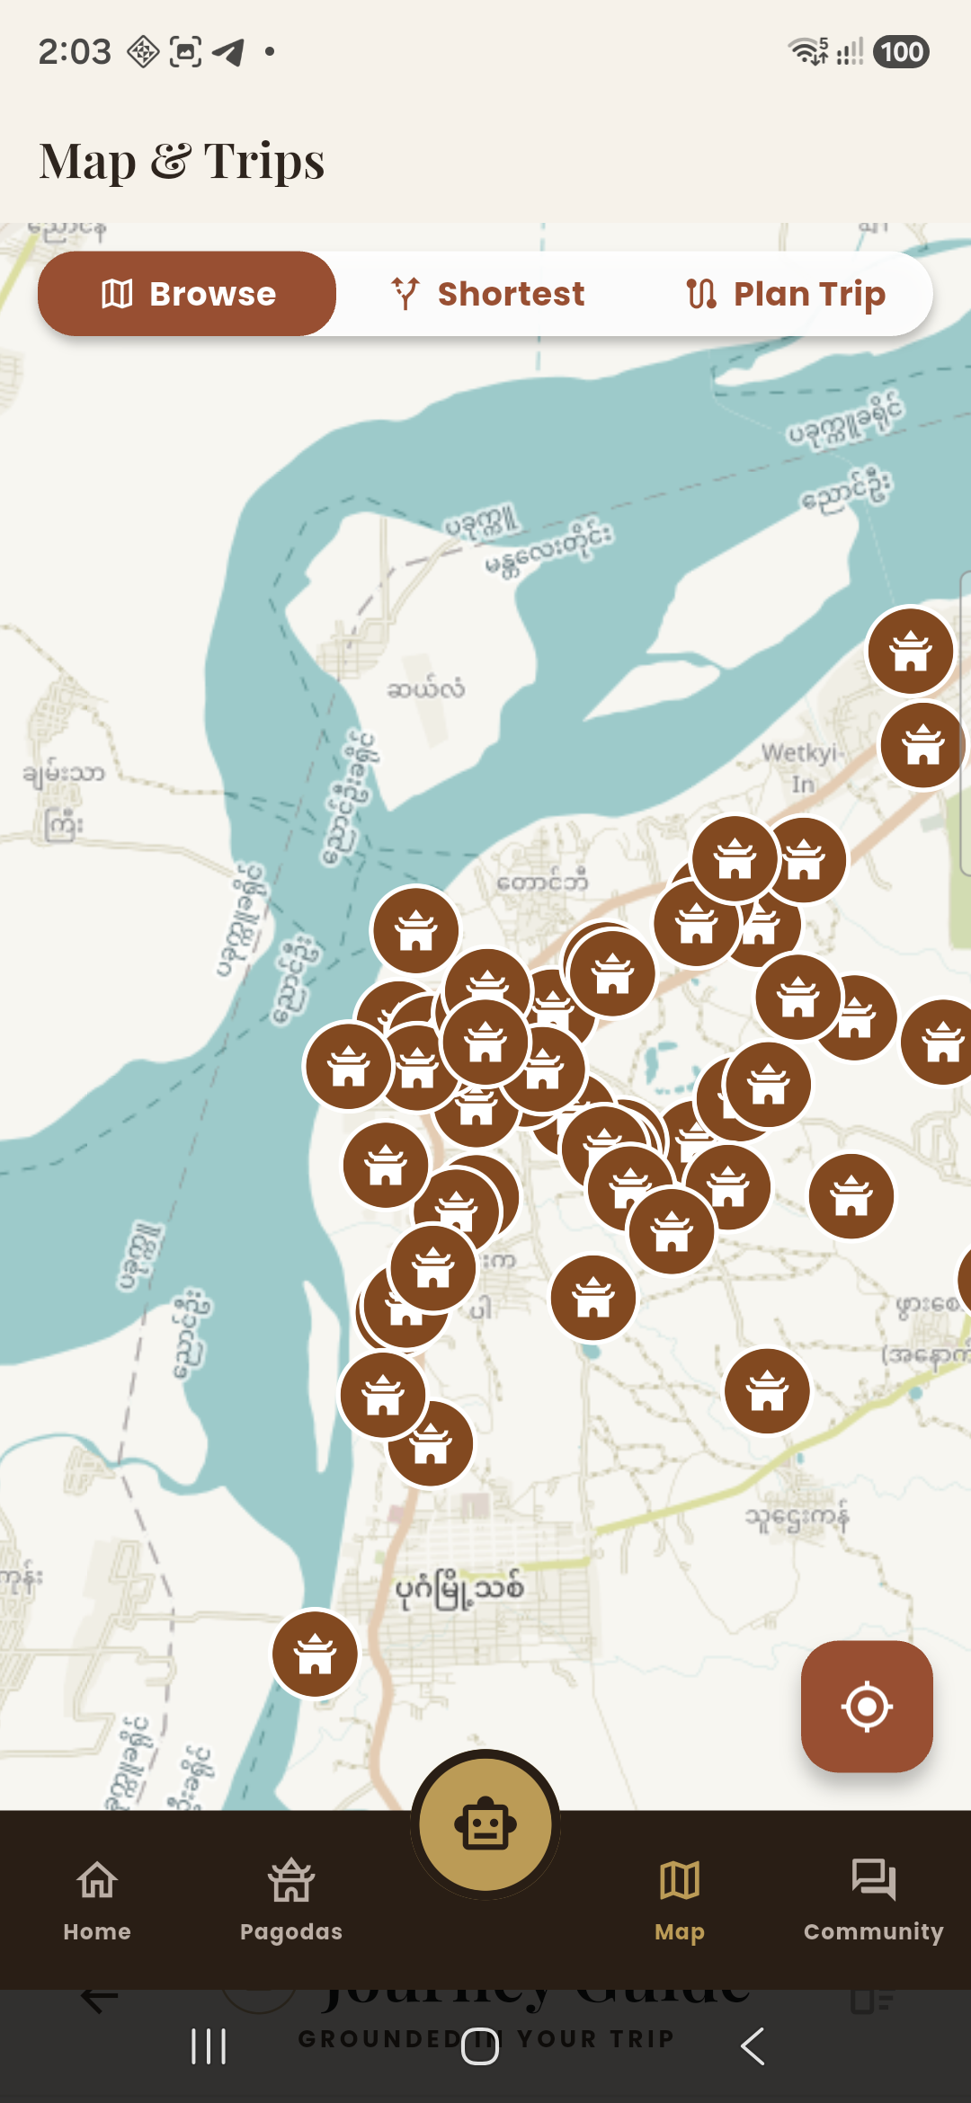
FEATURES • PERSONAL JOURNEY
05
Make every visit
your own.
Save pagodas, create journeys, join the community, and use the guide whenever you need context.
Useful before, during, and after the visit.
• Save meaningful places
• Build a route around time and travel mode
• Keep personal preferences and journeys together
• Ask or share through the AI guide and community
BAGANETIC • EXPLORE WITH CONTEXT
Notes:
Feature two is continuity. Explain that saving a site is not an isolated action: it can become part of a journey, a map route, a profile, and a conversation with other travellers.
[Sources]
- Android screenshots: self-captured from the Baganetic running build on a Galaxy A56, 12 Aug 2026.
[/Sources]

Slide 6
TECH STACK
06
A practical stack
behind the experience.
01
02
03
04
Flutter
Firebase
Maps
NVIDIA AI
Cross-platform mobile UI and navigation.
Authentication, Firestore data, and Storage.
Flutter Map, map tiles, and route services.
A guided travel assistant with live replies.
A focused stack connects a polished mobile experience to live cloud data.
BAGANETIC • EXPLORE WITH CONTEXT
Notes:
Keep this technical explanation short. Flutter delivers the mobile experience; Firebase handles identity and shared data; map services support exploration; NVIDIA AI powers the guide. Then move immediately to the working app.
[Sources]
- Stack reflects the Baganetic implementation in this project.
[/Sources]

Slide 7
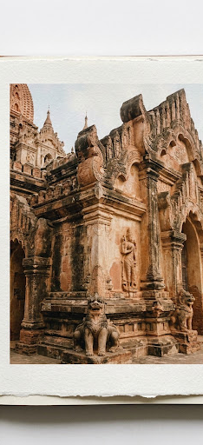
LIVE APP DEMO
07
One traveller flow.
Ready to show live.
•
Explore
Start on the visual home feed and open a pagoda.
•
Save
Bookmark a meaningful place for later.
•
Plan
Build a journey around saved stops and travel mode.
•
Navigate
Use the interactive map to explore with confidence.
•
Ask & share
Use the AI guide and community when context is needed.
Now switch to the
working Android app.
BAGANETIC • EXPLORE WITH CONTEXT
Notes:
This is the handoff to the live demo. Show the flow: Explore a pagoda, Save it, Plan a journey, Navigate on the map, then show the AI guide or community. Spend three to four minutes in the app.
[Sources]
- Project asset: assets/images/stitch/ananda_postcard.jpg (Baganetic workspace).
- Physical-device validation: Baganetic Android arm64 build tested on Galaxy A56, 12 Aug 2026.
[/Sources]

Slide 8
BAGANETIC
From curiosity
to a better Bagan journey.
Baganetic brings heritage discovery, practical planning, and local travel context into one working mobile app.
THANK YOU • LET'S SEE THE APP
Notes:
Close with the core takeaway: Baganetic turns fragmented planning into one more meaningful Bagan journey. Invite questions after the live demonstration.
[Sources]
- Project asset: assets/images/stitch/bagan_sunrise.jpg (Baganetic workspace).
[/Sources]

