Slide 1

BAGANETIC
A more meaningful
way to explore Bagan
Heritage discovery, trip planning, and local travel context in one mobile journal.
WORKING ANDROID PROTOTYPE • 10-MINUTE PITCH
Notes:
0:00–0:30. Open with the central promise: Baganetic makes a visit to Bagan easier to plan and richer to experience. The slides show the working Android result, not only a concept.
[Sources]
- Project asset: assets/images/stitch/bagan_sunrise.jpg (Baganetic workspace).
[/Sources]

Slide 2

THE OPPORTUNITY
02
Bagan is not just a place
to pin on a map.
Visitors need routes, but they also need stories, context, and confidence in the next stop.
01
Discover
Find sacred sites with a visual, searchable catalogue.
02
Plan
Turn saved places into a practical journey.
Experience
A travel companion
rooted in place
03
Keep local context and traveller knowledge together.
BAGANETIC • EXPLORE WITH CONTEXT
Notes:
0:30–1:30. Make the problem personal: planning a Bagan day usually splits between maps, searches, notes, and social advice. Baganetic brings these actions into one coherent journey.
[Sources]
- Project asset: assets/images/stitch/shwesandaw_postcard.jpg (Baganetic workspace).
[/Sources]

Slide 3
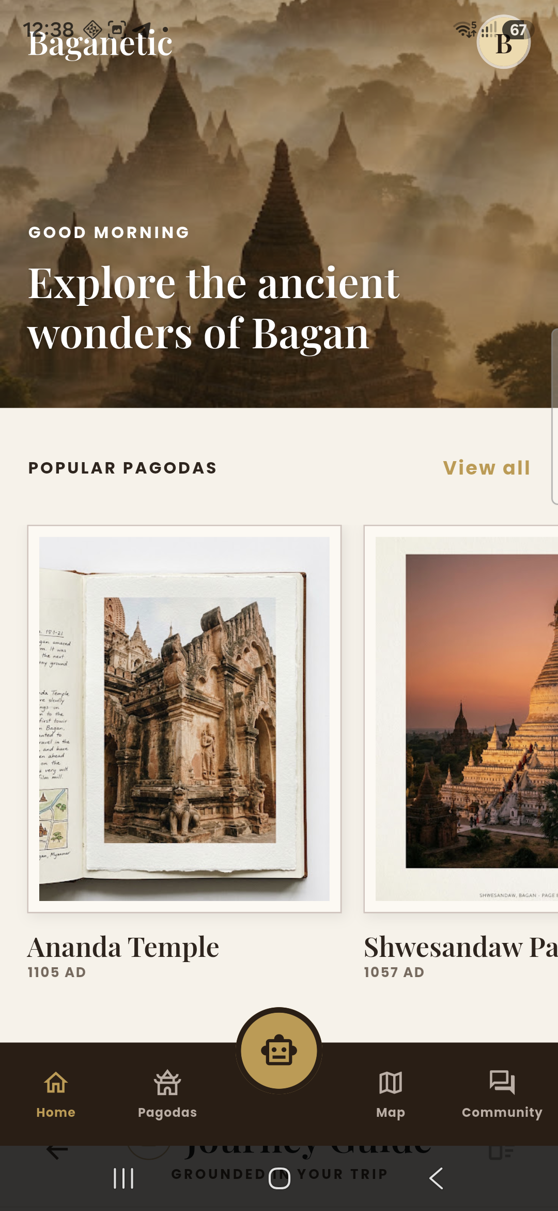
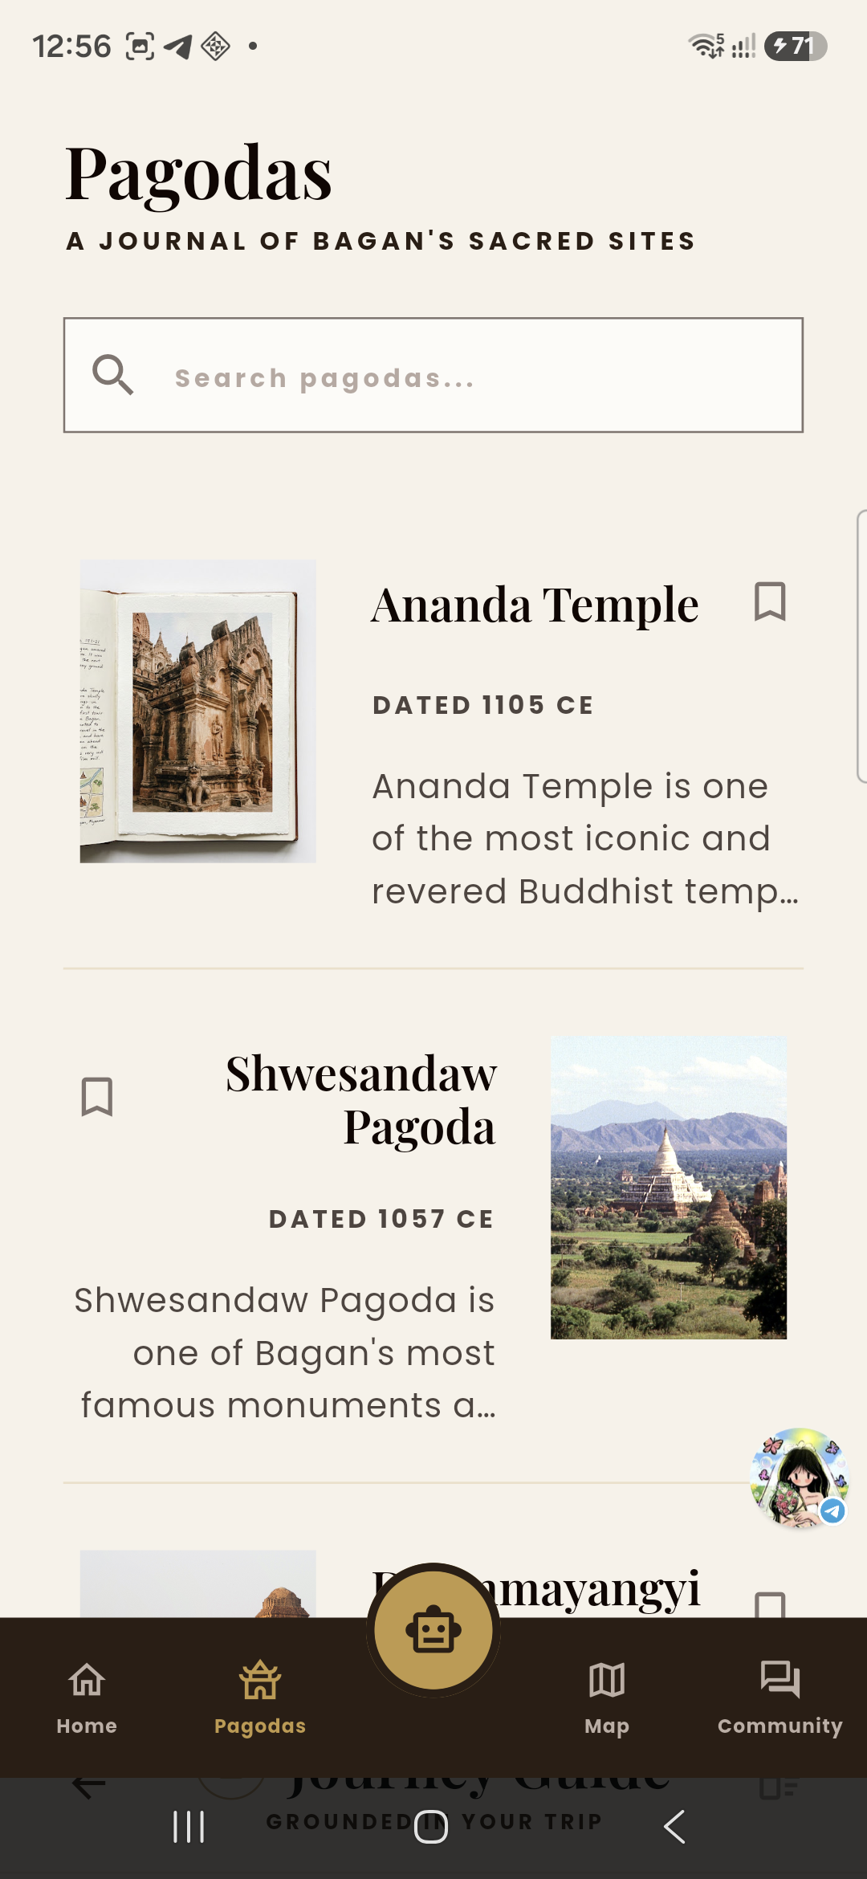
WORKING RESULT • DISCOVERY
03
Start with atmosphere.
Continue with detail.
The home screen presents Bagan as a visual journal; the pagoda catalogue makes the next site easy to find and save.
Visual cards make heritage feel inviting—not like a database.
HOME
PAGODA CATALOGUE
BAGANETIC • EXPLORE WITH CONTEXT
Notes:
1:30–3:00. Show these two screens briefly. Point out the visual home experience, featured pagodas, search, reading-friendly detail, and bookmark action. Then move to the map, where a saved place becomes a route.
[Sources]
- Android screenshots: self-captured from the Baganetic running build on a Galaxy A56, 12 Aug 2026.
[/Sources]

Slide 4
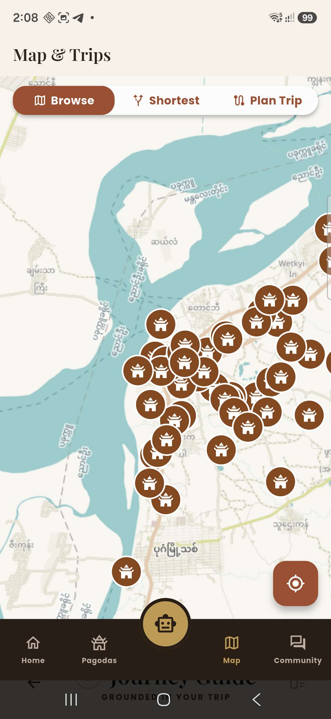
A map that
turns intent
into a journey.
Browse sites, compare routes, and plan a trip directly inside the app.
MAP RELIABILITY
The Android build now uses a primary tile source with automatic OpenStreetMap fallback—so a traveller is not dependent on one map server.
WORKING ON A PHYSICAL ANDROID DEVICE
Notes:
3:00–4:30. This is the key proof slide. Show the working map on the physical Android build. Explain that map markers represent the pagodas and the app offers Browse, Shortest, and Plan Trip modes. Mention the practical reliability improvement only briefly.
[Sources]
- Android screenshot: self-captured from the Baganetic running build on a Galaxy A56, 12 Aug 2026.
- Map tiles: OpenStreetMap-compatible public tile services, rendered in the app.
[/Sources]

Slide 5
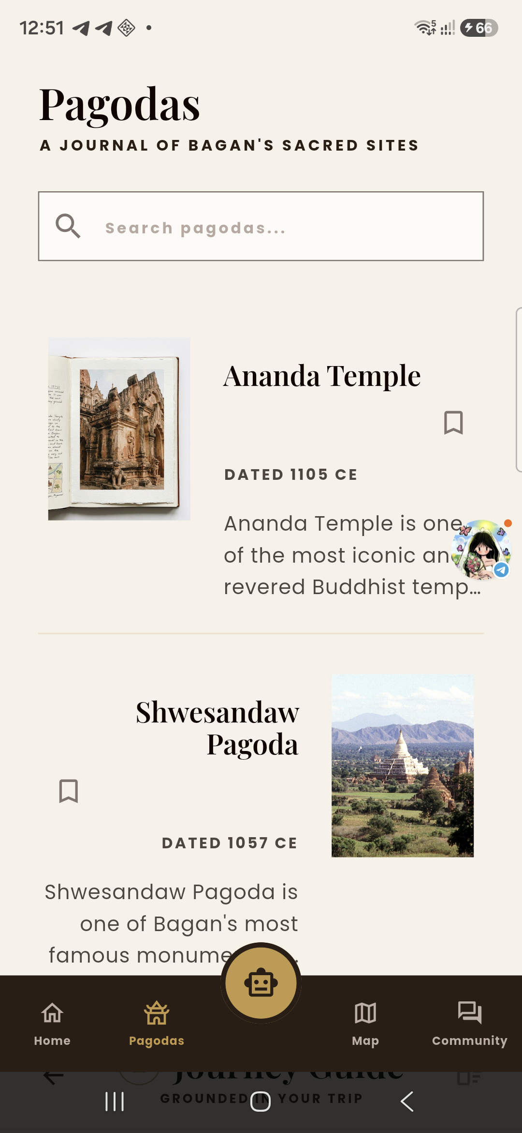
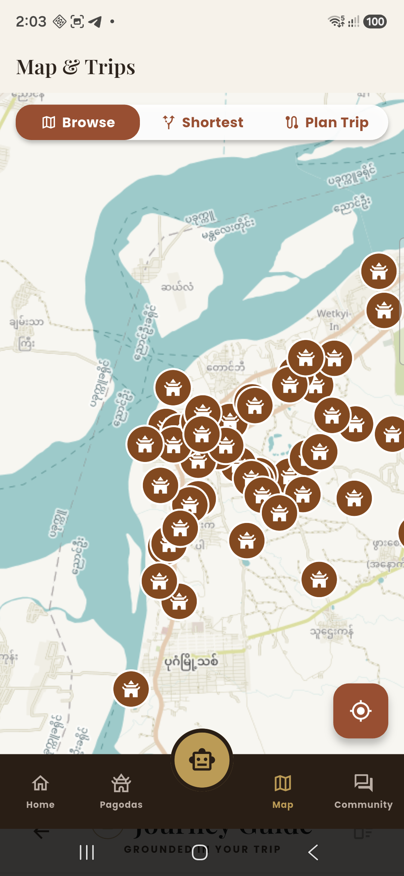
WORKING RESULT • PERSONAL JOURNEY
05
The visit becomes
a personal journal.
Saved pagodas, planned journeys, profile preferences, and community posts keep the experience useful before, during, and after the trip.
Built for the visitor journey—not just the visit.
• Save meaningful places
• Shape a route around time and travel mode
• Keep a local travel identity
• Participate through tips and questions
BAGANETIC • EXPLORE WITH CONTEXT
Notes:
4:30–6:00. Connect features to a single traveller story: discover Ananda, save it, add it to a journey, then return to the map. Community and profile complete the product as an ongoing travel journal.
[Sources]
- Android screenshots: self-captured from the Baganetic running build on a Galaxy A56, 12 Aug 2026.
[/Sources]

Slide 6
LIVE DEMO
06
One traveller journey.
Four simple actions.
01
02
03
04
Explore
Save
Plan
Go
Open the home feed and discover a pagoda.
Bookmark a place worth returning to.
Add saved stops to a journey on the map.
Use the route view to explore with confidence.
Live proof matters: the pitch can move straight from this slide into the Android app.
BAGANETIC • EXPLORE WITH CONTEXT
Notes:
6:00–8:30. Use this slide as the handoff to the live demo. Spend roughly 30 seconds per action. If time is short, show Explore → Save → Plan only; the audience will still see the complete loop.
[Sources]
- Product flow reflects the working Baganetic Android build.
[/Sources]

Slide 7
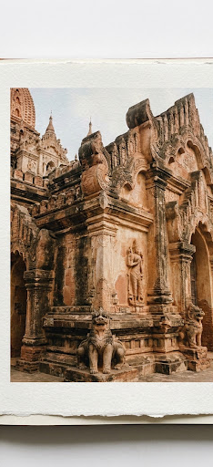
WHAT HAS BEEN DELIVERED
07
A working result—
not a static concept.
•
Flutter mobile app
Responsive mobile interface and app navigation
•
Pagoda discovery
Searchable, detail-rich sacred-site catalogue
•
Map & trips
Interactive map, markers, planning modes, and tile fallback
•
Personal experience
Saved places, journeys, profile, and community modules
•
Physical-device validation
Built and tested as an Android arm64 application
A focused foundation
for traveller feedback.
BAGANETIC • EXPLORE WITH CONTEXT
Notes:
8:30–9:30. Summarize the tangible output. Keep the language grounded: this is a working prototype that proves the main experience and is ready to be tested with real travellers.
[Sources]
- Project asset: assets/images/stitch/ananda_postcard.jpg (Baganetic workspace).
- Physical-device validation: Baganetic Android arm64 build tested on Galaxy A56, 12 Aug 2026.
[/Sources]

Slide 8
BAGANETIC
Explore Bagan
with context.
A working mobile journal for discovery, planning, and a more personal journey through Bagan.
READY FOR A LIVE DEMO
Notes:
9:30–10:00. Close by returning to the promise: Baganetic lets a visitor move from curiosity to a more meaningful, better-planned day in Bagan. Invite the audience to watch the live demo or ask questions.
[Sources]
- Project asset: assets/images/stitch/bagan_sunrise.jpg (Baganetic workspace).
[/Sources]

