Slide 1
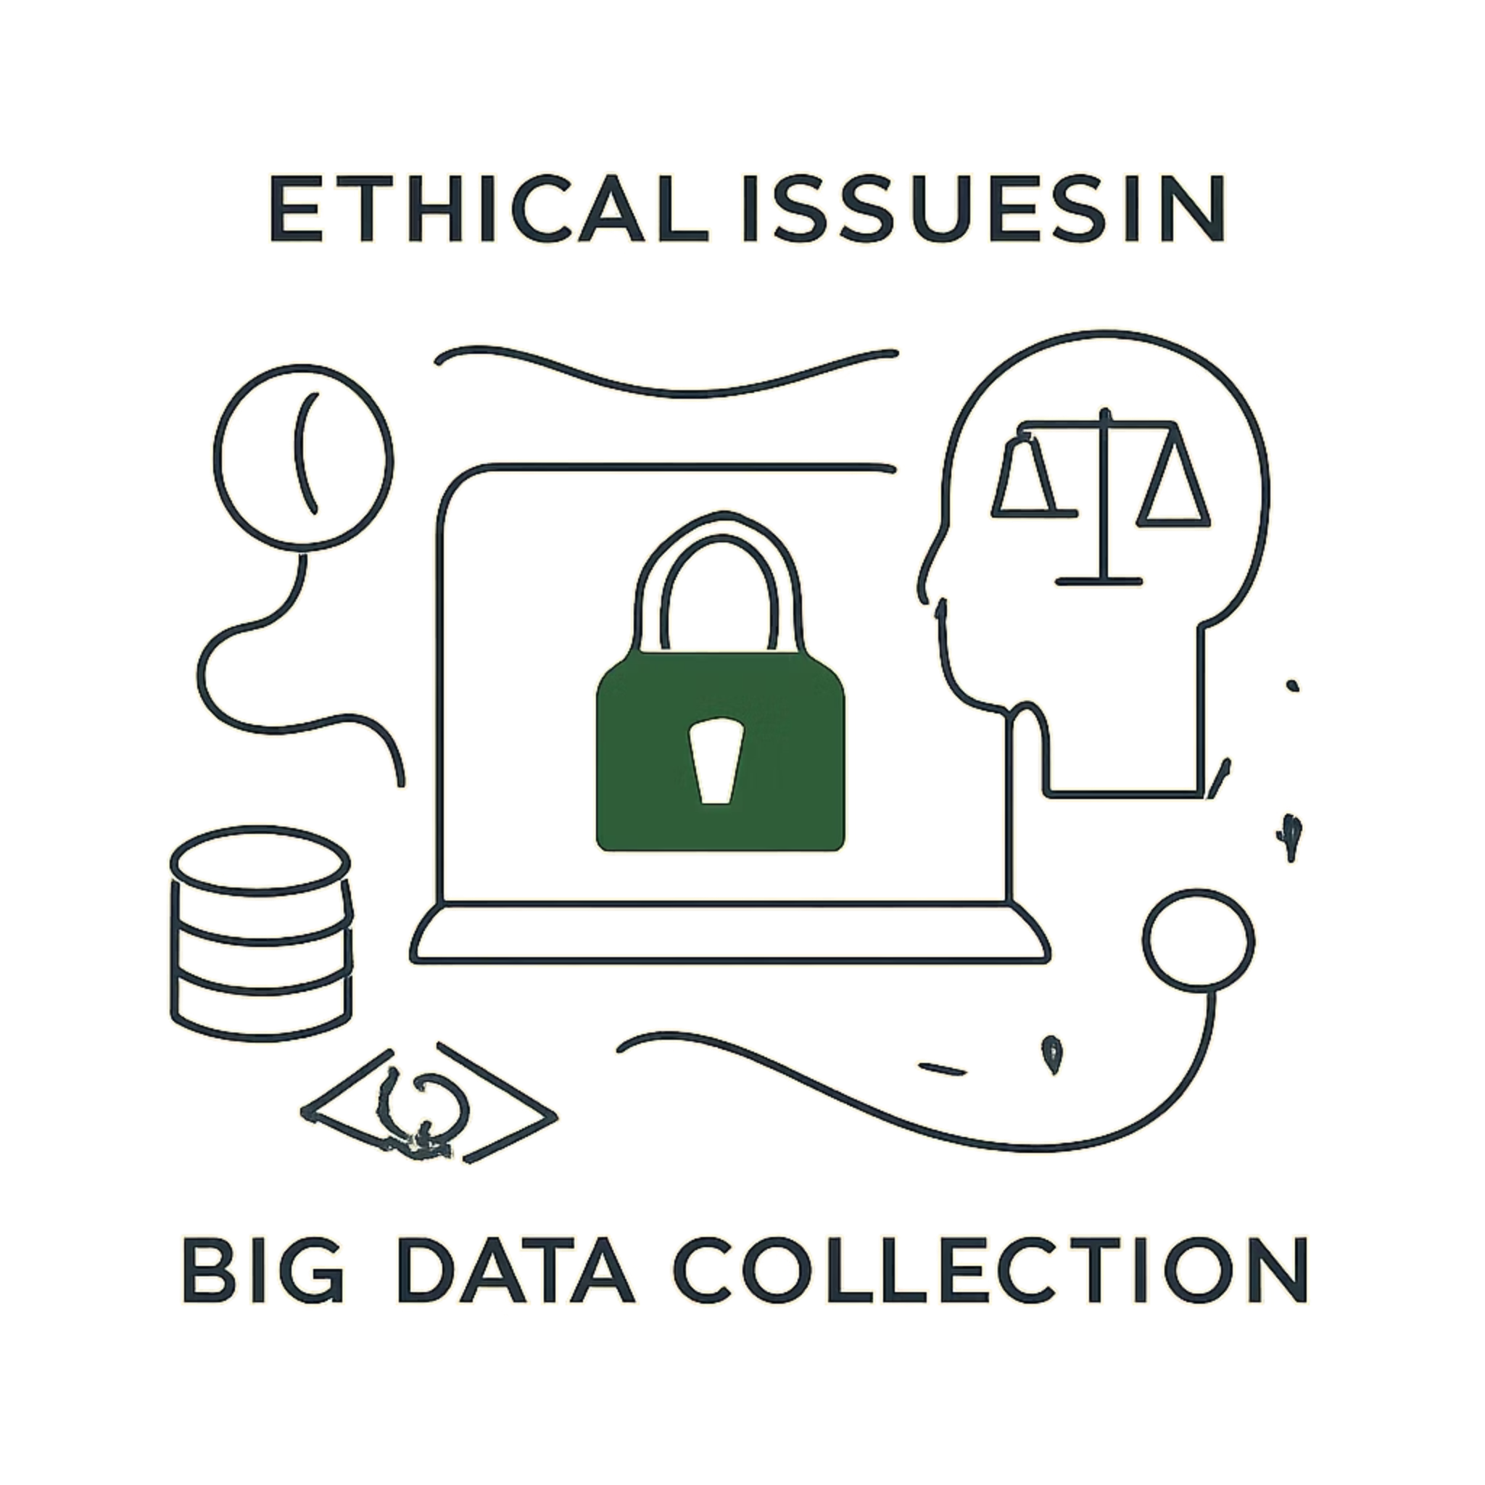
Ethical Issues in Big Data Collection
By: Swosti Makaju

Slide 2
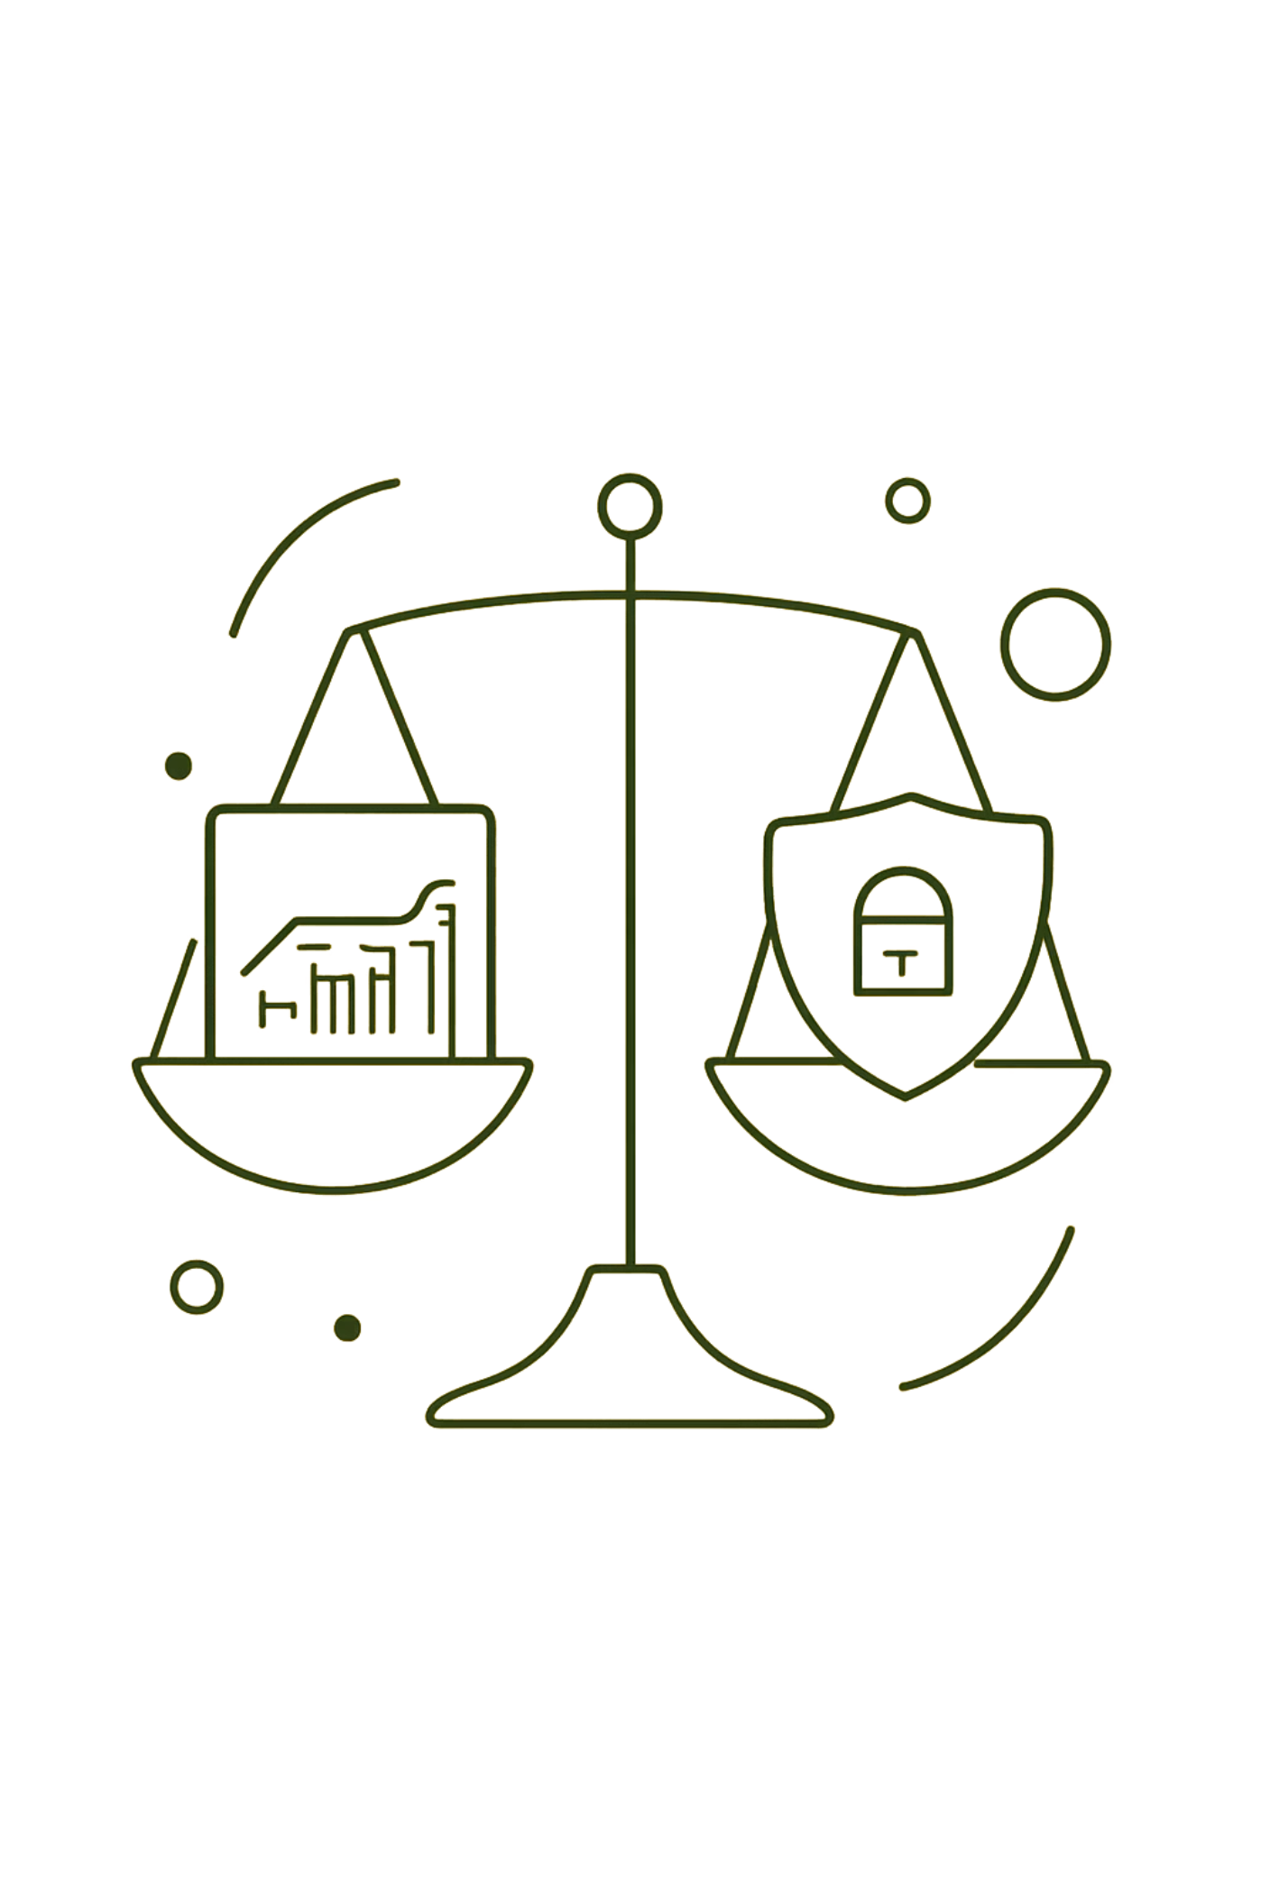
The Big Data Paradox: Innovation vs. Individual Rights
Big data fuels powerful innovation — personalized services, public‑health insights, and predictive systems. Yet the same scale and velocity of data collection can erode individual autonomy, amplify harms, and shift power toward organizations that control information.

Slide 3

Sources of Big Data
Before diving into ethical issues, it's important to understand where data comes from:
Social media
Mobile apps
Posts, likes, shares, and engagement patterns
Location, usage behavior, and device sensors
IoT devices
E-commerce platforms
Smart home systems, wearables, and connected infrastructure
Purchase history, browsing, and payment data
Healthcare records
Government databases
Medical histories, prescriptions, and biometric data
Tax records, licenses, and public registries
These diverse sources combine to create the massive datasets that power modern analytics and AI systems.

Slide 4
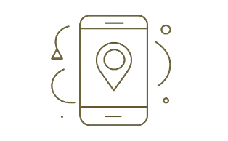
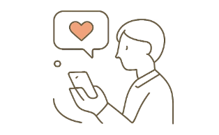
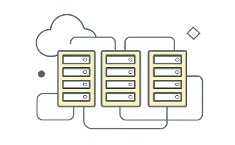
The Surveillance Apparatus
Ubiquitous collection
The price of free
State-level capabilities
“Free” services frequently convert personal behaviors into monetizable profiles — privacy becomes the currency of digital markets.
Companies gather clickstreams, location pings, sensor logs, and social signals at massive scale — often continuously and invisibly.
Private firms now operate infrastructure and analytic capabilities comparable to intelligence agencies — raising oversight and accountability questions.

Slide 5
Real-world Examples
Facebook and the Cambridge Analytica scandal
Netflix re-identification case
AOL search data leak
AOL released search logs from 650,000 users, intended to be anonymous. Journalists quickly identified individuals by their search queries, exposing private health concerns, financial struggles, and personal secrets.
Netflix released an "anonymized" dataset for a competition. Researchers matched records to IMDb reviews, exposing user identities and revealing sensitive viewing preferences.
Political consulting firm harvested personal data from millions of Facebook users without consent, using psychological profiles to target political messaging during elections.
These examples demonstrate how data breaches, misuse, and inadequate anonymization can harm individuals and erode public trust.

Slide 6
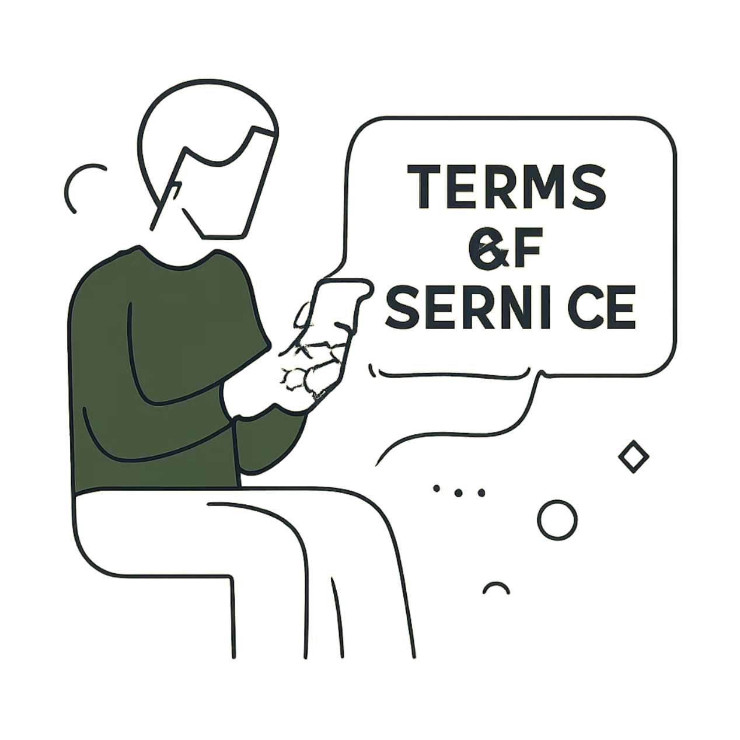
The Illusion of Consent
Why consent often fails:
Lengthy, jargon-filled agreements obscure implications of data use.
Defaults and pre-checked boxes shift the burden to users.
Consent for one purpose becomes a license for secondary uses.
Regulatory efforts like GDPR enforce transparency and purpose-limitation, but practical gaps remain between legal formality and genuine informed choice.

Slide 7
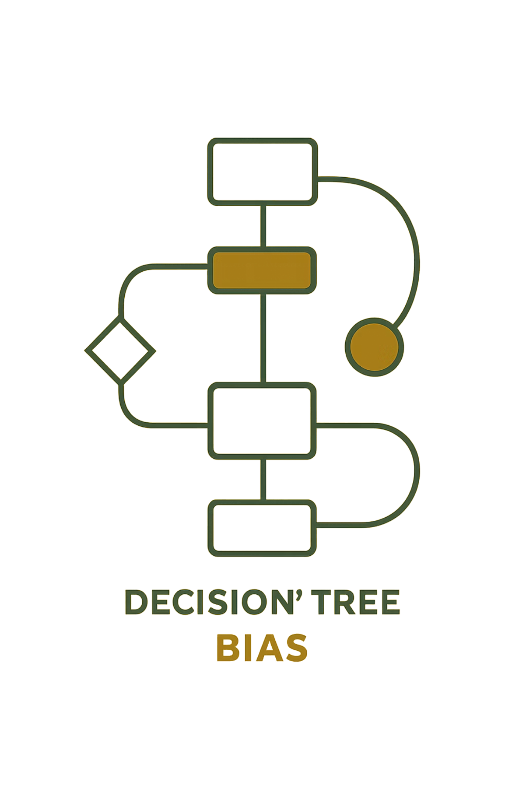
When Algorithms Reflect Our Worst Impulses
Bias by design
Historical data encodes social inequalities. Without correction, models replicate and amplify discrimination in hiring, lending, and policing.
Predicting the private
Research shows models can infer sensitive traits (e.g., health, sexuality) from images or behavior — often without consent or explanation.
Correlation ≠ causation
Automated decisions based purely on correlation risk incorrect or harmful inferences — human judgment and causal scrutiny are essential.

Slide 8

Case Study: The "Big Brother" University
Georgia State University used predictive analytics to identify at-risk students and intervene. Outcome: reported 37% increase in minority graduation rates.
Benefit: measurable improvement in retention and outcomes.
Ethical tension: constant tracking of attendance, LMS activity, and behaviors.
Question: Do positive outcomes justify pervasive surveillance without robust consent, oversight, and recourse?

Slide 9
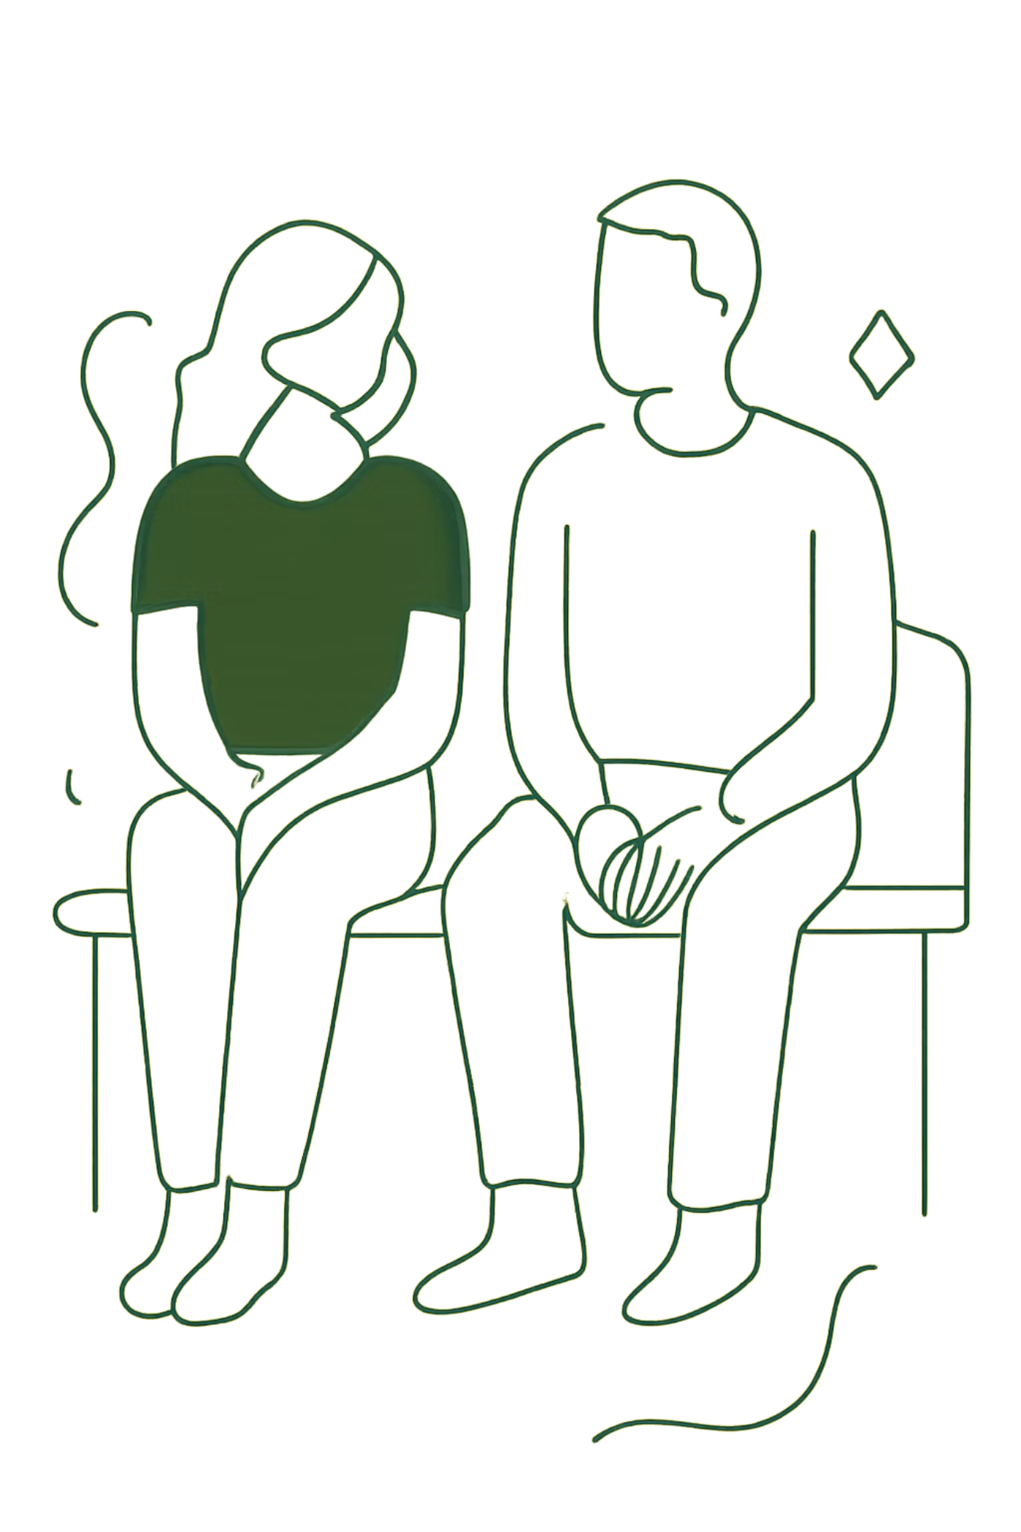

The Privacy Mirage
“Anonymization” is often fragile. High‑profile reidentification cases (AOL, Netflix) show how auxiliary data can reconstruct identities. Data persists — reused for new purposes long after collection — undermining the promise of permanent privacy safeguards.
Right to be forgotten exists in law but is technically and procedurally difficult to guarantee across data brokers and backups.

Slide 10
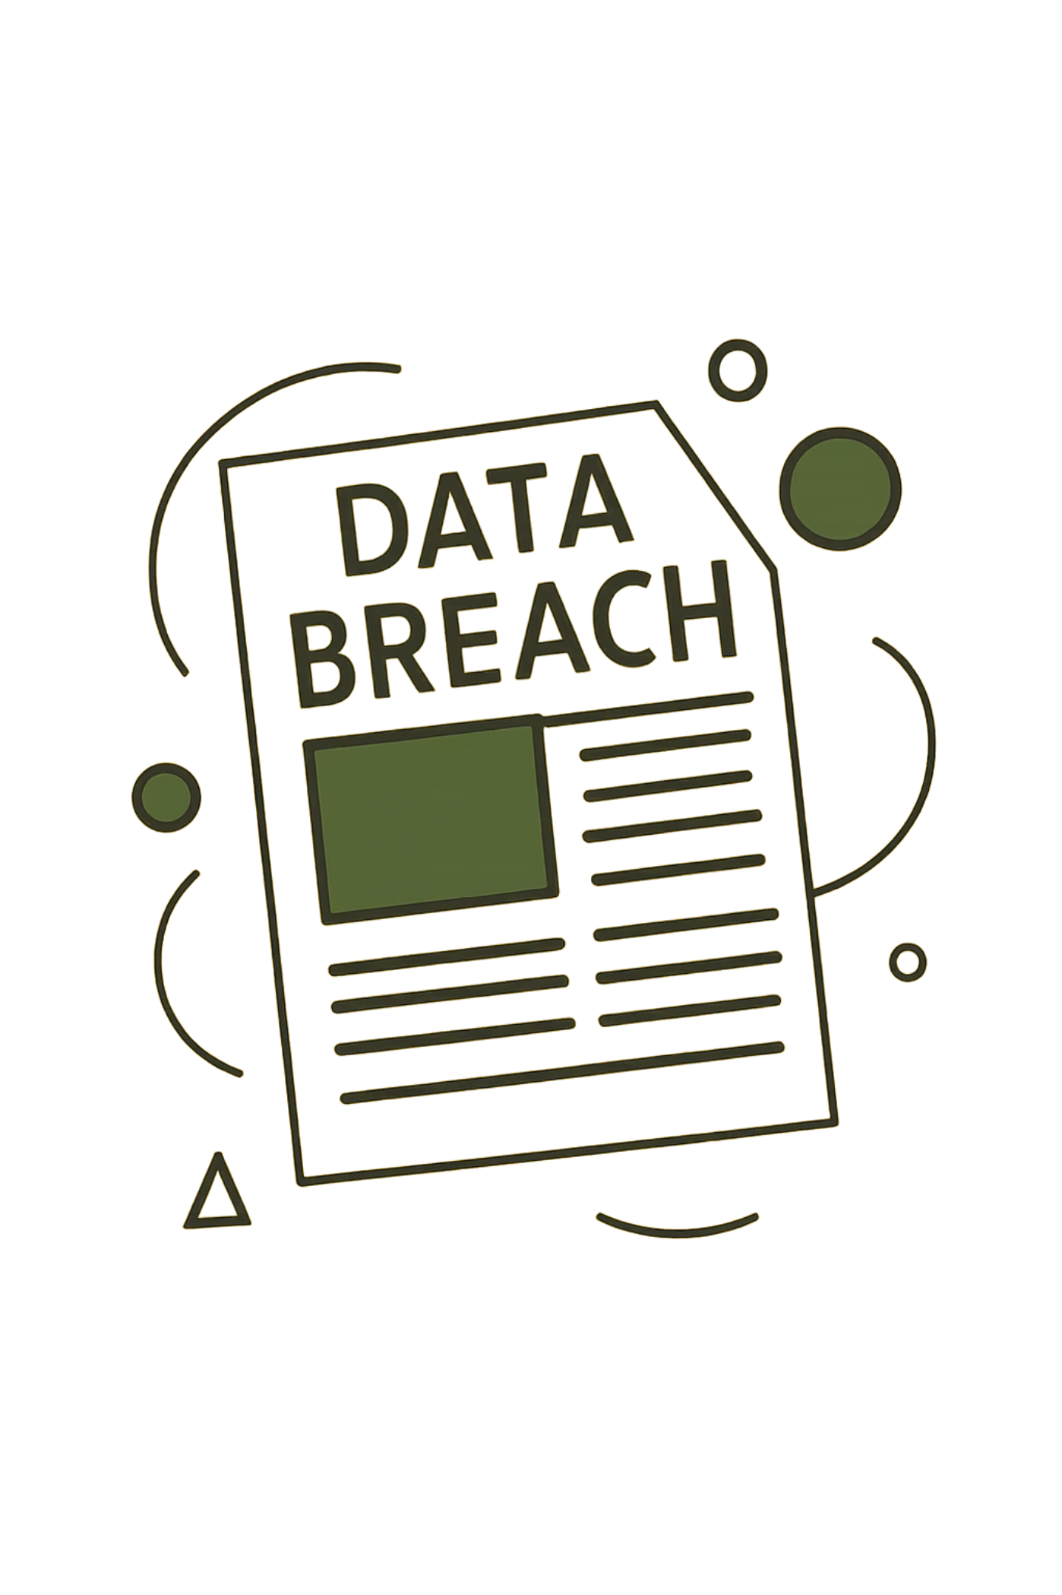
The Hidden Costs of Data Misuse
Lives at risk
Ethics beyond law
Breaches expose sensitive details that can endanger individuals — from identity theft to physical safety concerns.
Legal permissibility doesn't equal moral acceptability: firms may do what they can, not what they should.
Trust erosion
Repeated misuse reduces public trust, degrading the social license that enables beneficial data-driven services.

Slide 11
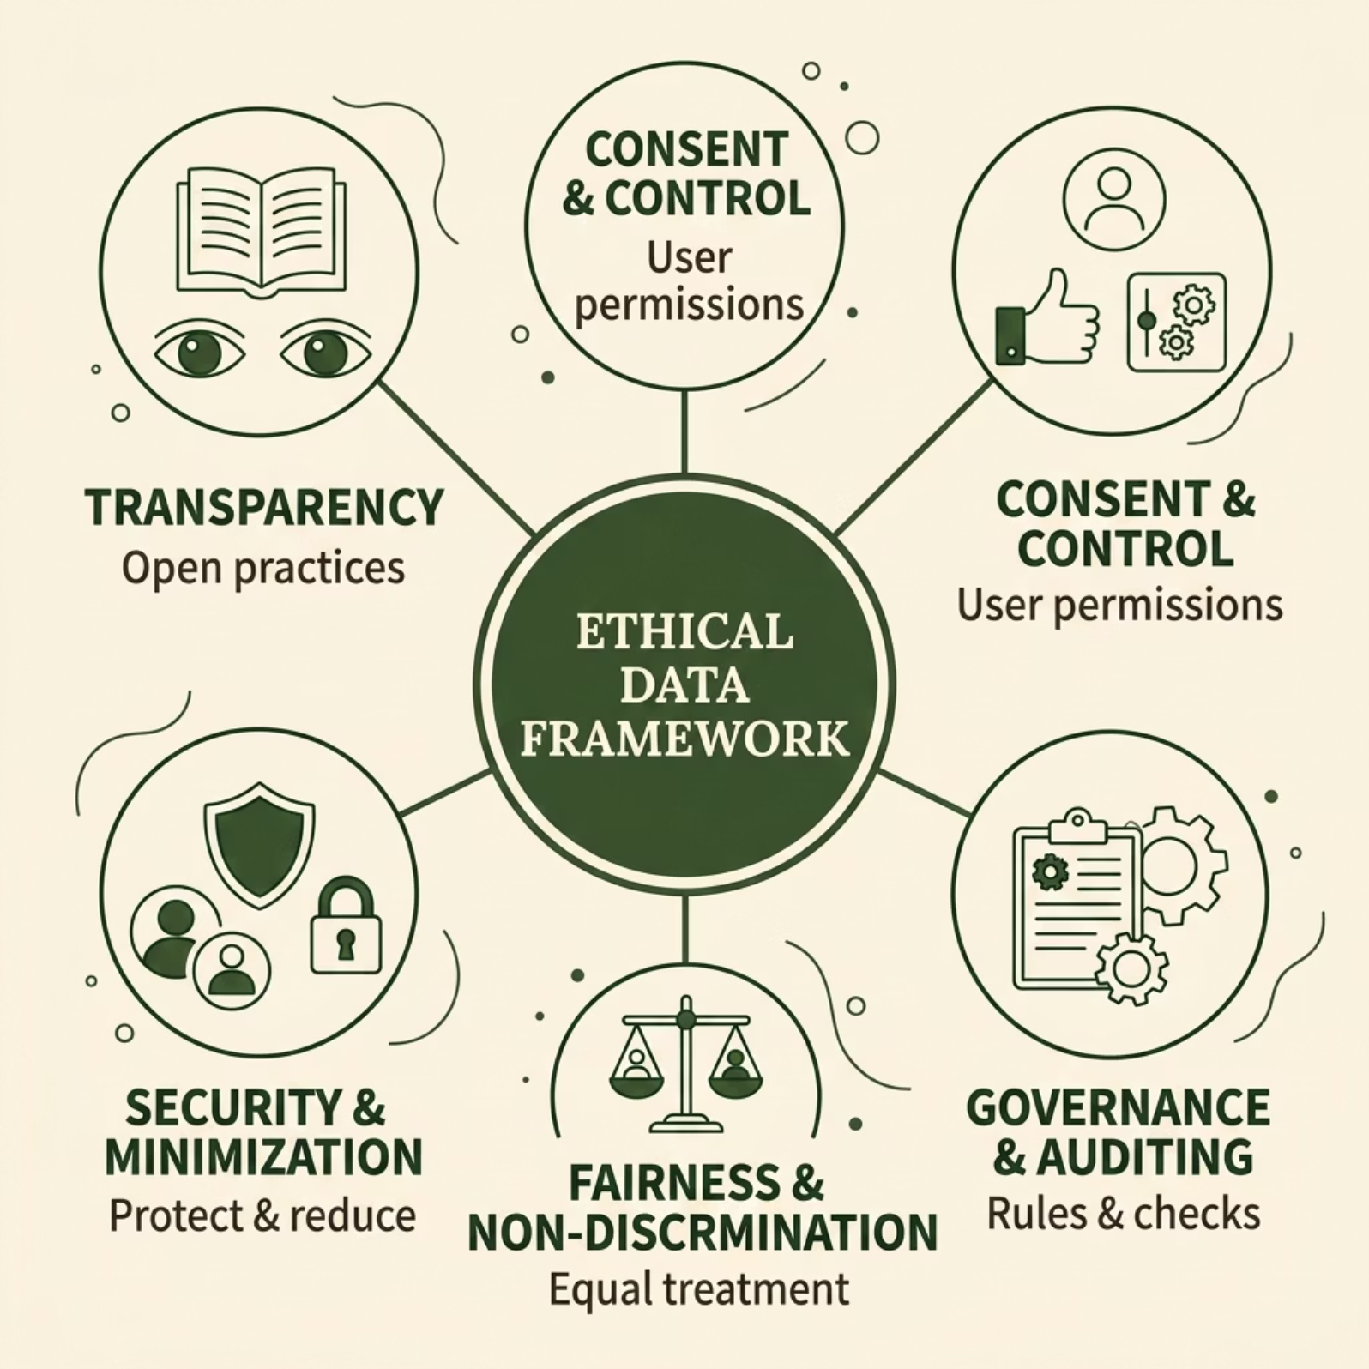
Building an Ethical Framework
Core pillars
Transparency — clear, accessible disclosures of collection, purpose, and retention.
Proactive governance — audits, lineage tracking, and enforceable policies.
Fairness by design — bias testing, representative data, and equitable objectives.

Slide 12
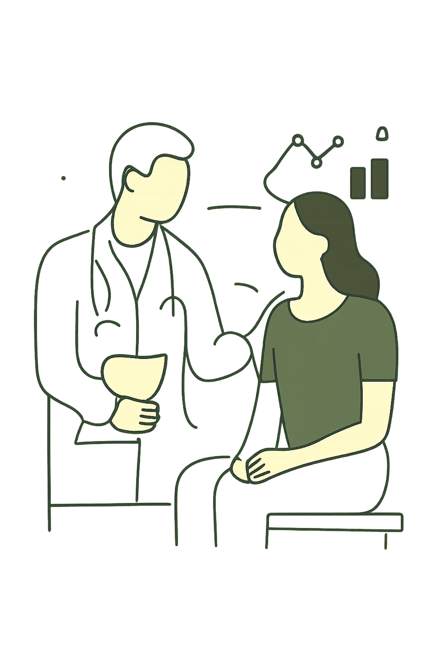
First, Do No Harm
Adopt research-grade ethics
Human oversight
Keep experts in the loop to interpret model outputs and intervene where harm is possible.
Apply consent principles, independent review, and harm‑impact assessments to commercial projects.
Ethical gatekeeping
Shift decisions from “Can we?” to “Should we?” with governance gates before deployment.

Slide 13
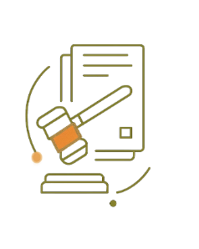
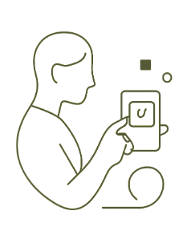
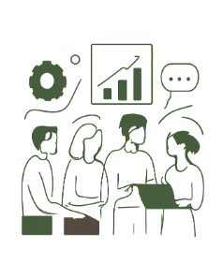
Call to Action: The Responsible Data Future
Demand accountability
Champion user autonomy
Make ethics a competitive advantage
Organizations should exceed mere compliance — publish audits, impact assessments, and remediation plans.
Give people real, usable controls: granular consent, data portability, and easy deletion.
Embed ethical practices in product roadmaps and celebrate responsible innovation as a market differentiator.
Together, these steps create a path where data powers progress without sacrificing human dignity. The choice is collective — and urgent.

Slide 14


Slide 15
THANK YOU

