Slide 1

Mobile Based App Development(Flutter) Internship at Aeditech Software Company
Presented By: Swosti Makju
TU Registration No: 6-2-1131-55-2022
Supervisor: Mr. Prajwal Bista

Slide 2
Contents
Organization Introduction
Technology Stack & Architecture
01
06
02
Project Introduction
07
My Roles & Contributions
03
Problem Statement
Work/Development Progress
08
04
Objectives
09
Current Status & Remaining Work
05
Proposed Solution / Key Features
10
Learning Outcomes & Conclusion

Slide 3
Organization Introduction
About the Organization
Nepal-based software development startup
Develops customized web and mobile applications
Provides software solutions for businesses and organizations
Major working domains:
Mobile App Development
Web Development
Backend Development
QA & Testing
Software Maintenance & Technical Support
Internship Details
Position: Mobile App Developer (Flutter Intern)
Department: Mobile Development
Duration: 15 June 2026 – 16 September 2026
Working Hours: 11:00 AM – 6:00 PM
Working Days: 6 days/week
Location: Kathmandu, Nepal

Slide 4
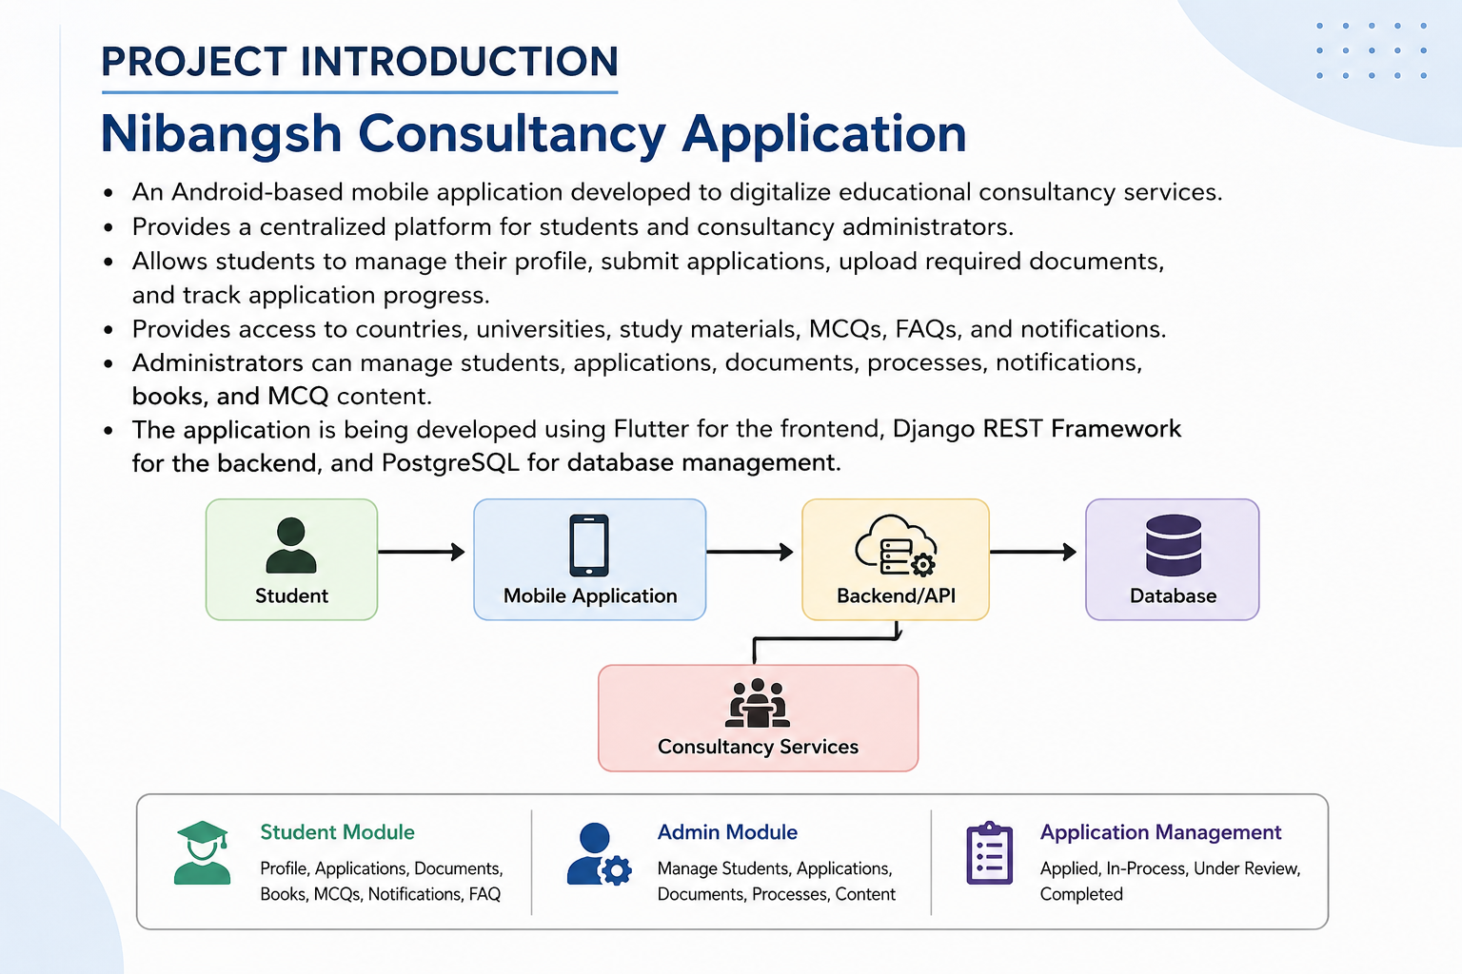

Slide 5
Problem Statement
STUDENT PROBLEMS🎓
Multiple office visits
Paperwork
Difficult status tracking
Delayed communication
CONSULTANCY PROBLEMS 🏢
Manual record keeping
Document management
Application tracking
Communication difficulties
Need: A centralized platform to simplify and digitalize the consultancy process.

Slide 6
Objectives
General Objective
To develop a secure, efficient, and user-friendly mobile consultancy application using Flutter and Django.
Specific Objectives
Develop a responsive mobile application using Flutter and Dart.
Integrate the Flutter frontend with Django REST APIs.
Implement secure authentication and authorization.
Enable student registration, application submission, document upload, and profile management.
Develop admin features for managing students, applications, notifications, books, and MCQs.
Implement image and PDF document upload functionality.

Slide 7
Proposed Solution / Key Features
Student Module
User Registration & Login
Student Profile Management
Application Form
Document Upload
Countries & Universities
Application Process Tracking
Books / Study Materials
MCQ Practice
Notifications
FAQ
Admin Module
Admin Dashboard
Student Management
Application Management
Document & Process Management
Notifications Management
Books Management
MCQ Management
Settings

Slide 8
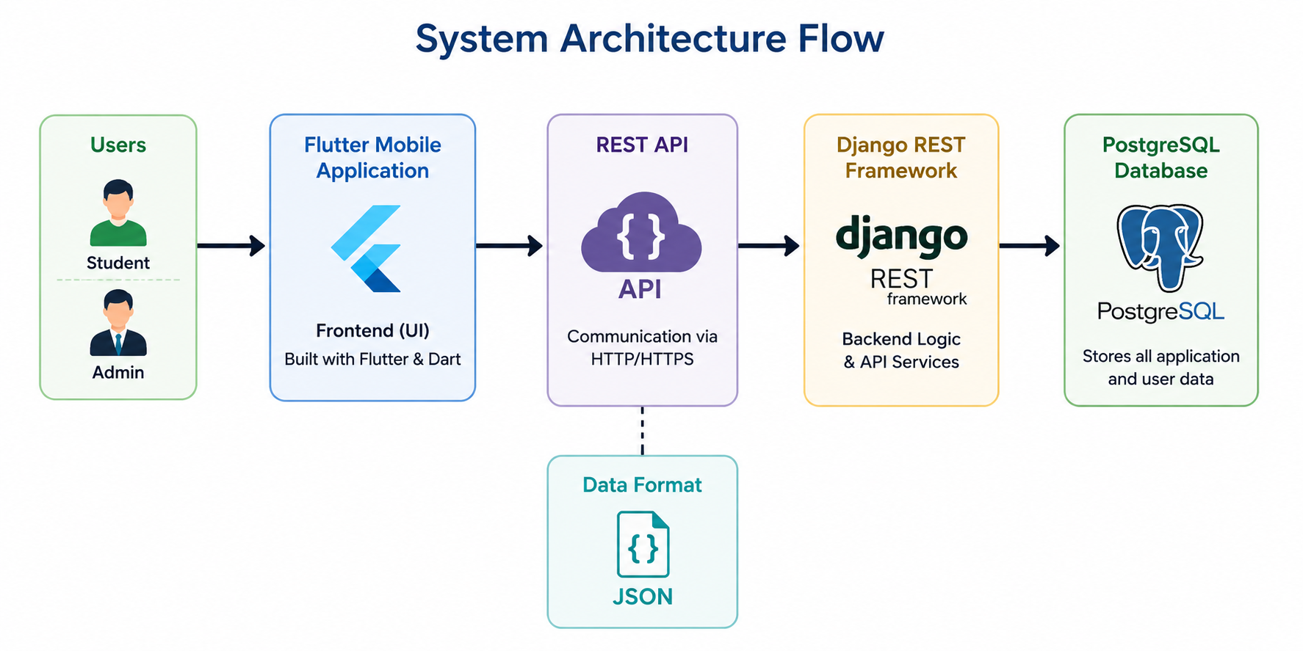
Technology Stack & Architecture
Frontend
Flutter
Dart
Backend
Django
Django REST Framework
Database
PostgreSQL
API & Data
REST API
JSON
Development Tools
Git
Android Studio / IDE
Platform
Android

Slide 9
My Roles & Contributions
Requirement analysis and project understanding
Designed and developed Flutter UI
Created reusable Flutter widgets
Developed Student and Admin modules
Implemented Login, Signup, Profile, Dashboard, Documents, Books, MCQ, Notifications, etc.
Integrated Django REST APIs for authentication and data retrieval
Implemented image/PDF document selection and camera functionality
Performed application testing and debugging
Collaborated with backend developers
Used Git for version control

Slide 10
Work/Development Progress
In Progress
Integration of remaining modules with Django REST APIs
Application process integration
Further testing and debugging
Final application refinement
Completed
UI design and implementation using Flutter
Student authentication screens
Student dashboard and profile
Countries and Universities
Document upload with image/PDF support
Notifications
Books / Study Materials
MCQ module
FAQ
Admin dashboard and management screens
Login & Signup API integration
Authentication flow testing

Slide 11
Current Status & Remaining Work
Technical Skills
Improved Flutter & Dart development skills
Learned responsive UI design and Flutter widgets
Gained experience with REST API integration
Learned JSON data handling and API communication
Implemented authentication interfaces
Learned image/PDF file handling and camera integration
Improved debugging and application testing
Gained practical experience with Git & version control
Professional Skills
Improved communication and teamwork
Developed problem-solving skills
Improved time management
Learned to work in a professional development environment
Gained experience understanding requirements and converting them into features

Slide 12
Learning Outcomes & Conclusion
Current Status
Flutter frontend development completed for major modules
Student and Admin interfaces implemented
Login & Signup successfully connected with Django backend
Document upload functionality implemented
Application is currently under development
Remaining backend integrations are in progress
Future Work
Complete remaining API integrations
Complete application process workflow
Perform full system testing
Improve application performance and usability
Implement advanced notifications
Consider live chat, payment gateway, offline synchronization, and multilingual support in future versions

Slide 13
THANK YOU!

