Slide 1

FINAL DEFENSE PRESENTATION
Mobile Based App Development
With Flutter
Internship at Aeditech Software Company
PRESENTED BY
TU REG. NO.
SUPERVISOR
DATE
Swosti Makaju
6-2-1131-55-2022
Mr. Prajwal Bista
5 October 2026

Slide 2
AGENDA
Contents
1
Internship Overview
7
Technology Stack
2
Organization Details
8
Roles & Responsibilities
3
Project Overview
9
Progress & System Interface
4
Problem Statement
10
Learning Outcomes
5
Objectives & Scope
11
Limitations & Next Steps
6
Weekly Development Log
12
Conclusion
FINAL DEFENSE • SWOSTI MAKAJU
01

Slide 3
01 • OVERVIEW
Internship Overview
Organization
Internship Details
Aeditech Software Company
Nepal-based startup focused on web and mobile solutions
Position: Mobile App Developer (Flutter Intern)
Department: Mobile Application Development
Period: 15 June – 16 September 2026
Working Arrangement
Internship Focus
11:00 AM – 6:00 PM, 6 days/week
Hybrid model with team meetings and code reviews
Cross-platform Flutter development
Responsive UI & REST API integration
Testing and debugging
FINAL DEFENSE • SWOSTI MAKAJU
02

Slide 4
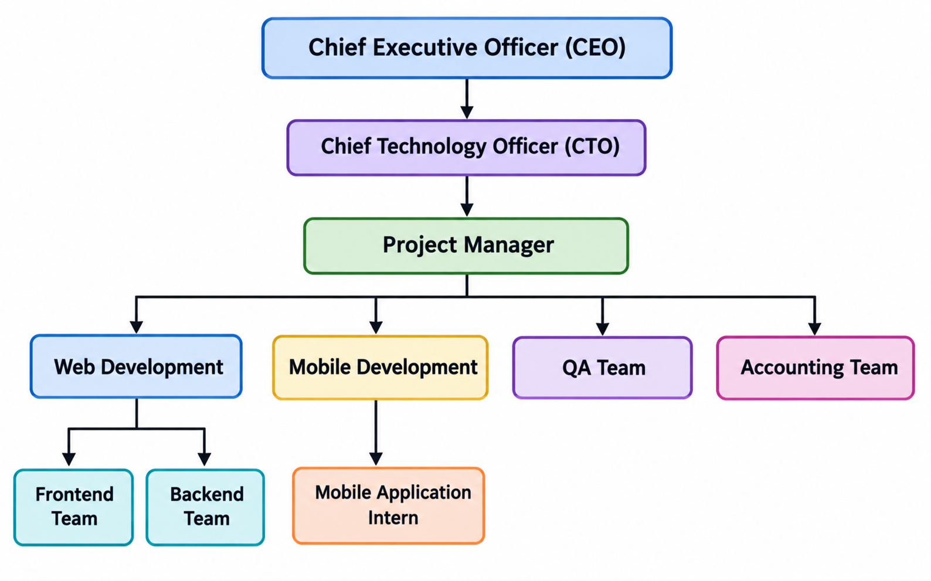
02 • ORGANIZATION
Organization Details & Working Domains
About Aeditech
Organization Hierarchy
Nepal-based startup software company
Builds customized web & mobile solutions
Collaborative, client-focused culture
Working Domains
Mobile App Development
Web Development
Backend Development
QA & Testing
Software Maintenance & Support
FINAL DEFENSE • SWOSTI MAKAJU
03

Slide 5
03 • PROJECTS
Project Overview
Chhingu Online Service
Nibangsh Consultancy App
Week 1 contribution
Main internship project
LC Issue
CCV1
Final Flight
Job Application
Exam-related services
Student registration & profiles
Application forms & tracking
Document management
Countries & universities
Books and MCQ practice
Notifications & student/admin workflows
Built authentication, home, services, profile, admin, user and process-record screens.
FINAL DEFENSE • SWOSTI MAKAJU
04

Slide 6
04 • PROBLEM
Problem Statement
Existing Challenges
THE NEED
Manual paperwork and form filling
Frequent in-person office visits
Fragmented communication channels
Difficult document management
Limited visibility of application status
Increased administrative workload
A centralized mobile platform to simplify and digitalize the consultancy process
Simplifying service requests, document handling, application processing and status tracking for both students and administrators.
FINAL DEFENSE • SWOSTI MAKAJU
05

Slide 7
05 • DIRECTION
Objectives & Scope
Objectives
Scope
Gain hands-on Flutter development experience
Develop a cross-platform Android/iOS application
Support forms, service requests and tracking
Implement role-based student/admin modules
Connect Flutter with Django REST APIs
Build responsive, user-friendly interfaces
Flutter + Dart cross-platform development
Consultancy workflow management
Student and administrator access levels
Form and document workflows
Application status management
REST API data exchange on PostgreSQL
FINAL DEFENSE • SWOSTI MAKAJU
06

Slide 8
06 • TIMELINE (1/2)
Weekly Development Log — Weeks 1–6
Week 1 — Chhingu Online Service
Week 2 — Requirement Planning
1
Orientation, requirement gathering, and core screens: auth, home, services, profile, admin.
2
Studied Nibangsh requirements; finalized student and admin feature set.
Week 3 — Core Screens
Week 4 — Profile & Documents
3
Built onboarding, authentication, student form-fillup, and dashboard screens.
4
Developed countries, documents, and profile screens; made forms editable.
Week 5 — Uploads & Notifications
Week 6 — Process Tracking
5
Integrated image/PDF picker and camera; started admin overview and settings screens.
6
Added process-tracking screens 4–10, approval screen, and books module.
FINAL DEFENSE • SWOSTI MAKAJU
07

Slide 9
06 • TIMELINE (2/2)
Weekly Development Log — Weeks 7–12
Week 7 — MCQ & Universities
Week 8 — Auth Integration
7
Built forgot password, FAQ, MCQ screens, and university/course screens.
8
Connected Login & Signup with the Django backend; tested the authentication flow.
Week 9 — Books & MCQ APIs
Week 10 — Content Testing
9
Integrated Books and MCQ modules with the Django REST backend.
10
Added sample books, MCQs, and question sets; validated content management.
Week 11 — Deployment
Week 12 — Final Refinement
11
Deployed the Django backend on Render; built the MCQ Review feature.
12
Final testing; submitted to the App Store (under review), Play Store in process.
FINAL DEFENSE • SWOSTI MAKAJU
08

Slide 10
07 • STACK
Technology Stack & Development Approach
Frontend
Backend & Database
Tools & Approach
Flutter
Dart
Responsive UI
Reusable widgets
Android & iOS
Python
Django REST Framework
PostgreSQL
REST APIs — JSON
Render (deployment)
Git
Android Studio / VS Code
Figma
Camera & image/PDF picker
Weekly development → mentor review → testing → refinement → integration
FINAL DEFENSE • SWOSTI MAKAJU
09

Slide 11
08 • CONTRIBUTION
Roles & Responsibilities
Requirement analysis and project understanding
Designed and developed responsive Flutter interfaces
Created reusable widgets with consistent navigation
Developed student modules: Login, Signup, Dashboard, Profile, Countries, Universities, Documents
Developed notifications, Books and MCQ modules
Developed administrator screens for students, applications, notifications, books and processes
Integrated Login, Signup, Books and MCQ with Django REST APIs
Implemented image/PDF selection and camera functionality
Performed testing, debugging and UI improvements
Collaborated with backend developers; used Git for version control
FINAL DEFENSE • SWOSTI MAKAJU
10

Slide 12
09 • PROGRESS
Current Progress & Backend Integration
Completed UI Work
Integrated
Remaining Work
Major student/admin screens
Forms and process flow
Authentication interfaces
Document upload UI
Notifications and FAQ
Signup & Login APIs
Authentication flow testing
Books API
MCQ API & JSON handling
MCQ Review feature
Remaining API integrations
Application process workflow
Further testing & debugging
Final refinement
Cross-module data sync
Status: Frontend substantially developed; remaining backend integrations and refinement are ongoing.
FINAL DEFENSE • SWOSTI MAKAJU
11

Slide 13
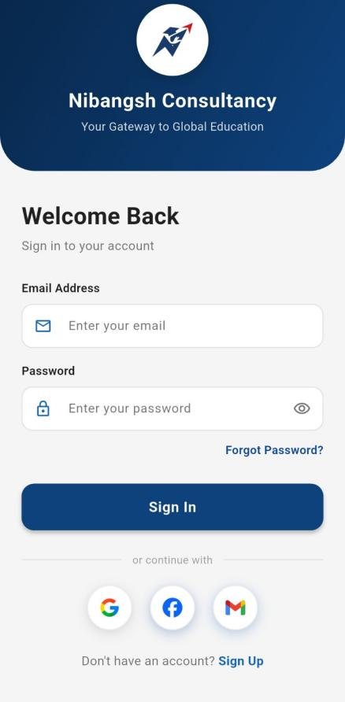
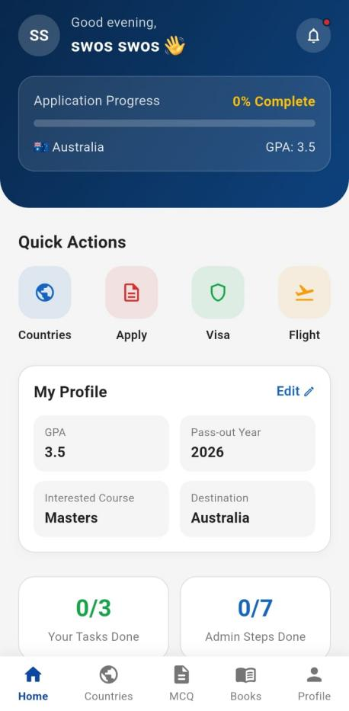
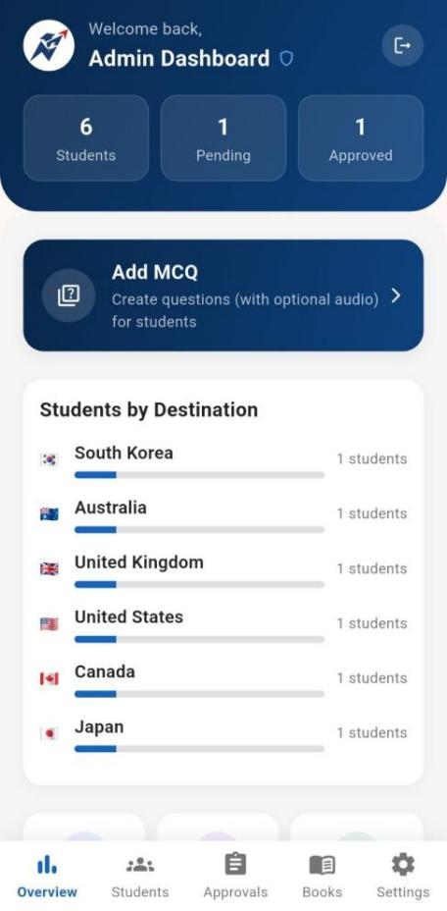
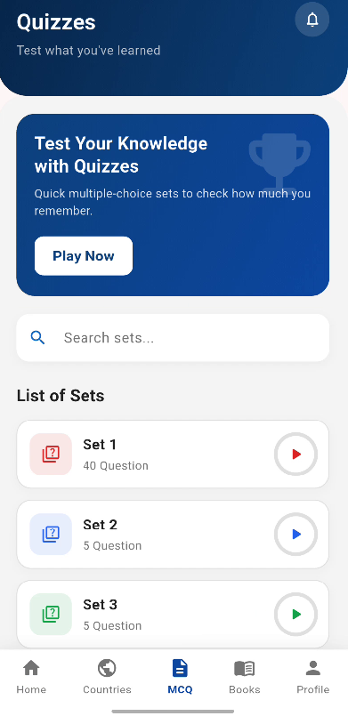
09 • INTERFACE
System Interface — Nibangsh Consultancy App
Login
Student Dashboard
Student MCQ
Admin Dashboard
FINAL DEFENSE • SWOSTI MAKAJU
12

Slide 14
10 • GROWTH
Learning Outcomes
Technical Skills
Professional Skills
Flutter & Dart development
Responsive UI and reusable widgets
REST API integration with Django
JSON data handling
Authentication interfaces
Camera and image/PDF picker integration
PostgreSQL concepts
Testing, debugging and Git
Communication with mentors and developers
Teamwork and collaboration
Problem-solving and debugging
Time management and weekly planning
Requirement understanding
Independent learning and self-study
Analytical thinking and decision-making
Focus on usability and maintainability
FINAL DEFENSE • SWOSTI MAKAJU
13

Slide 15
11 • OUTLOOK
Limitations & Next Steps
Current Limitations
Next Phase
Some backend modules are still being integrated
A few frontend features depend on API readiness
Advanced push notifications, offline sync, and multilingual support are not yet implemented
iOS version is under App Store review; Google Play Store release is in process
Complete remaining API integrations
Complete application-process data workflows
Expand testing and debugging
Improve data synchronization and usability
Refine the application using mentor/user feedback
Consider live chat and payment gateway in future versions
FINAL DEFENSE • SWOSTI MAKAJU
14

Slide 16
12 • SUMMARY
Conclusion
Gained practical experience in cross-platform mobile application development using Flutter.
Contributed to Chhingu Online Service and the Nibangsh Consultancy Application.
Developed student and admin interfaces, forms, workflows and device-level features.
Integrated Flutter with Django REST APIs for authentication, Books and MCQ modules.
Strengthened technical skills along with communication, teamwork, planning and problem-solving abilities.
Successfully connected academic knowledge with real-world software development practice.
FINAL DEFENSE • SWOSTI MAKAJU
15

Slide 17
THANK YOU
Any Queries?
Swosti Makaju • Mobile App Developer (Flutter Intern)

