Slide 1
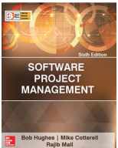
Software Project Management
Chapter One
An Introduction
Software project management (6e) - introduction © The McGraw-Hill Companies, 2017

Slide 2

Outline of talk
In this introduction the main questions to be addressed will be:
  What is software project management? Is it really different from ‘ordinary’ project management?
  How do you know when a project has been successful? For example, do the expectations of the customer/client match those of the developers?
Software project management (6e) - introduction © The McGraw-Hill Companies, 2017
Notes:
The two key questions are:
What exactly is software project management?
This is going to be tackled by looking firstly at what is meant by ‘project’. We are then going to examine whether ‘software project management’ is really different from ‘normal’ project management. Is there anything special about software as opposed to other engineered artefacts?
2. How do we define whether a project is a success or not?
The point about studying project management is to be able to have successful projects. So how do we know if we have been successful?

Slide 3

Why is project management important?
Large amounts of money are spent on ICT e.g. UK government in 2003-4 spent £2.3 billions on contracts for ICT and only £1.4 billions on road building
Project often fail – Standish Group claim only a third of ICT projects are successful. 82% were late and 43% exceeded their budget.
Poor project management a major factor in these failures
Software project management (6e) - introduction © The McGraw-Hill Companies, 2017
Notes:
The methodology used by the Standish Group to arrive at their findings has been criticized, but the general perception of the prevalence of ICT project failure is still clear.

Slide 4
What is a project?
Some dictionary definitions:
“A specific plan or design”
“A planned undertaking”
“A large undertaking e.g. a public works scheme”
Longmans dictionary
Key points above are planning and size of task
Software project management (6e) - introduction © The McGraw-Hill Companies, 2017
Notes:
Here are some definitions of ‘project’. No doubt there are other ones: for example
‘Unique process, consisting of a set of coordinated and controlled activities with start and finish dates, undertaken to achieve an objective conforming to specific requirements, including constraints of time, cost and resources’
BSO ISO 10006: 1997

Slide 5



What is a Project?
An endeavor with specific objectives:
  Usually consists of multiple tasks
  With defined precedence relationships
  With a specific time period for completion
Non-Software Examples:
  A wedding
  An MBA degree
  A house construction project
  A political election campaign
Software project management (6e) - introduction © The McGraw-Hill Companies, 2017

Slide 6


What is a Task?
A small piece of work:
  Meant to accomplish a straightforward goal
  Effort of no longer than a few person-hours
  Involves only a few people
  May or may not be a part of some project
  Usually repetition of a previously accomplished task
  Process management may be relevant!
Non-software Examples:
  Attend a lecture class
  Buy a chocolate from the market
  Book a railway ticket

Slide 7
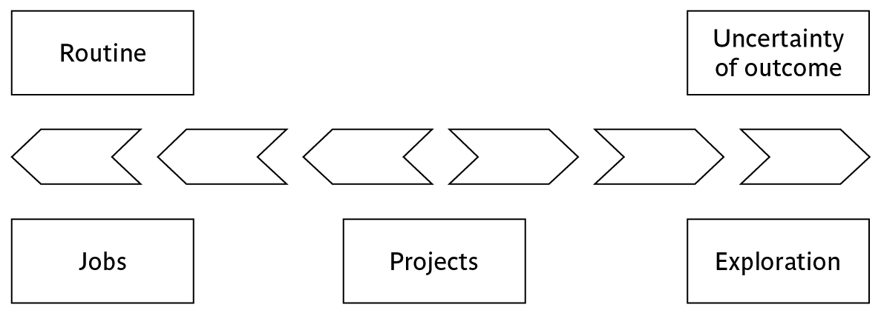
Jobs versus projects
‘Jobs’ – repetition of very well-defined and well understood tasks with very little uncertainty
‘Exploration’ – e.g. finding a cure for cancer: the outcome is very uncertain
Projects – in the middle!
Software project management (6e) - introduction © The McGraw-Hill Companies, 2017
Notes:
On the one hand there are repetitive jobs a similar task is carried out repeatedly, for example Kwikfit replacing a tyre on a car or a lecturer giving an introductory talk on project management. The task is well-defined and there is very little uncertainty. In some organizations, software development might tend to be like this – in these environments software process management might be more important than software project management
On the other hand some exploratory activities are very uncertain. Some research projects can be like this – we may not be sure what the outcome will be, but we hope that we will learn some things of importance. It may be very difficult to come up with precise plans, although we would probably have some idea of a general approach.
Projects seem to come somewhere between these two extremes. There are usually well-defined hoped-for outcomes but there are risks and uncertainties about achieving those outcomes.

Slide 8
Characteristics of projects
A task is more ‘project-like’ if it is:
Non-routine
Planned
Aiming at a specific target
Carried out for a customer
Carried out by a temporary work group
Involving several specialisms
Made up of several different phases
Constrained by time and resources
Large and/or complex
Software project management (6e) - introduction © The McGraw-Hill Companies, 2017
Notes:
Exercise 1.1 in the Software Project Management text is a good way of introducing this material if you have time. I have found this exercise to be a good ‘ice-breaker’. Get each student to list the example activities in an order which matches the degree to which they merit the description of ‘project’. You can create a grid on a whiteboard with the projects on the vertical axis and the positions 1st, 2nd, 3rd etc on the horizontal axis. You then go through asking how many put ‘producing a newspaper’ first, second, etc. (Avoid making jokes about this being like the Eurovision song contest). This is time-consuming but it does mean that every student participates in building up a general picture of people’s perceptions, and you can discuss disagreements in perceptions as you go along.

Slide 9

Are software projects really different from other projects?
Not really …but... The factors
Invisibility
Complexity
Conformity
Flexibility
make software more problematic to build than other engineered artefacts.
Software project management (6e) - introduction © The McGraw-Hill Companies, 2017
Notes:
This is based on Fred Brooks’ paper No Silver Bullet: Essence and Accidents of Software Engineering which appeared in IEEE Computer 20(4) pp10-19 April 1987

Slide 10
Contract management versus technical project management
Projects can be:
In-house: clients and developers are employed by the same organization
Out-sourced: clients and developers employed by different organizations
‘Project manager’ could be:
  a ‘contract manager’ in the client organization
  a technical project manager in the supplier/services organization
Software project management (6e) - introduction © The McGraw-Hill Companies, 2017
Notes:
In general the book looks at things from the point of view of the technical software project manager.

Slide 11
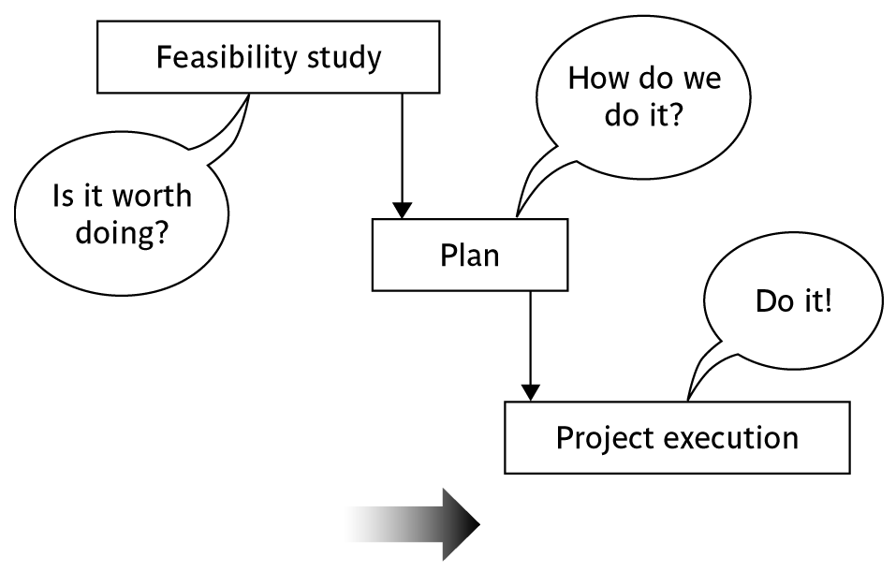
Activities covered by project management
Feasibility study
  Is project technically feasible and worthwhile from a business point of view?
Planning
  Only done if project is feasible
Execution
  Implement plan, but plan may be changed as we go along
Software project management (6e) - introduction © The McGraw-Hill Companies, 2017
Notes:
There are two key points here.
Often you see something like ‘feasibility study’ being put as the first stage of development life cycle, and indeed it might be. However, the recommendation of the feasibility study might be not to carry out the proposed project. Planning of the project should therefore take place after the feasibility study (or as a part of the feasibility study perhaps). Clearly the feasibility study itself might need a plan.
All plans are to some extent provisional and subject to change. The key point is that the evolving plan allows us to control the project.

Slide 12
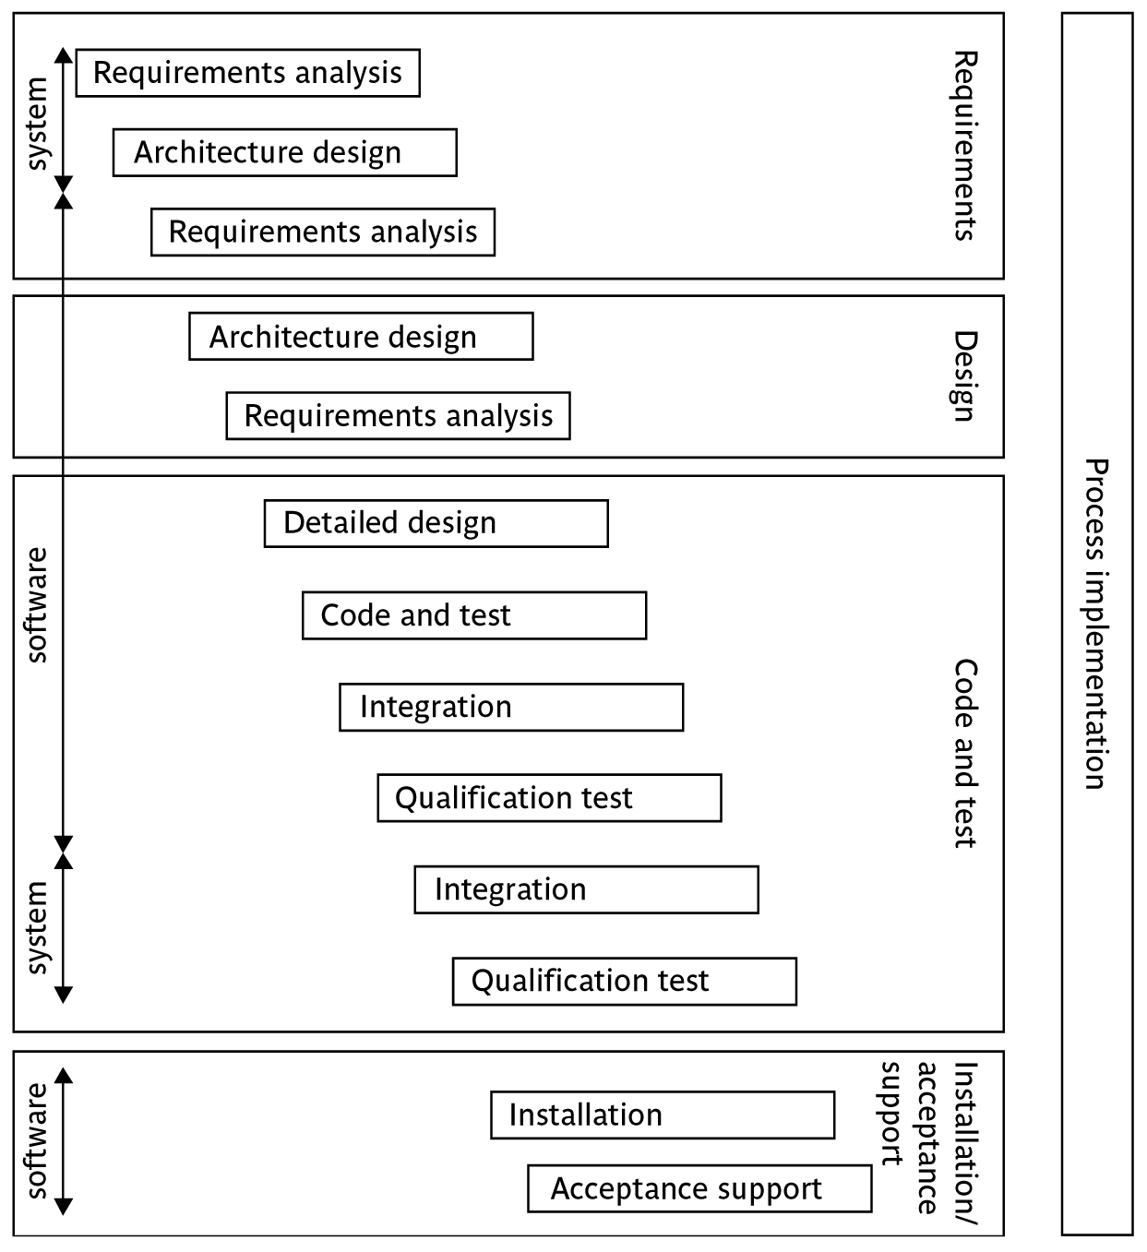
The software development life-cycle (ISO 12207)
Software project management (6e) - introduction © The McGraw-Hill Companies, 2017
Notes:
This section of the lecture discusses the software development life cycle. Note that this is a technical model. It identifies the technical constraints on the order activities are done. This does NOT imply that a ‘waterfall’ approach is the only way to organize projects. The technical model could be implemented as increments or in an evolutionary manner.

Slide 13
ISO 12207 life-cycle
Requirements analysis
  Requirements elicitation: what does the client need?
  Analysis: converting ‘customer-facing’ requirements into equivalents that developers can understand
  Requirements will cover
    Functions
    Quality
    Resource constraints i.e. costs
Software project management (6e) - introduction © The McGraw-Hill Companies, 2017
Notes:
The key point here is that requirement analysis has to face in (at least) two different directions. It needs to communicate and elicit the requirements of the users, speaking in their language. It needs to organize and translate those requirements into a form that developers can understand and relate to.

Slide 14
ISO 12207 life-cycle
Architecture design
  Based on system requirements
  Defines components of system: hardware, software, organizational
  Software requirements will come out of this
Code and test
  Of individual components
Integration
  Putting the components together
Software project management (6e) - introduction © The McGraw-Hill Companies, 2017
Notes:
The software project will almost certainly be part of a larger project which has non-software elements. In a software engineering environment it could be the software will be embedded in hardware product of some kind. Thus there are system requirements for the product as a whole and software requirements for the software element.
In a business information systems environment, the software development could be a relatively minor part of a much larger organizational change project.

Slide 15
ISO12207 continued
Qualification testing
  Testing the system (not just the software)
Installation
  The process of making the system operational
  Includes setting up standing data, setting system parameters, installing on operational hardware platforms, user training etc
Acceptance support
  Including maintenance and enhancement
Software project management (6e) - introduction © The McGraw-Hill Companies, 2017
Notes:
The confusion about what ‘implementation’ really means could be mentioned. Does it mean implementing the design (that is, coding) or implementing the complete system in its user environment? It is best to use ‘installation’ to describe the latter in order to avoid confusion.

Slide 16
Plans, methods and methodologies
Methodology = a set of methods
Context
Plan
Methods
+ start and end dates for each activity,
staffing, tools and materials etc
A way of working
Software project management (6e) - introduction © The McGraw-Hill Companies, 2017
Notes:
A plan of an activity must be based on some idea of a method of work. While a method relates to a type of activity in general, a plan takes one or more methods and converts them into real activities by identifying:
Start and end dates
Who will carry it out
What tools and materials would be needed.
A methodology is a set of related methods. Strictly speaking ‘methodology’ ought to mean the study of methods!

Slide 17
Some ways of categorizing projects
Distinguishing different types of project is important as different types of task need different project approaches e.g.
Voluntary systems (such as computer games) versus compulsory systems e.g. the order processing system in an organization
Information systems versus embedded systems
Objective-based versus product-based
Product-development versus outsourced
Software project management (6e) - introduction © The McGraw-Hill Companies, 2017
Notes:
With objective-based projects, a general objective or problem is defined, and there are several different ways in which that objective could be reached. The project team have freedom to select what appears to be the most appropriate approach.
With product-based projects, the product is already very strictly defined and the development team’s job is to implement the specification with which they have been presented.
Arguably, information systems projects are more likely to be objective-based than is the case with software engineering.
In many cases, an objective-based project could consider a problem and recommend a solution that is then implemented by a product-based project.
Exercise 1.5 in the text is relevant here.

Slide 18
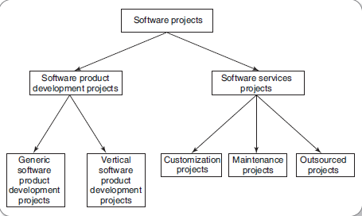
A Categorization of Software Projects
Software project management (5e) - introduction © The McGraw-Hill Companies, 2009

Slide 19

Two Types of Software Projects
Software product development projects
Software services projects
Software project management (6e) - introduction © The McGraw-Hill Companies, 2009

Slide 20

Software Services
Software service is an umbrella term, includes:
  Software customization
  Software maintenance
  Software testing
  Also contract programmers who carry out coding or any other assigned activities.

Slide 21
Stakeholders
These are people who have a stake or interest in the project
In general, they could be users/clients or developers/implementers
They could be:
Within the project team
Outside the project team, but within the same organization
Outside both the project team and the organization
Different stakeholders may have different objectives – need to define common project objectives
Software project management (6e) - introduction © The McGraw-Hill Companies, 2017
Notes:
Each stakeholder will have their own goals and concerns in relation to the project which may be different from those of the project as a whole. For example, a software developer might work to make a living, pay the mortgage, learn new things, solve interesting problems. The main stakeholders need, however, to understand and accept overall project objectives that everyone can agree to.
See Exercise 1.6 in the text.

Slide 22
Setting objectives
Answering the question ‘What do we have to do to have a success?’
Need for a project authority
  Sets the project scope
  Allocates/approves costs
Could be one person - or a group
  Project Board
  Project Management Board
  Steering committee
Software project management (6e) - introduction © The McGraw-Hill Companies, 2017
Notes:
Different people who are involved in a project (Stakeholders) will have different interests in the project and are likely to see different outcomes as being important.
For example, end-users would want a system that is ‘user-friendly’, that is, easy to learn and to use, and a system that helps rather than hinders them from doing their jobs. Their managers may be more interested in whether the new system would allow them to reduce staffing levels.
It is important therefore that a set of clearly defined objectives are identified and published for the project. Some individual or group needs to be pinpointed who acts as the main client for the project.
See Exercise 1.7 in the text.

Slide 23
Objectives
Informally, the objective of a project can be defined by completing the statement:
The project will be regarded as a success if……….
…………
Rather like post-conditions for the project
Focus on what will be put in place, rather than how activities will be carried out
Software project management (6e) - introduction © The McGraw-Hill Companies, 2017
Notes:
The focus here needs to be on what the situation will be when the project is completed. In what ways will the world be different? The objectives should avoid describing activities:
e.g. ‘a new payroll application will be operational by 4th April’ not ‘design and code a new payroll application’

Slide 24
Objectives should be SMART
S – specific, that is, concrete and well-defined
M – measurable, that is, satisfaction of the objective can be objectively judged
A – achievable, that is, it is within the power of the individual or group concerned to meet the target
R – relevant, the objective must relevant to the true purpose of the project
T – time constrained: there is defined point in time by which the objective should be achieved
Software project management (6e) - introduction © The McGraw-Hill Companies, 2017
Notes:
I have seen some places where the R is said to stand for ‘resource-constrained’, that is that there is a target cost associated with the achievement of the objective.

Slide 25
Goals/sub-objectives
These are steps along the way to achieving the objective
Informally, these can be defined by completing the sentence
To reach objective X, the following must be in place
A……………
B……………
C…………… etc
Software project management (6e) - introduction © The McGraw-Hill Companies, 2017
Notes:
Scoring a goal in football is a ‘goal’ or sub-objective on the way to achieving the overall objective of winning the match. Sub-objectives and objectives can be nested in a hierarchy, so that the objective of winning the match could itself be a goal or sub-objective on the way to winning the league etc.

Slide 26
Goals/sub-objectives continued
Often a goal can be allocated to an individual
Individual might have the capability of achieving goal on their own, but not the overall objective e.g.
Overall objective – user satisfaction with software product
Analyst goal – accurate requirements
Developer goal – reliable software
Software project management (6e) - introduction © The McGraw-Hill Companies, 2017
Notes:
Goals can be formulated in such a way that they represent what an individual or group need to do to contribute to the success of the project’s objectives.
In the example above, the analyst or developer, by themselves, cannot guarantee user satisfaction. However, the analyst can contribute to the achievement of the objective by making sure the users’ requirements are accurately recorded and the developer by making sure that the software is reliable.
See Exercise 1.7 in the text.

Slide 27
Measures of effectiveness
How do we know that the goal or objective has been achieved?
By a practical test, that can be objectively assessed.
e.g. for user satisfaction with software product:
Repeat business – they buy further products from us
Number of complaints – if low etc etc
Software project management (6e) - introduction © The McGraw-Hill Companies, 2017
Notes:
See Exercise 1.8 in the text.

Slide 28
The business case
Benefits of delivered project must outweigh costs
Costs include:
  Development
  Operation
Benefits
  Quantifiable
  Non-quantifiable
Benefits
£
Costs
£
Software project management (6e) - introduction © The McGraw-Hill Companies, 2017
Notes:
It is not always possible to put a precise financial on the benefits of a project. The client’s willingness to pay up to a certain price to get a project implemented implies that they have informally identified a value to them of getting that project implemented.

Slide 29
Project success/failure
Degree to which objectives are met
scope (of deliverables)
time
cost
In general if, for example, project is running out of time,
this can be recovered for by reducing scope or increasing
costs. Similarly costs and scope can be protected by
adjusting other corners of the ‘project triangle’.
Software project management (6e) - introduction © The McGraw-Hill Companies, 2017

Slide 30
Other success criteria
These can relate to longer term, less directly tangible assets
Improved skill and knowledge
Creation of assets that can be used on future projects e.g. software libraries
Improved customer relationships that lead to repeat business
Software project management (6e) - introduction © The McGraw-Hill Companies, 2017

Slide 31
What is management?
This involves the following activities:
Planning – deciding what is to be done
Organizing – making arrangements
Staffing – selecting the right people for the job
Directing – giving instructions
continued…
Software project management (6e) - introduction © The McGraw-Hill Companies, 2017
Notes:
This list is based on one that can be found in Introduction to Software Project Management and Quality Assurance by Darrel Ince, Helen Sharp and Mark Woodman, McGraw-Hill, 1993.

Slide 32
What is management?
(continued)
Monitoring – checking on progress
Controlling – taking action to remedy hold-ups
Innovating – coming up with solutions when problems emerge
Representing – liaising with clients, users, developers and other stakeholders
Software project management (6e) - introduction © The McGraw-Hill Companies, 2017
Notes:
Exercise 1.6 (a day in the life of a project manager) is of relevance here.

Slide 33
Project Planning
Carried out before development starts.
Important activities:
  Estimation
  Scheduling
  Staffing
  Risk management
  Miscellaneous plans
Software project management (6e) - introduction © The McGraw-Hill Companies, 2017
Notes:
In the project initiation stage, an initial plan is made. As the project start, the project is monitored and controlled to proceed as per the plan. But, the initial plan is refined from time to time to factor in additional details and constraints about the project become available.

Slide 34
Traditional versus Modern Project Management
Projects are increasingly being based on either tailoring some existing product or reusing certain pre-built libraries.
Facilitating and accommodating client feedbacks
Facilitating customer participation in project development work
Incremental delivery of the product with evolving functionalities.
Software project management (6e) - introduction © The McGraw-Hill Companies, 2017
Notes:
Rather than making a long term project completion plan, the project manager now plans all incremental deliveries with evolving functionalities. This type of project management is often called Extreme project management.

Slide 35
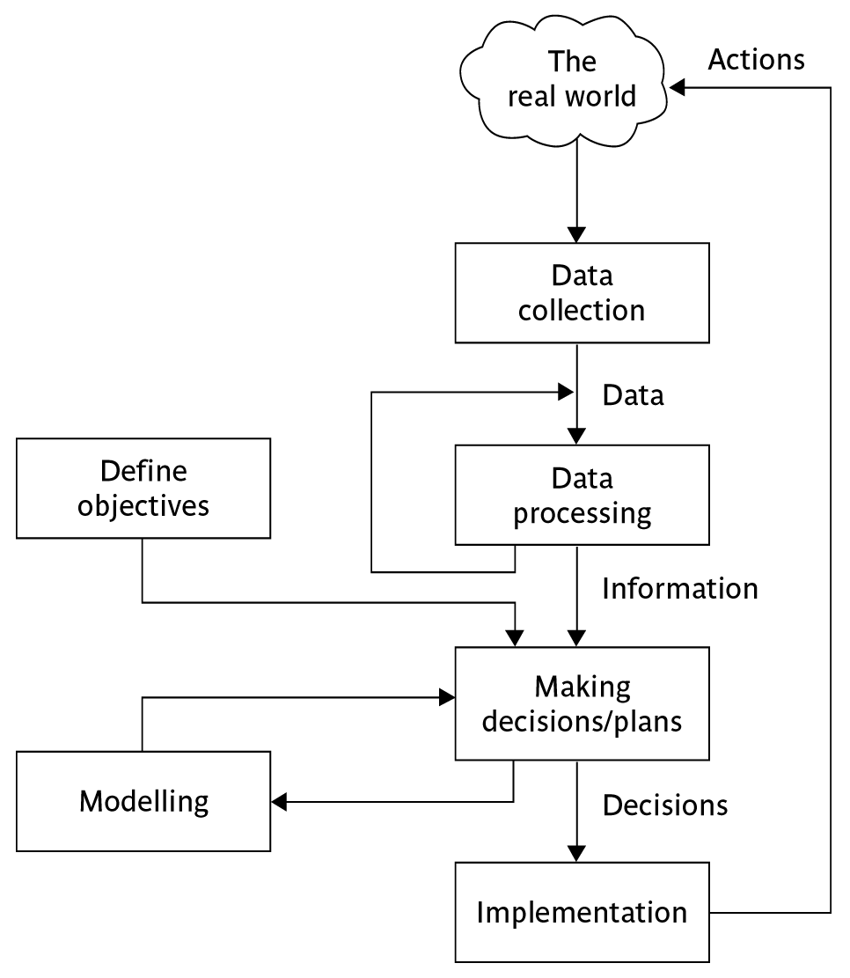
Management control
Software project management (6e) - introduction © The McGraw-Hill Companies, 2017
Notes:
This is explained on the next overhead.

Slide 36
Management control
Data – the raw details
  e.g. ‘6,000 documents processed at location X’
Information – the data is processed to produce something that is meaningful and useful
  e.g. ‘productivity is 100 documents a day’
Comparison with objectives/goals
  e.g. we will not meet target of processing all documents by 31st March
  continued…..
Software project management (5e) - introduction © The McGraw-Hill Companies, 2009
Notes:
This example is expanded in the text.

Slide 37
Management control - continued
Modelling – working out the probable outcomes of various decisions
  e.g. if we employ two more staff at location X how quickly can we get the documents processed?
Implementation – carrying out the remedial actions that have been decided upon
Software project management (5e) - introduction © The McGraw-Hill Companies, 2009
Notes:
The authors’ view is that an initially defective plan can often be remedied by good project control and management. This could be a discussion point.

Slide 38
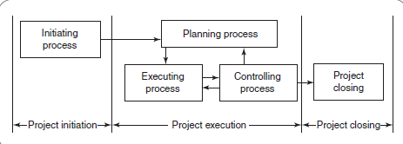
Project Management Processes
In the project initiation stage, an initial plan is made. As the project starts, the project is executed and controlled to proceed as planned. Finally, the project is closed.
Software project management (5e) - introduction © The McGraw-Hill Companies, 2009

Slide 39
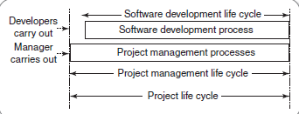
Project Management Life Cycle Versus Product Development Life Cycle
During the software development life cycle, the software developers carry out several types of development processes. On the other hand, during the software project management life cycle, the software project manager carries out several project management processes
Software project management (5e) - introduction © The McGraw-Hill Companies, 2009

Slide 40
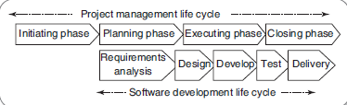
Phases of Project Management Life Cycle
Software project management (5e) - introduction © The McGraw-Hill Companies, 2009

Slide 41
Project Initiation
During the project initiation phase it is crucial for the champions of the project to develop a thorough understanding of the important characteristics of the project.
In his W5HH principle, Barry Boehm summarized the questions that need to be asked and answered in order to have an understanding of these project characteristics.
Software project management (5e) - introduction © The McGraw-Hill Companies, 2009

Slide 42
W5HH Principle
A series of questions that lead to a definition of key project characteristics:
  Why is the software being built?
  What will be done?
  When will it be done?
  Who is responsible for a function?
  Where are they organizationally located?
  How will the job be done technically and managerially?
  How much of each resource is needed?

Slide 43
Project Planning
Various plans are made:
  Project plan: Assign project resources and time frames to the tasks.
  Resource plan: List the resources, manpower and equipment that required to execute the project.
  Financial plan: plan for manpower, equipment and other costs.
  Quality plan: Plan of quality targets and control.
  Risk plan: Identification of the potential risks, their prioritization and a plan for the actions that would be taken to contain the different risks.
Software project management (5e) - introduction © The McGraw-Hill Companies, 2009

Slide 44
Project Execution
Tasks are executed as per the project plan
Monitoring and control processes are executed to ensure that the tasks are executed as per plan
Corrective actions are initiated whenever any deviations from the plan are noticed.
Software project management (5e) - introduction © The McGraw-Hill Companies, 2009

Slide 45
Project Closure
Involves completing the release of all the required deliverables to the customer along with the
necessary documentation.
Subsequently, all the project resources are released and supply agreements with the vendors are terminated and all the pending payments are completed.
Finally, a post-implementation review is undertaken to analyze the project performance and to list the lessons learnt for use in future projects.
Software project management (5e) - introduction © The McGraw-Hill Companies, 2009

Slide 46
Key points in lecture
Projects are non-routine - thus uncertain
The particular problems of projects e.g. lack of visibility
Clear objectives which can be objectively assessed are essential
Stuff happens. Not usually possible to keep precisely plan – need for control
Communicate, communicate, communicate!
Software project management (6e) - introduction © The McGraw-Hill Companies, 2017

