Slide 1
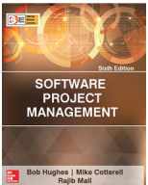
Software Project Management
Chapter Four
Selection of an appropriate project approach
SPM (6e) Selection of project approach© The McGraw-Hill Companies, 2017
Notes:
This lecture outlines the differences between the waterfall, v-process, incremental and evolutionary approaches to projects. It also looks at agile methods such as Atern DSDM (Dynamic Systems Development Method) and XP (Extreme Programming).

Slide 2


Outline of lecture
Building versus buying software
Taking account of the characteristics of the project
Process models
  Waterfall
  Prototyping and iterative approaches
  Incremental delivery
Agile approaches
SPM (5e) Selection of project approach© The McGraw-Hill Companies, 2009
Notes:
It can be argued that agile approaches are often a repackaging of prototyping and incremental delivery.

Slide 3
Selection of project approaches
This lecture concerned with choosing the right approach to a particular project: variously called technical planning, project analysis, methods engineering and methods tailoring
In-house: often the methods to be used dictated by organizational standards
Suppliers: need for tailoring as different customers have different needs
SPM (5e) Selection of project approach© The McGraw-Hill Companies, 2009
Notes:
Section 4.1 and 4.3 of the textbook discuss these issues. Different types of project need different types of approach. If you are working in one particular environment which specializes in one type of software, then the approach is likely not to change much from one project to another. Where you work for different clients in different organizations developing a variety of applications then the approach for each project may need to be tailored.

Slide 4
Build or buy?
In-house
development?
Outsource?
either
Build
Buy
SPM (6e) Selection of project approach© The McGraw-Hill Companies, 2017
Notes:
In-house development almost always involves developing new code.
If it is decided to use a specialist organization to implement system, the supplier could either build a ‘bespoke’ system for you, or could install a pre-existing application. There are hybrids of these options, e.g. to build in-house but use temporary contract staff, or Customised Off-the-Shelf (COTS) where a basic existing core system is modified for your particular requirements.

Slide 5
Some advantages of off-the-shelf (OTS) software
Cheaper as supplier can spread development costs over a large number of customers
Software already exists
  Can be trialled by potential customer
  No delay while software being developed
Where there have been existing users, bugs are likely to have been found and eradicated
SPM (6e) Selection of project approach© The McGraw-Hill Companies, 2017

Slide 6
Some possible disadvantages of off-the-shelf
Customer will have same application as everyone else: no competitive advantage, but competitive advantage may come from the way application is used
Customer may need to change the way they work in order to fit in with OTS application
Customer does not own the code and cannot change it
Danger of over-reliance on a single supplier
SPM (6e) Selection of project approach© The McGraw-Hill Companies, 2017
Notes:
One concern is what happens if the supplier goes out of business. Customer might not then be able to maintain system: hence the use of ‘escrow’ services where a 3rd party retains a copy of the code.

Slide 7
General approach
Look at risks and uncertainties e.g.
  are requirement well understood?
  are technologies to be used well understood?
Look at the type of application being built e.g.
  information system? embedded system?
  criticality? differences between target and development environments?
Clients’ own requirements
  need to use a particular method
SPM (6e) Selection of project approach© The McGraw-Hill Companies, 2017
Notes:
See section 4.3 of the textbook.

Slide 8

Structure versus speed of delivery
Structured approach
Also called ‘heavyweight’ approaches
Step-by-step methods where each step and intermediate product is carefully defined
Emphasis on getting quality right first time
Example: use of UML and USDP
Future vision: Model-Driven Architecture (MDA). UML supplemented with Object Constraint Language, press the button and application code generated from the UML/OCL model
SPM (6e) Selection of project approach© The McGraw-Hill Companies, 2017

Slide 9
Structure versus speed of delivery
Agile methods
Emphasis on speed of delivery rather than documentation
RAD Rapid application development emphasized use of quickly developed prototypes
JAD Joint application development. Requirements are identified and agreed in intensive workshops with users
SPM (6e) Selection of project approach© The McGraw-Hill Companies, 2017

Slide 10
Processes versus Process Models
Starting from the inception stage:
  A product undergoes a series of transformations through a few identifiable stages
  Until it is fully developed and released to the customer.
  This forms its life cycle or development process.
Life cycle model (also called a process model):
  A graphical or textual representation of the life cycle.
SPM (6e) Selection of project approach© The McGraw-Hill Companies, 2017

Slide 11
Choice of process models
‘waterfall’ also known as ‘one-shot’, ‘once-through’
incremental delivery
evolutionary development
Also use of ‘agile methods’ e.g. extreme programming
SPM (6e) Selection of project approach© The McGraw-Hill Companies, 2017
Notes:
It could be argued that extreme programming is mainly a particular way of carrying out incremental and evolutionary development

Slide 12
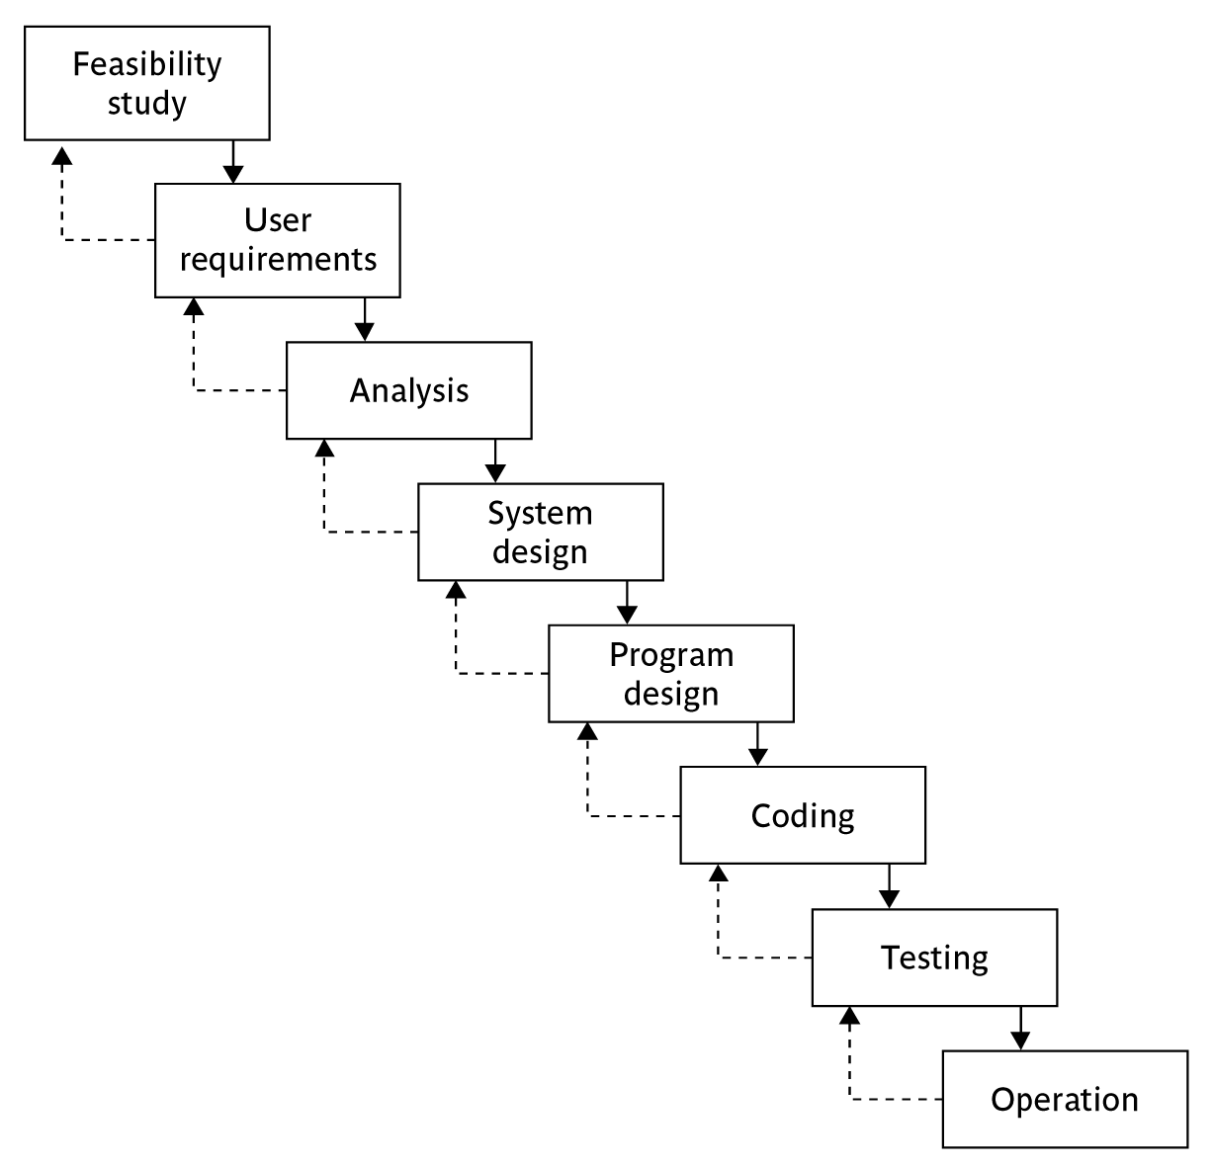
Waterfall
SPM (6e) Selection of project approach© The McGraw-Hill Companies, 2017
Notes:
Section 4.6 of the textbook discusses this topic.
We have already touched upon the Waterfall approach in Lecture/Chapter 1 when we discussed the ISO 12207. The way that the Waterfall approach is usually interpreted, it implies that all work on one phase has to be completed and checked off before the next one can start. However, it can be argued that ISO 12207 is really a technical model showing the order technical processes need to be carried out on a software component. You might break down an application into component increments, but the technical processes relating to that increment are carried out in the ISO 12207 sequence. You can, within the ISO 12207 sequence, loop back in an iterative manner, but the technical sequence still remains.

Slide 13
Waterfall
the ‘classical’ model
imposes structure on the project
every stage needs to be checked and signed off
BUT
  limited scope for iteration
V model approach is an extension of waterfall where different testing phases are identified which check the quality of different development phases
SPM (6e) Selection of project approach© The McGraw-Hill Companies, 2017

Slide 14
Evolutionary delivery: prototyping
‘ An iterative process of creating quickly and inexpensively live and working models to test out requirements and assumptions’
Sprague and McNurlin
main types
‘throw away’ prototypes
evolutionary prototypes
what is being prototyped?
human-computer interface
functionality
SPM (6e) Selection of project approach© The McGraw-Hill Companies, 2017

Slide 15
Reasons for prototyping
learning by doing
improved communication
improved user involvement
a feedback loop is established
reduces the need for documentation
reduces maintenance costs i.e. changes after the application goes live
prototype can be used for producing expected results
SPM (6e) Selection of project approach© The McGraw-Hill Companies, 2017
Notes:
A prototype is a working model of one or more aspects of the project application. It is constructed quickly and inexpensively in order to test out assumptions.
Sections 4.9, 4.10 and 4.11 discuss this topic.
learning by doing - useful where requirements are only partially known
improved communication - users are reluctant to read massive documents, but when system is ‘live’ you get a better feeling for it
improved user involvement - user ideas and requests are quickly implemented
the reduction of maintenance costs – the idea is that if you do not have a prototype then the first release of the application will effectively become a prototype as users will find things that they do not like and then ask for them to be changed. It is easier and safer to make such changes before the application becomes operational.
testing - involves devising test cases and then documenting the results expected when the test cases are run. If these are done by hand, then effectively you have a manual prototype. Why not get the software prototype to generate the expected results?

Slide 16
prototyping: some dangers
users may misunderstand the role of the prototype
lack of project control and standards possible
additional expense of building prototype
focus on user-friendly interface could be at expense of machine efficiency
SPM (6e) Selection of project approach© The McGraw-Hill Companies, 2017

Slide 17
other ways of categorizing prototyping
what is being learnt?
  organizational prototype
  hardware/software prototype (‘experimental’)
  application prototype (‘exploratory’)
to what extent
  mock-ups
  simulated interaction
  partial working models: vertical versus horizontal
SPM (6e) Selection of project approach© The McGraw-Hill Companies, 2017
Notes:
When a prototype is to be produced as part of a student’s final year project, then the learning objectives that the prototypes will help be achieved need to defined at project inception. The details of what has been learnt through the development and exercising of the prototype should be documented during the project.

Slide 18
Incremental delivery
delivered
system
design
build
install
evaluate
increment
1
first incremental delivery
increment
2
design
build
install
evaluate
second incremental delivery
increment
3
design
build
install
evaluate
third incremental delivery
SPM (6e) Selection of project approach© The McGraw-Hill Companies, 2017
Notes:
The application to be delivered is broken down into a number of components each of which will be actually used by the users. Each of these is then developed as a separate ‘mini-project’ or increment.

Slide 19
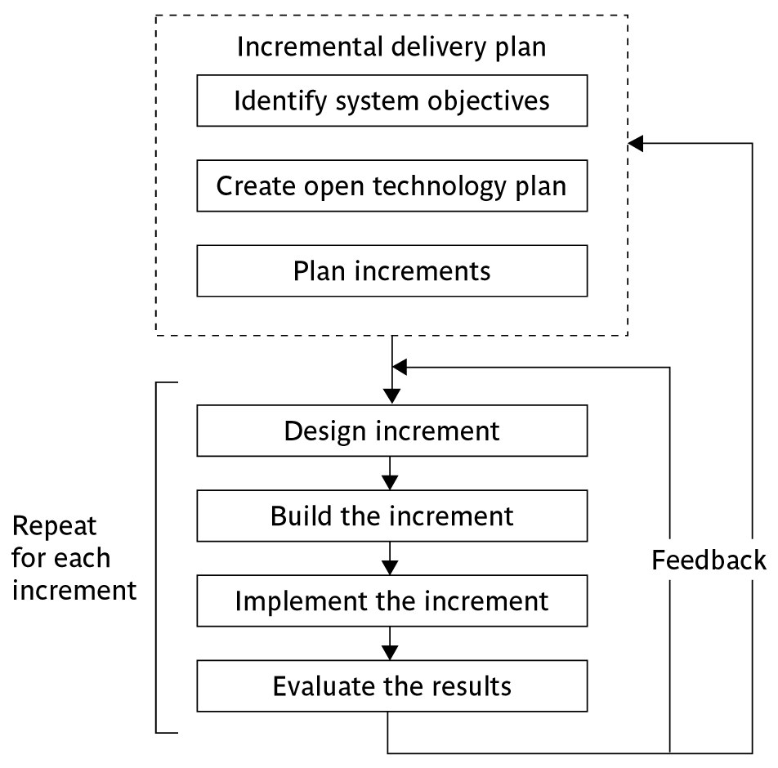
The incremental process
SPM (6e) Selection of project approach© The McGraw-Hill Companies, 2017
Notes:
This approach has had a very vocal advocate in Tom Gilb (see the book Principles of Software Engineering Management published by Addison-Wesley (1988)).
Gilb argues that the initial focus should be on high level business objectives. There may be many ways in which important objectives can be achieved and we ought to allow ourselves freedom in the way we try to achieve the objectives.
Open technology plan – we need to ensure that the technologies we use are ones that facilitate the addition of components to an existing application.
Plan increments – the nature and order of the increments to be delivered needs to be delivered to the users have to be planned at the outset.

Slide 20
Incremental approach: benefits
feedback from early stages used in developing latter stages
shorter development thresholds
user gets some benefits earlier
project may be put aside temporarily
reduces ‘gold-plating’
BUT there are some possible disadvantages
loss of economy of scale
‘software breakage’
SPM (6e) Selection of project approach© The McGraw-Hill Companies, 2017
Notes:
Advantages of prototyping
feedback from early stages used in developing latter stages
shorter development thresholds - important when requirements are likely to change
user gets some benefits earlier - may assist cash flow
project may be put aside temporarily - more urgent jobs may emerge
reduces ‘gold-plating’ i.e. features requested but not used
But there are possible disadvantages
loss of economy of scale - some costs will be repeated
‘software breakage’ - later increments might change earlier increments

Slide 21
Overview of incremental plan
steps ideally 1% to 5% of the total project
non-computer steps should be included
ideal if a step takes one month or less:
  not more than three months
each step should deliver some benefit to the user
some steps will be physically dependent on others
SPM (6e) Selection of project approach© The McGraw-Hill Companies, 2017

Slide 22
which step first?
some steps will be pre-requisite because of physical dependencies
others may be in any order
value to cost ratios may be used
  V/C where
  V is a score 1-10 representing value to customer
  C is a score 0-10 representing value to developers
SPM (6e) Selection of project approach© The McGraw-Hill Companies, 2017

Slide 23
V/C ratios: an example
SPM (6e) Selection of project approach© The McGraw-Hill Companies, 2017

Slide 24
Genesis of ‘Agile’ methods
Structured development methods have several disadvantages
  produce large amounts of documentation which can largely remain unread
  documentation has to be kept up to date
  division into specialist groups and need to follow procedures stifles communication
  users can be excluded from decision process
  long lead times to deliver anything etc. etc
The answer? ‘Agile’ methods?
SPM (6e) Selection of project approach© The McGraw-Hill Companies, 2017

Slide 25
Agile Methods
Agile is an umbrella term that refers to a group of development processes:
  Crystal technologies
  Atern (formerly DSDM)
  Feature-driven development
  Scrum
  Extreme Programming (XP)
Similar themes:
  Some variations
SPM (6e) Selection of project approach© The McGraw-Hill Companies, 2017

Slide 26
Important Themes of Agile Methods
Base on the incremental approach:
  At a time, only one increment is planned, developed, and then deployed at the customer site.
Agile model emphasizes face-to-face communication over written documents.
An agile project usually includes a customer representative in the team.
Agile development projects usually deploy pair programming.
SPM (6e) Selection of project approach© The McGraw-Hill Companies, 2017

Slide 27
Atern/Dynamic system development method (DSDM)
UK-based consortium
arguably DSDM can be seen as replacement for SSADM
DSDM is more a project management approach than a development approach
Can still use DFDs, LDSs etc!
An update of DSDM has been badged as ‘Atern’
SPM (6e) Selection of project approach© The McGraw-Hill Companies, 2017
Notes:
A fuller explanation can be found in the DSDM Atern Pocket Book published by the Atern/DSDM Consortium.
SSADM is Structured Systems Analysis and Design Method a very heavy-weight and bureaucratic methodology that was promoted by the UK government
DFD = Data Flow Diagram
LDS = Logical Data Structure, effectively an Entity-Relationship Diagram

Slide 28
Six core Atern/DSDM principles
1. Focus on business need
2. Delivery on time – use of time-boxing
3. Collaborate
4. Never compromise qualitiy
5. Deliver iteratively
6. Build incrementally
SPM (6e) Selection of project approach© The McGraw-Hill Companies, 2017
Notes:
This can be seen as a re-packaging of a lot of the ideas that have been discussed under the incremental and evolutionary approaches

Slide 29
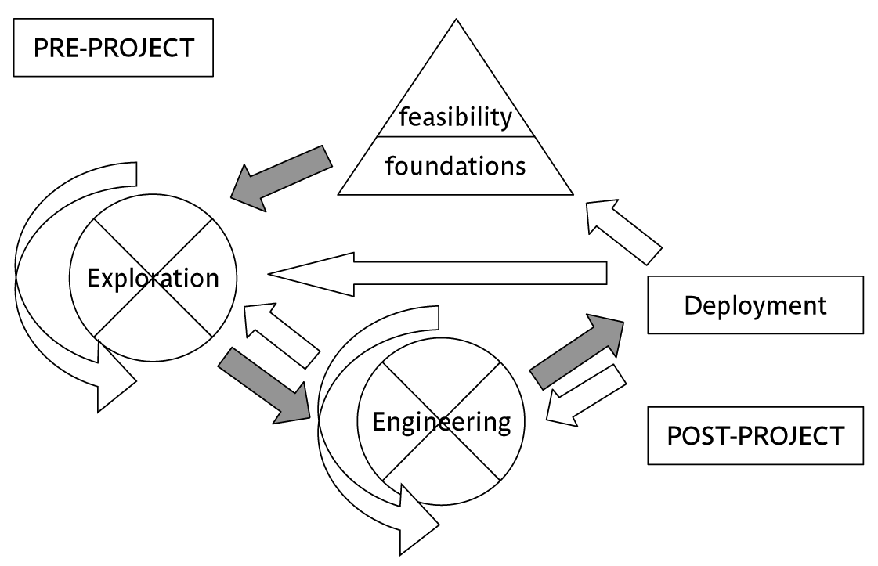
Atern/DSDM framework
SPM (6e) Selection of project approach© The McGraw-Hill Companies, 2017
Notes:
The feasibility/business study stage will not only look at the business feasibility of the proposed project, but also as whether DSDM would be the best framework for it. Applications where there is a prominent user interface would be prime candidates.

Slide 30

Atern DSDM: time-boxing
time-box fixed deadline by which something has to be delivered
typically two to six weeks
MOSCOW priorities
  Must have - essential
  Should have - very important, but system could operate without
  Could have
  Want - but probably won’t get!
SPM (6e) Selection of project approach© The McGraw-Hill Companies, 2017
Notes:
Time-boxes mean that the focus moves from having a fixed set of functional requirements and then extending the planned project completion until they have all been developed. The deadline is fixed and we deliver what we have completed so far even if it is not everything that was originally planned.
In order to make the delivered package coherent and as useful as possible to the users, requirements are prioritized according to the MoSCoW rules.

Slide 31


Extreme Programming Model
Extreme programming (XP) was proposed by Kent Beck in 1999.
The methodology got its name from the fact that:
  Recommends taking the best practices to extreme levels.
  If something is good, why not do it all the time.
SPM (6e) Selection of project approach© The McGraw-Hill Companies, 2017

Slide 32
Extreme programming
increments of one to three weeks
  customer can suggest improvement at any point
argued that distinction between design and building of software are artificial
code to be developed to meet current needs only
frequent re-factoring to keep code structured
SPM (6e) Selection of project approach© The McGraw-Hill Companies, 2017
Notes:
Associated with Kent Beck - see Extreme programming explained
Developed originally on Chrysler C3 payroll (Smalltalk) project
Agile methods include Jim Highsmith’s Adaptive Software Development and Alistair Cocburn’s Chrystal Lite methods

Slide 33
Taking Good Practices to Extreme
If code review is good:
  Always review --- pair programming
If testing is good:
  Continually write and execute test cases --- test-driven development
If incremental development is good:
  Come up with new increments every few days
If simplicity is good:
  Create the simplest design that will support only the currently required functionality.
SPM (6e) Selection of project approach© The McGraw-Hill Companies, 2017

Slide 34
Taking Good Practices to Extreme
If design is good,
  everybody will design daily (refactoring)
If architecture is important,
  everybody will work at defining and refining the architecture (metaphor)
If integration testing is important,
  build and integrate test several times a day (continuous integration)
SPM (6e) Selection of project approach© The McGraw-Hill Companies, 2017

Slide 35
extreme programming - contd
developers work in pairs
test cases and expected results devised before software design
after testing of increment, test cases added to a consolidated set of test cases
SPM (6e) Selection of project approach© The McGraw-Hill Companies, 2017

Slide 36
Limitations of extreme programming
Reliance on availability of high quality developers
Dependence on personal knowledge – after development knowledge of software may decay making future development less easy
Rationale for decisions may be lost e.g. which test case checks a particular requirement
Reuse of existing code less likely
SPM (6e) Selection of project approach© The McGraw-Hill Companies, 2017

Slide 37
Grady Booch’s concern
Booch, an OO authority, is concerned that with requirements driven projects:
‘Conceptual integrity sometimes suffers because this is little motivation to deal with scalability, extensibility, portability, or reusability beyond what any vague requirement might imply’
Tendency towards a large number of discrete functions with little common infrastructure?
SPM (6e) Selection of project approach© The McGraw-Hill Companies, 2017

Slide 38
Project Characteristics that Suggest Suitability of Extreme Programming
Projects involving new technology or research projects.
  In this case, the requirements change rapidly and unforeseen technical problems need to be resolved.
Small projects:
  These are easily developed using extreme programming.
SPM (6e) Selection of project approach© The McGraw-Hill Companies, 2017

Slide 39

Scrum
One of the “agile processes”
Self-organizing teams
Product progresses in a series of month-long “sprints”
Requirements are captured as items in a list of “product backlog”
SPM (6e) Selection of project approach© The McGraw-Hill Companies, 2017

Slide 40
Sprints
Scrum projects make progress in a series of “sprints”
Analogous to XP iterations
Target duration is one month
  +/- a week or two
During a sprint, a product increment is designed, coded, and tested
SPM (6e) Selection of project approach© The McGraw-Hill Companies, 2017

Slide 41
Key Roles in Scrum Process
Product Owner
  Acts on behalf of customers to represent their interests.
Development Team
  Team of five-nine people with cross-functional skill sets.
Scrum Master
  Facilitates scrum process and resolves impediments at the team and organization level by acting as a buffer between the team and outside interference.
SPM (6e) Selection of project approach© The McGraw-Hill Companies, 2017

Slide 42

Scrum Ceremonies
Sprint Planning Meeting
Sprint
Daily Scrum
Sprint Review Meeting
SPM (6e) Selection of project approach© The McGraw-Hill Companies, 2017

Slide 43
Sprint Planning
In this meeting, the product owner and the team members decide which Backlog Items the Team will work on in the next sprint
Scrum Master should ensure that the Team agrees to realistic goals
SPM (6e) Selection of project approach© The McGraw-Hill Companies, 2017

Slide 44
Sprint
Fundamental process flow of Scrum
A month-long iteration, during which an incremental product functionality completed
NO outside influence can interfere with the Scrum team during the Sprint
Each Sprint begins with the Daily Scrum Meeting
SPM (6e) Selection of project approach© The McGraw-Hill Companies, 2017

Slide 45
Daily Scrum
Held daily:
  Short meeting
  Lasts for about 15mins only
Main objective is to answer three questions:
  What did you do yesterday
  What will you do today?
  What obstacles are in your way?
SPM (6e) Selection of project approach© The McGraw-Hill Companies, 2017

Slide 46
Sprint Review Meeting
Team presents what it accomplished during the sprint
  Typically takes the form of a demo of new features or underlying architecture
Informal meeting:
  The preparation time should not exceed about 2-hours
SPM (6e) Selection of project approach© The McGraw-Hill Companies, 2017

Slide 47
Sprint Artefacts
Product backlog
Sprint backlog
Sprint burndown chart
SPM (6e) Selection of project approach© The McGraw-Hill Companies, 2017

Slide 48
Product Backlog
A list of all desired work on the project --- usually a combination of :
  story-based work (e.g. “let user search and replace”)
  task-based work (“improve exception handling”)
List is prioritized by the Product Owner
SPM (6e) Selection of project approach© The McGraw-Hill Companies, 2017

Slide 49
Sprint Backlog
A subset of Product Backlog Items, which define the work for a Sprint
  Created by Team members
  Each Item has it’s own status
  Updated daily
SPM (6e) Selection of project approach© The McGraw-Hill Companies, 2017

Slide 50
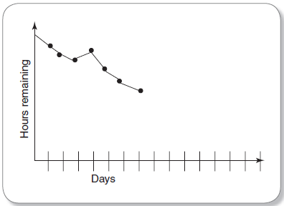
Sprint Burndown Chart
Day-wise depicts the total Sprint Backlog hours remaining
Ideally should burn down to zero to the end of the Sprint
SPM (6e) Selection of project approach© The McGraw-Hill Companies, 2017

Slide 51
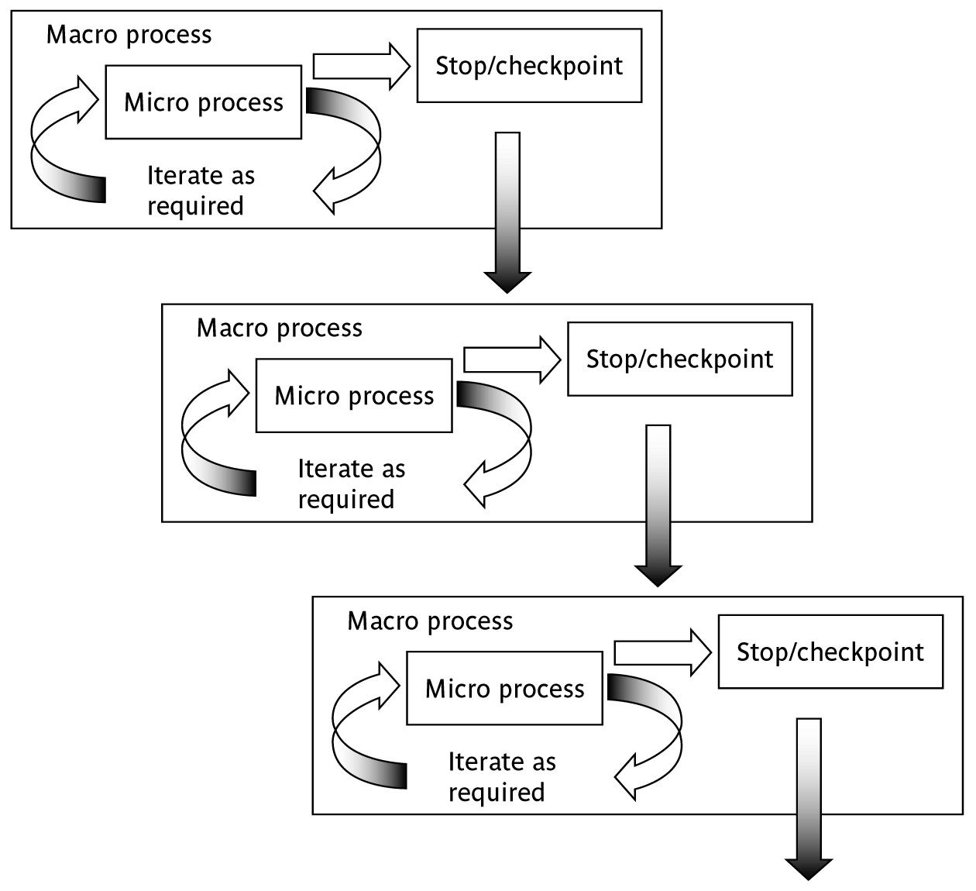
macro and micro processes
SPM (6e) Selection of project approach© The McGraw-Hill Companies, 2017
Notes:
Section 4.14 discusses these ideas in a little more detail

Slide 52
combinations of approach
installation
one-shot
incremental
evolutionary
one-shot
yes
yes
no
construction
incremental
yes
yes
no
evolutionary
yes
yes
yes
one-shot or incremental installation - any
construction approach possible
evolutionary installation implies evolutionary construction
SPM (6e) Selection of project approach© The McGraw-Hill Companies, 2017

Slide 53
‘rules of thumb’ about approach to be used
IF uncertainty is high
  THEN use evolutionary approach
IF complexity is high but uncertainty is not
  THEN use incremental approach
IF uncertainty and complexity both low
  THEN use one-shot
IF schedule is tight
  THEN use evolutionary or incremental
SPM (6e) Selection of project approach© The McGraw-Hill Companies, 2017

