Slide 1
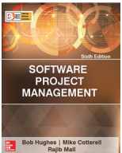
Software Project Management
Chapter Seven
Risk management
SPM (6e) risk management© The McGraw-Hill Companies, 2017
Notes:
This set of overheads looks at risk management.
It discusses the definition of ‘risk’ and ‘risk management’.
Some taxonomies of risk are touched upon.
The main steps in risk management are then presented in turn:
Risk identification
2. Risk analysis and prioritization
3. Risk planning
4. Risk monitoring – this is not dealt with properly because of time and space constraints
The PERT risk technique is touched upon and also the critical chain concepts.
There is a lot of material here, as with other chapters, and the OHPs can only give an overview of the topics. More detailed information is to be found on all these areas in the textbook.

Slide 2



Risk management
This lecture will touch upon:
Definition of ‘risk’ and ‘risk management’
Some ways of categorizing risk
Risk management
  Risk identification – what are the risks to a project?
  Risk analysis – which ones are really serious?
  Risk planning – what shall we do?
  Risk monitoring – has the planning worked?
We will also look at PERT risk and critical chains
SPM (6e) risk management© The McGraw-Hill Companies, 2017

Slide 3
Some definitions of risk
‘the chance of exposure to the adverse consequences of future events’ PRINCE2
‘an uncertain event or condition that, if it occurs, has a positive or negative effect on a project’s objectives’ PM-BOK
Risks relate to possible future problems, not current ones
They involve a possible cause and its effect(s) e.g. developer leaves > task delayed
SPM (6e) risk management© The McGraw-Hill Companies, 2017
Notes:
Note that good risk management may identify situations where an unexpected future event might present an opportunity to be exploited e.g. a task being less difficult than expected.

Slide 4
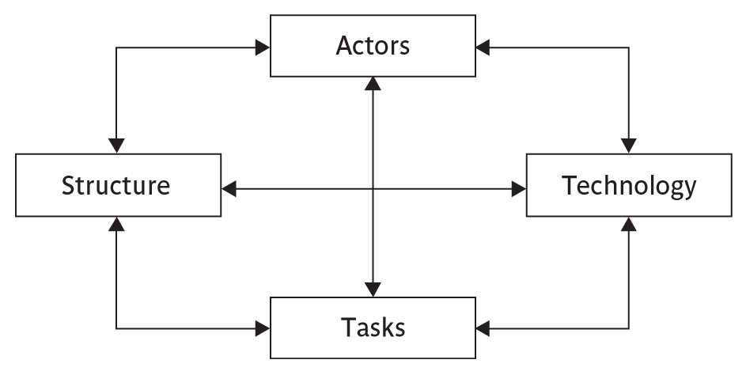
Categories of risk
SPM (6e) risk management© The McGraw-Hill Companies, 2017
Notes:
This is based on Lyytinen’s sociotechnical model of risk
Actors relate to all those involved in the project including both developers, users and managers e.g. a risk could be that high staff turnover leads to information of importance to the project being lost
Technology – both that used to implement the project and that embedded in the project deliverables – risk could be that the technologies selected are not in fact appropriate.
Structure – this includes management procedures, risk here is that a group who need to carry out a particular project task are not informed of this need because they are not part of the project communication network
Tasks – the work to be carried out. A typical risk is that the amount of effort needed to carry out the task is underestimated.
A risk could be well belong to more than one of the four areas – for example, estimates being wrong could be influenced by problems with actors (e.g. lack of experience with a technical domain) or the structure (over optimism of managers keen to win work).
Exercise 7.2 in the text will be some practice in identifying and categorizing risks

Slide 5
Risk Management Approaches
Proactive:
  The proactive approaches try to anticipate the possible risks that the project is susceptible to.
  After identifying the possible risks, actions are taken to eliminate the risks.
Reactive:
  Reactive approaches take no action until an unfavourable event occurs.
  Once an unfavourable event occurs, these approaches try to contain the adverse effects associated with the risk and take steps to prevent future occurrence of the same risk events.
SPM (6e) risk management© The McGraw-Hill Companies, 2017

Slide 6
A framework for dealing with risk
The planning for risk includes these steps:
Risk identification – what risks might there be?
Risk analysis and prioritization – which are the most serious risks?
Risk planning – what are we going to do about them?
Risk monitoring – what is the current state of the risk?
SPM (6e) risk management© The McGraw-Hill Companies, 2017
Notes:
Section 7.4 Page 166

Slide 7
Risk identification
Approaches to identifying risks include:
Use of checklists – usually based on the experience of past projects
Brainstorming – getting knowledgeable stakeholders together to pool concerns
Causal mapping – identifying possible chains of cause and effect
SPM (6e) risk management© The McGraw-Hill Companies, 2017

Slide 8
Boehm’s top 10 development risks
Risk | Risk reduction techniques
Personnel shortfalls | Staffing with top talent; job matching; teambuilding; training and career development; early scheduling of key personnel
Unrealistic time and cost estimates | Multiple estimation techniques; design to cost; incremental development; recording and analysis of past projects; standardization of methods
Developing the wrong software functions | Improved software evaluation; formal specification methods; user surveys; prototyping; early user manuals
Developing the wrong user interface | Prototyping; task analysis; user involvement
SPM (5e) risk management© The McGraw-Hill Companies, 2009
Notes:
Barry Boehm surveyed software engineering project leaders to find out the main risks that they had experienced with their projects. For each risk, some risk reduction techniques has been suggested.

Slide 9
Boehm’s top ten risk - continued
Gold plating | Requirements scrubbing, prototyping, design to cost
Late changes to requirements | Change control, incremental development
Shortfalls in externally supplied components | Benchmarking, inspections, formal specifications, contractual agreements, quality controls
Shortfalls in externally performed tasks | Quality assurance procedures, competitive design etc
Real time performance problems | Simulation, prototyping, tuning
Development technically too difficult | Technical analysis, cost-benefit analysis, prototyping , training
SPM (5e) risk management© The McGraw-Hill Companies, 2009
Notes:
‘Gold plating‘ refers to inclusion of features that in fact are unnecessary and which end up never actually being used.

Slide 10
Risk prioritization
Risk exposure (RE)
= (potential damage) x (probability of occurrence)
Ideally
Potential damage: a money value e.g. a flood would cause £0.5 millions of damage
Probability 0.00 (absolutely no chance) to 1.00 (absolutely certain) e.g. 0.01 (one in hundred chance)
RE = £0.5m x 0.01 = £5,000
Crudely analogous to the amount needed for an insurance premium
SPM (6e) risk management© The McGraw-Hill Companies, 2017
Notes:
If there were 100 people chipping in £5,000 each, there would be enough for the 1 in 100 chance of the flooding. If there were 2 floods then the system collapses!
Exercise 7.3 in the textbook is strongly recommended to explore these issues.
In practice, with project risks, these quantitative approaches are usually impractical and more qualitative approaches are used instead. See the next overhead.

Slide 11
Risk probability: qualitative descriptors
Probability level | Range
High | Greater than 50% chance of happening
Significant | 30-50% chance of happening
Moderate | 10-29% chance of happening
Low | Less than 10% chance of happening
SPM (6e) risk management© The McGraw-Hill Companies, 2017
Notes:
Managers would be happier identifying an approximate range rather than a precise probability.

Slide 12
Qualitative descriptors of impact on cost and associated range values
Impact level | Range
High | Greater than 30% above budgeted expenditure
Significant | 20 to 29% above budgeted expenditure
Moderate | 10 to 19% above budgeted expenditure
Low | Within 10% of budgeted expenditure.
SPM (6e) risk management© The McGraw-Hill Companies, 2017
Notes:
Similar tables can be produced for the impact on project duration and on the quality of project deliverables.
The problem with the qualitative approach is how do you combine the judgements about probability and impact – you can’t multiply them together.

Slide 13
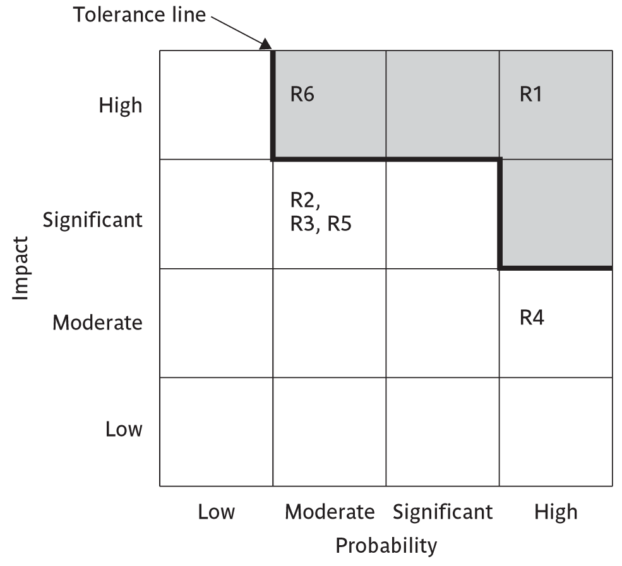
Probability impact matrix
SPM (6e) risk management© The McGraw-Hill Companies, 2017
Notes:
R1, R2 etc refer to particular risks (See Table 7.2 in the textbook). They are located on the grid according to the likelihood and impact ratings that have been allocated to them. A zone around the top right hand corner of the grid can be designated and risks falling within that zone are treated as requiring urgent action.

Slide 14

Risk planning
Risks can be dealt with by:
Risk acceptance
Risk avoidance
Risk reduction
Risk transfer
Risk mitigation/contingency measures
SPM (6e) risk management© The McGraw-Hill Companies, 2017
Notes:
Risk acceptance – the cost of avoiding the risk may be greater than the actual cost of the damage that might be inflicted
Risk avoidance – avoid the environment in which the risk occurs e.g. buying an OTS application would avoid a lot of the risks associated with software development e.g. poor estimates of effort.
Risk reduction – the risk is accepted but actions are taken to reduce its likelihood e.g. prototypes ought to reduce the risk of incorrect requirements
Risk transfer – the risk is transferred to another person or organization. The risk of incorrect development estimates can be transferred by negotiating a fixed price contract with an outside software supplier.
Risk mitigation – tries to reduce the impact if the risk does occur e.g. taking backups to allow rapid recovery in the case of data corruption
See Section 7.7 pp 172-73

Slide 15
Risk reduction leverage
Risk reduction leverage =
(RE_{before}- RE_{after})/ (cost of risk reduction)
RE_{before}is risk exposure before risk reduction e.g. 1% chance of a fire causing £200k damage
RE_{after} is risk exposure after risk reduction e.g. fire alarm costing £500 reduces probability of fire damage to 0.5%
RRL = (1% of £200k)-(0.5% of £200k)/£500 = 2
RRL > 1.00 therefore worth doing
SPM (6e) risk management© The McGraw-Hill Companies, 2017
Notes:
You could think in terms of the analogy to insurance. An insurance company might reduce the fire insurance premium from £2k to £1k on condition that a fire alarm is installed. The insured would save £1k a year by investing £500 so it would be worth doing.

Slide 16
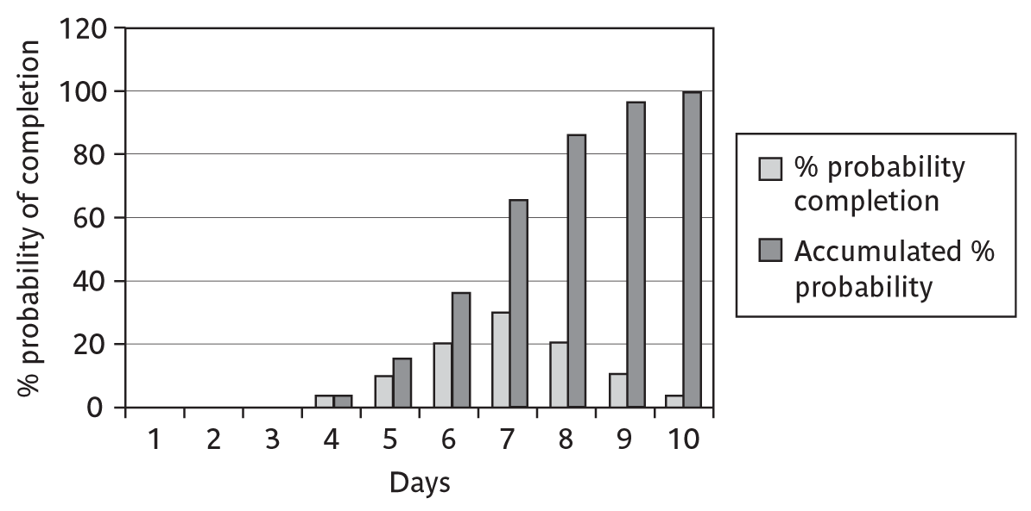
Probability chart
SPM (6e) risk management© The McGraw-Hill Companies, 2017
Notes:
As was pointed out in Chapter 5, an estimate of activity duration is realistically a range of values clustered around the most likely value are trailing off on either side of this central value.
How can we take account of this in project planning? An answer might be the PERT risk technique.

Slide 17
Using PERT to evaluate the effects of uncertainty
Three estimates are produced for each activity
Most likely time (m)
Optimistic time (a)
Pessimistic (b)
‘expected time’ t_{e} = (a + 4m +b) / 6
‘activity standard deviation’ S = (b-a)/6
SPM (6e) risk management© The McGraw-Hill Companies, 2017
Notes:
Most likely time (m) the time we would expect the task to take normally
Optimistic time (a) the shortest time that could be realistically be expected
Pessimistic (b) worst possible time (only 1% chance of being worse, say)
Some straightforward activities (data input of standing data might perhaps be an example) might have little uncertainty and therefore have a low standard deviation, while others (software design, for instance?) have more uncertainty and would have a bigger standard deviation.
Exercise 7.5 in the textbook will give some practice in calculating these values.

Slide 18
A chain of activities
Task A
Task B
Task C
Task | a | m | b | t_{e} | s
A | 10 | 12 | 16 | ? | ?
B | 8 | 10 | 14 | ? | ?
C | 20 | 24 | 38 | ? | ?
SPM (6e) risk management© The McGraw-Hill Companies, 2017
Notes:
Fill the missing gaps?
Task A t_{e} = (10+ (12 x 4) + 16)/ 6 i.e. 12.66 s = (16-10)/6 i.e. 1
Task B t_{e} = (8 + (10 x 4) + 14)/ 6 i.e. 10.33 s = (14-8)/6 i.e. 1
Task C T_{e} = (20 + (24 x 4) + 38)/6 i.e. 25.66 s = (38-20)/6 i.e. 3

Slide 19
A chain of activities
What would be the expected duration of the chain A + B + C?
Answer: 12.66 + 10.33 + 25.66 i.e. 48.65
What would be the standard deviation for A + B+ C?
Answer: square root of (1² + 1² + 3²) i.e.
3.32
SPM (6e) risk management© The McGraw-Hill Companies, 2017
Notes:
Get them to guess the square root if no one has a laptop with Excel or a scientific calculator!

Slide 20
Assessing the likelihood of meeting a target
Say the target for completing A+B+C was 52 days (T)
Calculate the z value thus
z = (T – t_{e})/s
In this example z = (52-48.33)/3.32 i.e. 1.01
Look up in table of z values – see next overhead
SPM (6e) risk management© The McGraw-Hill Companies, 2017
Notes:
The target, in this case 52 days, is one that could be based on an externally imposed deadline e.g. the start of the London Olympics. The STANDARDIZE calculation in Excel can be used to calculate the Z value.

Slide 21
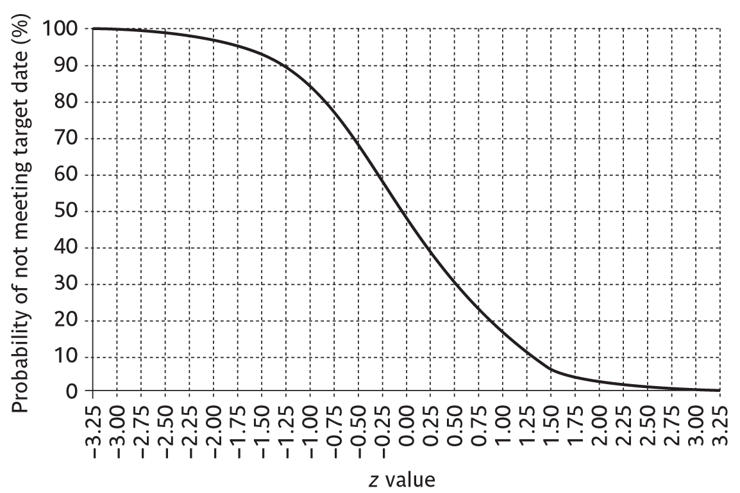
Graph of z values
SPM (6e) risk management© The McGraw-Hill Companies, 2017
Notes:
There is about a 15% chance of not meeting the target of 52 days. The Excel NORMSDIST can be used to do this calculation.

Slide 22

Monte Carlo Simulation
An alternative to PERT.
A class of general analysis techniques:
  Valuable to solve any problem that is complex, nonlinear, or involves more than just a couple of uncertain parameters.
Monte Carlo simulations involve repeated random sampling to compute the results.
Gives more realistic results as compared to manual approaches.
SPM (6e) risk management© The McGraw-Hill Companies, 2017

Slide 23
Steps of a Monte Carlo Analysis
Assess the range for the variables being considered.
Determine the probability distribution of each variable.
For each variable, select a random value based on the probability distribution.
Run a deterministic analysis or one pass through the model.
Repeat steps 3 and 4 many times to obtain the probability distribution of the model’s results.
SPM (6e) risk management© The McGraw-Hill Companies, 2017

Slide 24
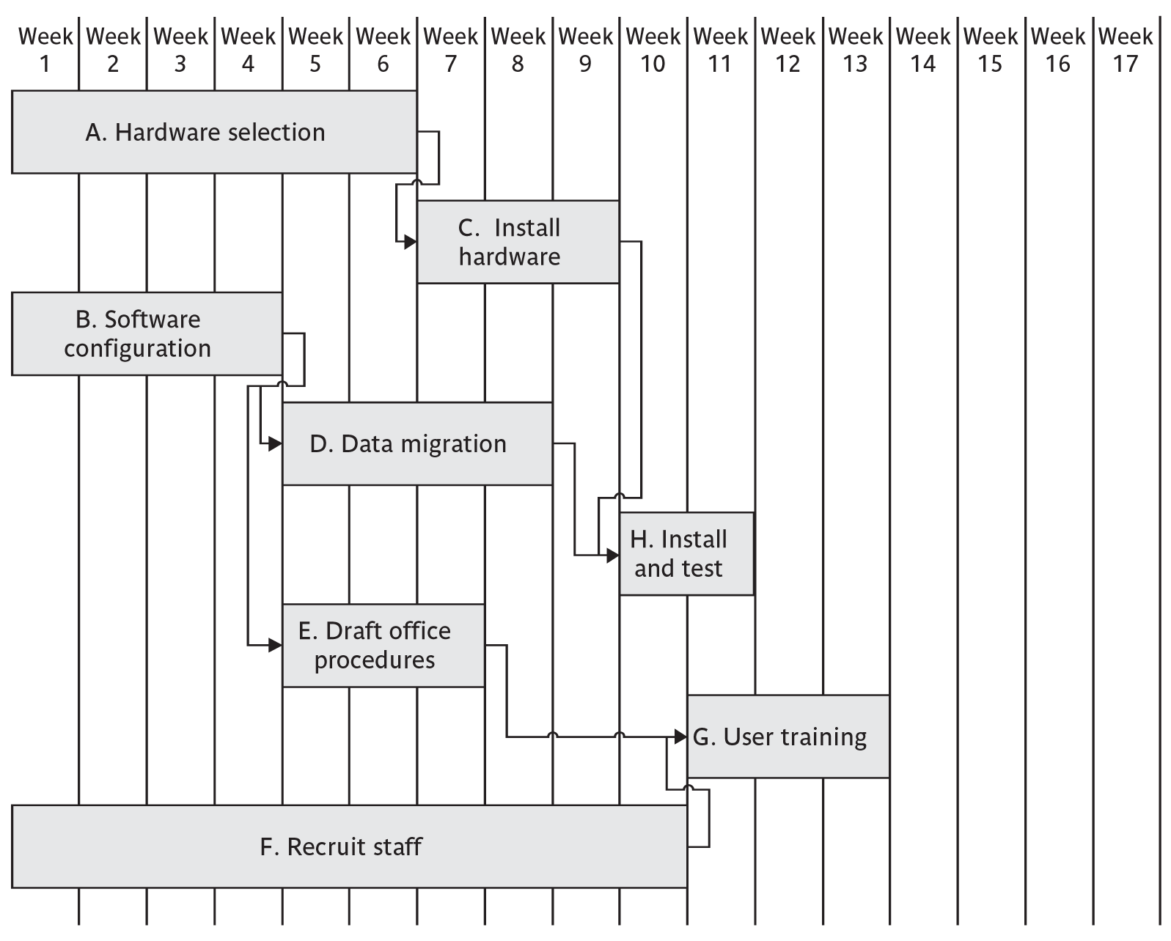
Critical chain concept
Traditional planning approach
SPM (6e) risk management© The McGraw-Hill Companies, 2017
Notes:
Note that this plan tends to start activities as early as possible – for example see Activities E and H. While the float on these activities could be used as a buffer if they were late, other activities e.g. F. although of substantial duration do not have the same kind of cushion. In the case of F, the planner would have to make any safety buffer part of the core activity duration.

Slide 25
Critical chain approach
One problem with estimates of task duration:
Estimators add a safety zone to estimate to take account of possible difficulties
Developers work to the estimate + safety zone, so time is lost
No advantage is taken of opportunities where tasks can finish early – and provide a buffer for later activities
SPM (6e) risk management© The McGraw-Hill Companies, 2017
Notes:
Developers will tend to start activities as late as is compatible with meeting the target date as they often have other urgent work to be getting on with in the mean time.

Slide 26
Critical chain approach
One answer to this:
Ask the estimators for two estimates
  Most likely duration: 50% chance of meeting this
  Comfort zone: additional time needed to have 95% chance
Schedule all activities using most likely values and starting all activities on latest start dates
SPM (6e) risk management© The McGraw-Hill Companies, 2017
Notes:
This approach means that the ‘safety buffer’ in the estimate for an activity is moved from the individual developer to the project as a whole.
.

Slide 27
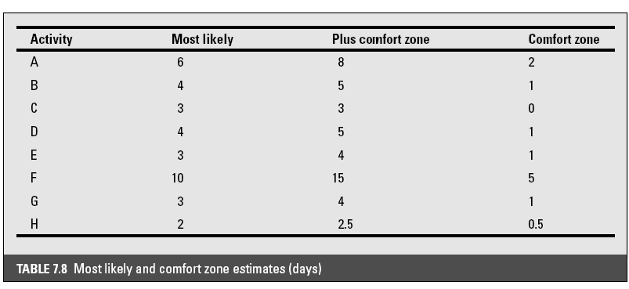
Most likely and comfort zone estimates
SPM (6e) risk management© The McGraw-Hill Companies, 2017

Slide 28
Critical chain - continued
Identify the critical chain – same a critical path but resource constraints also taken into account
Put a project buffer at the end of the critical chain with duration 50% of sum of comfort zones of the activities on the critical chain.
SPM (5e) risk management© The McGraw-Hill Companies, 2009

Slide 29
Critical chain -continued
Where subsidiary chains of activities feed into critical chain, add feeding buffer
Duration of feeding buffer 50% of sum of comfort zones of activities in the feeding chain
Where there are parallel chains, take the longest and sum those activities
SPM (6e) risk management© The McGraw-Hill Companies, 2017

Slide 30
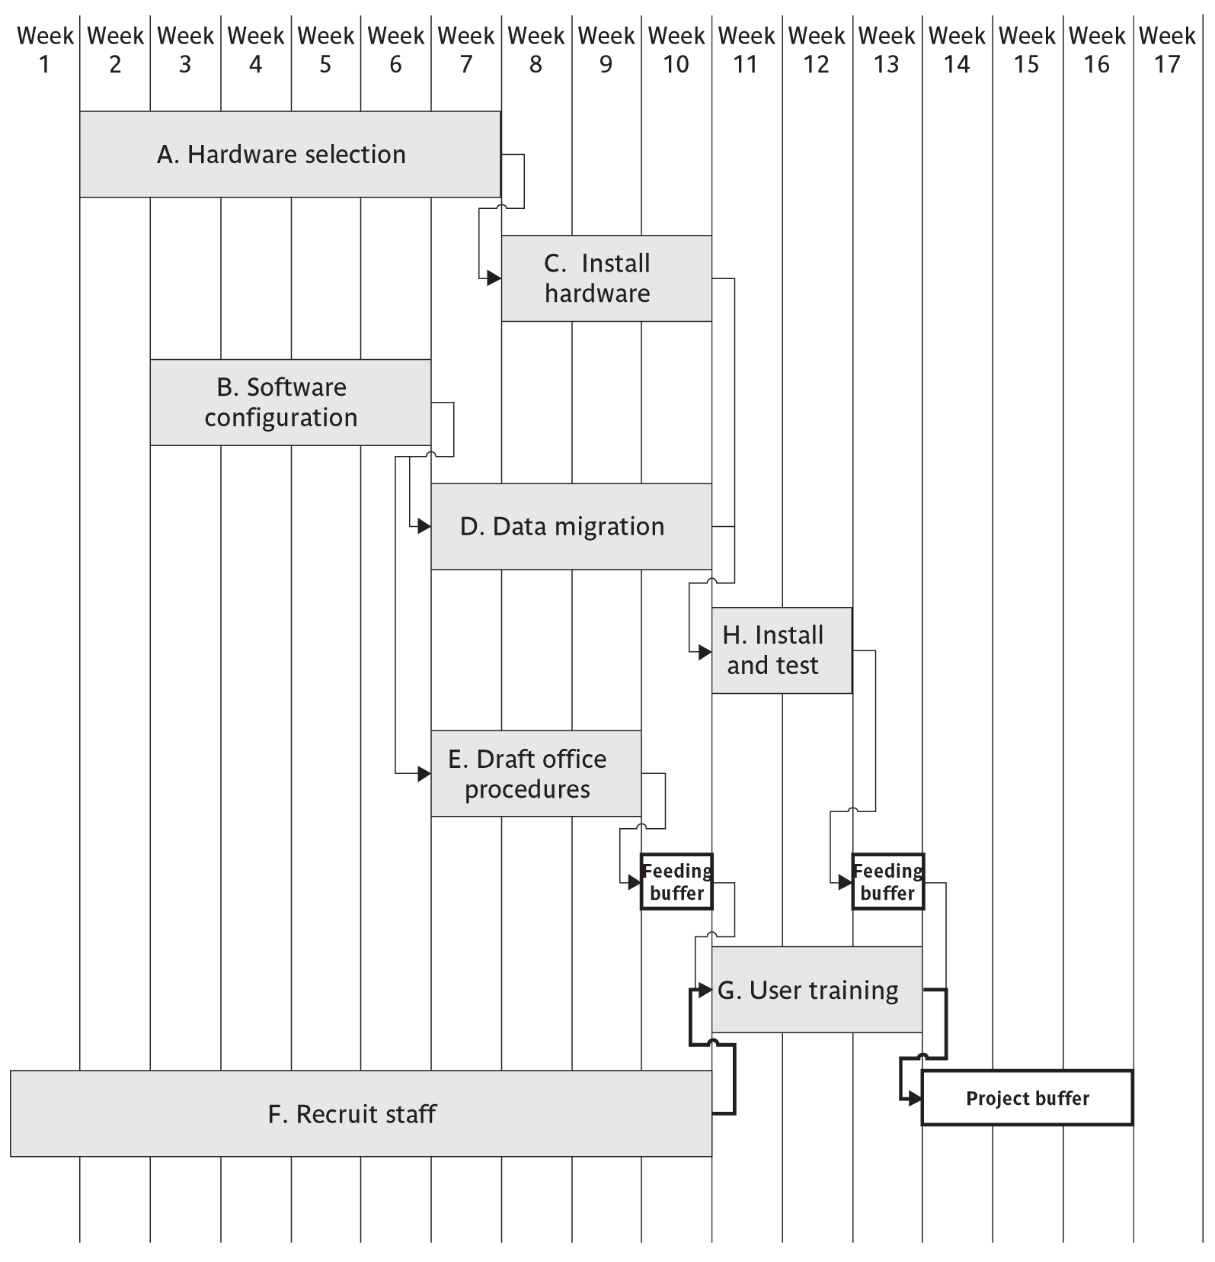
Plan employing critical chain concepts
SPM (6e) risk management© The McGraw-Hill Companies, 2017

Slide 31
Executing the critical chain-based plan
No chain of tasks is started earlier than scheduled, but once it has started is finished as soon as possible
This means the activity following the current one starts as soon as the current one is completed, even if this is early – the relay race principle
SPM (6e) risk management© The McGraw-Hill Companies, 2017

Slide 32
Executing the critical chain-based plan
Buffers are divided into three zones:
Green: the first 33%. No action required
Amber : the next 33%. Plan is formulated
Red : last 33%. Plan is executed.
SPM (6e) risk management© The McGraw-Hill Companies, 2017

