Slide 1
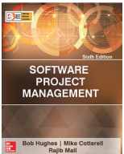
Software Project Management
Sixth Edition
Chapter 9
Monitoring
and
control
SPM (6e) monitoring and control© The McGraw-Hill Companies, 2017

Slide 2
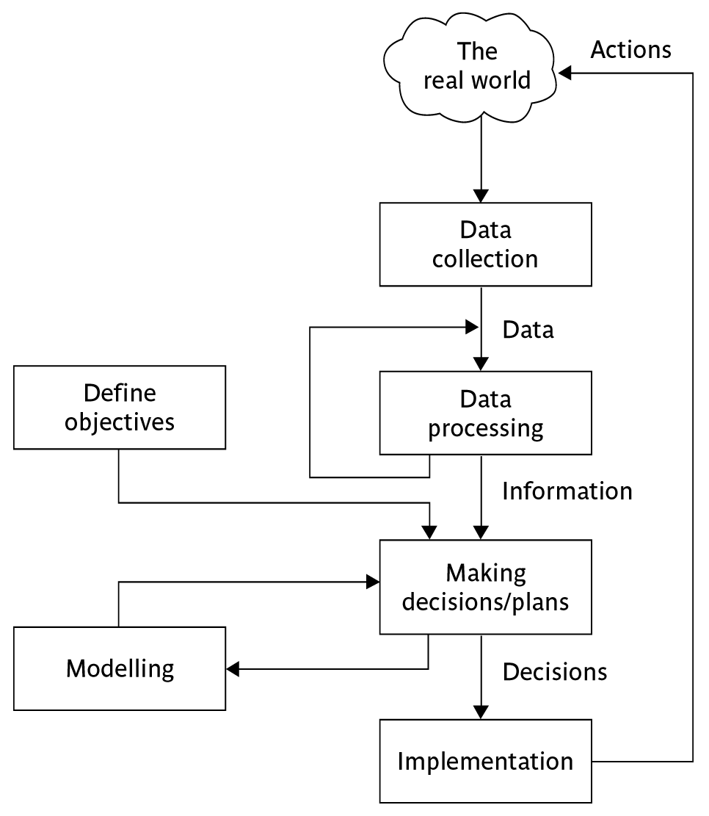
The control cycle
SPM (6e) monitoring and control© The McGraw-Hill Companies, 2017
Notes:
SPM monitoring and control
Define objectives – at the beginning of the project we decide on what we want to achieve
Making decisions/plans – we decide how we are going to achieve the objectives i.e. we create a plan
Modelling – as part of the process of creating a plan we will consider different approaches and attempt to assess the consequences of each of these approaches in terms of how much it will cost and how long it will take, and so on.
Implementation – the plan is now carried out
Data collection – we gather information at regular intervals about how the project is progressing. These raw details could be quite numerous and complex on a large project
Data processing – we process the progress data and convert it into ‘information’ which makes it easier for the project managers and others to understand the overall condition of the project
Making decisions/plans – in the light of the comparison of actual project progress with that planned, the plans are modified. This may require the modelling of the outcomes of different possible courses of action
…and so the cycle goes on.

Slide 3
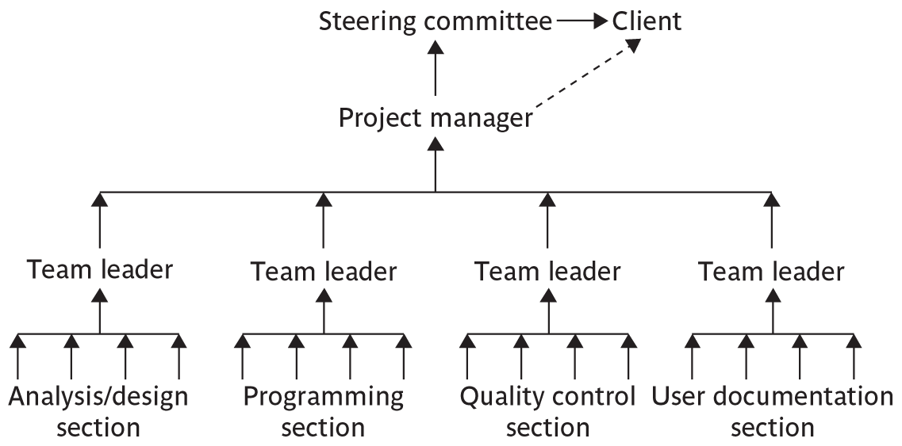
Responsibilities
SPM (6e) monitoring and control© The McGraw-Hill Companies, 2017
Notes:
SPM monitoring and control
The concept of a reporting hierarchy was introduced in Chapter 1.
The main lesson here is that the details relating to project progress have to originate with the people actually doing the work and have then to be fed up through the management structure. At each management level there is going to be some summarising and commentary before information is passed up to the next level. This means that there is always a danger of ‘information overload’ as information passes from the many to the few.

Slide 4


Assessing progress
Checkpoints – predetermined times when progress is checked
  Event driven: check takes place when a particular event has been achieved
  Time driven: date of the check is pre-determined
Frequency of reporting
  The higher the management level then generally the longer the gaps between checkpoints
SPM 65e) monitoring and control© The McGraw-Hill Companies, 2017
Notes:
SPM monitoring and control
Section 9.2 page 215

Slide 5

Collecting progress details
Need to collect data about:
Achievements
Costs
A big problem: how to deal with partial completions
99% completion syndrome
Possible solutions:
Control of products, not activities
Subdivide into lots of sub-activities
SPM (6e) monitoring and control© The McGraw-Hill Companies, 2017
Notes:
SPM monitoring and control
Projects have to be delivered on time and within budget, hence the concern with monitoring achievements and costs.
Partial completion is where, for example, data is being collected at the end of Week 2 of an activity that should take four weeks. We want to know if it is about 50% completed.
An example of the ’99% completion syndrome’ would be in the above case if the developer reported at the end of weeks 1,2 and 3 that the task was respectively 25%, 50% and 75% complete. However at the end of week 4 it is reported that the task is 99% complete. The same thing is reported at the end of week 5 and so on until the task is actually completed.
Control on products implies that actual examination of intermediate allows us to verify independently and objectively that sub-tasks have been completed.
Section 9.3 page 216

Slide 6


Red/Amber/Green reporting
Identify key tasks
  Break down into sub-tasks
Assess subtasks as:
  Green – ‘on target’
  Amber – ‘not on target but recoverable’
  Red – ‘not on target and recoverable only with difficulty’
Status of ‘critical’ tasks is particularly important
SPM (6e) monitoring and control© The McGraw-Hill Companies, 2017
Notes:
SPM monitoring and control
RAG reporting highlights those activities which need particular attention. The status of a troubled activity might typically move from green to amber; if corrective action is possible it might go back to green, otherwise it could switch to red. If there are lots of instances where activities switch directly from green to red, this could indicate more management control.
‘Critical tasks’ would be those on the critical path and/or reliant on critical resources.
Page 217

Slide 7

Review
Review of work products is an important mechanism for monitoring the progress of a project and ensuring the quality of the work products.
Testing is an effective defect removal mechanism.
  However, testing is applicable to only executable code.
  Review is applicable to all work products.
SPM (6e) monitoring and control© The McGraw-Hill Companies, 2017

Slide 8

Utility of Review
A cost-effective defect removal mechanism.
Review usually helps to identify any deviation from standards.
Reviewers suggest ways to improve the work product
a review meeting often provides learning opportunities to not only the author of a work product, but also the other participants of the review meeting.
The review participants gain a good understanding of the work product under review, making it easier for them to interface or use the work product in their work.
SPM (6e) monitoring and control© The McGraw-Hill Companies, 2017

Slide 9
Review Roles
Moderator:
  Schedules and convenes meetings, distributes review materials, leads and moderates review sessions.
Recorder:
  Records the defects found and the time and effort data.
Reviewers.
SPM (6e) monitoring and control© The McGraw-Hill Companies, 2017

Slide 10
Review Process
Planning
Preparation
Rework and follow-up
Review meeting
SPM (5e) monitoring and control© The McGraw-Hill Companies, 2009

Slide 11
Project Termination Review
Project termination reviews provide important opportunities to learn from past mistakes as well as successes.
Project termination need not necessarily mean project failure or premature abandonment.
  A project may be terminated on successful completion
SPM (6e) monitoring and control© The McGraw-Hill Companies, 2017

Slide 12
Reasons for Project Termination
Project is completed successfully handed over to the customer.
Incomplete requirements
Lack of resources
Some key technologies used in the project have become obsolete during project execution
Economics of the project has changed, for example because many competing product may have become available in the market.
SPM (6e) monitoring and control© The McGraw-Hill Companies, 2017

Slide 13
Project Termination Process
Project survey
Collection of objective information
Debriefing meeting
Final project review
Result publication
SPM (6e) monitoring and control© The McGraw-Hill Companies, 2017

Slide 14
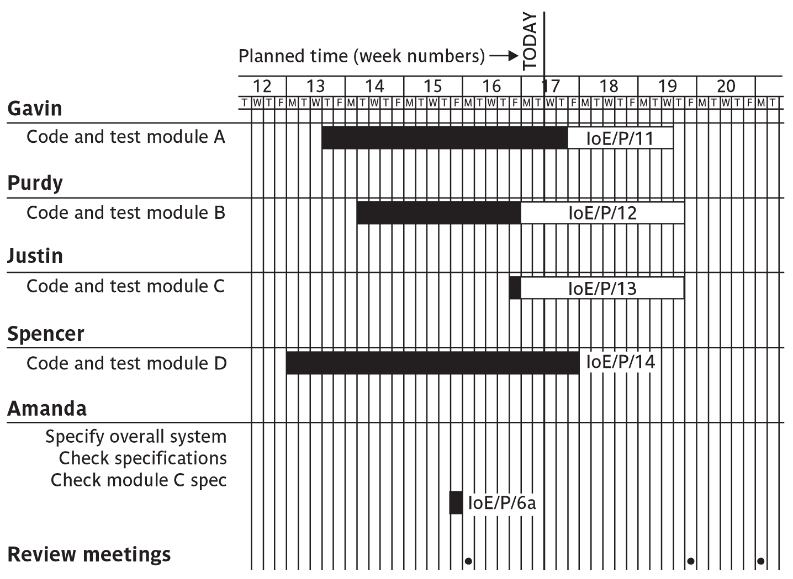
Gantt charts
SPM (6e) monitoring and control© The McGraw-Hill Companies, 2017
Notes:
SPM monitoring and control
Note that the Gantt chart is named after Henry Gantt (1861-1919) and so should not be written in capitals! You could ask students what they think GANTT stands for before you tell them this to impress this on them. I really find Gantt written as GANTT very, very annoying and threaten students with instant failure of the module if they do this!
The format of the Gantt chart here differs from the format used in Microsoft project as the activities for each team member are grouped together. You could input the details so that they came out in this format, but it would not occur automatically.

Slide 15
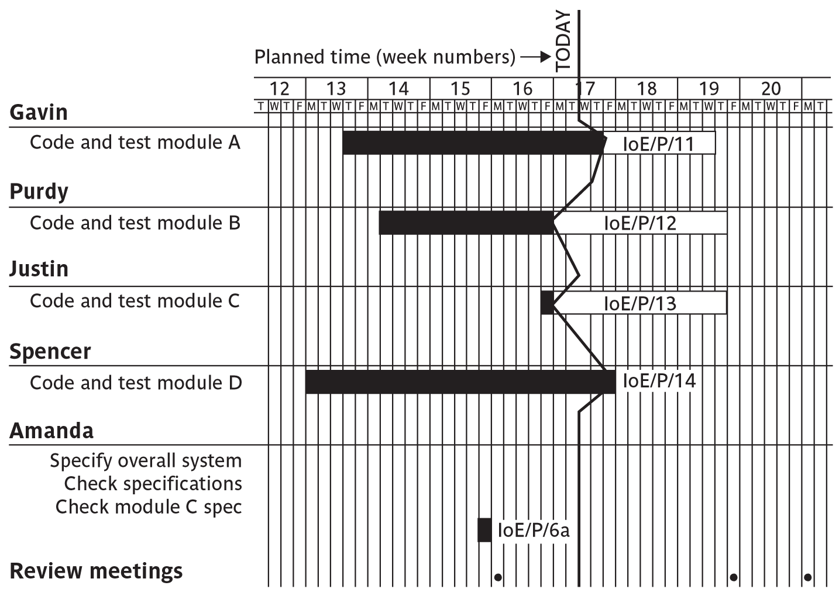
Slip charts
SPM 65e) monitoring and control© The McGraw-Hill Companies, 2017
Notes:
SPM monitoring and control
A slip chart is a version of the Gantt chart where a line is drawn from top to bottom. To the left of the line are all the completed activities and to the right those activities ( or parts of activities) that have not been completed.
The more jagged the line, the more it means that that there are some activities that are lagging to various degrees and some that are ahead of themselves. A very jagged line means that there is scope for re-planning to move resources from those activities that are ahead to those that are behind.

Slide 16
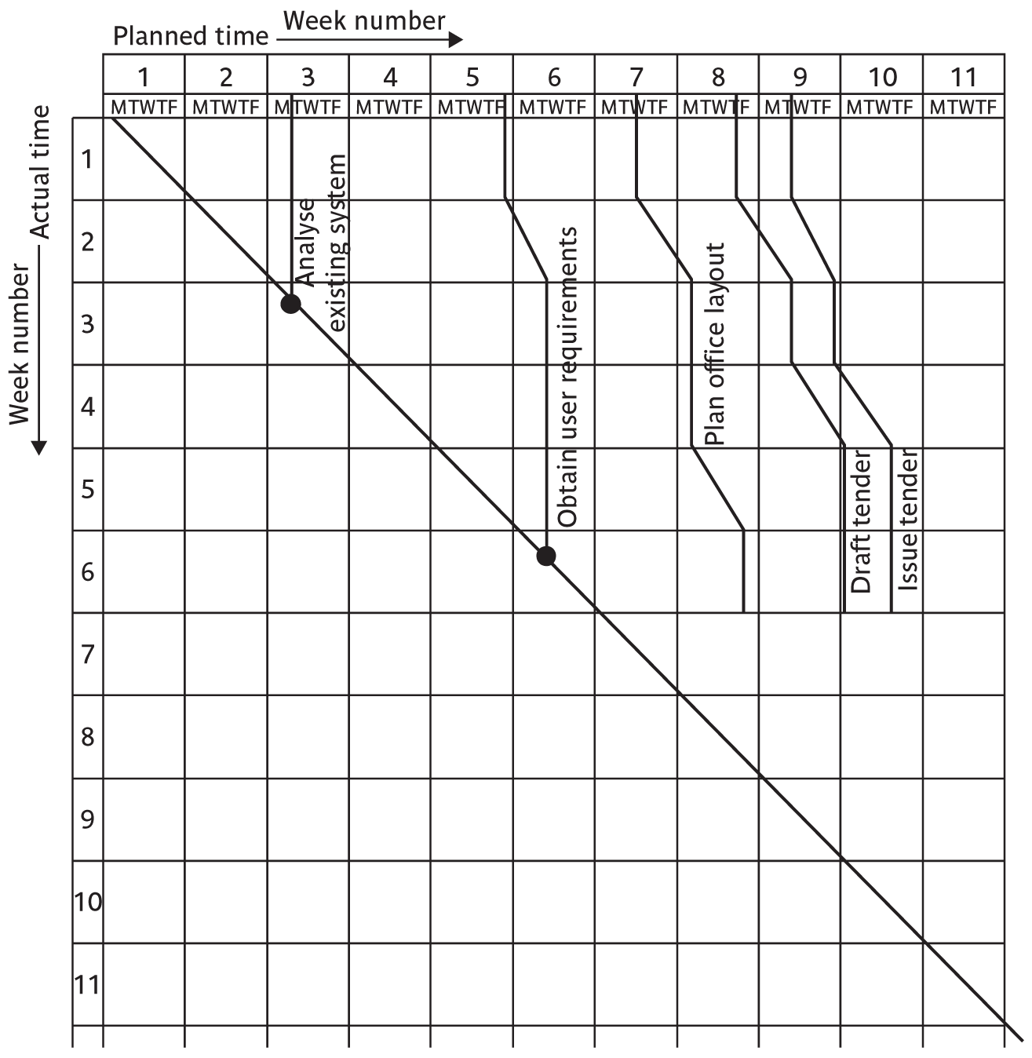
The timeline
SPM (6e) monitoring and control© The McGraw-Hill Companies, 2017
Notes:
SPM monitoring and control
This records the way that targets have changed throughout the project.
Planned time is plotted on the horizontal axis, and actual time on the vertical axis. The bendy lines going from top to bottom represent the scheduled completion date for each activity e.g.
‘analyse existing system’ – at start this was due finish on the Monday of week 3 and it did finish then
‘obtain user requirements’ was originally planned to finish on the Thursday of week 5, but at the end of the first week it was rescheduled to finish on the Tuesday of week 6.

Slide 17
Cost monitoring
A project could be late because the staff originally committed have not been deployed
In this case the project will be behind time but under budget
A project could be on time but only because additional resources have been added and so be over budget
Need to monitor both achievements and costs
SPM (6e) monitoring and control© The McGraw-Hill Companies, 2017
Notes:
SPM monitoring and control

Slide 18
Earned value analysis
Planned value (PV) or Budgeted cost of work scheduled (BCWS) – original estimate of the effort/cost to complete a task (compare with idea of a ‘price’)
Earned value (EV) or Budgeted cost of work performed (BCWP) – total of PVs for the work completed at this time
SPM (5e) monitoring and control© The McGraw-Hill Companies, 2009
Notes:
SPM monitoring and control

Slide 19
Accounting conventions
Work completed allocated on the basis
  50/50 half allocated at start, the other half on completion. These proportions can vary e.g. 0/100, 75/25 etc
  Milestone current value depends on the milestones achieved
  Units processed
Can use money values, or staff effort as a surrogate
SPM (6e) monitoring and control© The McGraw-Hill Companies, 2017
Notes:
SPM monitoring and control

Slide 20
Earned value – an example
Tasks
  Specify module 5 days
  Code module 8 days
  Test module 6 days
At the beginning of day 20, PV = 19 days
If everything but testing completed EV = 13 days
Schedule variance = EV-PV i.e. 13-19 = -6
Schedule performance indicator (SPI) = 13/19 = 0.68
SV negative or SPI <1.00, project behind schedule
SPM 65e) monitoring and control© The McGraw-Hill Companies, 2017
Notes:
SPM monitoring and control
A negative schedule variance (SV) means that the project is behind schedule as does a SPI that is less than 1.0.

Slide 21
Earned value analysis – actual cost
Actual cost (AC) is also known as Actual cost of work performed (ACWP)
In previous example, if
  ‘Specify module’ actually took 3 days
  ‘Code module’ actually took 4 days
Actual cost = 7 days
Cost variance (CV) = EV-AC i.e. 13-7 = 6 days
Cost performance indicator = 13/7 = 1.86
Positive CV or CPI > 1.00 means project within budget
SPM (6e) monitoring and control© The McGraw-Hill Companies, 2017
Notes:
SPM monitoring and control

Slide 22
Earned value analysis – actual costs
CPI can be used to produce new cost estimate
Budget at completion (BAC) – current budget allocated to total costs of project
Estimate at completion (EAC) – updated estimate = BAC/CPI
  e.g. say budget at completion is £19,000 and CPI is 1.86
  EAC = BAC/CPI = £10,215 (projected costs reduced because work being completed in less time)
SPM (6e) monitoring and control© The McGraw-Hill Companies, 2017

Slide 23
Time variance
Time variance (TV) – difference between time when specified EV should have been reached and time it actually did reach.
For example say an EV of £19000 was supposed to have been reached on 1st April and it was actually reached on 1st July then TV = - 3 months
SPM (6e) monitoring and control© The McGraw-Hill Companies, 2017

Slide 24
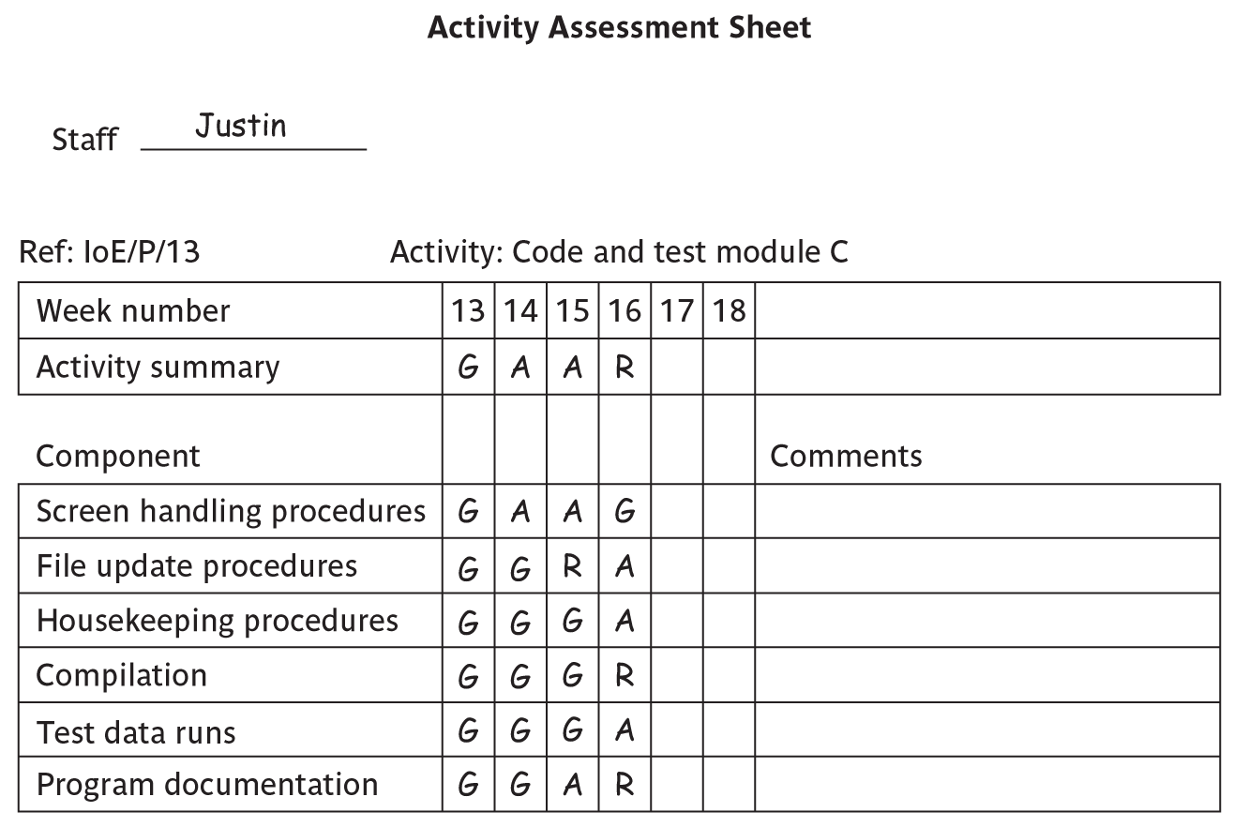
Earned value chart with revised forecasts
SPM (6e) monitoring and control© The McGraw-Hill Companies, 2017
Notes:
SPM monitoring and control
This shows how the planned value (PV), earned value (EV) and actual cost (AC) can be tracked over the lifetime of a project.
It also shows how the graph can be used to show adjustments to the final estimated cost and duration. A revised assessment of the budget at completion (EAC estimate at completion) can be produced by dividing the original estimated budget at completion (BAC) by the current CPI.
Similarly a forecast of the actual duration of the project can be derived by dividing the original estimated duration by the SPI.

Slide 25
Prioritizing monitoring
We might focus more on monitoring certain types of activity e.g.
Critical path activities
Activities with no free float – if delayed later dependent activities are delayed
Activities with less than a specified float
High risk activities
Activities using critical resources
SPM (6e) monitoring and control© The McGraw-Hill Companies, 2017
Notes:
SPM monitoring and control
Critical path activities – by definition if these are late then the project as a whole will be delayed
Activities with no free float – free float was defined in Lecture/Chapter 6. A project with no free float will delay following dependent activities, although the project end date may not be directly threatened.
Activities with less than a specified float – projects when being executed can be very dynamic: some activities will take longer than estimated others less; this could lead to the critical shifting. Activities with small floats are the most likely to find themselves turned into activities on the critical path if their floats get eroded.
High risk activities – recall the calculation of activity standard deviations in Chapter 7. If the standard deviation for an activity is large, this indicates that there is a lot of uncertainty about how long it will actually take.
Activities using critical resources – some resources may only be available for a limited period and if the activities that need the resource are delayed the resource could become unavailable.

Slide 26
Getting back on track: options
Renegotiate the deadline – if not possible then
Try to shorten critical path e.g.
  Work overtime
  Re-allocate staff from less pressing work
  Buy in more staff
Reconsider activity dependencies
  Over-lap the activities so that the start of one activity does not have to wait for completion of another
  Split activities
SPM (6e) monitoring and control© The McGraw-Hill Companies, 2017
Notes:
SPM monitoring and control
Renegotiating the deadline – one way of doing this is to divide the deliverables into ‘tranches’ (see Lecture/Chapter 3), delivering the ones most valuable to the client on or before the deadline, but delaying less valuable ones.
Shortening the critical path – the idea is to try to get things done more quickly by adding more staff. Some activities lend themselves to this more readily than others – it is often quite difficult to do this with software development. It also increases costs
Reconsidering activity dependencies – allowing activities to overlap often increases the risk of quality shortfalls

Slide 27
Exception planning
Some changes could affect
  Users
  The business case (e.g. costs increase reducing the potential profits of delivered software product)
These changes could be to
  Delivery date
  Scope
  Cost
In these cases an exception report is needed
SPM (6e) monitoring and control© The McGraw-Hill Companies, 2017

Slide 28
Exception planning - continued
First stage
  Write an exception report for sponsors (perhaps through project board)
    Explaining problems
    Setting out options for resolution
Second stage
  Sponsor selects an option ( or identifies another option)
  Project manager produces an exception plan implementing selected option
  Exception plan is reviewed and accepted/rejected by sponsors/Project Board
SPM 65e) monitoring and control© The McGraw-Hill Companies, 2017

Slide 29
Change control
The role of configuration librarian:
Identifying items that need to be subject to change control
Management of a central repository of the master copies of software and documentation
Administering change procedures
Maintenance of access records
SPM (6e) monitoring and control© The McGraw-Hill Companies, 2017
Notes:
SPM monitoring and control
Identifying items that need to be subject to change control – it is unlikely, for example, that a feasibility report would be subject to change control once agreement has been obtained to start the project
Management of a central repository of the master copies of software and documentation
Administering change procedures It is important that someone ensures that there is adherence to change control procedures.
Maintenance of access records. A situation to be avoided is where two different developers are making changes to the same software component.

Slide 30
Typical change control process
One or more users might perceive the need for a change
User management decide that the change is valid and worthwhile and pass it to development management
A developer is assigned to assess the practicality and cost of making the change
Development management report back to user management on the cost of the change; user management decide whether to go ahead
SPM 65e) monitoring and control© The McGraw-Hill Companies, 2017
Notes:
SPM monitoring and control
1 and 2. The user community itself must come to a consensus about whether a proposal for a change should go forward. A change deemed desirable by one part of the user community could cause opposition with other users.
2 and 3. This part of the process often involves a multipart form, initially raised by a user representative and then completed with a response by the developers.
4. There could be a change control board with user and developer representatives that oversees this decision-making process

Slide 31
Change control process contd.
One or more developers are authorized to make copies of components to be modified
Copies modified. After initial testing, a test version might be released to users for acceptance testing
When users are satisfied then operational release authorized – master configuration items updated
SPM 65e) monitoring and control© The McGraw-Hill Companies, 2017
Notes:
SPM monitoring and control
5. The configuration librarian would control this release
6. Note that it is a copy that is modified; the original would still exist as the current operational version
7. The previous version of the configuration items would be archived but preserved. If there are unforeseen problems with the new version when it is made operational then a fall-back to the previous version could be considered

Slide 32
Software Configuration Management (SCM)
SCM is concerned with tracking and controlling changes to a software.
Development and maintenance environment:
  Various work products associated with the software continually change.
  Unless a proper configuration management system is deployed, several problems can appear.
SPM (6e) monitoring and control© The McGraw-Hill Companies, 2017

Slide 33
Why Use SCM?
Problems associated with concurrent access
Undoing Changes
System accounting
Handling variants
Accurate determination project status
Preventing unauthorized access to the work products
SPM (6e) monitoring and control© The McGraw-Hill Companies, 2017

Slide 34
Configuration Control
Two main operations:
  Reserve
  Restore
W1
W2
W3
…
Wn-1
Wn
Configuration
Reserve
Restore
Developer’s work space
SPM (6e) monitoring and control© The McGraw-Hill Companies, 2017

