Slide 1

Software Project Management
Sixth Edition
Chapter 13.1
Software product quality
SPM (6e) Product quality© The McGraw-Hill Companies, 2017

Slide 2


The importance of software quality
Increasing criticality of software
The intangibility of software
Project control concerns:
  errors accumulate with each stage
  errors become more expensive to remove the later they are found
  it is difficult to control the error removal process (e.g. testing)
SPM (6e) Product quality© The McGraw-Hill Companies, 2017
Notes:
Increasing criticality of software – e.g .software is increasingly being used in systems that can threaten or support human life and well-being
The intangibility of software – it is difficult for observers to judge the quality of software development, especially during its early stages
Project control concerns:
The products of one sub-process in the development process are the inputs to subsequent sub-processes, thus
errors accumulate with each stage e.g. at the design stage, the specification errors are incorporated into the design, and at the coding stage specification and design errors are incorporated into the software
errors become more expensive to remove the later they are found
it is difficult to control the error removal process (e.g. testing)
See Section 13.3 page 295

Slide 3
Quality specifications
Where there is a specific need for a quality, produce a quality specification
Definition/description of the quality
Scale: the unit of measurement
Test: practical test of extent of quality
Minimally acceptable: lowest acceptable value, if compensated for by higher quality level elsewhere
Target range: desirable value
Now: value that currently applies
SPM (6e) Product quality© The McGraw-Hill Companies, 2017
Notes:
Section 13.4 page 296.

Slide 4
ISO standards: development life cycles
A development life cycle (like ISO 12207) indicates the sequence of processes that will produce the software deliverable and the intermediate products that will pass between the processes.
deliverable
elicit require-
ments
requirements
intermediate
products
tested code
design
software
s/w
architecture
code/test
processes
SPM (6e) Product quality© The McGraw-Hill Companies, 2017
Notes:
The deliverables are the products that are handed over to the client at the end of the project, typically the executable code.
Intermediate products are things that are produced during the project, but which are not (usually) handed to the client at the end. Typically they are things that are produced by one sub-process (e.g. a requirements document created by the requirements elicitation and analysis processes) and used by others (e.g. a design process which produces a design that fulfils the requirements).
These sub-processes will fit into the overall framework of a development cycle.
Some software quality models focus on evaluating the quality of software products, others on the processes by which the products are created.

Slide 5
ISO standards
ISO 9126 Software product quality
  Attributes of software product quality
  External qualities i.e. apparent to the user of the deliverable
  Internal qualities i.e. apparent to the developers of the deliverables and the intermediate products
ISO 14598 Procedures to carry out the assessment of the product qualities defined in ISO 9126
SPM (6e) Product quality© The McGraw-Hill Companies, 2017
Notes:
ISO 9126 focuses on the definition of software quality, while ISO 14598 focuses on the way that the quality, once defined, is assessed. The ISO 9000 series of standards establishes requirements for quality management systems for the creation/supply of all types of goods and services while the ones mentioned here relate specifically to software.

Slide 6

Types of quality assessment
During software development:
  To assist developers to build software with the required qualities
During software acquisition:
  To allow a customer to compare and select the best quality product
For a particular community of users:
  Independent evaluation by assessors rating a software product
SPM (6e) Product quality© The McGraw-Hill Companies, 2017

Slide 7
ISO 9126 software product quality
Process
Software products
Effect of software product
influences
internal
quality
attributes
influences
external
quality
attributes
influences
quality
in use
attributes
process
quality
depends on
depends on
Internal
measures
External measures
Process measures (ISO 15504)
Quality in use measures
Context of use
SPM (6e) Product quality© The McGraw-Hill Companies, 2017
Notes:
Internal quality attributes are the things that developers would be aware of during the project. They could be qualities in the intermediate products that are created. External quality attributes are the qualities of the final products that are delivered to the users. Thus users would be very aware of these. A key task is mapping these two types of quality.
Acceptable quality in software depends on the use to which the software is put. For example, a higher standard of reliability would be expected of a software component that was very heavily used and the continued functioning of which was essential to the organization, than of a rarely used software tool for which there were many alternatives.
See Section 13.4 page 298

Slide 8

Quality in use
Effectiveness – ability to achieve user goals with accuracy and completeness
Productivity – avoids excessive use of resources in achieving user goals
Safety – within reasonable levels of risk of harm to people, business, software, property, environment etc,
Satisfaction – happy users!
‘users’ include those maintain software as well as those who operate it.
SPM (6e) Product quality© The McGraw-Hill Companies, 2017
Notes:
Section 13.5 page 298

Slide 9

Quality Models
It is a model of the software:
  Constructed with the objective to describe, assess and/or predict quality.
Popular models:
  Garvin’s model
  Boehm’s model
  ISO 9126
  Dromey’s Model
SPM (6e) Product quality© The McGraw-Hill Companies, 2017

Slide 10
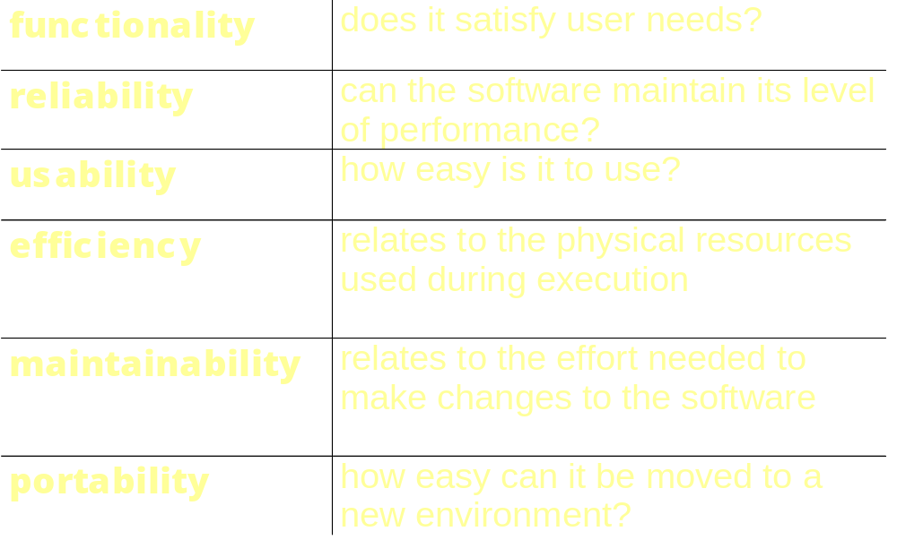
ISO 9126 software qualities
SPM (6e) Product quality© The McGraw-Hill Companies, 2017
Notes:
These are the six top-level qualities identified in ISO9126.
Note that ‘functionality’ is listed as a quality. Sometimes ‘functional’ requirements are distinguished from ‘non-functional’ (i.e. quality)
requirements.
Page 299.

Slide 11
Sub-characteristics of Functionality
Suitability
Accuracy
Interoperability
  ability of software to interact with other software components
Functionality compliance
  degree to which software adheres to application-related standards or legal requirements e.g audit
Security
  control of access to the system
SPM (6e) Product quality© The McGraw-Hill Companies, 2017
Notes:
In the case of interoperability, a good example is the ability to copy and paste content between different Microsoft products such as Excel and Word.
Page 299.

Slide 12
Sub-characteristics of Reliability
Maturity
  frequency of failure due to faults - the more the software has been used, the more faults will have been removed
Fault-tolerance
Recoverability
  note that this is distinguished from ‘security’ - see above
Reliability compliance
  – complies with standards relating to reliability
SPM (6e) Product quality© The McGraw-Hill Companies, 2017
Notes:
Maturity – in general you would expect software that has been in operation for a relatively long time and had many users to be more reliable than brand-new software which has only a few users. In the first case, one would hope that most of the bugs had been found by the users and had been fixed by the developers.

Slide 13
Sub-characteristics of Usability
Understandability
  easy to understand?
Learnability
  easy to learn?
Operability
  easy to use?
Attractiveness – this is a recent addition
Usability compliance
  compliance with relevant standards
SPM (6e) Product quality© The McGraw-Hill Companies, 2017
Notes:
Note that there may need to be a trade-off between ‘learnability’ and ‘operability’ – an analogy would be in learning shorthand writing: it takes a long time to do, but once you have done it you can write very quickly indeed.
‘Attractiveness’ is a new addition – it is important where the use of software is optional – if users don’t like the software then they won’t use it.
See page 300.

Slide 14
Sub-characteristics of Efficiency
Time behaviour
  e.g. response time
Resource utilization
  e.g. memory usage
Efficiency compliance
  compliance with relevant standards
SPM (6e) Product quality© The McGraw-Hill Companies, 2017
Notes:
Page 300

Slide 15
Sub-characteristics of Maintainability
“Analysability”
  ease with which the cause of a failure can be found
Changeability
  how easy is software to change?
Stability
  low risk of modification having unexpected effects
“Testability”
Maintainability conformance
SPM (6e) Product quality© The McGraw-Hill Companies, 2017
Notes:
Testability can be particularly important with embedded software, such as that used to control aircraft. Software that simulates the actions of the aircraft in terms of inputs to the control system etc would need to be built.
Page 301

Slide 16
Sub-characteristics of portability
Adaptability
“Installability”
Co-existence
  Capability of co-existing with other independent software products
“Replaceability”
  factors giving ‘upwards’ compatibility - ‘downwards’ compatibility is excluded
Portability conformance
  Adherence to standards that support portability
SPM (6e) Product quality© The McGraw-Hill Companies, 2017
Notes:
Replaceability - A new version of a software product should be able to deal correctly with all the inputs that the previous versions could deal with. However there could be new features that need new inputs that the old system would not be able to deal with.
Page 301

Slide 17

Using ISO 9126 quality standards
(development mode)
Judge the importance of each quality factor for the application
  for example, safety critical systems - reliability very important
  real-time systems - efficiency important
Select relevant external measurements within ISO 9126 framework for these qualities, for example
  mean-time between failures for reliability
  response-time for efficiency
SPM (5e) Product quality© The McGraw-Hill Companies, 2009
Notes:
Pages 301-302

Slide 18
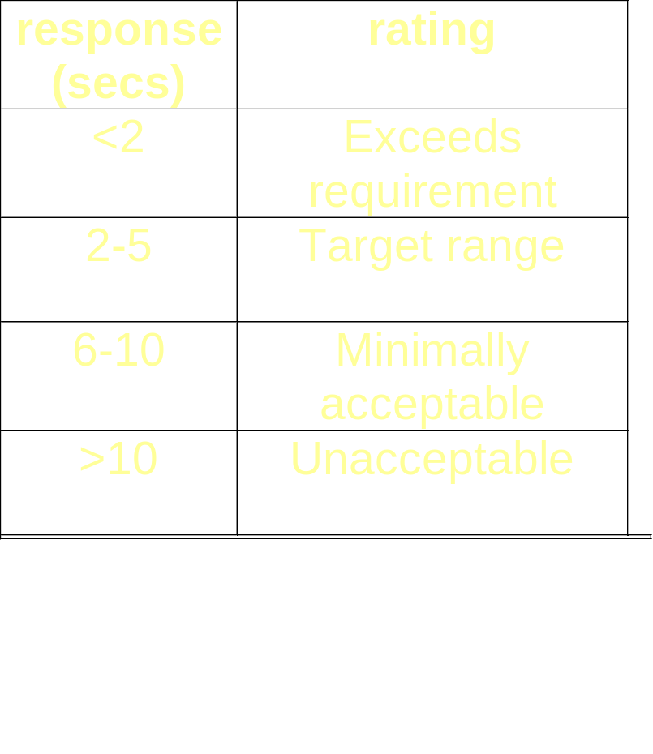
Using ISO 9126 quality standards
Map measurement onto ratings scale to show degree of user satisfaction – for example response time
SPM (6e) Product quality© The McGraw-Hill Companies, 2017

Slide 19
Using ISO 9126 quality standards
Identify the relevant internal measurements and the intermediate products in which they would appear
  For example, at software design stage the estimated execution time for a transaction could be calculated
SPM (6e) Product quality© The McGraw-Hill Companies, 2017

Slide 20
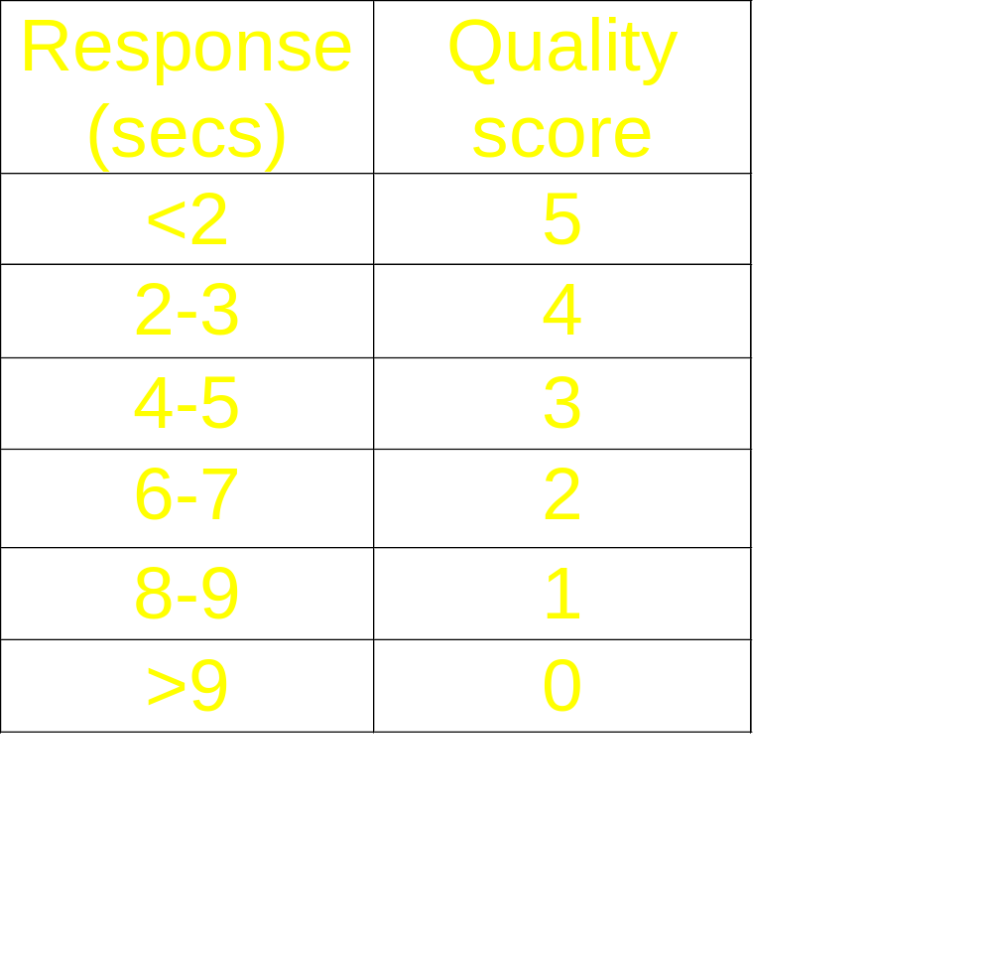
Using ISO9126 approach for application software selection
Rather than map engineering measurement to qualitative rating, map it to a score
Rate the importance of each quality in the range 1-5
Multiply quality and importance scores – see next slide
SPM (6e) Product quality© The McGraw-Hill Companies, 2017

Slide 21
Weighted quality scores
 |  | Product A |  | Product B
Product quality | Importance rating (a) | Quality score (b) | Weighted score (a x b) | Quality score (c) | Weighted score (a x c)
usability | 3 | 1 | 3 | 3 | 9
efficiency | 4 | 2 | 8 | 2 | 8
maintain-ability | 2 | 3 | 6 | 1 | 2
Overall totals |  |  | 17 |  | 19
SPM (6e) Product quality© The McGraw-Hill Companies, 2017
Notes:
This suggests that Product B is slightly more likely to meet the users’ quality needs.

Slide 22
How do we achieve product quality?
The problem: quality attributes tend to retrospectively measurable
Need to be able to examine processes by which product is created beforehand
The production process is a network of sub-processes
  Output from one process forms the input to the next
  Errors can enter the process at any stage
SPM (6e) Product quality© The McGraw-Hill Companies, 2017
Notes:
There is a bridge here between the focus on the quality of products as discussed in this lecture and the quality of processes discussed in the lecture 13.2 on process quality

Slide 23
Correction of errors
Errors are more expensive to correct at later stages
  need to rework more stages
  later stages are more detailed and less able to absorb change
Barry Boehm
  Error typically 10 times more expensive to correct at coding stage than at requirements stage
  100 times more expensive at maintenance stage
SPM (6e) Product quality© The McGraw-Hill Companies, 2017
Notes:
The additional time needed to change products later is partly because more products in the project life cycle have to change e.g. the specification, design and code, rather than just the specification. Also the later products of the project tend to be more detailed and therefore more complicated.

Slide 24
For each activity, define:
Entry requirements
  these have to be in place before an activity can be started
  example: ‘a comprehensive set of test data and expected results be prepared and independently reviewed against the system requirement before program testing can commence’
SPM (6e) Product quality© The McGraw-Hill Companies, 2017
Notes:
We are moving into process quality now. However, the entry requirements could well relate to the quality of the products of other processes tha this process will need to use.

Slide 25
For each activity, define:
Implementation requirements
  these define how the process is to be conducted
  example ‘whenever an error is found and corrected, all test runs must be completed, including those previously successfully passed’
SPM (6e) Product quality© The McGraw-Hill Companies, 2017

Slide 26
For each activity, define:
Exit requirements
  an activity will not be completed until these requirements have been met
  example: ‘the testing phase is finished only when all tests have been run in succession with no outstanding errors’
SPM (6e) Product quality© The McGraw-Hill Companies, 2017
Notes:
The exit requirements, however, could well relate to characteristics of the products created by the process in question.

Slide 27
Techniques to Enhance Product Quality
Increasing visibility
  ‘egoless programming’. Weinberg encouraged the simple practice of programmers looking at each other’s code.
Procedural structure
  Over the years there has been the growth of
  Methodologies
Checking intermediate stages
  checking the correctness of work at various stages of development
SPM (6e) Product quality© The McGraw-Hill Companies, 2017

Slide 28
Testing
Objective of testing is to expose as many bugs as possible.
How is testing done?
  Input test data to the program.
  Observe the output: Check if the program behaves as expected
SPM (6e) Product quality© The McGraw-Hill Companies, 2017

Slide 29


3 Testing Levels
Software tested at 3 levels:
  Unit testing
  Integration testing
  System testing
  Regression testing
SPM (6e) Product quality© The McGraw-Hill Companies, 2017

Slide 30
Test Levels
Unit testing
  Test each module (unit, or component) independently
  Mostly done by developers of the modules
Integration and system testing
  Test the system as a whole
  Often done by separate testing or QA team
Acceptance testing
  Validation of system functions by the customer
SPM (6e) Product quality© The McGraw-Hill Companies, 2017

Slide 31
Verification versus Validation
Verification is the process of determining:
  Whether output of one phase of development conforms to its previous phase.
Validation is the process of determining:
  Whether a fully developed system conforms to its SRS document.
Verification is concerned with phase containment of errors:
  Whereas the aim of validation is that the final product be error free.
SPM (6e) Product quality© The McGraw-Hill Companies, 2017

Slide 32
Testing: the V-process model
This shown diagrammatically in the next slide
It is an extension of the waterfall approach
For each development stage there is a testing stage
The testing associated with different stages serves different purposes e.g. system testing tests that components work together correctly, user acceptance testing that users can use system to carry out their work
SPM (6e) Software process quality© The McGraw-Hill Companies, 2017

Slide 33
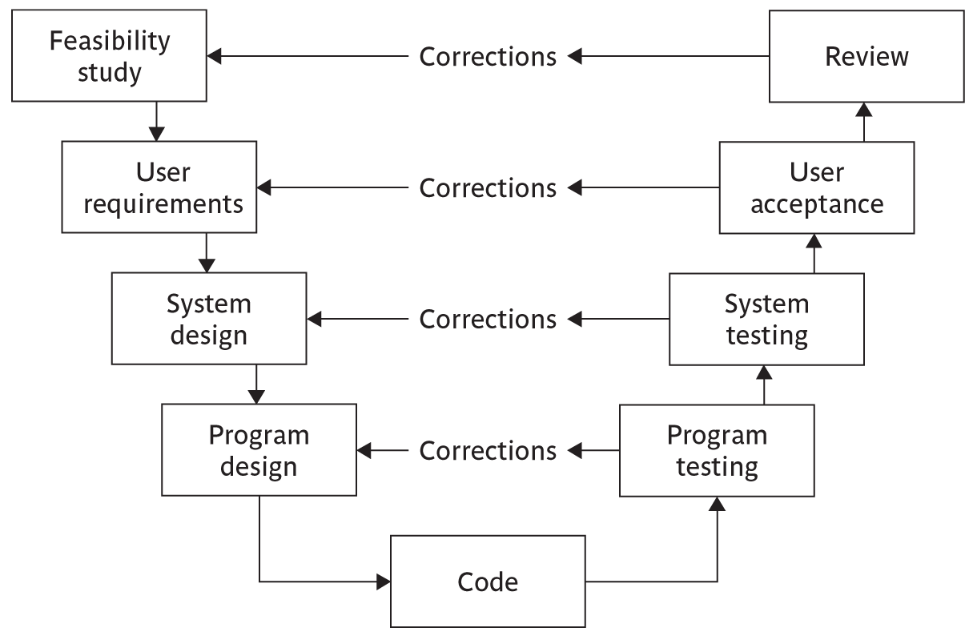
Testing: the V-process model
SPM (56) Software process quality© The McGraw-Hill Companies, 2017

Slide 34
Black box versus glass box test
Glass box testing
  The tester is aware of the internal structure of the code; can test each path; can assess percentage test coverage of the tests e.g. proportion of code that has been executed
Black box testing
  The tester is not aware of internal structure; concerned with degree to which it meets user requirements
SPM (6e) Software process quality© The McGraw-Hill Companies, 2017

Slide 35
Levels of testing
Unit testing
Integration testing
System testing
SPM (6e) Software process quality© The McGraw-Hill Companies, 2017

Slide 36
Testing activities
Test planning
Test suite design
Test case execution and result checking
Test reporting:
Debugging:
Error correction:
Defect retesting
Regression testing
Test closure:
SPM (6e) Software process quality© The McGraw-Hill Companies, 2017

Slide 37
Test plans
Specify test environment
  In many cases, especially with software that controls equipment, a special test system will need to be set up
Usage profile
  failures in operational system more likely in the more heavily used components
  Faults in less used parts can lie hidden for a long time
  Testing heavily used components more thoroughly tends to reduce number of operational failures
SPM (6e) Software process quality© The McGraw-Hill Companies, 2017

Slide 38
Management of testing
The tester executes test cases and may as a result find discrepancies between actual results and expected results – issues
Issue resolution – could be:
a mistake by tester
a fault – needs correction
a fault – may decide not to correct: off-specification
a change – software works as specified, but specification wrong: submit to change control
SPM (6e) Software process quality© The McGraw-Hill Companies, 2017

Slide 39
Decision to stop testing
The problem: impossible to know there are no more errors in code
Need to estimate how many errors are likely to be left
Bug seeding – insert (or leave) known bugs in code
Estimate of bugs left =
  (total errors found)/(seeded errors found) x (total seeded errors)
SPM (6e) Software process quality© The McGraw-Hill Companies, 2017

Slide 40
Alternative method of error estimation
Have two independent testers, A and B
N₁ = valid errors found by A
N₂ = valid errors found by B
N₁₂ = number of cases where same error found by A and B
Estimate = (N₁ × N₂)/ N₁₂
Example: A finds 30 errors, B finds 20 errors. 15 are common to A and B. How many errors are there likely to be?
SPM (6e) Software process quality© The McGraw-Hill Companies, 2017
Notes:
(30 X 20)/15 = 40 errors

Slide 41
Test automation
Other than reducing human effort and time in this otherwise time and effort-intensive work,
  Test automation also significantly improves the thoroughness of testing.
A large number of tools are at present available both in the public domain as well as from commercial sources.
SPM (6e) Software process quality© The McGraw-Hill Companies, 2017

Slide 42
Types of Testing Tools
Capture and playback
Automated test script
Random input test
Model-based test
SPM (6e) Software process quality© The McGraw-Hill Companies, 2017

Slide 43
Software reliability
The reliability of a software product essentially denotes its trustworthiness or dependability.
  Usually keeps on improving with time during the testing and operational phases as defects are identified and repaired.
A reliability growth model (RGM) models how the reliability of a software product improves as failures are reported and bugs are corrected.
  An RGM can be used to determine when during the testing phase a given reliability level will be attained, so that testing can be stopped
SPM (6e) Software process quality© The McGraw-Hill Companies, 2017

