Slide 1


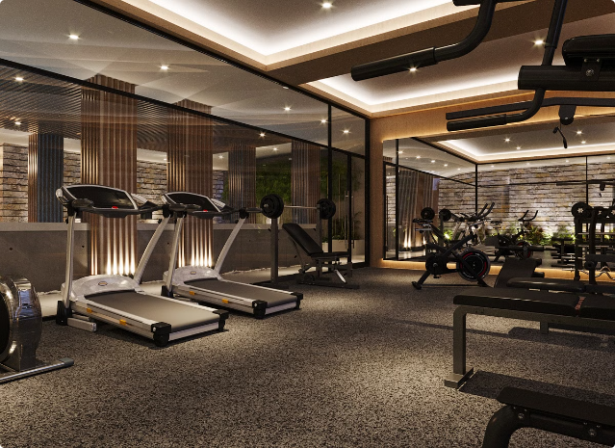
Online Gym Management System
Welcome to the Online Gym Management System, a user-friendly platform designed to streamline gym booking operations and enhance customer experience. This presentation will outline the key features and functionalities of the system.

Slide 2


Team Members
Saugat Mohanty - 2141013224
Ronik Kumar Das - 2141004063
Ankit Mishra - 2141013145
Swoyam Prakash Mohanty - 2141013226

Slide 3

Technology
Front-end : Java Server Pages , CSS ,
JavaScript.
Back-end : Spring boot , Spring data JPA ,
Spring MVC, Spring Security.
Database : MySQL.
IDE : Eclipse ide for enterprise java
and web developers.
Web Server : Tomcat

Slide 4
Admin Dashboard
Gym Item Management
Timing Slot Management
Customer Management
Add new gym items to the system. View a list of all gym items. Update existing gym items.
Schedule and manage gym slot timings.
View, update, and cancel slot bookings.
View customers feedbacks.
Delete customers.

Slide 5
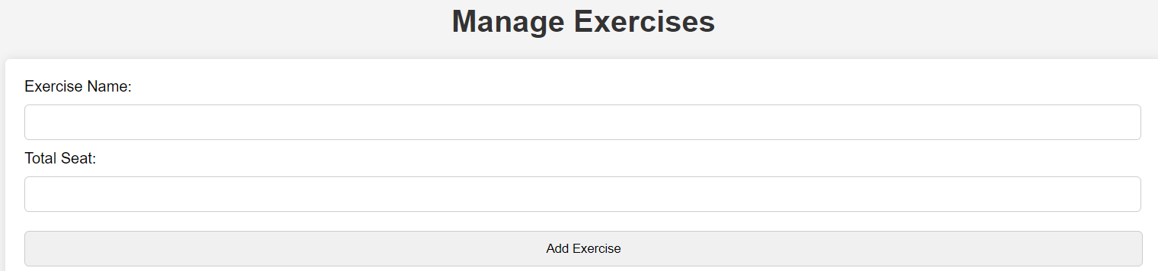
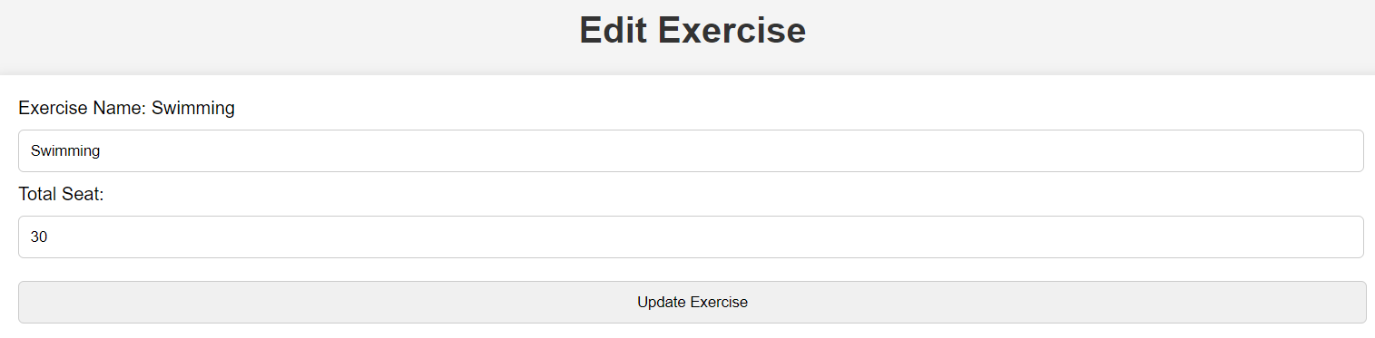
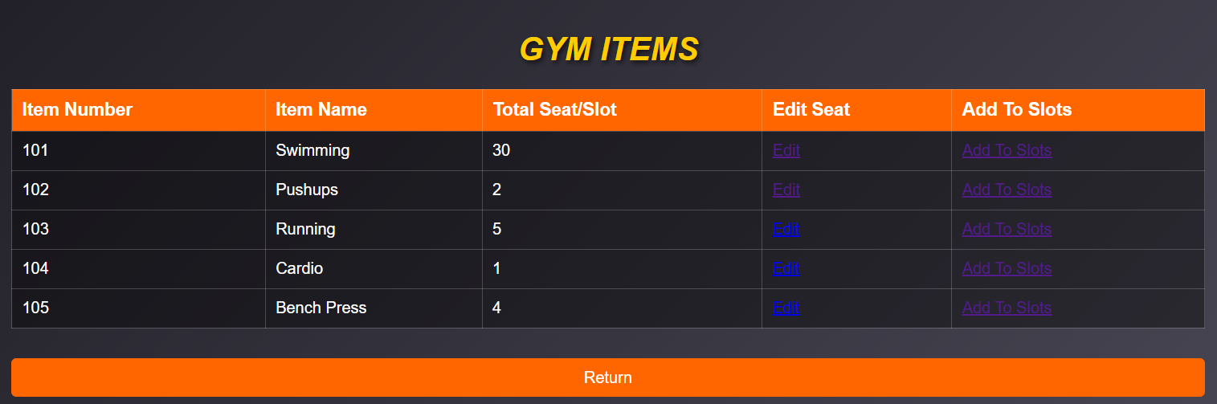
Adding and Modifying Gym Items
Item Details
Edit Item Details
Admin can enter gym item name and Total seats.
Admin can edit gym item details.
1
3
View Item Details
Admin can view item details
2

Slide 6


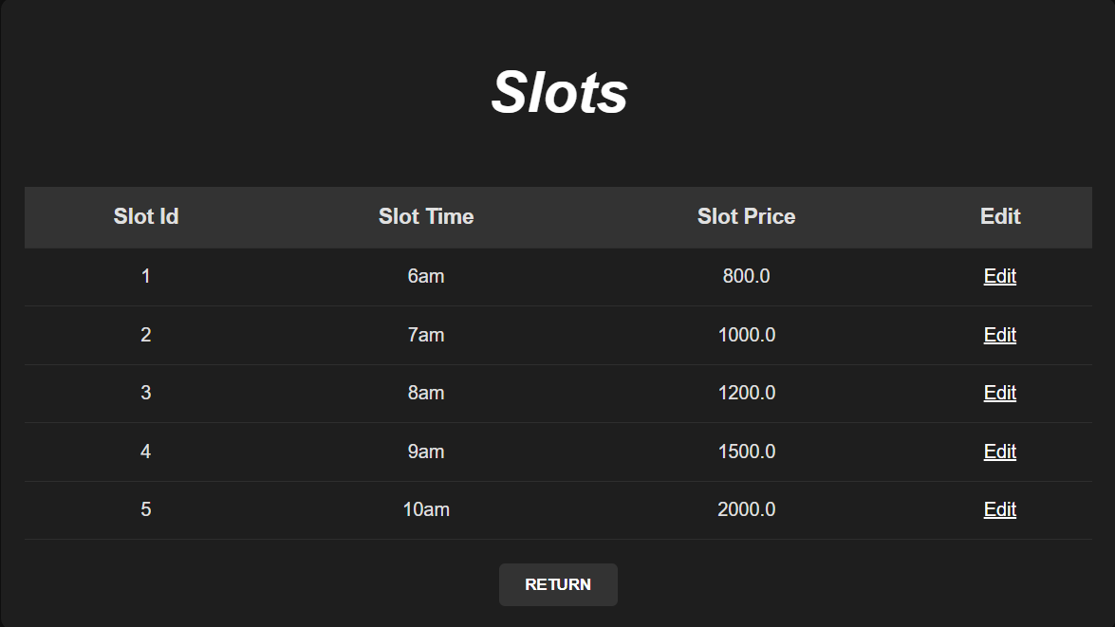


Timing Slot Management
Create New Slot
Set the time and price for the slot.
Assign Gym Items
Choose which gym items are available for use during this slot.
Edit Price
Edit price for the slot.

Slide 7


Customer Dashboard
Registration
Login
Slot Booking
View Bookings
Cancel Bookings
Feedback

Slide 8

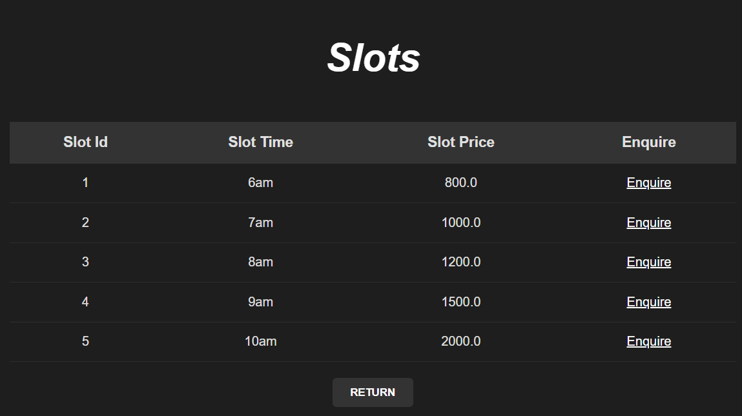
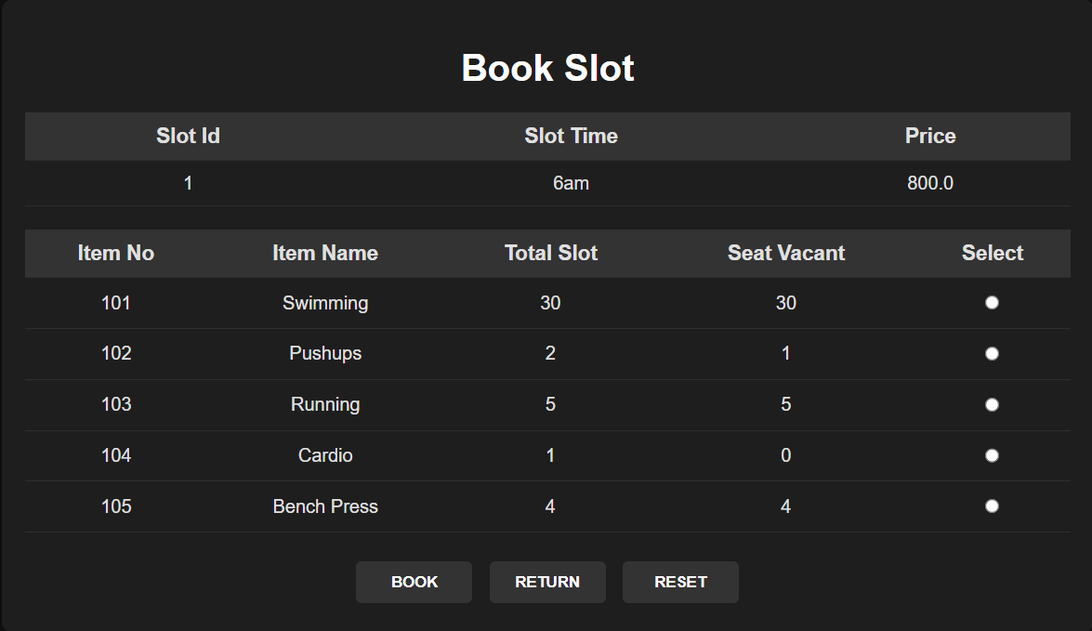
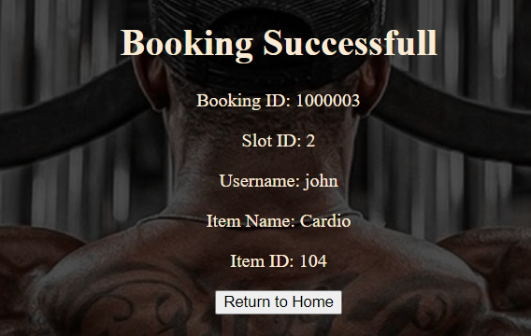
Slot Booking and Cancelling
for Customers
1
Select Slots
Customer can choose slots according to their flexible timing.
.
2
Select Gym Item and book
Choose gym item attached with that slot and book it.
3
Booking Confirmation
Shows the booking success message after booking the slot.
4
View bookings and cancel it
Customer have the option to view bookings and cancel their it if needed.

Slide 9
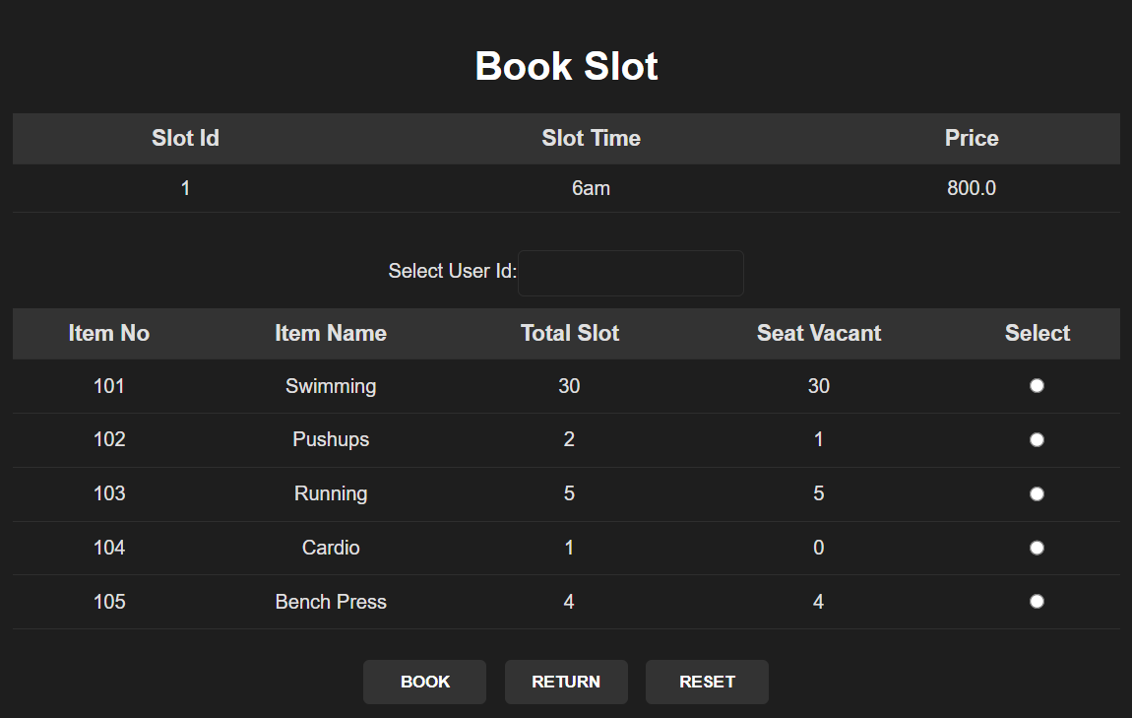
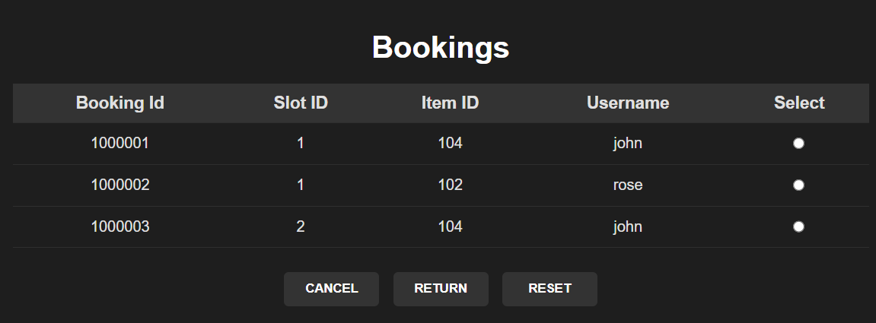




Slot Booking and Cancelling for Customer by Admin
Select slot
Select Customer and
gym items
Confirm Booking
Cancel Booking
Choose time slot and slot price that suits customer schedule.
Admin can select customers by their username , select gym items and book.
Shows the booking success message after booking the slot.
Admin can see all the bookings done by customers and able to cancel bookings.

Slide 10

Conclusion and Key Features
The Online Gym Management System offers a comprehensive platform for streamlining gym operations, providing a seamless experience for both admins and customers. Key features include gym item management, timing slot booking and feedback system.

