Slide 1
Financial Time Series Forecasting Using Support Vector Machines
By Daniel Socci, Swrajit Paul, Erjon Skenderi, Lilangyan He

Slide 2
Introduction to SVM
Topics of Discussion
•Competing methods of Time Series Analysis and their weaknesses
•Benefits of SVM as opposed to other Algorithms
•Introducing SVM and how it works (Both linear and nonlinear)

Slide 3
Time Series Analysis
Time Series Analysis: Analysis of the change of some given data over a period of time.
In particular SVM's and other models are used to predict the change in price index of a given stock.
Most methods including SVM's utilize Training and holdout data in order to more accurately predict the fluctuations of the price index.
Different models for calculating the change in this price index are compared based on their accuracy in predicting the holdout data.

Slide 4
SVM v.s. competing models
SVM
Neural Networks
Implements the structural risk minimization principle.
Global Minimization.
Overfitting unlikely to occur due to it's hyperplane design.
Implement the empirical risk minimization principle (Minimizing misclassification error).
Local Minimization.
Overfitting more likely to occur than in SVM.
Inconsistent and unpredictable performance on noisy data proving difficult for stock market predictions.

Slide 5
SVM and it's basic structure
The goal of SVM is to design a Hyperplane that classifies all training vectors into 2 classes.
The vectors closest to the hyperplane are known as "Support Vectors" and the margin of the hyperplane is the distance between the hyperplane and these support vectors.
The maximization of these margins is what the SVM attempts to accomplish.

Slide 6
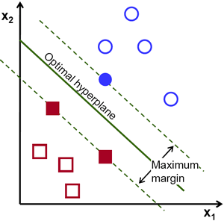
SVM in basic linear case
Linear Structure is more easily defined.
SVM in multidimensional situations get far more complicated.
In order to solve a problem in a multidimensional case a Kernel Function is implemented to simplify the problem.

Slide 7
SVM Breakdown (Linearly Separable Case)
A hyperplane can be defined as: wx+b=0.
Hyperplane divides vectors into 2 cases {-1,1}, for the 2 classifications.
At points where wx+b=1 and wx+b=-1 are the locations of the support vectors above and below the hyperplane.
"Margin of separation" (d) we intend to maximize for our optimal solution.
d=(1/w) therefore minimizing the weights "w" maximizes this distance.

Slide 8

Linearly Separable Case continued
In this case variables "b" and "αi" are values used in determining the hyperplane
"Yi" are the corresponding values to each of the support vectors X(i).
X is the test example (part of the holdout data) and the dot product between X(i) and X is used as the method of testing similarity.
The above equation is designed for the Linearly Separable case but can be extended for multidimensional problems when used in tandem with a Kernel function.

Slide 9

SVM for Nonlinear cases
The key difference between the above equation and the previous one is the function K(X(i),X) as opposed to the dot product in the previous example
The function "K" is the Kernel function which takes the same inputs X(i), X.
"b", "αi" and "yi" all represent the same things as in the previous equation.

Slide 10
Kernel Functions
The basic job of Kernel functions are to compare to inputs given to the function and return how similar they are.
The Kernel Function is selected depending on the data to be studied and can be one of many functions.
A nonlinear problem can prove difficult for an SVM to solve but the Kernel function transforms a nonlinear problem into a linear problem.

Slide 11
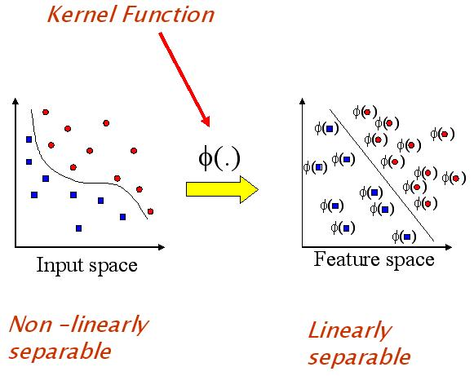

Slide 12
Application of SVM VS BP
BP (Back Propagation) is a widely used neural network for financial time series analysis.
Overfitting in BP is caused by the necessity to determine the value of many controlling parameters.
In the case of SVM the hyperplane creates a relatively stable decision boundary therefore overfitting is far less likely to occur.

Slide 13
Research data and experiments
The methods and tools used in this study. As well as, the purpose or goal of the study and how the study was carried out.

Slide 14
The goal of this study was to predict the direction of change in the daily Korea composite stock price index.
The study uses 12 technical indicators as inputs. These indicators were determined by experts in the area of finance and by prior research.
The change of direction in the stock price index is categorized as 0 or 1 in the data. 0 means that next days index is lower than today’s index. 1 means that next days index is higher than today’s index.

Slide 15
The data from 2928 trading days ( January 1989 – December 1998) was used to construct the model and test it.
80% of the data was used for training and 20% as holdout data. This translates to 2347 training data and 581 holdout data.
The purpose of holdout data is only to test and is not used to develop models.

Slide 16
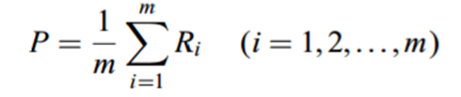

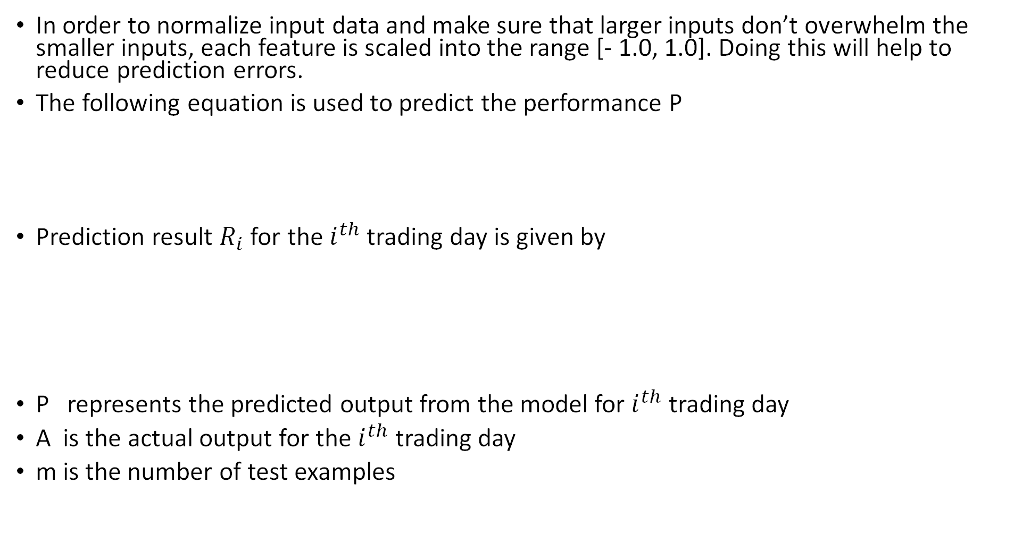
In order to normalize input data and make sure that larger inputs don’t overwhelm the smaller inputs, each feature is scaled into the range [- 1.0, 1.0]. Doing this will help to reduce prediction errors.
The following equation is used to predict the performance P
Prediction result $R_{i}$ for the $i^{th}$ trading day is given by
P represents the predicted output from the model for $i^{th}$ trading day
A is the actual output for the $i^{th}$ trading day
m is the number of test examples

Slide 17
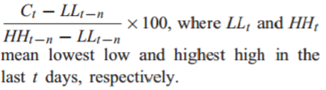




Feature name | Description | Formula
%K | Stochastic %K. It compares where a security’s price closed relative to its price range over a given time period
%D | Stochastic %D. Moving average of %K
Slow %D | Stochastic slow %D. Moving average of %D.
Momentum | It measures the amount that a security’s price has changed over a given time span
ROC | Price rate-of-change. It displays the difference between the current price and the price n days ago.

Slide 18




Williams’ %R | Larry William’s %R. It is a momentum indicator that measures overbought/oversold levels.
A/D Oscillator | Accumulation/distribution oscillator. It is a momentum indicator that associates changes in price.
Disparity5 | 5-day disparity. It means the distance of current price and the moving average of 5 days.
Disparity10 | 10-day disparity
OSCP | Price oscillator. It displays the difference between two moving averages of a security’s price

Slide 19
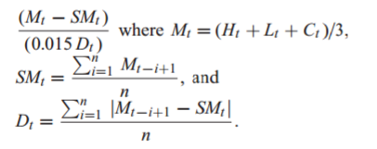
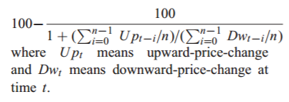
CCI | Commodity channel index. It measures the variation of a security’s price from its statistical mean.
RSI | Relative strength index. It is a price following an oscillator that ranges from 0 to 100.

Slide 20
Feature name | Max | Min | Mean | Standard deviation
%K | 100.007 | 0.000 | 45.407 | 33.637
%D | 100.000 | 0.000 | 45.409 | 28.518
Slow %D | 99.370 | 0.423 | 45.397 | 26.505
Momentum | 102.900 | −108.780 | -0.458 | 21.317
ROC | 119.337 | 81.992 | 99.994 | 3.449
Williams’s %R | 100.000 | −0.107 | 54.593 | 33.637
A/D Oscillator | 3.730 | −0.157 | 0.447 | 0.334
Disparity5 | 110.003 | 90.077 | 99.974 | 1.866
Disparity10 | 115.682 | 87.959 | 99.949 | 2.682
OSCP | 5.975 | −7.461 | -0.052 | 1.330
CCI | 226.273 | -221.448 | -5.945 | 80.731
RSI | 100.000 | 0.000 | 47.598 | 29.531

Slide 21
SVM
Polynomial kernel and Gaussian radial basis function are used as the kernel function of SVM.
It has been showed by previous research that upper bound C and kernel parameter $δ^{2}$ are important in determining the performance of SVMs.
If the values of these two parameters are selected incorrectly, it could lead to overfitting and underfitting problems.
Since there are no methods for choosing the optimal values for these two parameters, the study varies the parameter in order for best prediction performance.
LIBSVM software is used to perform experiments.

Slide 22
BP (Back Propagation)
Standard three layer BP networks and CBR are used to compare the results of SVM with.
Different number of nodes are used in hidden layer and stopping criteria for training.
Since there are no basic rules for determining the optimal number of hidden nodes, 6, 12, 24 hidden nodes are used for each stopping criteria.
In addition, for stopping criteria of BP, 50, 100, 200 learning epochs are allowed per one training example.

Slide 23
Back Propagation continued
Therefore the study uses 146 400, 292 800, 565 600 learning epochs for the stopping criteria of BP because there were 2928 pieces of data.
The learning rate was 0.1 and momentum was 0.1 as well.
Sigmoid transfer function and linear transfer function were used by hidden nodes and output node respectively.
12 input nodes were used because there were 12 input variables.

Slide 24
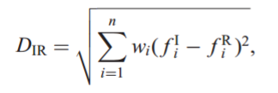

CBR (Case-based reasoning)
Nearest neighbor method is used to find relevant cases. This is a popular method because it can be applied to financial data very easily. Nearest neighbor 1 to 5 is used.
The evaluation function of the nearest neighbor method is the Euclidean distance. It is represented by the function

Slide 25
Experimental Results
- Statistical results for each of experiments conducted
with the three models
- Comparisons between each prediction performance

Slide 26
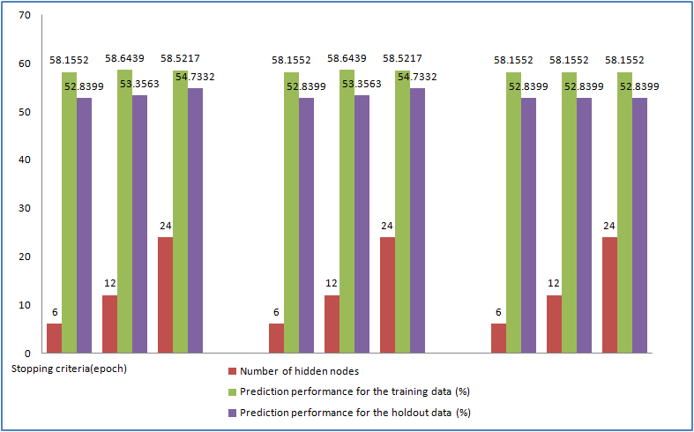
Experimental Results – Backpropagation Neural Network

Slide 27
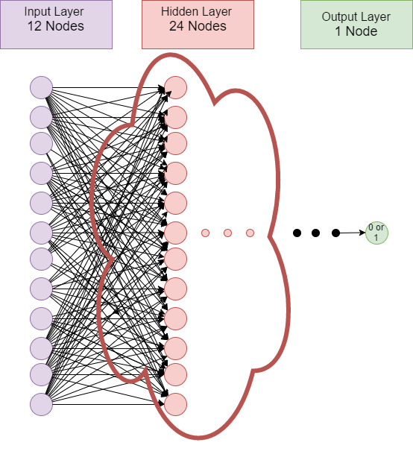
Experimental Results – Backpropagation Neural Network
Back-propagation Learning method
12 Input Nodes
1 Output Node
Optimal performance at 24 Hidden nodes
Stops Learning after 292,800 Epochs
Performance: -Training Data: 58.52% -Holdout Data: 54.73%

Slide 28
Experimental Results – Case-Based Reasoning
For CBR, this study used different number of cases, varying from 1 to 5, to classify each new data.
We found out that the prediction performances of these experiments produce same results. Thus, this study uses the prediction performance when the number of retrieved cases is 1.
Accuracy of the holdout data is 51.9793%.
For CBR, the performance of the training data is ignored because the retrieved case and the new case are the same in the training data.

Slide 29
Experimental Results – Support Vector Machine
Nonlinear SVM
We need to tune the upper bound by finding the right 'C' constant value
We need to introduce the kernel parameter.
Gaussian Radial Basis function is chosen over the polynomial function

Slide 30
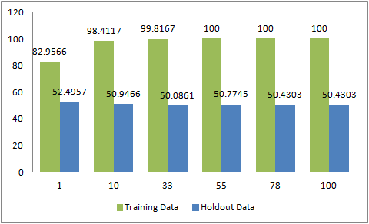
Experimental Results – Support Vector Machine
δ²= 1

Slide 31
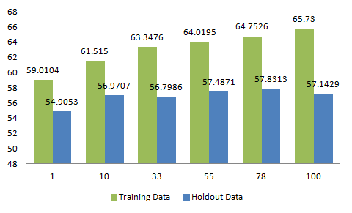
Experimental Results – Support Vector Machine
δ²= 25

Slide 32
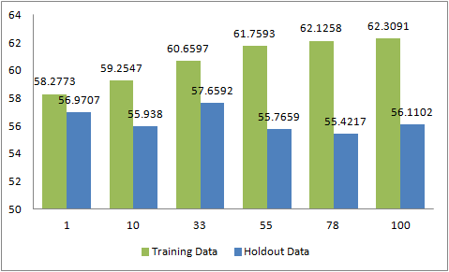
Experimental Results – Support Vector Machine
δ²= 50

Slide 33
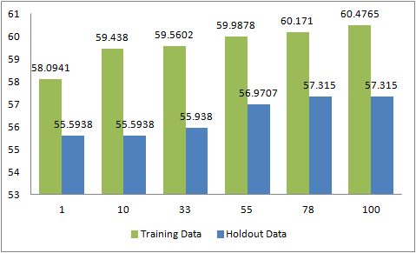
Experimental Results – Support Vector Machine
δ²= 75

Slide 34
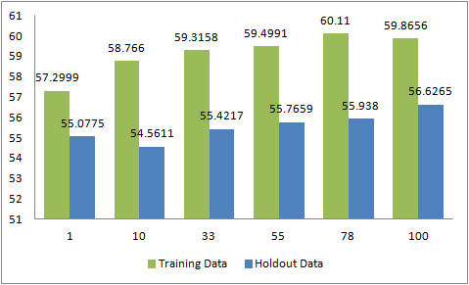
Experimental Results – Support Vector Machine
δ²= 100

Slide 35
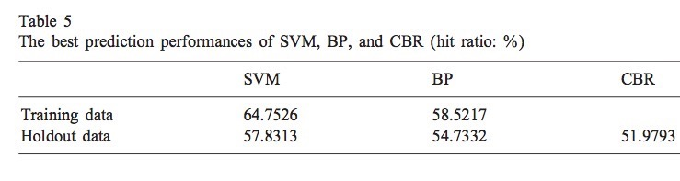
Compare result from SVM BP and CBR
(in Tab 5)SVM has higher prediction accuracy than BPN by about 6.23%
Training Data is a sample of data that using for the algorithm
Holdout data is a sample of data not used in fitting a model, used to assess the performance of that model
Hit Ratio is the Ratio of accuracy

Slide 36
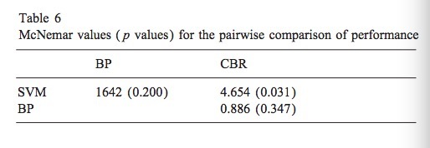
P values
(in Tab 6)SVM performs better than CBR at 5% , that means

Slide 37
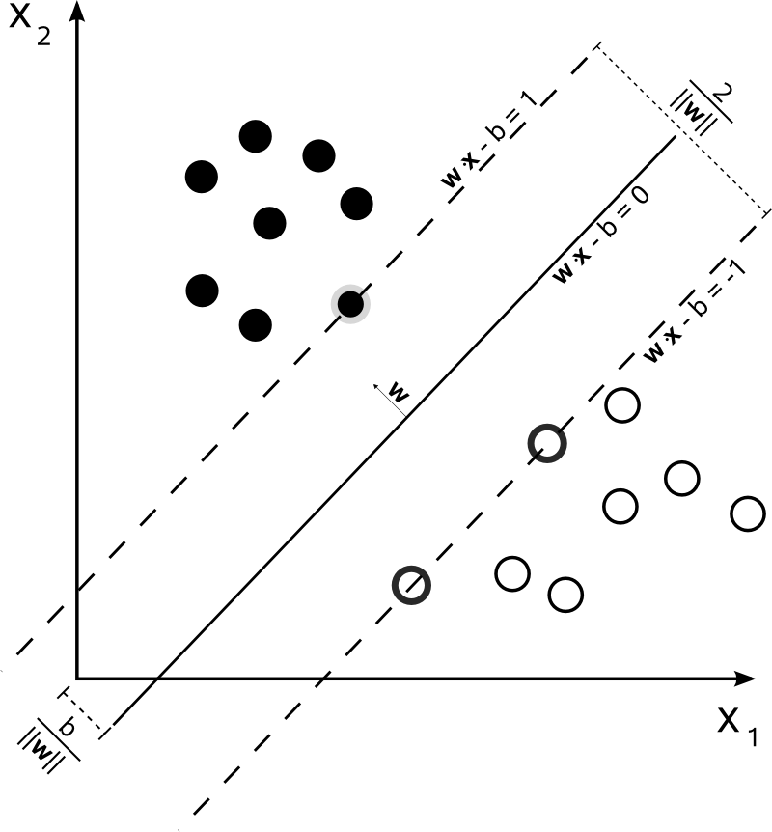
SVM

Slide 38
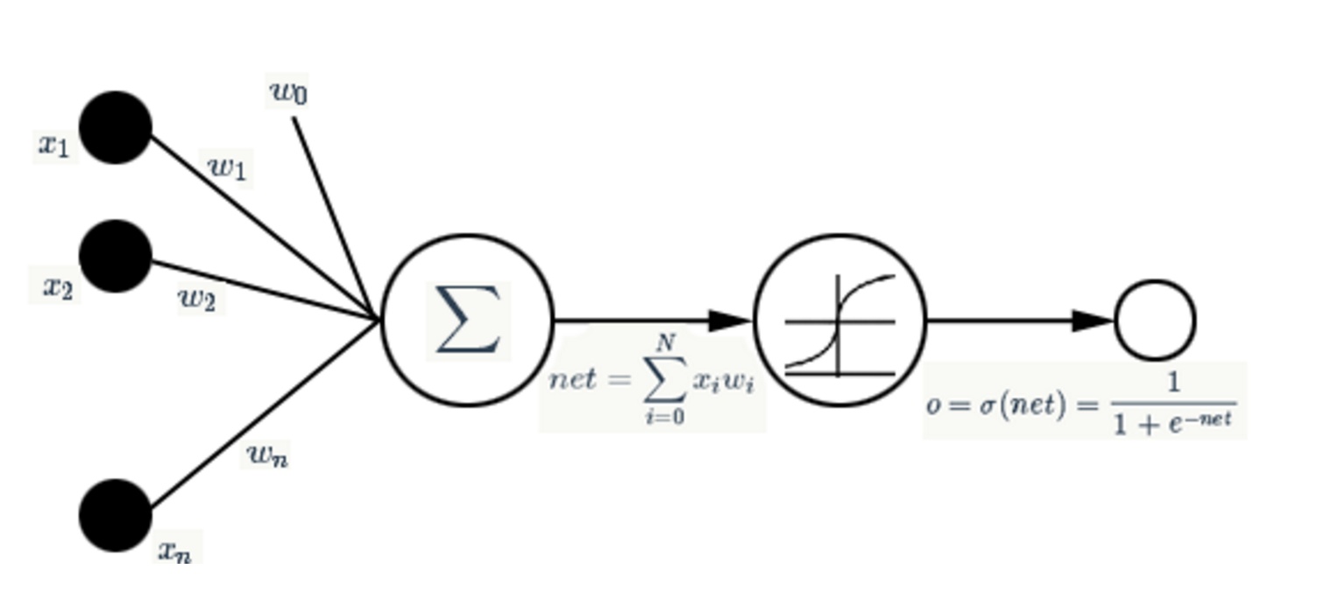

BP

Slide 39
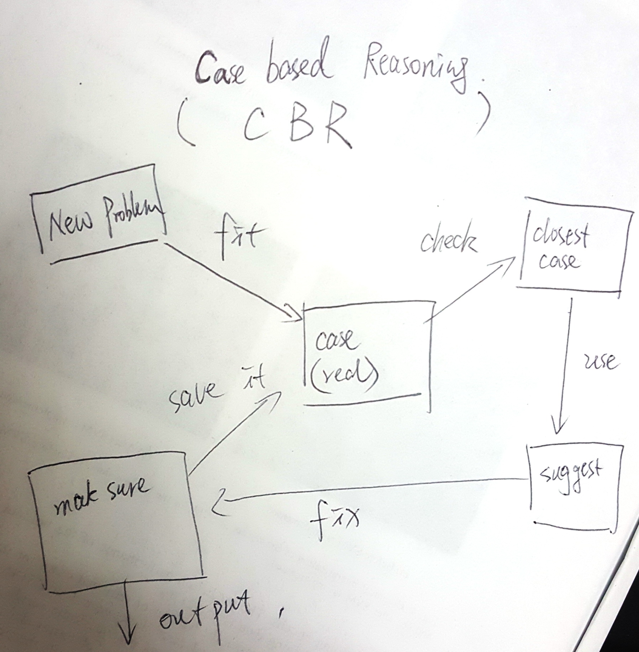
CBR
Looking for old case and find the closest case.
Make a suggestion and output the result
Check the suggestion and finally fix it
Save back to the case library

Slide 40
THE END

