Slide 1

Espresso & Robolectric
Swrajit Paul

Slide 2


Android testing
Android
Java

Slide 3

Android operating system is built by using java. When creating a android app
Android
Java

Slide 4
Android testing
JVM
Device

Slide 5
Android testing

Slide 6
Android testing
 | JVM

Slide 7
Android testing
 | JVM | DEVICE

Slide 8
Android testing
 | JVM | DEVICE
NON UI

Slide 9
Android testing
 | JVM | DEVICE
NON UI
UI

Slide 10
Android testing
 | JVM | DEVICE
NON UI | JVM UNIT TEST
UI

Slide 11
Android testing
 | JVM | DEVICE
NON UI | JVM UNIT TEST | INSTRUMENTATION UNIT TEST
UI

Slide 12
Android testing
 | JVM | DEVICE
NON UI | JVM UNIT TEST | INSTRUMENTATION UNIT TEST
UI |  | ESPRESSO

Slide 13

Espresso

Slide 14
ESPRESSO
onView(ViewMatcher)
.perform(ViewAction)
.check(ViewAssertion);

Slide 15
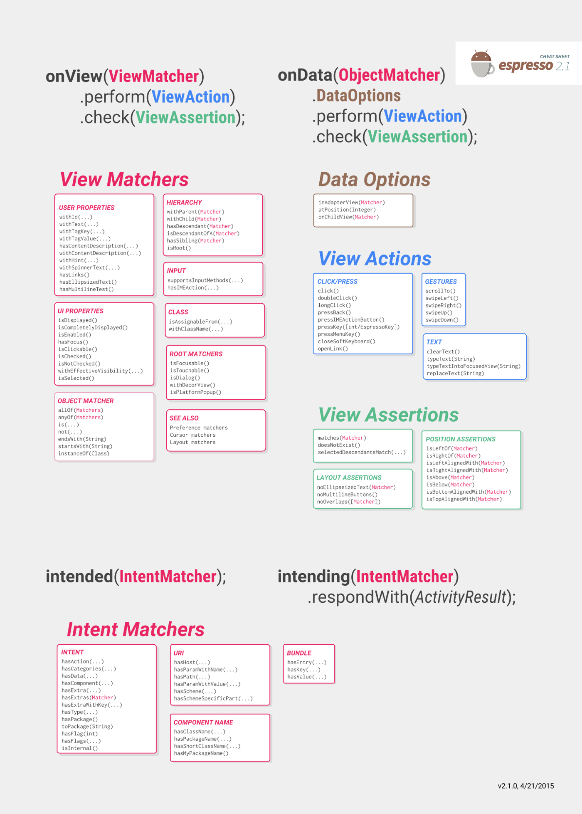

Slide 16
Android testing
 | JVM | DEVICE
NON UI | JVM UNIT TEST | INSTRUMENTATION UNIT TEST
UI |  | ESPRESSO

Slide 17
Android testing
 | JVM | DEVICE
NON UI | JVM UNIT TEST | INSTRUMENTATION UNIT TEST
UI | ? | ESPRESSO

Slide 18

Robolectric

Slide 20
REferences
Cheat sheet
The linked in learning site
Espresso book
Espresso developers guide

Slide 21
THE END

