Slide 1


Robolectric and Espresso
By: Swrajit Paul

Slide 2
Android Testing
JVM
Device

Slide 3
Android Testing
 | JVM | DEVICE
NON UI
UI

Slide 4
Android Testing
 | JVM | DEVICE
NON UI | JVM UNIT TEST
UI

Slide 5
Android Testing
 | JVM | DEVICE
NON UI | JVM UNIT TEST | INSTRUMENTATION UNIT TEST
UI

Slide 6
Android Testing
 | JVM | DEVICE
NON UI | JVM UNIT TEST | INSTRUMENTATION UNIT TEST
UI |  | ESPRESSO

Slide 7

Espresso
What is Espresso?
Espresso is a testing framework

Slide 8
Espresso
How does Espresso work?
Espresso creates a test apk next to the app apk

Slide 9
Espresso
Advantages of using Espresso
Synchronization
Easy to learn

Slide 10
ESPRESSO
onView(ViewMatcher)
.perform(ViewAction)
.check(ViewAssertion);
onView(withId(R.id.firstName))
.perform(typeText(“Swrajit”))
.check(matches(withText(“Swrajit Paul”));
Swrajit

Slide 11
ESPRESSO
onView(ViewMatcher)
.perform(ViewAction)
.check(ViewAssertion);
T
onData(ObjectMatcher)
.DataOptions
.perform(ViewAction)
.check(ViewAssertion);

Slide 12
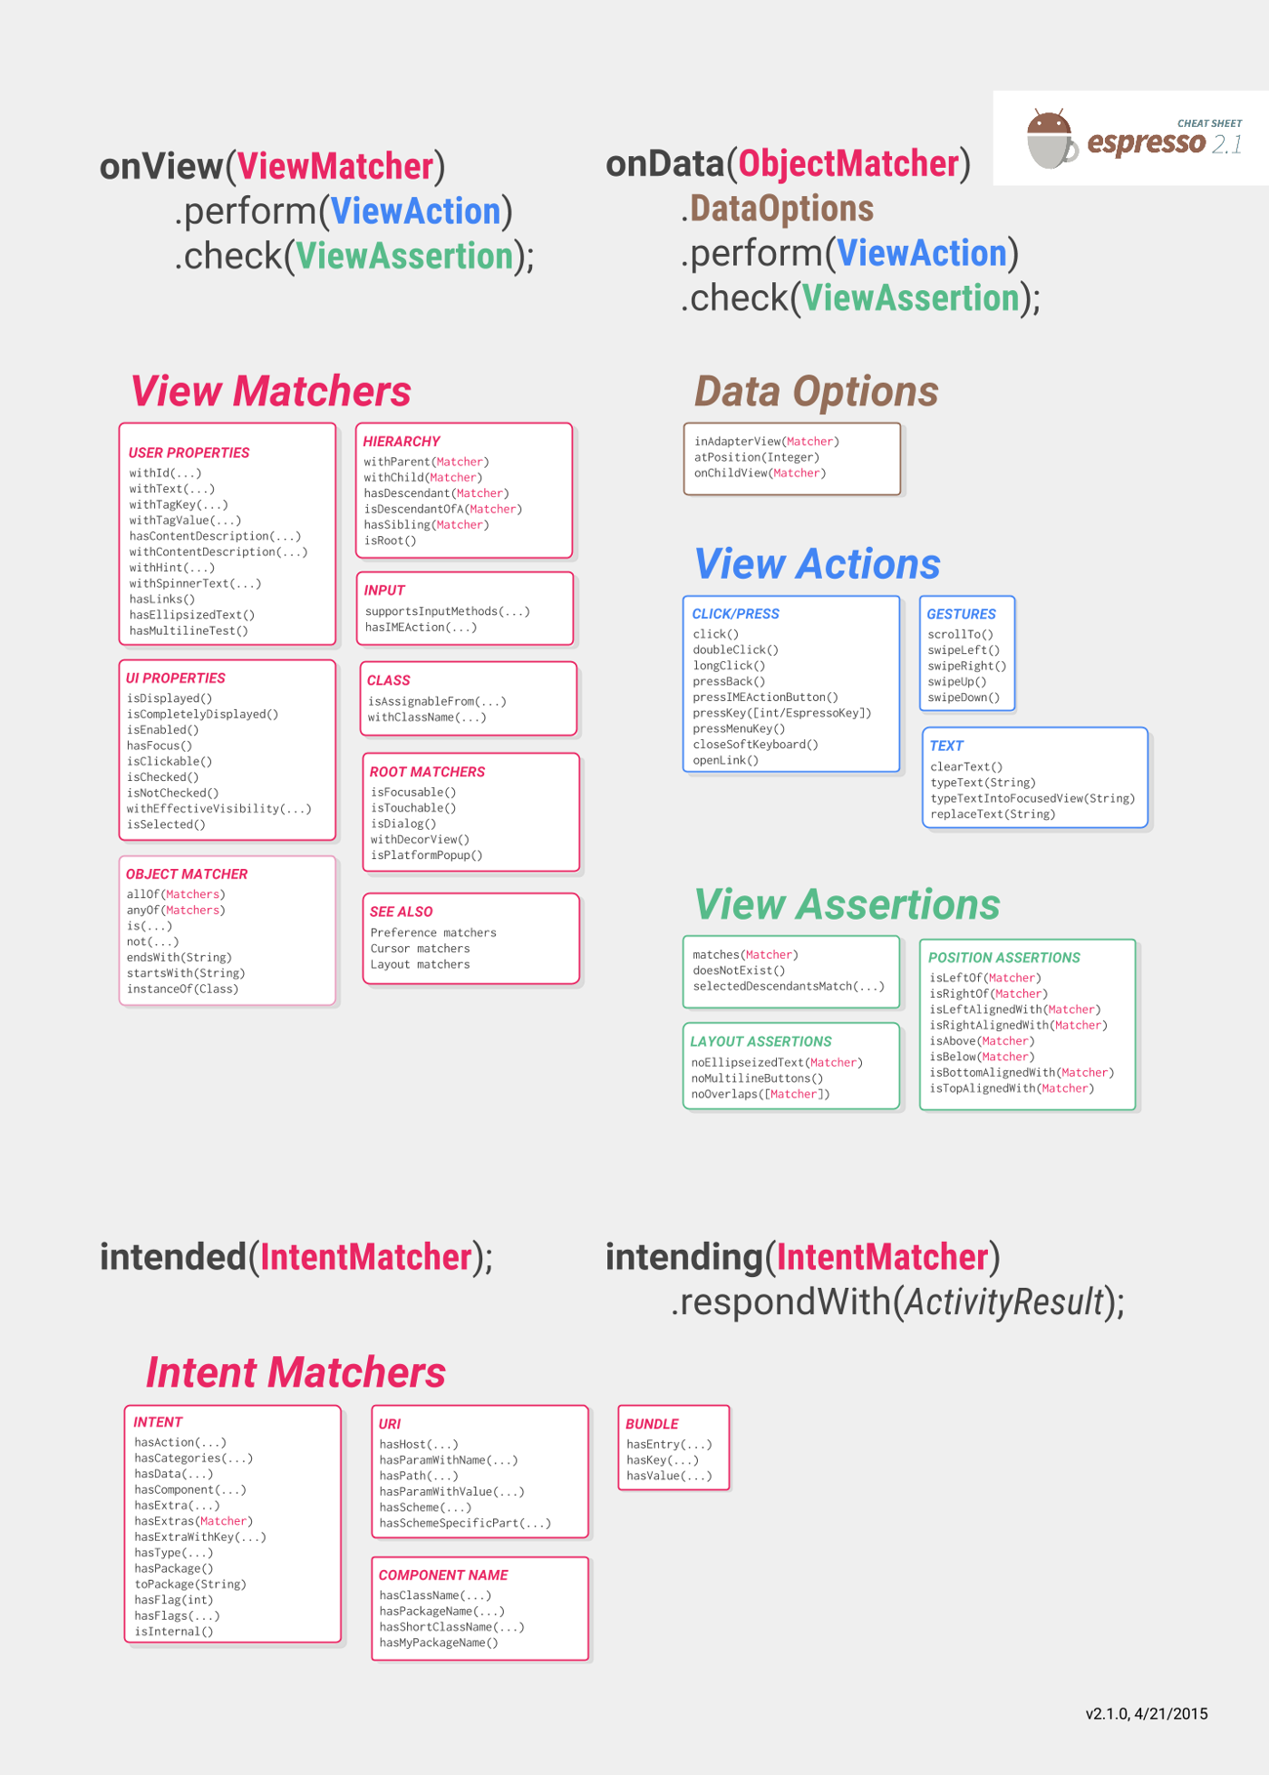

Slide 13
-----------------------------

Slide 14
Android testing
 | JVM | DEVICE
NON UI | JVM UNIT TEST | INSTRUMENTATION UNIT TEST
UI |  | ESPRESSO

Slide 15
Android testing
 | JVM | DEVICE
NON UI | JVM UNIT TEST | INSTRUMENTATION UNIT TEST
UI | ? | ESPRESSO

Slide 16
Robolectric
What is Robolectric ?

Slide 18
-----------------------------

Slide 19
THE END

Slide 20
References
“Espresso | Android Developers.” Android Developers, developer.android.com/training/testing/espresso.
Espresso book
Espresso developers guide

